Slide 1


Do you speak English?
Efficient work in an international company

Slide 2
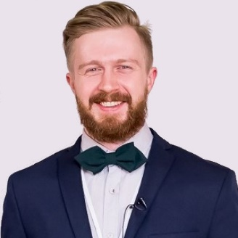




Leonid Iudenkov
Lead business-analyst
and
Resource manager
in EPAM Saint-Petersburg

Slide 3



In scope
1
Context and problem
2
English level assessment
3
BA role language skills specifics
4
Efficient work in English
5
Approach

Slide 4
Growing, Global Presence in More Than 35 Countries*
NORTH AMERICA
Canada
Mexico
United States
EUROPE
Austria
Bulgaria
Czech Republic
France
Georgia
Germany
Hungary
Ireland
Italy
Lithuania
Malta
Netherlands
Poland
Romania
Spain
Sweden
Switzerland
Ukraine
United Kingdom
CIS
Armenia
Belarus
Kazakhstan
Russia
Uzbekistan
APAC
Australia
China
Hong Kong SAR
India
Israel
Japan
Singapore
United Arab Emirates
Vietnam
*As of FY 2020
EF English Proficiency Index (EF EPI) 2020

Slide 5




Language proficiency in CIS
B1+
C1
Intermediate
Advanced
2018
2021
2019
B2+
Upper-intermediate

Slide 6



Language proficiency in CIS
2018

Slide 7





Importance and significance for EPAM
Quality criteria for production specialists
Strongly negative impact on reputation
Applicable for ALL communication roles
Easy to see, hard to change

Slide 8

Importance and significance for EPAM
Quality criteria for production specialists
Strongly negative impact on reputation
Applicable for ALL communication roles
Easy to see, hard to change

Slide 9
Importance and significance
Quality criteria for production specialists
Strongly negative impact on reputation
Applicable for ALL communication roles
Easy to see, hard to change

Slide 10
Importance and significance for EPAM
Quality criteria for production specialists
Strongly negative impact on reputation
Applicable for ALL communication roles
Easy to see, hard to change

Slide 11



BA work in English: myths and reality
BA work in English ≠ BA Hard skills + General English
I can easily speak English on vacation
I watch movies / TV-series in English
I have TOEFL/IELTS certificate
I have a pen-friend
I read Harry Potter in English

Slide 12


English level assessment
TOEFLS and IELTS assessment areas:
Listening
Reading
Speaking
Writing
B2 (Upper-intermediate)
CEFR: Common Reference level
Criteria:
Can understand the main ideas of complex text on both concrete and abstract topics, including technical discussions in his/her field of specialization. Can interact with a degree of fluency and spontaneity that makes regular interaction with native speakers quite possible without strain for either party. Can produce clear, detailed text on a wide range of subjects and explain a viewpoint on a topical issue giving the advantages and disadvantages of various options.
Fluency coherence
Lexical resource
Grammatical range
Pronunciation

Slide 13

Interview case in English
I’d appreciate it if you could help me with an issue that concerns me….

Slide 14
Interview case in English
London is a capital of Great Britain. Please create a ticket in Jira

Slide 15

Framework
BA work in English
=
Practice * (BA Hard skills + BA Soft Skills +
General English + Business Vocabulary + IT Vocabulary)

Slide 16


Framework
Backlog refinement
Solution options demonstration
Results demonstration (demo)
With a Customer
1-2-1 Interview
Group workshop
Problem solving in a group
Failure
Communication activities
Discovery results presentation
Project interview
Success
Daily meeting
Brainstorming
With a Team
Storytelling
Sprint planning
Retrospective
Status update

Slide 17









Example 1: Demo to a Customer
Failure
Disputing on how solution should or shouldn’t work during the demo or providing premature commitments
Use words and phrases which can be considered too direct or passive-agressive by English-speaking stakeholders
Concrete experience [1]
Describe what’s happening on the screen instead of focusing on business value
Confusion and freeze during screen sharing problems, hardware malfunctions or unexpected issues with presented solution
Testing in new situations [4]
Observation and reflection [2]
Success
Facilitation
Introduce yourself, team and stakeholders
Set up meeting rules
Control timings
Handle questions
Deal with objections
Results
Summarize results
Articulate next steps
Send a clear MFU
Forming abstract concepts [3]
Kolb learning cycle wiki
Preparation
Scenario
Environment
Scripts
Test data etc.
Context
Where are we now
User journey
Business value

Slide 18
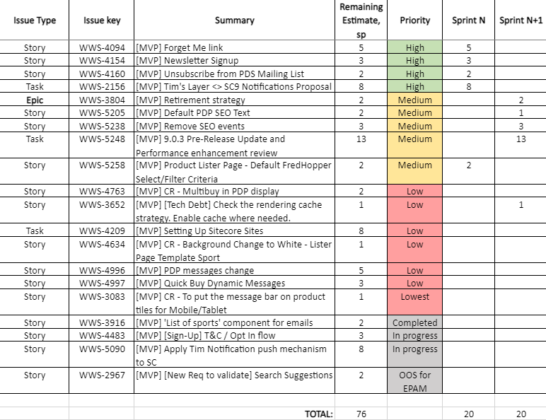






Example 2: Backlog grooming / refinement and Sprint planning
Failure
Audience doesn’t understand format, goals of the meeting and expected results.
BA doesn't provide any options and alternatives for achieving business goals within existing capacity limitations.
Backlog is not prepared:
items are not pre-groomed, dependencies and blockers are not identified.
BA doesn’t “drive” the meeting. Team spends time to discuss topics, that don’t help achieving goals of the meeting.
Success
Introduction
Introduce yourself, the team and stakeholders
Set up rules and timings
Articulate expected output
Results
Summarize results
Get a sign-off
Articulate action items
Send a clear MFU
Preparation
Track dependencies/blockers
Select a visualization tool
Prepare the backlog
Align tactics with your team
Approach
Challenge given priorities
Suggest different strategies to avoid scope creep
Focus on problems
Drive the process
Track time
Try to find a compromise

Slide 19

What can you do (self and group practice examples)
BA work in English
=
Practice * (BA Hard skills + BA Soft Skills + General English +
Business Vocabulary + IT Vocabulary)
Interview
Solution options demonstration
Backlog grooming
Sprint planning
Demo

Slide 20


What can you do (self and group practice examples)
BA work in English
=
Practice * (BA Hard skills + BA Soft Skills + General English +
Business Vocabulary + IT Vocabulary)
Interview [1]
Demo [5]
Solution options demonstration [2]
B1
Sprint planning [4]
Backlog grooming [3]

Slide 21

Keep learning!
Telegram: @repka1
Facebook: leonid.yudenkov

