Slide 1
IT Analyst Days, St. Petersburg
Changing by Projects -
A Challenge for Managing Requirements
Roland Gareis, April 2018

Slide 2
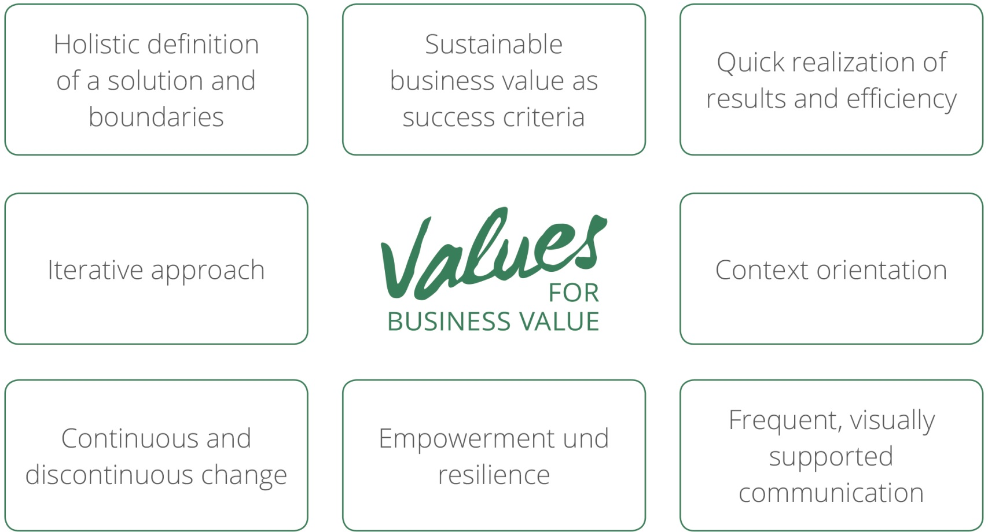
Notes:
Continuous and discontinuous learning – ausbessern

Slide 3
Agenda
  Changes and change architectures
  Challenges in managing requirements
Requirements in change contexts

Slide 4
Social Systems as Objects of Change
Social Systems
Interactions
Societies
Organizations
Temporary
Organizations
Permanent
Organizations
Projects
Programs
Companies
Divisions
Departments

Slide 5
Change Types
high
Radical
repositioning
Major
Changes
Transforming
Change
demand
Further
developing
Minor
Changes
Organizational
learning
low
few
many
Change dimensions
Notes:
x

Slide 6
Change Architecture: Transforming
Daily business
Change: Transforming
Conceptualizing
Planning and preparing
Implementing
Using and stabilizing
Using
Project
Network of projects
or program
Project or
network of projects
Organizations performing the change
Notes:
Siehe CM

Slide 7
Change Architecture: Further Developing
Daily business
Change: Further Developing
Conceptualizing
Planning and implementing
Using and stabilizing
Using
Organizations performing the change
Project or
network of projects
Working group or project
Notes:
Siehe CM

Slide 8
Agenda
  Changes and change architectures
  Challenges in managing requirements
Requirements in change contexts

Slide 9
  Managing Requirements: Structural Issues
No differentiation of requirement types
No differentiation of „solutions“, thinking in „product solutions“
  … an app, a service, a building, etc.
Too narrow understanding of transition requirements
  basically defined for data migration, temporary personnel assignments, etc.
No holistic problem definitions
No differentiation in requirements management processes
Agile approaches are not solving all of these problems!

Slide 10
Solutions!!
                Differentiating types of requirements
                Differentiating solutions
                Products, services, organization, personnel, etc. and decision basis
                Additional transition requirements
                Requirements regarding project, program & change management

Slide 11
Types of Requirements
Business requirements
Stakeholder requirements
Transition requirements
Solution requirements
Functional
solution
requirements
Non-functional
solution
requirements
Notes:
x

Slide 12
Requirements Management in a Change Context
Business requirements
Stakeholder requirements
Program
Project
Project
A
Project
D
Project
C
Transition requirements
Solution requirements
Project
B
Functional
solution
requirements
Change
Non-functional
solution
requirements

Slide 13
                Holistic definition of requirements based on change dimensions
                Requirement management processes over time
                Defining initial requirements in a feasibility/conception project
                Controlling solution requirements in an implementation project
                Controlling business requirements over the change/investment period

Slide 14
Change Dimensions for Holistic Solutions
Stakeholder
Structures
  Services, products
  Technologies
  Organizational structures
  Organizational culture
  Personnel
  Infrastructure
  Budget, financing
Social System
Stakeholder
Contexts
  Higher social system
  Stakeholders
  History and expectations about the future

Slide 15
  Managing Requirements: Quality Issues
Bad quality of requirement definitions
  incomplete, not testable, too little customer-orientation
Unclear definitions
  demands, expectations, requirements, specifications, user stories, use cases
  change, change request
Many change requests because of dynamics
  complicated performance of change requests
Agile approaches are not solving all of these problems!

Slide 16
Solutions!!
Traceability, testability of requirements
Application of a common terminology
Accepting dynamics
  Application of iterative approaches
Prioritization of requirements
Definition of a formal change request process

Slide 17
Agenda
  Changes and change architectures
  Challenges in managing requirements
Requirements in change contexts

Slide 18
Requirements Management in a Change Context
Business requirements
Stakeholder requirements
Program
Project
Project
A
Project
D
Project
C
Transition requirements
Solution requirements
Project
B
Functional
solution
requirements
Change
Non-functional
solution
requirements

Slide 19






Competing Management Approaches

Slide 20
Company-internal Competitions
Standards for …
  change management, process management
  project & program management
  business analysis
Organizational units
  Project Management Office, Process Management Office, Change Management Office
  Business Analysis Department, Quality Management Department

Slide 21
Competition “Costs”
no holistic developments but sub-optimal solutions
high resource demands due to parallel activities
unclear relationships between the roles in changes, processes, projects
personnel is not broadly qualified
confused stakeholders because of unclear terminology, varying responsibilities

Slide 22
Integrative Management Approach
Change
Change management
Developing a
feasibility study
Designing a
solution
Developing, testing, etc.
a solution
Stabilizing
Process management
Implementing a solution
Project
plans:
Studying
Project
plans:
Implemen-
ting
Project
plans:
Stabilizing
Project management
Feasibility
study
Solution
requirements
document
Change
request
Business analysis
Business
requirements
document
Technical
design
specifications
Test cases
and other
documents

Slide 23
BA & Project Management
A chain of a feasibility study project and an implementation project might be required for investing in a new “solution”. BA is to be performed in both projects.
Business requirements as investment objectives are a context dimension for projects. Solution requirements are the basis for defining project objectives.
BA tasks have to be planned, communicated, and managed. These tasks have to be considered in the project plans.
The business analyst is a project team member.

Slide 24
Relationships between Requirements and Objectives
Business
Requirements
Investment Objectives
Stakeholder
Requirements
Project Objectives
Solution Requirements

Slide 25
Business Analyst as a Project Team Member
Project Organisation
Project
contributor
Project
contributor
Business
analyst
Project team
member
Sub-Team 2
Sub-Team 1
Project Team
Project
manager
Project
contributor
Project
sponsor

Slide 26
BA & Process Management
  Business analysis is a set of sub-processes.
  To analyze a business also requires to analyze its business processes.
  To develop a new “solution” usually requires to adapt existing business processes and/or to develop new processes.

Slide 27
BA & Change Management
  The implementation of a new solution can be perceived as a change of the implementing company.
  Several change dimensions of an organization are considered in changes, not just the IT-dimension.
  The business analysis tasks performed for implementing a solution might lead to resistance to change.

Slide 28
A Common Management Basis is Necessary!!
  common values
  a common perception of organizations
  common role understandings
  common communication formats
  common terminology
  common methods

Slide 29
Consequences for Business Analysts:
They need …
to understand change structures
competences in project & program management, process management, change management

Slide 30
Roland Gareis
www.rolandgareis.com

