Slide 1
some Process Tools for Business Analysts, Architects and Project managers
Roger T. Burlton, P.Eng. , CMC
+1-604-240-5436
Roger.burlton@processrenewal.com
Twitter: @RogerBurlton
www.processrenewal.com

Slide 2
Agenda
1
Stakeholder E³ (Exchanges, Expectations and Experiences)
The Process IGOE (more than flow)
Multiple Dimensions of Process Measurement (more than time and cost)
Decisions, Processes and Business Rules
The Burlton Hexagon (from process to capability)
Pain and Gain for Prioritization
Behavior Design (from process to culture)
2
3
4
5
6
7

Slide 3
Agenda
1
Stakeholder E³ (Exchanges, Expectations and Experiences)
The Process IGOE (more than flow)
Multiple Dimensions of Process Measurement (more than time and cost)
Decisions, Processes and Business Rules
The Burlton Hexagon (from process to capability)
Pain and Gain for Prioritization
Behavior Design (from process to culture)
2
3
4
5
6
7

Slide 4





Stakeholders E^{3:} exchanges with the Value Chain, Stream or Process
Regulations
Certification
Product
Invoice
Regulator
Customer
Reports
Penalties
Order request
Payment
Supplies
Invoice
Job
Pay
P.O.
Payment
$
Reports
Ideas
Investment
Job Appl.
Time
Staff
Supplier
Owner

Slide 5
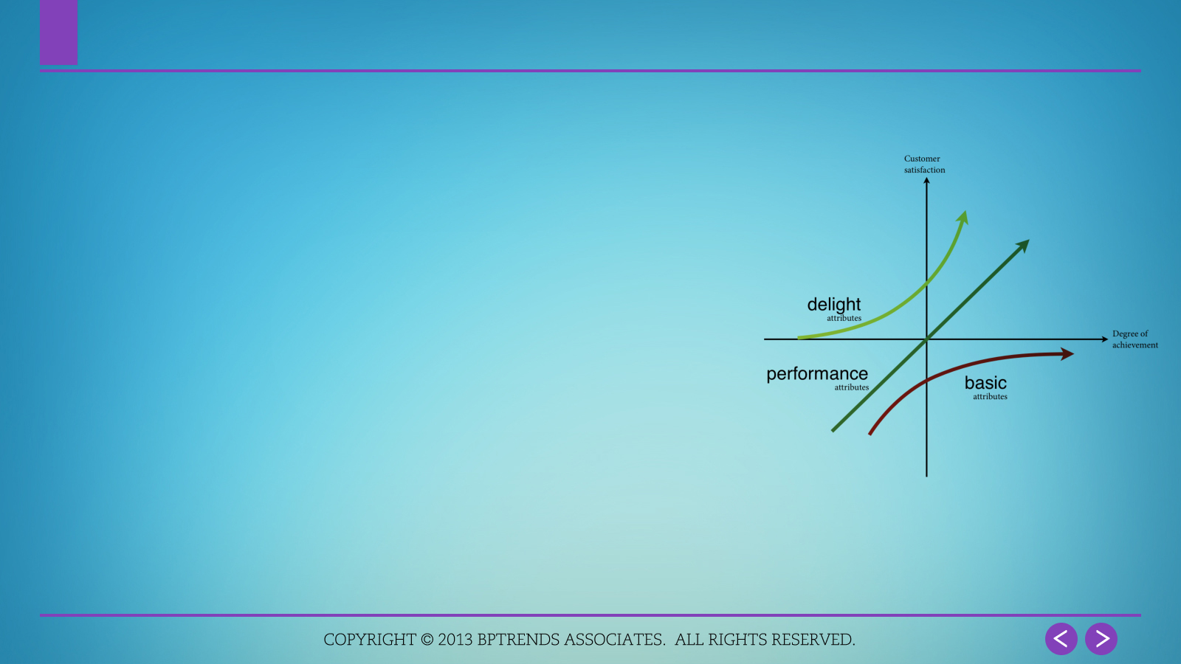
Stakeholder value: Value is often Submerged or Implied
Exchanges =
What tangible things we give them, what we get from them
Products, services, information, commitments
Expectations =
What they absolutely need
What satisfies them
Falling short leads to relationship failure
Experience =
How we and they drive services
How we and they interact with each another
How we can differentiate when Exchanges and Expectations are similar in the industry
Kano Chart
Notes:
20.Must understand both needs – the delivery of output results and expectations of how service will be provided.

Slide 6
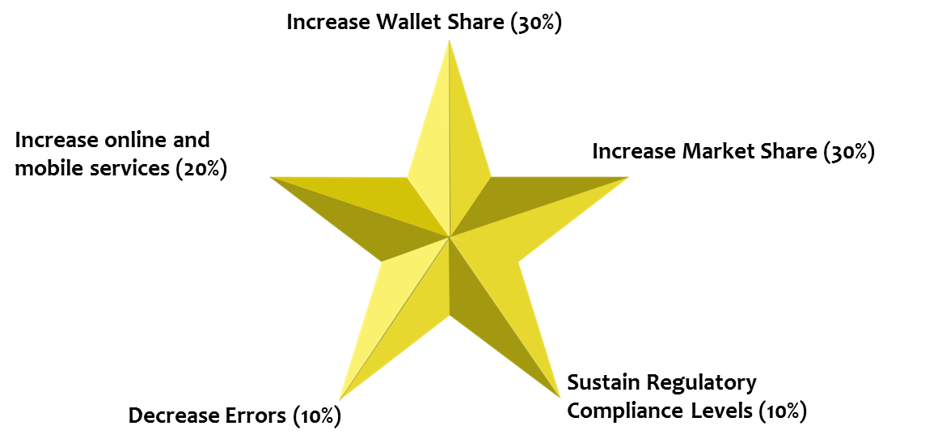
Consolidate stakeholders E³ : perspectives: Decision and design criteria
Note: the % numbers are the relative importance of that outcome statement.
They are not all the same

Slide 7

Exercise: Getting a Cup of Coffee
It’s morning and you want a cup of coffee.
Describe the value expected and the experience wanted by the main stakeholders.
E
Notes:
Do not model the process just yet
Discuss approach
6 minutes on countdown clock

Slide 8
Agenda
1
Stakeholder E³ (Exchanges, Expectations and Experiences)
The Process IGOE (more than flow)
Multiple Dimensions of Process Measurement (more than time and cost)
Decisions, Processes and Business Rules
The Burlton Hexagon (from process to capability)
Pain and Gain for prioritization
Behavior Design (from process to culture)
2
3
4
5
6
7

Slide 9
Use the right Technique for the right Problem: This is not recommended!

Slide 10
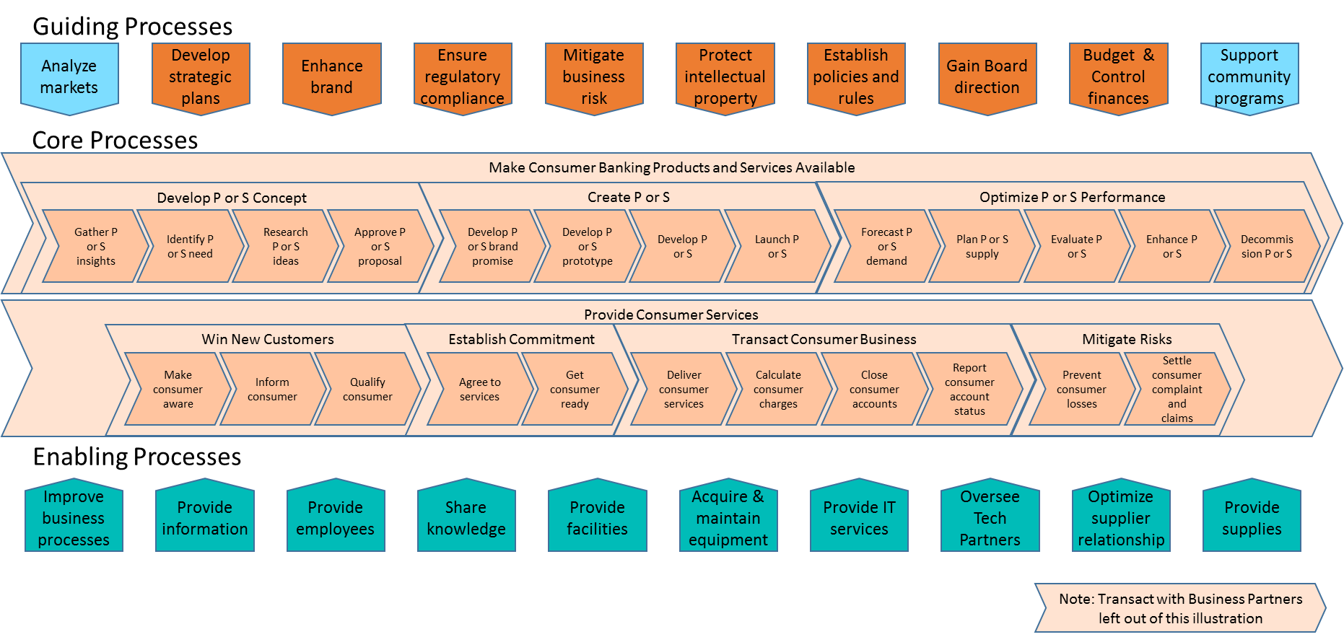
Consumer Financial Services Value Chain Process Architecture (value stream level)
Notes:
10

Slide 11


Six Sigma Models (SIPOC): No longer sufficient
Suppliers
Inputs
Process
Outputs
Customer
Notes:
There’s more about Six Sigma in the Analysis section. Just want to touch on the measurement aspect of it here. What it gives us and what it doesn’t, if it’s the ONLY approach being used.

Slide 12
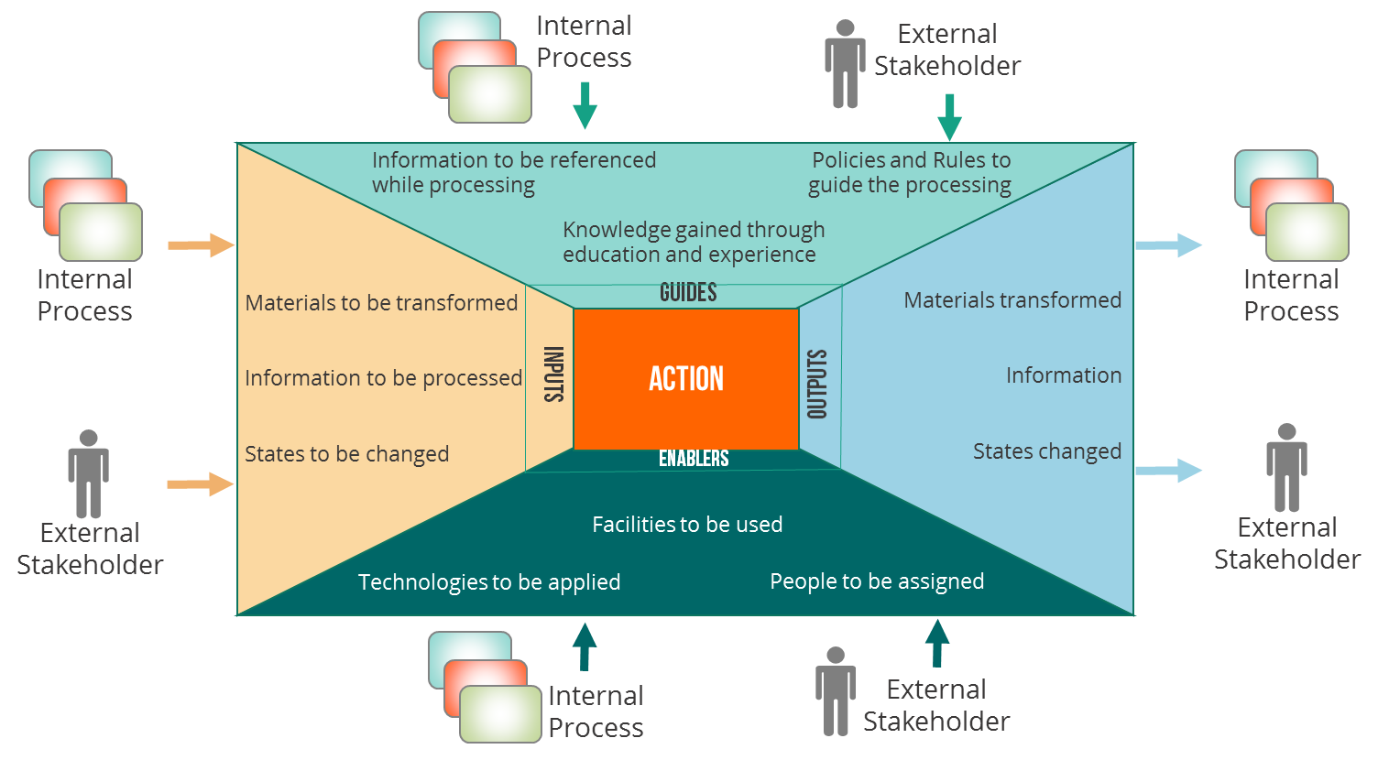
Additional perspectives needed: the IGOE with Guides and Enablers
Inputs are transformed into Outputs according to Guides using Enablers when Events occur

Slide 13
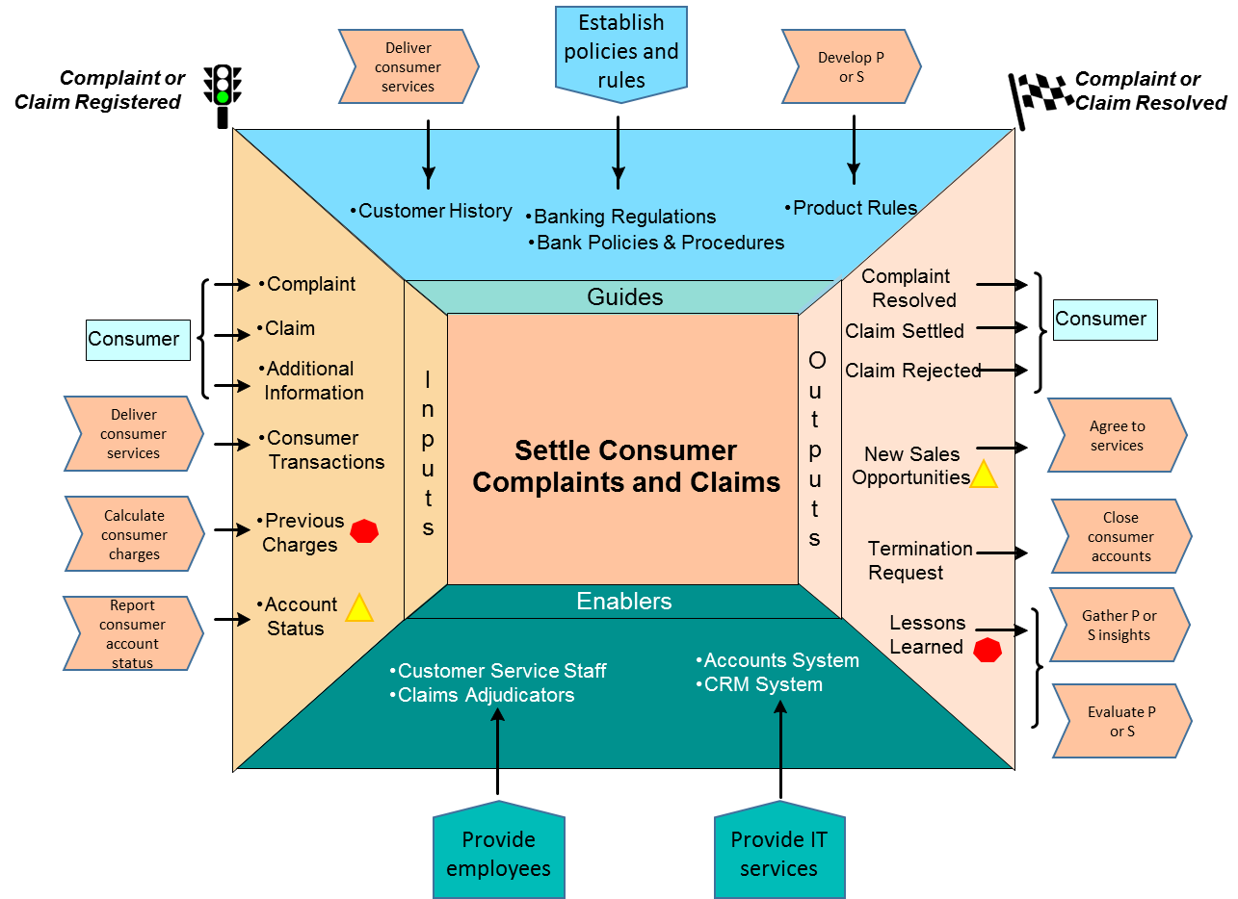
Processes connectivity: Bank IGOE scope example
Inputs are processed into Outputs according to Guides using Enablers when Events occur

Slide 14
Swim lane view inside each IGOE
Notes:
In this diagram, we picture a process in which the Customer interacts with a Website, which in turn, relays information to people at the company. In other words the two swimlanes within the Systems function are completely automated. As you can see, it really doesn’t make any difference whether the activities are done by systems or employees.

Slide 15
Exercise: Getting a Cup of Coffee
It’s morning and you want a cup of coffee.
Document an IGOE chart with 2 Inputs, Outputs, Guides and Enablers
E
Notes:
Do not model the process just yet
Discuss approach
6 minutes on countdown clock

Slide 16
Agenda
1
Stakeholder E³ (Exchanges, Expectations and Experiences)
The Process IGOE (more than flow)
Multiple Dimensions of Process Measurement (more than time and cost)
Decisions, Processes and Business Rules
The Burlton Hexagon (from process to capability)
Pain and Gain for prioritization
Behavior Design (from process to culture)
2
3
4
5
6
7

Slide 17
A New Business Scorecard
Agility
Effectiveness
Quality
Efficiency

Slide 18
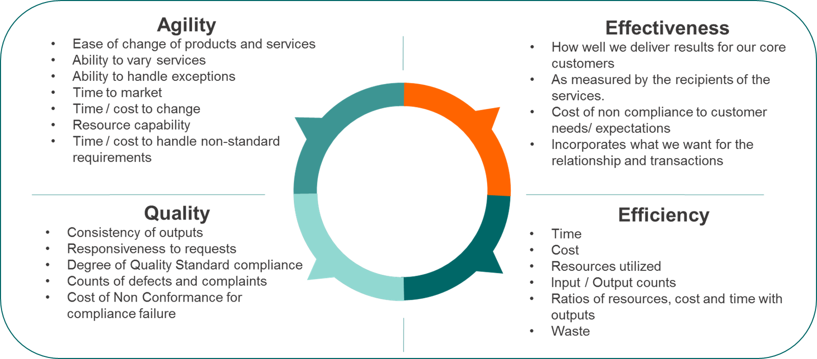
Process hierarchy: Tracing business performance
Value Chain
KPIs
Level 1 Process
KPIs
Level 2 Process
KPIs

Slide 19
Exercise: Getting a Cup of Coffee
It’s morning and you want a cup of coffee.
Define a KPI for each measurement category.
E
Notes:
Do not model the process just yet
Discuss approach
6 minutes on countdown clock

Slide 20
Agenda
1
Stakeholder E³ (Exchanges, Expectations and Experiences)
The process IGOE (more than flow)
Multiple Dimensions of Process Measurement (more than time and cost)
Decisions, Processes and Business Rules
The Burlton Hexagon (from process to capability)
Pain and Gain for prioritization
Behavior Design (from process to culture)
2
3
4
5
6
7

Slide 21
Questions and Decisions: Intersection of Processes and Business Rules
Decision Structure
Is the applicant eligible for the loan?
Is the application complete?
Is the credit score acceptable?
Are the loan risk parameters in range?
Are there more sub decisions that must be made to know if the applicant is eligible?
A service representative must be assigned to a received application not yet completed.
The applicant’s credit score must be higher than the minimum published in the current credit risk table.
The monthly repayment amount must be less than the authorized % of the applicant’s income.
An application for a loan greater than $1 million must be approved by a Vice President.
slide courtesy of Business Rule Solutions, LLC www.BRSolutions.com
What set of business rules are required to guide what is ‘acceptable’?

Slide 22
Integration of Value Stream or Process with Decisions and Business Rules
Is the applicant eligible for the loan?
Determine credit score
Decide credit worthiness
Approve loan
Review application for loan
Is the application complete?
Is the credit score above the minimum?
Are the loan risk parameters in range?
slide courtesy of Business Rule Solutions, LLC www.BRSolutions.com

Slide 23
Exercise: Getting a Cup of Coffee
It’s morning and you want a cup of coffee.
Identify 1 major decision and one set of sub decisions as well as 2 business rules.
E
Notes:
Do not model the process just yet
Discuss approach
6 minutes on countdown clock

Slide 24
Agenda
1
Stakeholder E³ (Exchanges, Expectations and Experiences)
The process IGOE (more than flow)
Multiple Dimensions of Process Measurement (more than time and cost)
Decisions, Processes and Business Rules
The Burlton Hexagon (from process to capability)
Pain and Gain for prioritization
Behavior Design (from process to culture)
2
3
4
5
6
7

Slide 25
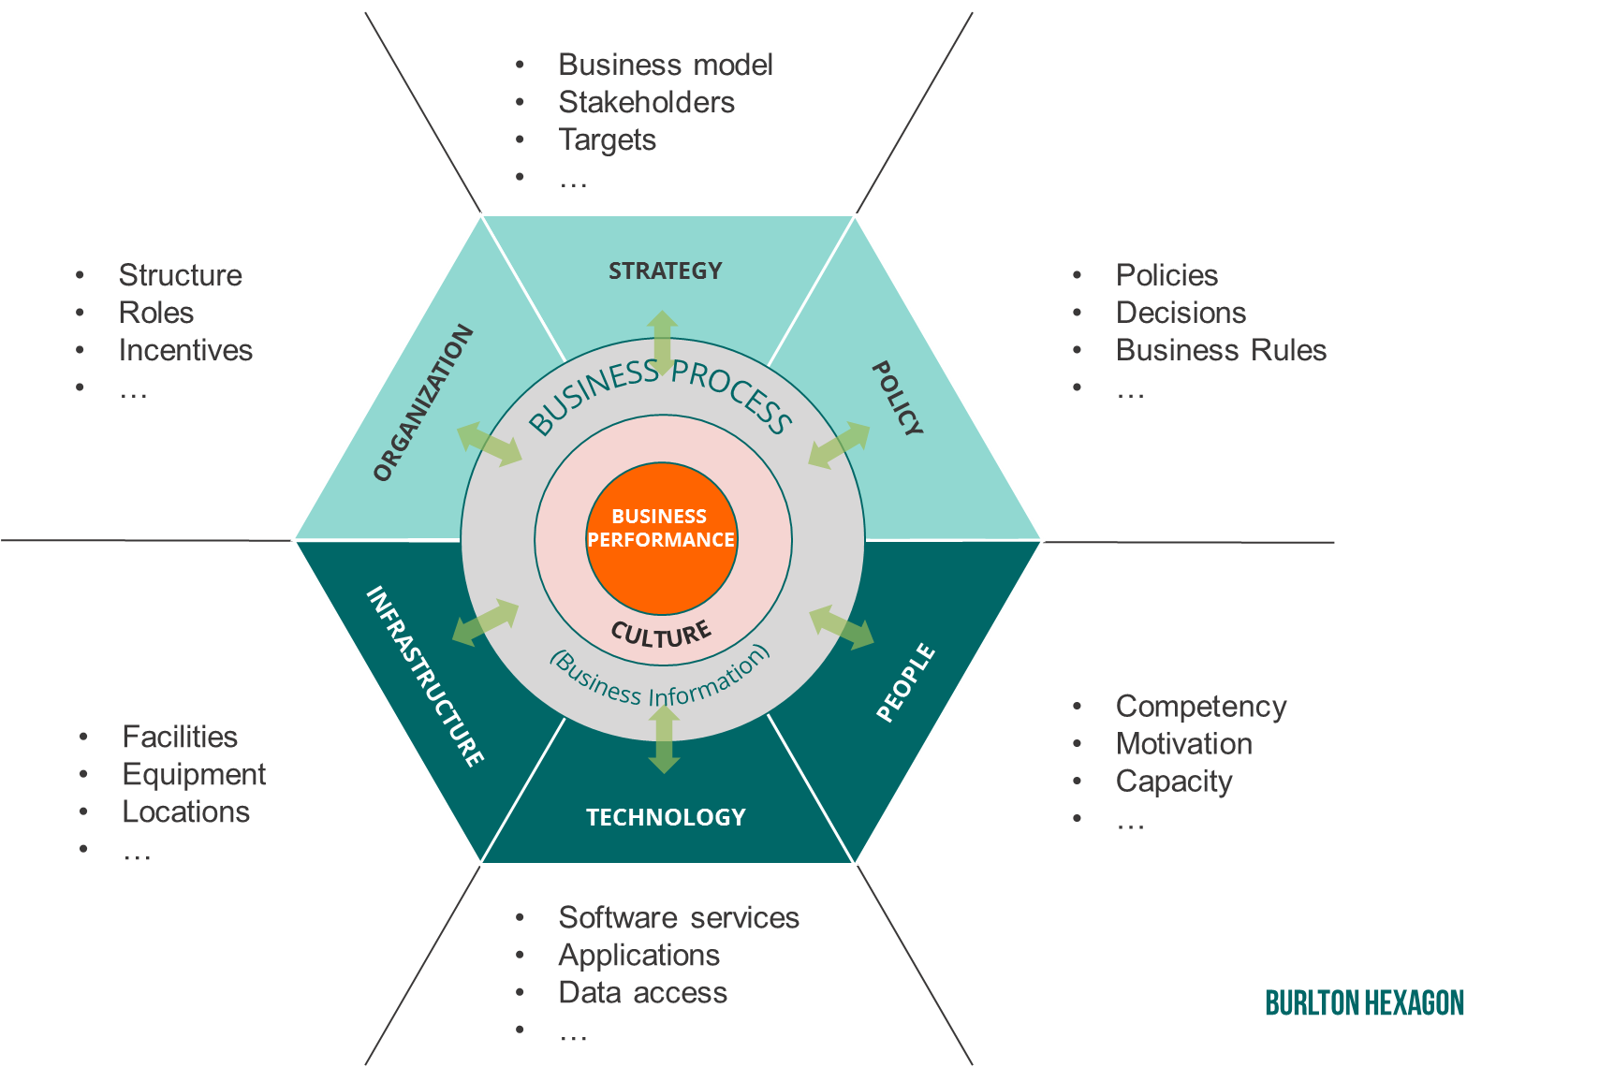
Business Processes define requirements for and align required capabilities: Change can happen in any or all segments
A true Capability of the Business brings together the Business Process and all its associated resources to deliver its intended business performance results

Slide 26
Business Processes and Capabilities: A many to many association
Business processes require shared capabilities delivered as shared services
Defines Need for
Value Chain
Level1 Process (Value Stream)
Level 2 Process 1.1
Level 2 Process 1.2
Level1 Process (Value Stream)
Level 3 Process 1.1.1
Level 3 Process 1.1.2
Level 3 Process 1.1.3
Level 2 Process 1.3
Things we develop, implement and use
Things we do, measure and manage
Strategic Frame
Level 1 Capability
Level 2 Capability a
Level 2 Capability b
Level 1 Capability
Level 2 Capability c
Level 3 Capability a.a
Level 3 Capability a.b
Capability ‘a’ requires process 1.1.1 & 1.1.3 to work well
Process 1.1.3 requires capability ‘a.a’ to be able
Processes 1.1.2 & 1.1.3 require capability ‘a.b’ to be effective

Slide 27
Exercise: Getting a Cup of Coffee
It’s morning and you want a cup of coffee.
Using the Burlton Hexagon identify 1 item in 3 categories required for coffee success.
E
Notes:
Do not model the process just yet
Discuss approach
6 minutes on countdown clock

Slide 28
Agenda
1
Stakeholder E³ (Exchanges, Expectations and Experiences)
The Process IGOE (more than flow)
Multiple Dimensions of Process Measurement (more than time and cost)
Decisions, Processes and Business Rules
The Burlton Hexagon (from process to capability)
Pain and Gain for prioritization
Behavior Design (from process to culture)
2
3
4
5
6
7

Slide 29
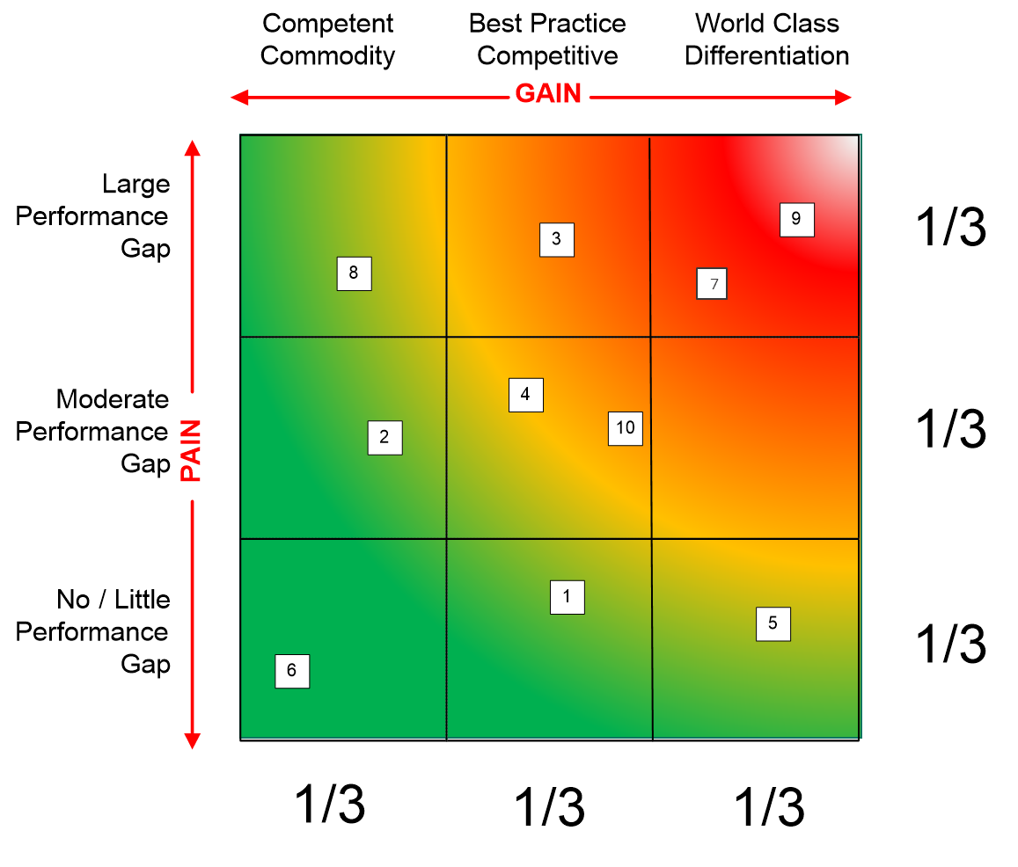
Prioritize Process and capabilities : Pain-Gain Triage
Invest in what’s strategic and potentially broken first
Process Gain
World Class will set us apart from others
Best Practice provides no value in being better than others BUT is noticed if it is worse
Competent means that getting by somehow and doing it the hard way is OK
Process Pain
Bottom third (smallest gap)?
Middle?
Top (largest gap)?
Notes:
ADD THAT THE CRITERIA MUST BE ESTABLISHED FIRST – AGAINST THE STRATEGIC INTENT AND ESPECIALLY THE VALUE PROPOSITION
- Water the flowers

Slide 30
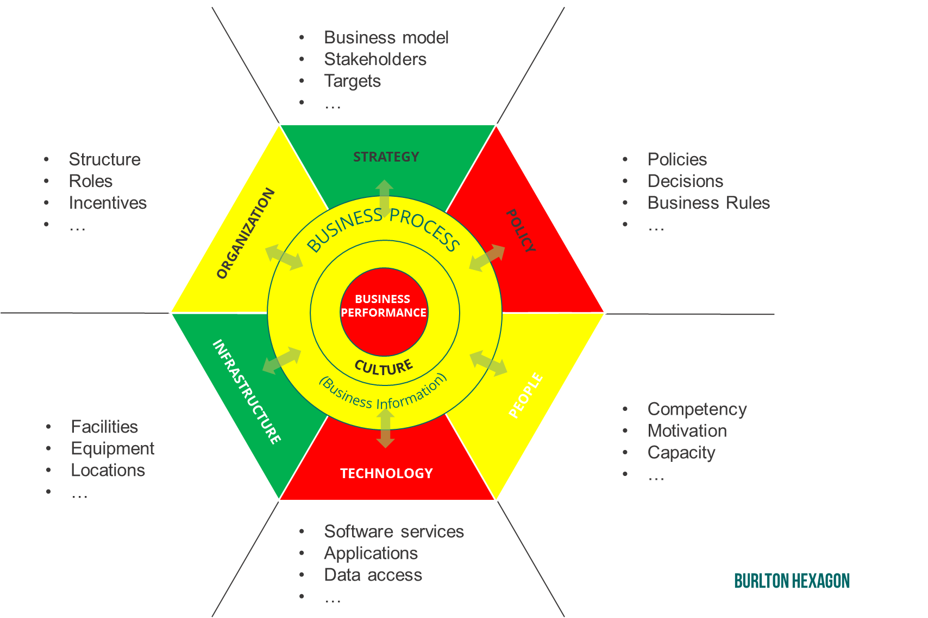
Determine capability Gaps for priority changes
Cause of Performance Gaps and Plan for Transformation

Slide 31
Exercise: Getting a Cup of Coffee
It’s morning and you want a cup of coffee.
For your coffee process identify two sub-activities that are High Pain and High Gain.
E
Notes:
Do not model the process just yet
Discuss approach
6 minutes on countdown clock

Slide 32
Agenda
1
Stakeholder E³ (Exchanges, Expectations and Experiences)
The Process IGOE (more than flow)
Multiple Dimensions of Process Measurement (more than time and cost)
Decisions, Processes and Business Rules
The Burlton Hexagon (from process to capability)
Pain and Gain for prioritization
Behavior Design (from process to culture)
2
3
4
5
6
7

Slide 33
Culture Definition
“How we do things around here”
Everyone
“It is pervasive patterns of behavior
(conscious and subconscious)
in response to situations”
Sasha Aganova, PRG
“Culture can be seen as the sum of the behaviors of the organization”.
Steve Stanton, Linked-In Pulse

Slide 34
Culture is the filter of process and capability performance
A true Capability of the Business brings together the Business Process and all its associated resources to deliver its intended business performance results

Slide 35
Making it stick…
Components of organizational transformation
+
Work Structure
People
Inputs
Expectations
Value
Outputs
Action

Slide 36
Making it stick
“It’s easier to act your way into a new way of thinking, than to think your way into a new way of acting.” *
+
Work Structure
People
Inputs
Expectations
Value
Outputs
Update Design
Action
Train & Coach
Monitor
!
Structural
Issues
Analyze Deviations
Cultural
Issues
* Steve Stanton, Linked-In Pulse

Slide 37
Exercise: Getting a Cup of Coffee
It’s morning and you want a cup of coffee.
Define one behavior that you want changed and how you would coach to change it.
E
Notes:
Do not model the process just yet
Discuss approach
6 minutes on countdown clock

Slide 38
Roger T. Burlton
+1-604-240-5436
Roger.Burlton@processrenewal.com
Twitter: @RogerBurlton
www.processrenewal.com

