Slide 1



User stories differ
Applicability boundaries
Стори стори – рознь
границы применимости
Natalia Semenova
Senior Business Analyst
December 2018
Notes:
Disclaimers:
Language
Agile / Scrum
Real experience
The idea: take ideal story and see how does it impacted in real project

Slide 2

AGENDA
Synchronizing watches
Historic mission
Constraints
Complexity enablers
Notes:
Цели: посмотреть, гд

Slide 3
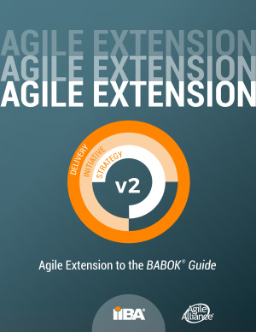

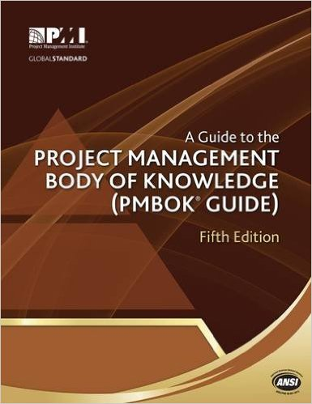
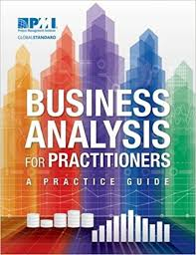
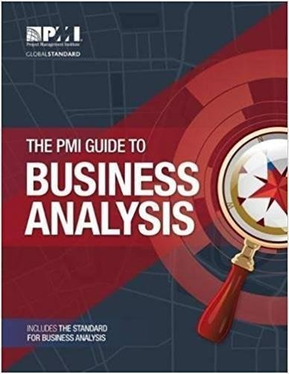




STANDARDS
agilemanifesto.org

Slide 4

SYNCHONIZING WATCHES
What is User story?
What does it contain?
How is it used?
What are the quality gates?
Benefits & Constrains

Slide 5
SYNCHONIZING WATCHES
What is User story?
What does it contain?
How is it used?
What are the quality gates?
Benefits & Constrains
“User stories are a reminder to have a conversation with your stakeholders”
(Alistair Cocburn®, 1998)
User Stories are a representation of the customer need and are expressed as a small, concise statement of a feature needed to deliver value.
(Agile Extension to the BABOK® Guide, 7.21.2)

Slide 6
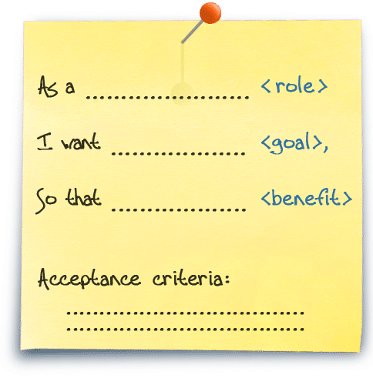
SYNCHONIZING WATCHES
3С-Formula
Card / Statement
Conversation
Confirmation / Acceptance criteria
(Ron Jeffries, 2001)
A user story is typically a sentence or two that describes
who has the need addressed by the story,
the goal the user is trying to accomplish, and
any additional information that may be critical to understanding the scope of the story
(BABOK® Guide, 10.48.2)

Slide 7
SYNCHONIZING WATCHES
Capture SH needs
Prioritize development of solution
Estimating & planning solution delivery
Generating UAT
Measuring the delivery of value
Tracing related requirements
Additional Analysis
A unit for project management and reporting
What is User story?
What does it contain?
How is it used?
What are the quality gates?
Benefits & Constrains
Typically, a user story is used in an adaptive methodology, such as agile development, but can be used in any methodology approach.
(PMI BA Guide® for Practitioners, Practice Guide, 4.10.8.3)

Slide 8
SYNCHONIZING WATCHES
What is User story?
What does it contain?
How is it used?
What are the quality gates?
Benefits & Constrains
INVEST criteria:
Independent
Negotiable
Valuable
Estimable
Small
Testable
Definition of Ready (DoR)
Definition of Done (DoD)
Acceptance criteria

Slide 9
SYNCHONIZING WATCHES
BENEFITS
Easy to understand for SH
Focuses on value to SH
A shared understanding of business domain
Rapid delivery
Frequent customer feedback
CONSTRAINTS
No answers and detailed specification upfront
Requires context and visibility
Supplementary documentation is required
(BABOK Guide, 10.48.2)
What is User story?
What does it contain?
How is it used?
What are the quality gates?
Benefits & Constrains

Slide 10
WRONG USAGE
B: Focuses on value to SH
AS a user
I WANT all data backed up
SO THAT everything can be fully recovered
Technical tasks
AS a system
I WANT validate user authentication data
SO THAT ensure secure connection
System action
AS a site-visitor
I WANT see advertising
SO THAT I notice the products and services I may be interested in
Business requirements
AS a registered user
I WANT to have my authentication data been moved to the new SSO system
SO THAT I may authenticate with already set credentials
Transition requirements
Notes:
Focuses on value to SH
Not everything is US

Slide 11

HAPPY AGILE
B: Easy to understand for SH
Statement
Acceptance criteria
Title
User gets smth
AS.. I WANT TO.. SO THAT..
GIVEN.. WHEN.. THEN..
Notes:
B: Easy to understand for SH

Slide 12

IN THEORY
Motivated individuals
Work together
Face-to-face
conversation
PO
SM
QA
BA
UX
DEV
Team
Business
Notes:
A shared understanding of business domain
Rapid delivery
Frequent customer feedback
Business people and developers must work together daily throughout the project.
Build projects around motivated individuals. Give them the environment and support they need, and trust them to get the job done.
The most efficient and effective method of conveying information to and within a development team is face-to-face conversation.

Slide 13
Project case
project
client
Digital transformation, custom development
Deliver to 30+ countries
> 3 years
Changing development process
Top 30 of the largest priv. American C.
US, EU, RU, IN etc.
Vendor
80-150+ FTE, >10 teams
3+ countries (ru-speaking)
Partner systems
90+ integrated systems
US, EU, IN + per market
Notes:
Описание проектного кейса

Slide 14

PROJECT BA DOC. GOVERNANCE
C: Supplementary documentation is required
User Story
Functional Specification document
Business Rules
Business Requirement document
UX Specification
High Level Design Document
Technical design documents
Integration design documents
Notes:
C: Supplementary documentation is required

Slide 15
ENABLERS
USER
STORY
PEOPLE
TOOLS
SCOPE
PROCESS
TIME
RESOURCES
Notes:
Ideal situation:
People: Collocated customer & team. Professionals. Motivated.
Process: Agile building. Validation + Verification
Time: just-in-time. No delays
Scope: Defined by business value. Planned by PO and team
Tools: Common accessible tools
Resources:

Slide 16
PEOPLE
SME
Work together
Motivated individuals
PO
SME
Face-to-face conversation
Statement
Acceptance criteria
Title
Assumptions
Wireframes
SM
QA
BA
UX
DEV
Team
Product Owner
Business
Notes:
Client.People Q+Q
Fail: Face-to-face conversation –> UX + BA works upfront
Fail: Work together -> Assumptions + WF + References (OI, BR, MFU, Req, Agr., Trace)
Few async. PO -> Fail: Trust -> More uncontrolled change -> Value documents more
Fail: Motivated Individuals –> Implement what is written only
People.Intentions
Fail: Trust -> PO as proxy; formal approval

Slide 17

PROCESS
SME
PO
SME
BA
SME
SM
QA
UX
SME
DEV
SME
Team
Product Owner
Business
Notes:
Client.Process -> Epam.Process
Fail: Requirement validation -> Fail: Team process -> Fail: delivery
Slice stories; Jump to another epics
Agile processes promote sustainable development. The sponsors, developers, and users should be able to maintain a constant pace indefinitely.

Slide 18

PROCESS
Statement
Acceptance criteria
Title
Assumptions
Wireframes
References
Limitations
Notes:
Dependencies, References, Limitations – waiting for resoling

Slide 19

PROCESS
PS
PS
PS
PS
PS
PO
BA
SM
PS
QA
UX
DEV
PS
Team
Product Owner
Partner Systems
Notes:
Process.PS Q+Q
PS != team; Quantity. Own process, not sync. Changes
[Tools: J&C]
Proposed solution. HLD

Slide 20

PROCESS
Best requirements
Self-organizing teams
Best architecture
Best design
Design enhances agility
Technical excellence
Notes:
Process.PS
The best architectures, requirements, and designs emerge from self-organizing teams
Continuous attention to technical excellence and good design enhances agility.

Slide 21
PROCESS
PS
PS
Statement
Acceptance criteria
Title
Assumptions
Wireframes
References
Limitations
Proposed solution
PS
PS
PS
PO
BA
SM
PS
QA
UX
DEV
PS
Team
Product Owner
Partner Systems
Notes:
Fail: End-to-end stories in one sprint

Slide 22
PEOPLE / SCOPE
SME
PS
PS
Statement
Acceptance criteria
Title
Assumptions
Wireframes
References
Limitations
Proposed solution
SME
SME
PO
SM
QA
BA
DEV
Team
Product Owner
Business
Shared Services
Partner systems
Arc
UX
Notes:
+ few teams + shared services
BA: more upfront
More references, copy-past, sync, join
Detalization

Slide 23

SCOPE
Statement
Acceptance criteria
Title
Assumptions
Wireframes
References
Limitations
Proposed solution
Business need
Context
Glossary
Process flow
Notes:
Client.Scope.Quality/Quantity/Intentions Not clear, increasing, changing. Not confirmed, ambiguous. Get more with same money. Scope decreasing. Not clear understanding about scope dividing within partner system teams
EPAM.Scope.Quality/Quantity/Intentions Changing. Divided within few teams, orchestrated by Core Team. Not highly controlled (differs per teams). A lot of requirement gaps.
Trust. Requirements change. Provide not more than paid. Do not pay for own mistakes and lack of quality
Scope decreasing. Reassign responsibility to Customer
PS.Scope.Quality Unclear for Epam. Epam doesn’t care and provide request at the last moment.
Project grows -> Transparency lost;
Build process: sync

Slide 24

SCOPE IMPACT
Statement
Acceptance criteria
Title
Assumptions
Wireframes
References
Limitations
Proposed solution
Business need
Context
Glossary
Process flow
Solution requirement
Impact Analylis
Statement
Acceptance criteria
Title
Notes:
Epam.People.Intentions
Управление рисками на уровне БА
Low mature dev team / тех. Долг / клиент диктует реализация (справочники)
Епам – понижение уровня специалистов. Работа на качество или чтоб отстали
Not transparent impact / large impact of any change
Недоверие клиенту (контракты) – ограничение скопа

Slide 25

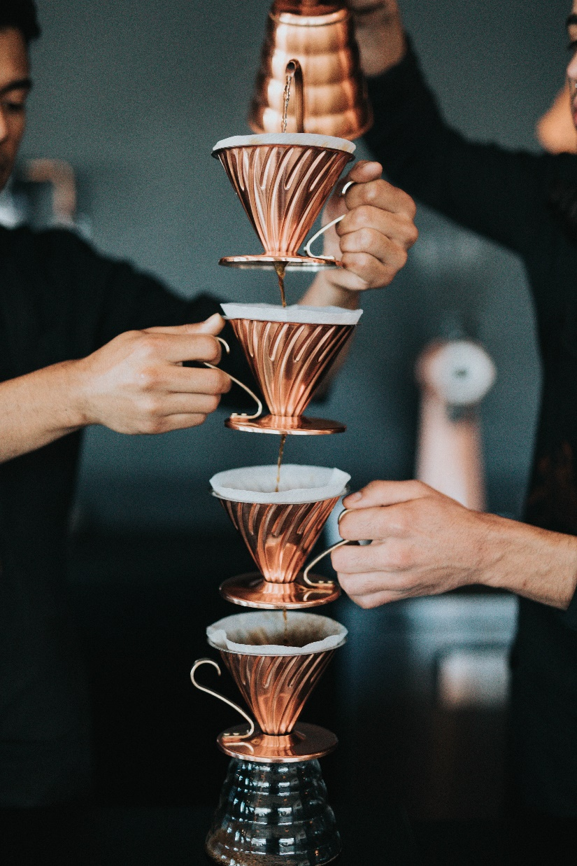
REAL STORY
Notes:
No team play

Slide 26
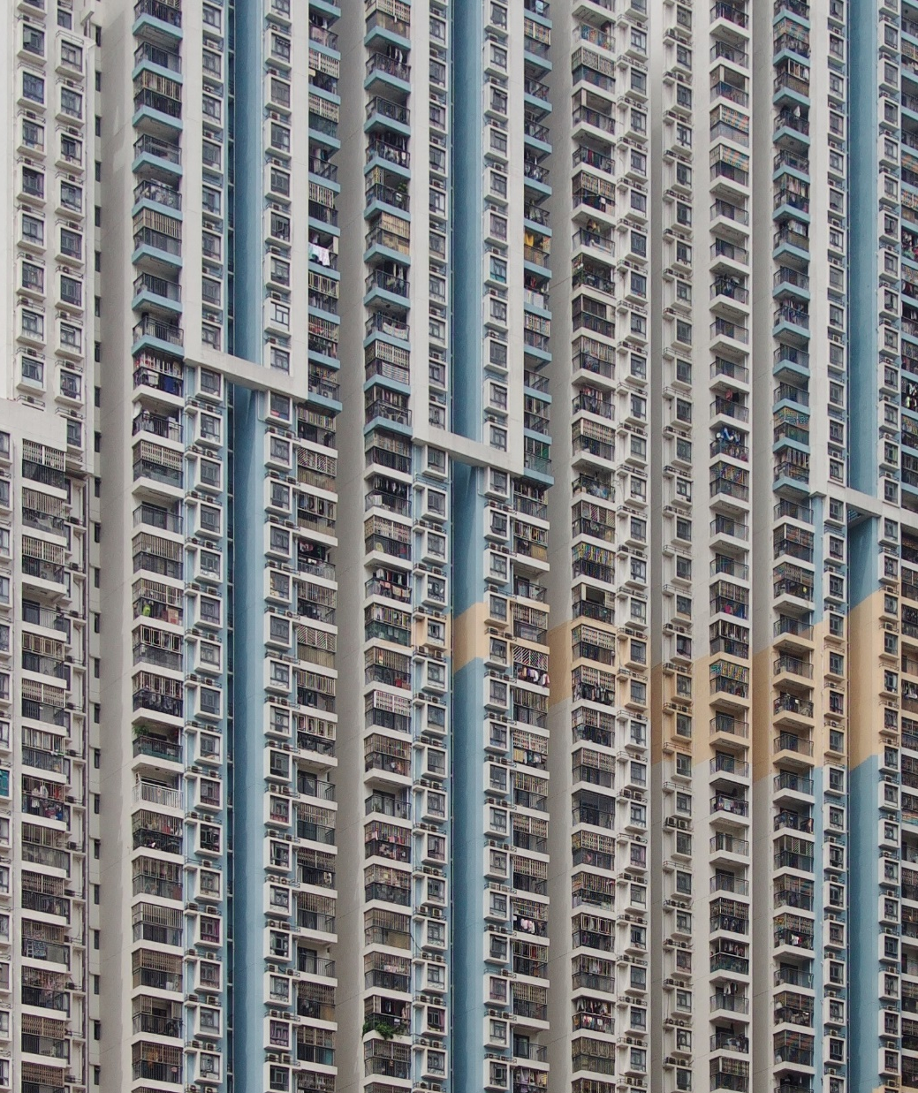
SCOPE / CHANGE
Current state
+ Delta
= Target state
US elaboration
Release
Next releases
Support
Notes:
Supplementary specification
Станислав Рождественский. Подход к спецификации изменений
https://vimeo.com/166800429

Slide 27
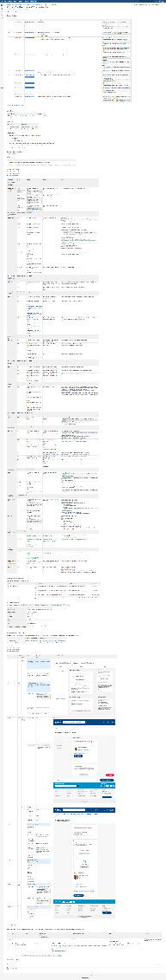
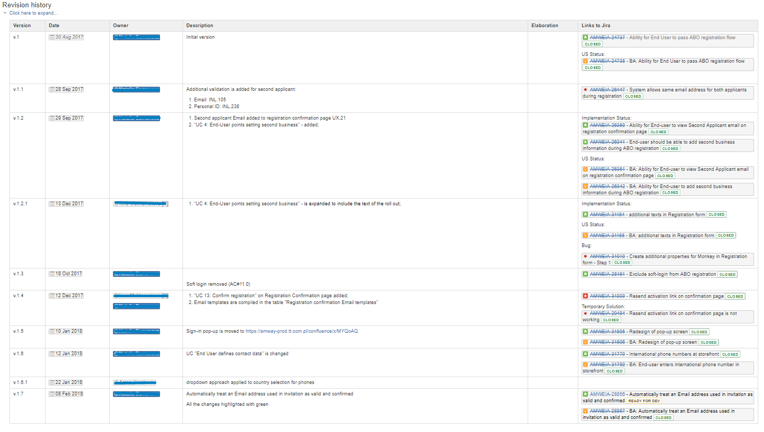
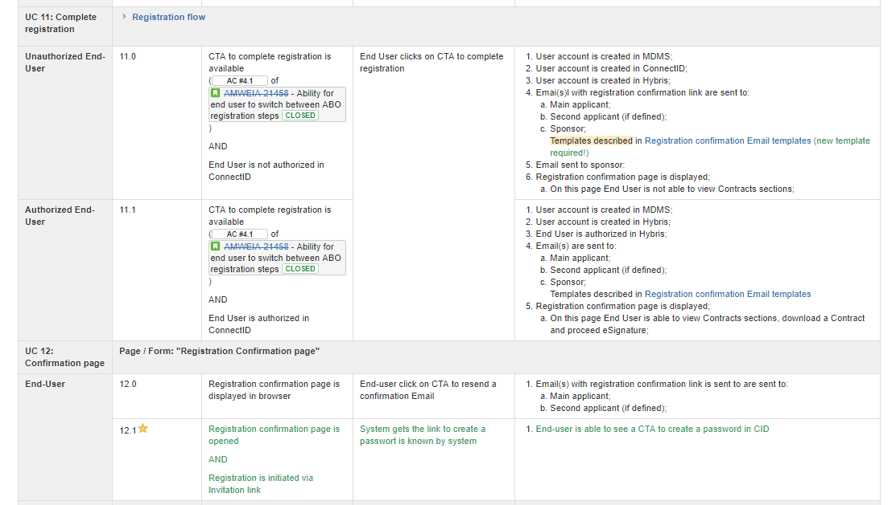
SCOPE / CHANGE
Notes:
Supplementary specification

Slide 28
BACK TO THE ROOTS
Title
Acceptance criteria
Wireframes
Assumptions
Proposed solution
References
Card
Business Need
Context
Solution requirements
Glossary
Limitations of Scope
Process flow
Impact Analysis
Definitions of Done
Revision history
Table of content
Ease understanding
Capture solutions wanted by SH
Capture dependencies
Share the value to the team
What is implemented
Align with 3rd parties
Provide shared terms underst-g
Save from scope creep
Provide process context
Track affecting business objects
Provide non BDD AC
Track changes
Navigate
Protect from uncertainties
Title
Card
Acceptance criteria
Notes:
No answers and detailed specification upfront
Requires context and visibility
Supplementary documentation is required

Slide 29
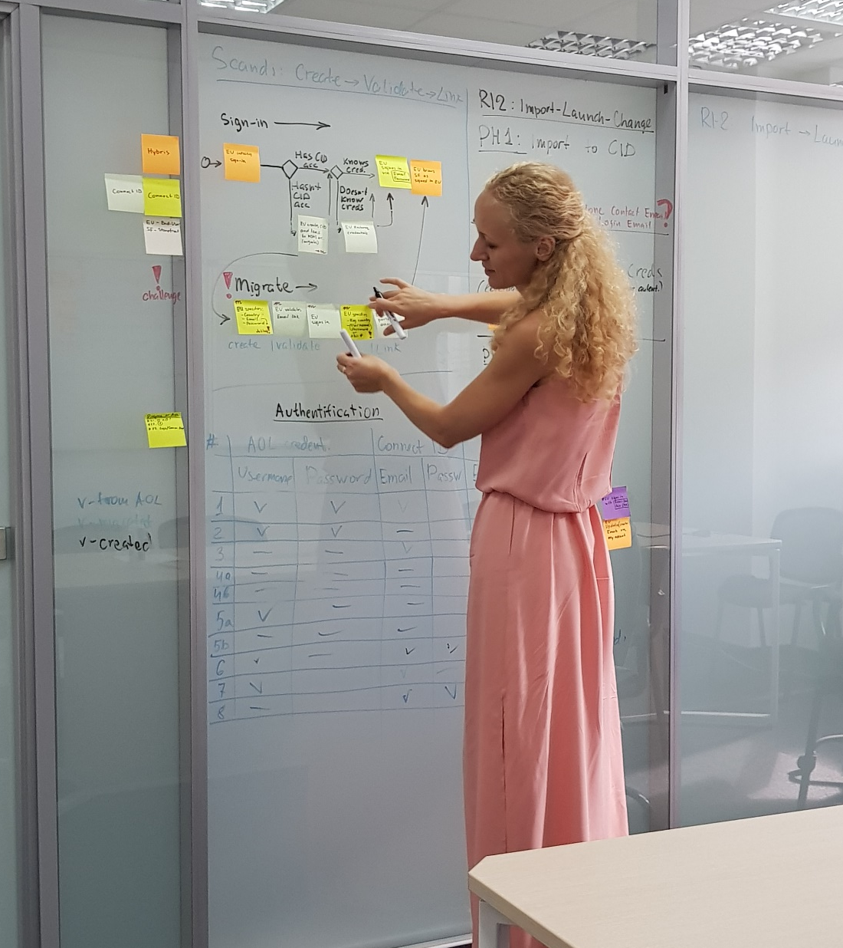
SYNCHONIZING WATCHES
BENEFITS
Easy to understand for SH
Focuses on value to SH
A shared understanding of business domain
Rapid delivery
Frequent customer feedback
CONSTRAINTS
No answers and detailed specification upfront
Requires context and visibility
Supplementary documentation is required

Slide 30
TEAM PAIN POINT. USER STORIES
 | BA | Dev | QA | Support | Future
No transparent “AS IS” state | time | time | time | time | time
Delta is not clear |  | bugs | bugs
Impact is not clear | gaps | bugs | bugs | bugs | b+t+g
Long-time elaboration | time |  |  |  | time
GOALS
Decreasing quality
Customer dissatisfaction
Reputational risks
Decrease Story size
Increase Transparency

Slide 31



THANK YOU!
Let’s discuss
December, 2018

Slide 32
GET BENEFITS, ADMIT CONSTRAINTS
USER STORY
USER STORY
USER STORY
AS IS STATE
value
100% valuable
USER STORY
USER STORY
delta
USER STORY
value

Slide 33
GET BENEFITS, ADMIT CONSTRAINTS
USER STORY
USER STORY
USER STORY
AS IS STATE
value
100% valuable
USER STORY
USER STORY
delta
USER STORY
value

Slide 34
STORY & ‘AS IS STATE’. TO BE
Revision history
Table of content
Business requirements
Business-need
Table of requirements, Discovery results, In scope
Context
Related high-level documents
Functional solution #
Business rules, Assumptions, Constraints, Process flow, Stories (Jira filter)
Constrains of solution
Countries & Localization, Business-users groups, End-user groups, Channels
Impact Analysis
Wireframes
Glossary
References
Title
Card
Acceptance criteria
Countries
Additional DoD
Notes for Dev
DoD
User gets smth
AS.. I WANT TO.. SO THAT..
GIVEN.. WHEN.. THEN..
In Jira
Customer Demo performed
FSD updated
How-to updated

Slide 35
TRANSITION
FREEZE
COPY
FREEZE
COPY
RI-2 AS IS
RI-3 AS IS
RI-4 AS IS
? % valuable
100 % valuable
100 % valuable
Update
Update

Slide 36
BENEFITS
 | BA | Dev | QA | Support | Future
Updated ASIS state description
Small, simple and valuable stories
Tracking transparency
Easier investigation & Elaboration
Notes:
US – tracking delta - the most difficult but the only valuable part

Slide 37
THANK YOU!
Let’s discuss
December, 2018

