Slide 1

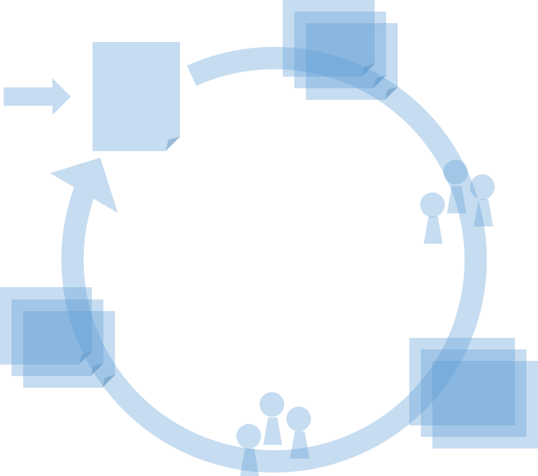
Workshop Continuous Requirements Engineering
Hans van Loenhoud
Taraxacum, the Netherlands
@HansvanLoenhoud

Slide 2
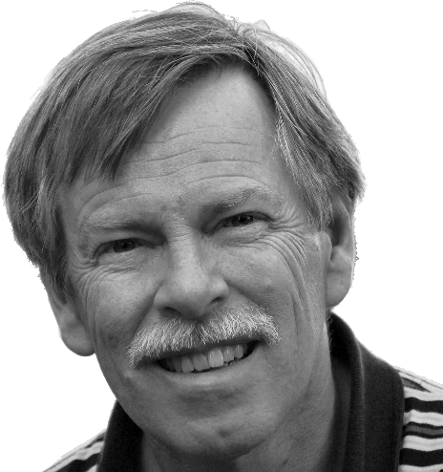

Pleased to meet you
Hans van Loenhoud
Taraxacum, the Netherlands
Trainer | coach | consultant
Business Analysis
Requirements Engineering
Software testing
Member of the

Slide 3
Route
[Case] User stories are enough
Points of engagement
Requirements?
[Case] Continuous RE
The end …

Slide 4

Requirements
A requirement is ‘a condition or capability needed by a user to solve a problem or achieve an objective’
(IEEE Std 610.12 - 1990)

Slide 5
The scope
Environment
System
Needs
Func-tion

Slide 6

Requirements engineering
Environment
… investigates the needs in relation to an intended function in the environment
… designs a solution that will enable that function in the environment
System
Needs
Func-tion
… from which developers can build a system
Requirements engineering

Slide 7
From needs to solution
Needs
Use
Analyze
Design
Build
Test
Deploy

Slide 8
From the waterfall …
Needs
Use
Analyze
Design
Build
Test
Deploy

Slide 9
… to Agile
Needs
Iterative
Use
Analyze
Analyze
Incremental
Design
Build
Test
Deploy

Slide 10
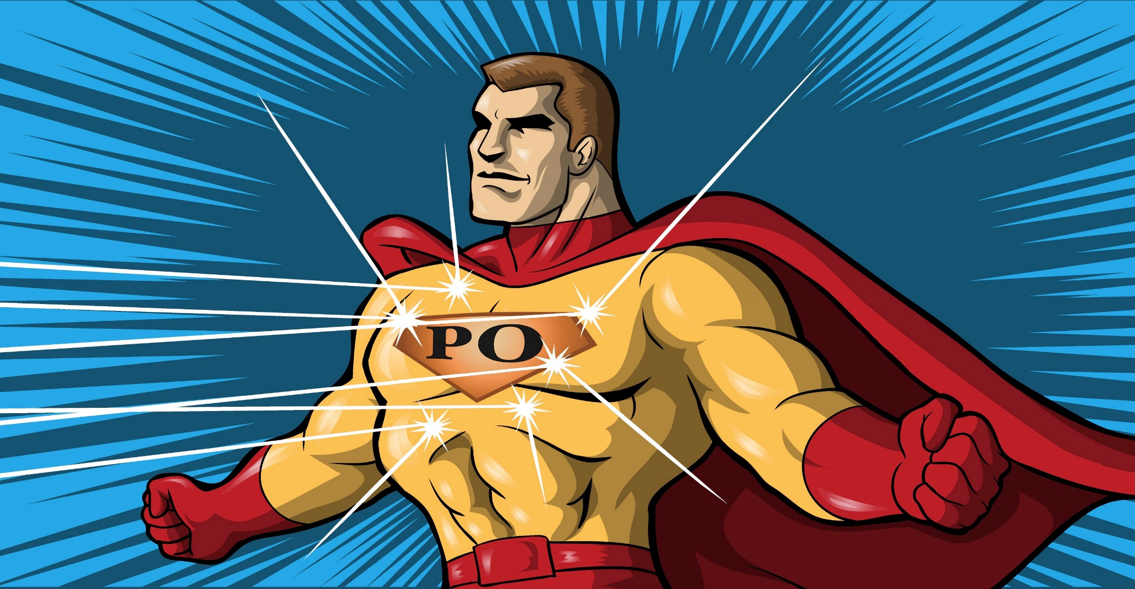
Requirements? Just ask the Product Owner!

Slide 11




Common misunderstandings about requirements today

Slide 12
Route
[Case] User stories are enough
Points of engagement
Requirements?
[Case] Continuous RE
The end …

Slide 13
[Case] User stories are enough

Slide 14


[Case] User stories are enough
(5 min) Form teams of 3 or 4 partici- pants and study case description CharIT4all (1)
(15 min) Define a few user stories
As a [… role …], I want [… some functionality …], so that I [… can achieve some objective …].
(10 min) Together, discuss the results
Is this enough to develop the system?

Slide 15
[Case] User stories are enough
(5 min) Form teams of 3 or 4 partici- pants and study case description CharIT4all (1)
(15 min) Define a few user stories
As a [… role …], I want [… some functionality …], so that I [… can achieve some objective …].
(10 min) Together, discuss the results
Is this enough to develop the system?

Slide 16
[Case] User stories are enough
(5 min) Form teams of 3 or 4 partici- pants and study case description CharIT4all (1)
(15 min) Define a few user stories
As a [… role …], I want [… some functionality …], so that I [… can achieve some objective …].
(10 min) Together, discuss the results
Is this enough to develop the system?

Slide 17
[Case] User stories are enough
Is this enough to develop the system?
Did you think of all stakeholders?
Box collectors
Citizens
Charity organization management
CharIT4all management
Banks
Government
Did you think of
Quality requirements?
Technical / organizational / legal constrains?
Contractual / implementational aspects?
Did you avoid (premature) design decisions?

Slide 18
Common misunderstandings about requirements today
Upfront is evil
User stories are enough
Only working software counts
Documen- tation = waste!

Slide 19
Route
[Case] User stories are enough
Points of engagement
Requirements?
[Case] Continuous RE
The end …

Slide 20

Points of engagement
2. Selection
Backlog item
…………
Backlog
…
…
…
…
1. Initial definition
input for
4. Update
Team
3. Validation
develops
Feedback
…………
Product increment
give
reviewed by
Stakeholders

Slide 21
1. Initial definition
Putting on backlog
High level
Features, epics
From business
By elicitation
Role of analyst
Check for completeness
Maintain consistency and traceability

Slide 22
2. Selection
Accepting in iteration
Realizable
User stories
Define - re(de)fine
Definition of Ready
Definition of Done
Role of analyst
Check for DoR
Check team for knowledge level
Spikes!

Slide 23
3. Validation
Checking quality
Upfront | end
Complexity ⬄ risk ⬄ rework ⬄ detail
Role of analyst
Discuss approach and timing
Reviews
Prototyping
Tests
Do | support | manage

Slide 24
4. Update
Handle feedback
Input backlog
Creativity!
Impact?
Size, complexity
Team ⇨ PO ⇨ client
Role of analyst
Impact analysis
Spikes | user stories

Slide 25
Route
[Case] User stories are enough
Points of engagement
Requirements?
[Case] Continuous RE
The end …

Slide 26
[Case] Continuous RE
2. Selection
Backlog item
…………
Backlog
…
…
…
…
1. Initial definition
input for
4. Update
Team
3. Validation
develops
Feedback
…………
Product increment
give
reviewed by
Stakeholders

Slide 27
[Case] Continuous RE
(5 min) Study case description CharIT4all (2) (same teams)
(15 min) Discuss the given user stories (and/or your own)
Definition of Ready, Definition of Done
Validation approach
(10 min) Together, discuss the results
Can RE add value?

Slide 28
[Case] Continuous RE
(5 min) Study case description CharIT4all (2) (same teams)
(15 min) Discuss the given user stories (and/or your own)
Definition of Ready, Definition of Done
Validation approach
(10 min) Together, discuss the results
Can RE add value?

Slide 29
[Case] Continuous RE
(5 min) Study case description CharIT4all (2) (same teams)
(15 min) Discuss the given user stories (and/or your own)
Definition of Ready, Definition of Done
Validation approach
(10 min) Together, discuss the results
Can RE add value?

Slide 30
[Case] Continuous RE
Can RE add value?
Did you check consistency between user stories?
Did you change user stories during discussion?
How about traceability?
How about relations between user stories?
Did you agree on DoR?
Did you agree on DoD?
Did you agree on acceptance criteria?
Which user stories can be validated upfront and which after development?
How did you decide on it?

Slide 31
The end

Slide 32

Continuous Requirements Engineering
Both a professional specialization
and a role for all team members
Not a single initial phase
but a continuous attention point

Slide 33


Thank you for your attention
Hans van Loenhoud ✓ http://www.ireb.org
 hans.vanloenhoud@ireb.org
@HansvanLoenhoud

