Slide 1

Lego4Scrum
Project simulation game

Slide 2

Key goals
Just for fun, not a competition
Simulate a project lifecycle, incl. estimations
  Discovery
  Construction
  Acceptance
  Unpredictable conditions
Develop out-of-the-box thinking
Promote SCRUM values - self-organize, collaborate and continuously improve

Slide 3
General rules
Main Highlights
Schedule, minutes
No how-to limitations, no reference solution
No managers or ”pushed” decisions
Hard time frames
Be accurate and help organizers to collect all bricks after the game
15 intro
10 discovery
5 estimate
5 construction intro
15 min / sprint
15 feedback
Based on https://www.lego4scrum.com/ framework

Slide 4
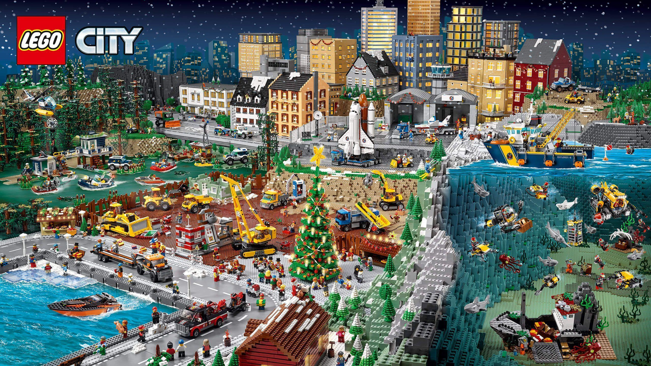
Product Vision

Slide 5
Backlog
Item |  | Estimate, min

Slide 6
Construction lifecycle
Construction
Demo
Retro
Planning
7 minutes
Not time-limited
3 minutes
3 minutes
All sprint tasks should be complete
No construction beyond this point
Acceptance by business
Time to discuss your processes
What is for the next sprint?

Slide 7
Actual workload
Item | Team | Sprint | Accepted

Slide 8
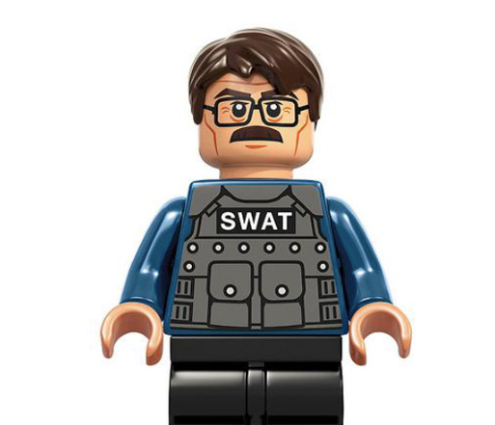
Top project delay reasons
Inadequate estimations (budgets, timeframes, human resources)
Incorrect or low-detail understanding of requirements
Unexpected events
Changes or new requirements, affecting architecture
Lack of cooperation

Slide 9

Time for feedback and suggestions

