Slide 1
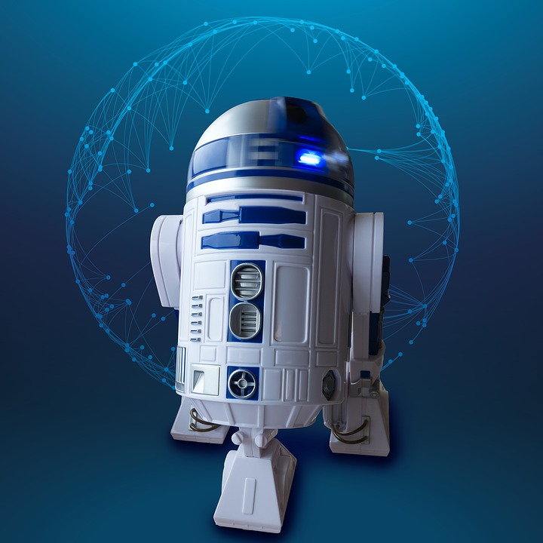

RE@Anywhere!
On the future of Requirements Engineering
Hans van Loenhoud
Taraxacum,
the Netherlands
@HansvanLoenhoud

Slide 2
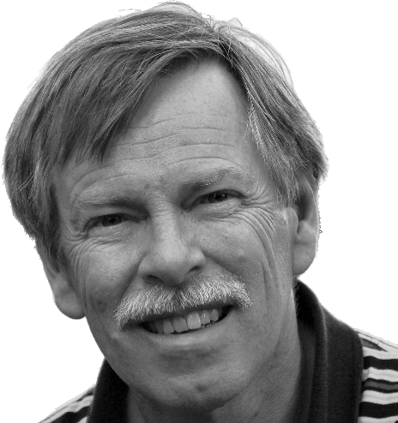

Pleased to meet you
Hans van Loenhoud
Taraxacum, the Netherlands
Trainer | coach | consultant
  Business Analysis
  Requirements Engineering
  Software testing
Member of the

Slide 3
Route
And now for something completely different ...
Once upon a time …
Requirements?
What’s next?
How to get there?

Slide 4
The scope
Environment
System
Needs
Func-tion

Slide 5

Requirements
A requirement is ‘a condition or capability
needed by a user to solve a problem or achieve an objective’
(IEEE Std 610.12 - 1990)

Slide 6

Engineering
Engineering is ‘the creative application of scientific principles to design or develop structures, [… etc. …] all as respects an intended function, economics of operation or safety to life and property’
(Am. Engineers' Council for Professional Dev’mnt)

Slide 7

Requirements engineering
Environment
… investigates the
needs in relation
to an intended
function in the
environment
… designs a solution that will enable that
function in the
environment
System
Needs
Func-tion
… from which developers
can build a system
Requirements
engineering

Slide 8
Route
And now for something completely different ...
Once upon a time …
Requirements?
What’s next?
How to get there?

Slide 9
… we developed by the waterfall
Needs
Use
Analyze
Design
Build
Test
Deploy

Slide 10
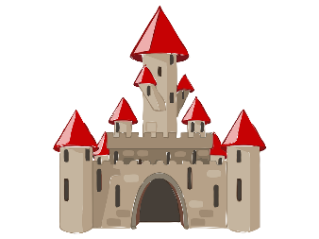


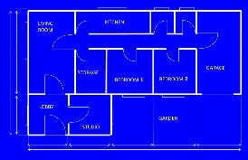

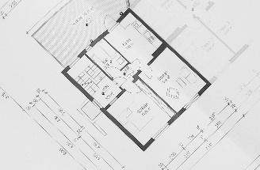
Requirements for a solution
?

Slide 11
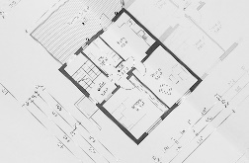
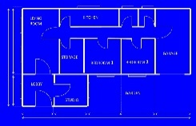
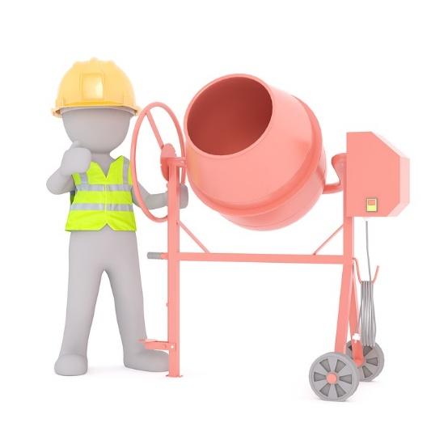




Using requirements

Slide 12

Sorry for that …
)
(

Slide 13

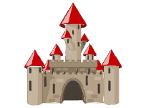

Old school
Client asks for system
RE collects requirements
Project builds system

Slide 14
Route
And now for something completely different ...
Once upon a time …
Requirements?
What’s next?
How to get there?

Slide 15

The Agile storm!

Slide 16
From the waterfall …
Needs
Use
Analyze
Design
Build
Test
Deploy

Slide 17
… to Agile
Needs
Iterative
Use
Analyze
Analyze
Incremental
Design
Build
Test
Deploy

Slide 18
RE@Anywhere!
2. Selection
Backlog
item
…………
Backlog
…
…
…
…
1. Initial
definition
input for
4. Update
Team
3. Validation
develops
Feedback
…………
Product
increment
give
reviewed by
Stakeholders

Slide 19

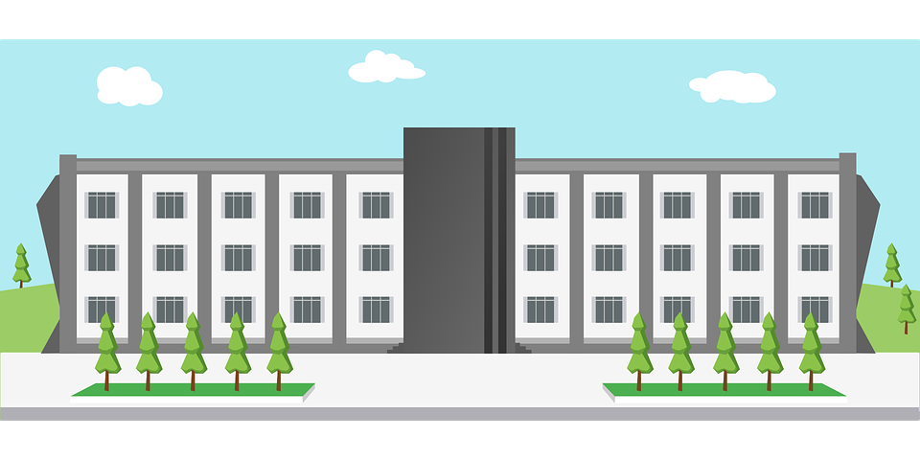
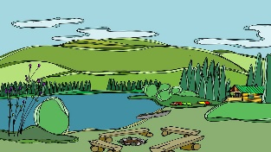
New school
Client asks for help
RE analyzes context
and proposes solutions
Project develops chosen solution
require-
ments
⬄
system

Slide 20
Route
And now for something completely different ...
Once upon a time …
Requirements?
What’s next?
How to get there?

Slide 21


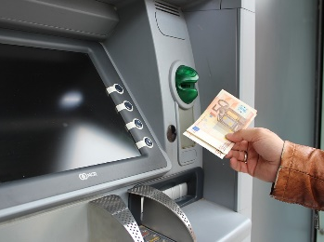
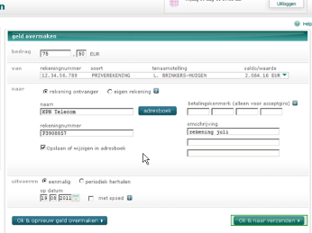



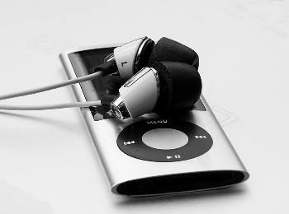



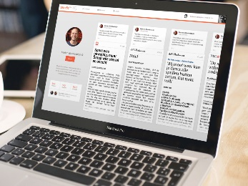

Digi … what?
digitization
digitalization
digital transformation

Slide 22

The innovation challenge
It is a green field
  No examples
  No stakeholders
  No customers (yet…)

Slide 23


Supplier centered ⇨ customer centered

Slide 24


Customer affected ⇨ customer involved

Slide 25


Product oriented ⇨ service oriented

Slide 26

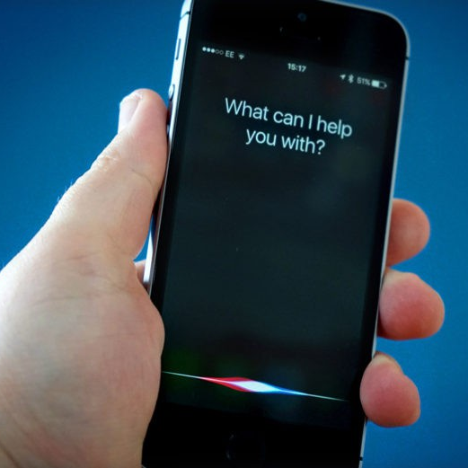
IT supported ⇨
IT enabled

Slide 27
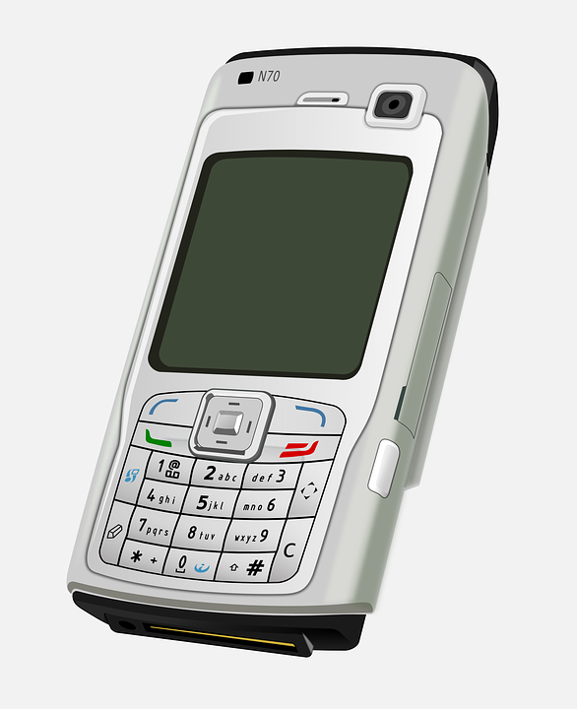
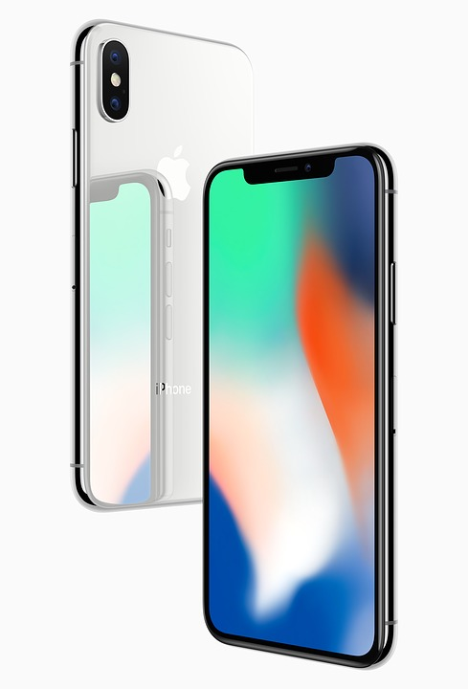
Engineered ⇨ designed

Slide 28

Steve Jobs on Design
Design is not just what it looks like.
Design is how it works.
The broader one’s understanding
of the human experience,
the better design we will have.
Simple can be harder then complex.
You have to work hard to make your
thinking clean to make it simple.
Most important, have the courage
to follow your heart and intuition.
Steve Jobs
(1955 - 2011)

Slide 29
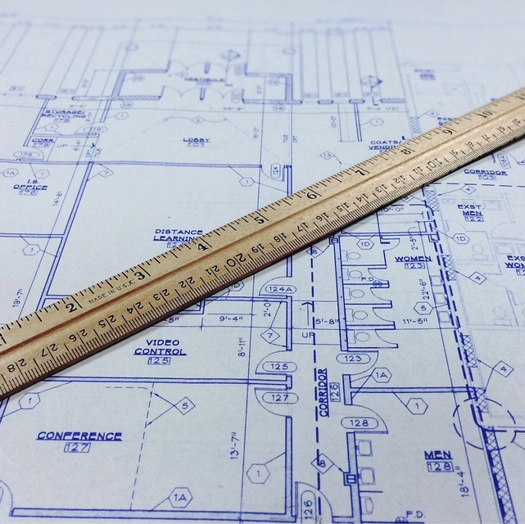

Requirements ⇨ ideas

Slide 30
The Next Generation
From requirements engineering
to requirements engineering
  From descriptive to creative
RE to create business value by providing solutions
  Participate in projects creating IT-systems that effectively support the needs of clients

Slide 31
Route
And now for something completely different ...
Once upon a time …
Requirements?
What’s next?
How to get there?

Slide 32
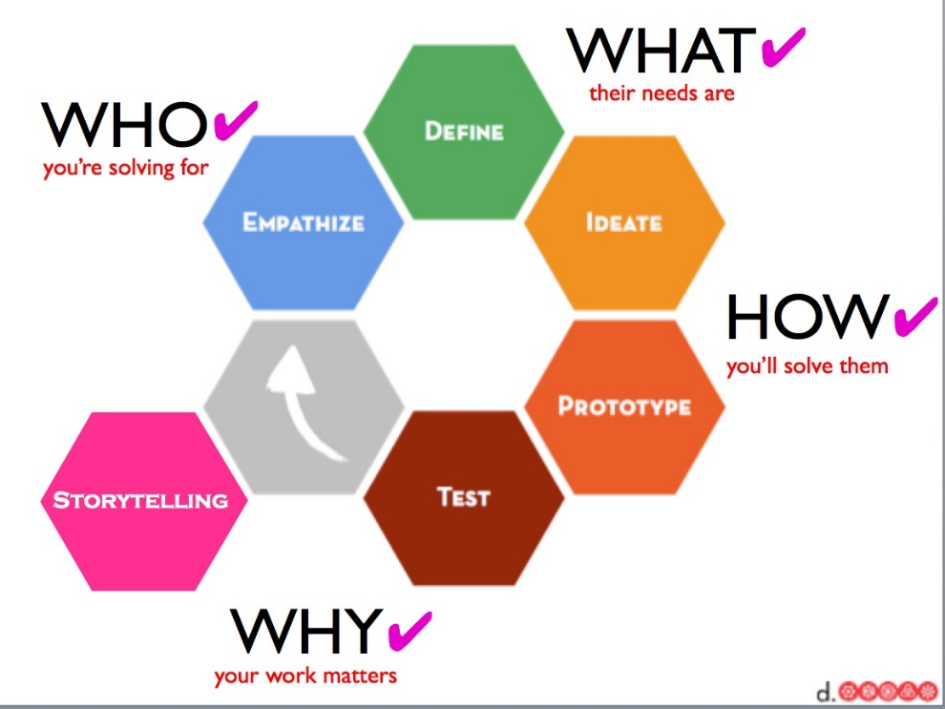
Design Thinking
A light-weight approach using different methods and techniques
  … to develop practical and sustainable solutions for wicked / ill-defined problems
  … focused on building
  quick and cheap prototypes
‘Fail faster to succeed sooner’

Slide 33
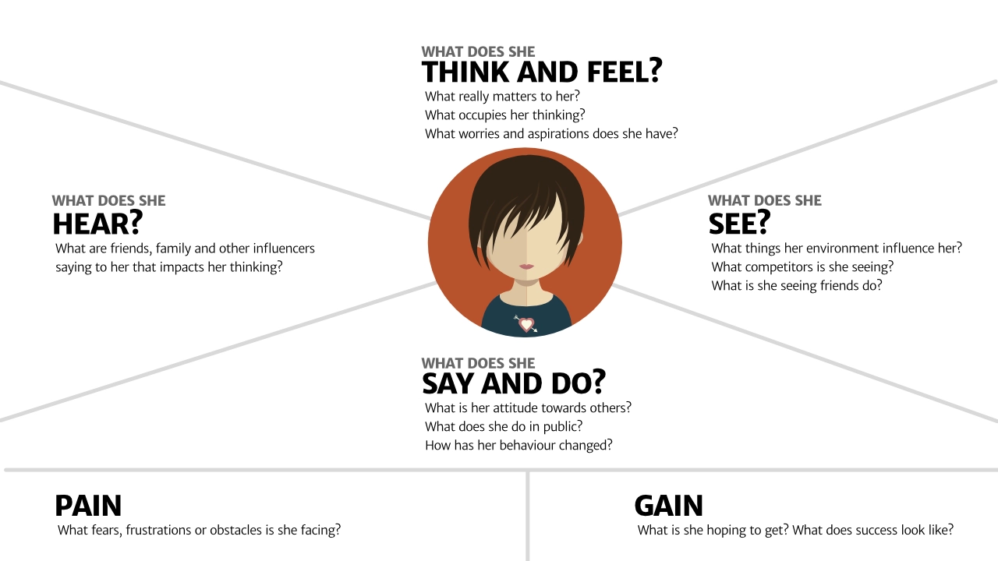
Design Thinking (cont.)
Empathy map

Slide 34
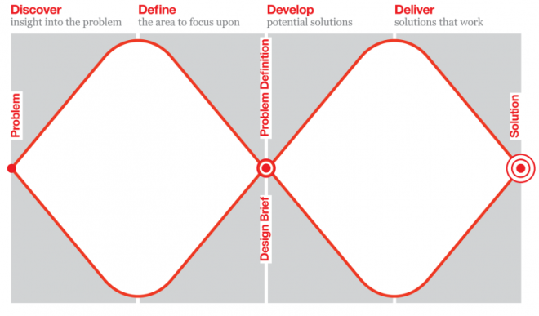
Design Thinking (cont.)
Z
The Double Diamond
http://www.designcouncil.org.uk/news-opinion/design-process-what-double-diamond

Slide 35


Design Thinking (cont.)
Define: POV – Point of Vue
Ideate: HMW – How might we?

Slide 36
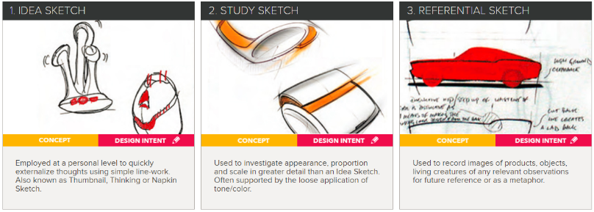
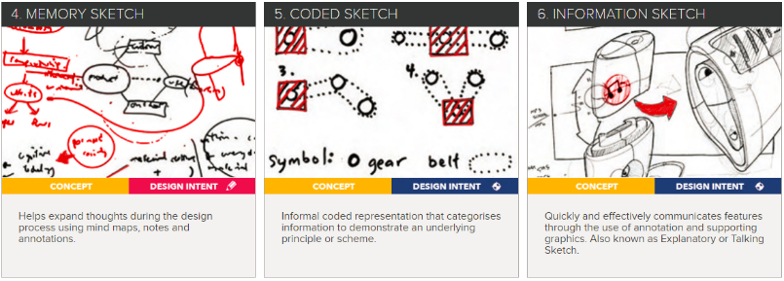
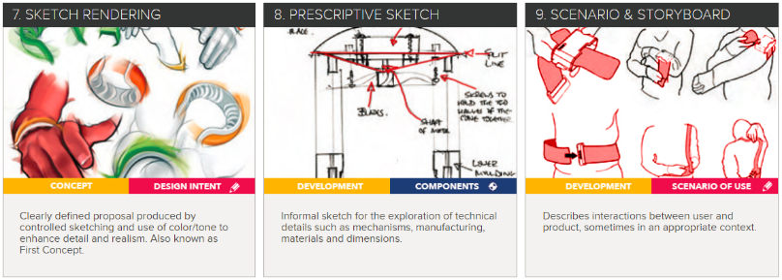
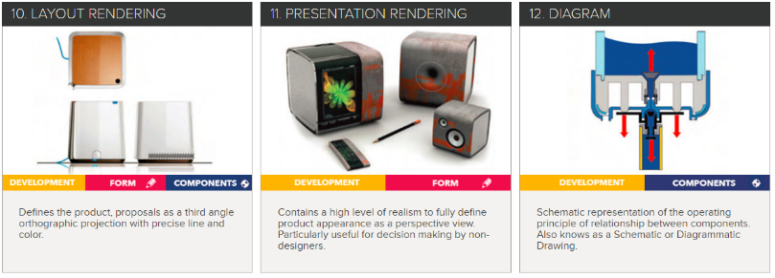
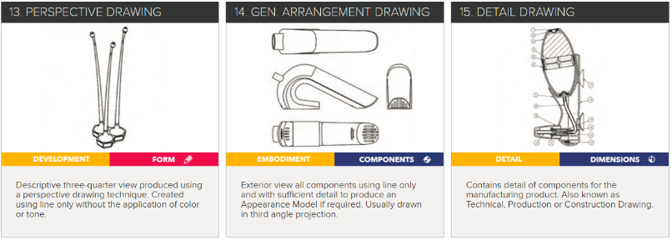
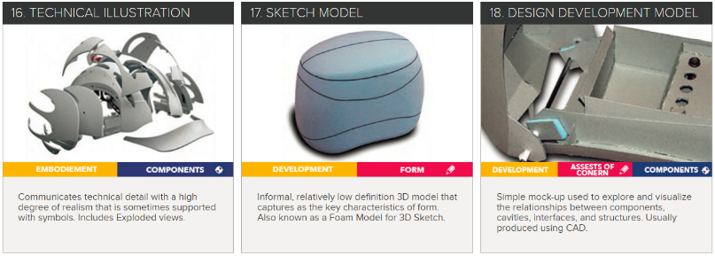
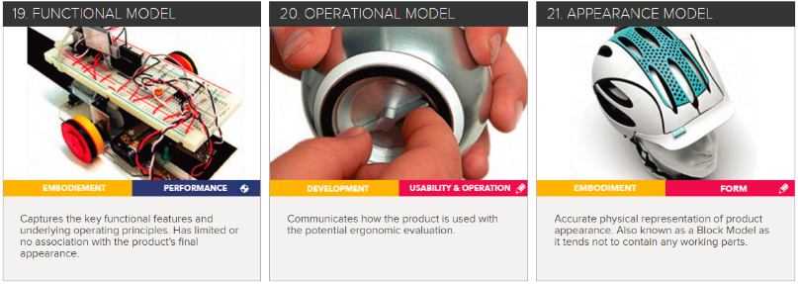
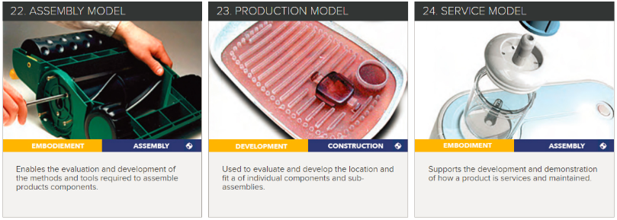
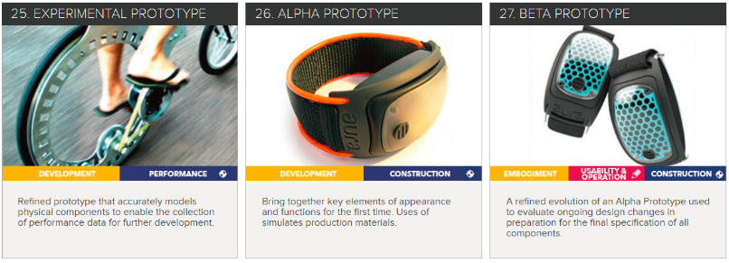
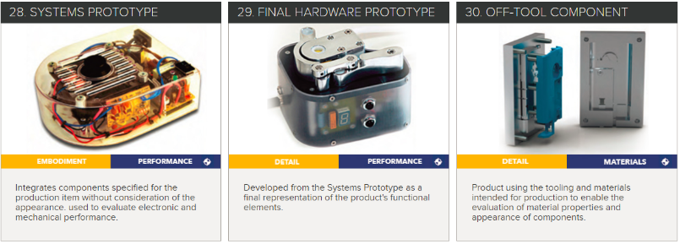
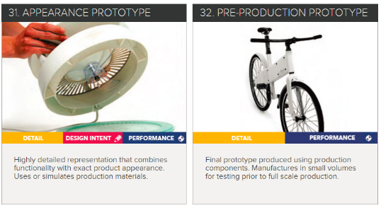
Prototyping, prototyping, prototyping
http://www.idsa.org/education/how-they-do-it

Slide 37
The end

Slide 38
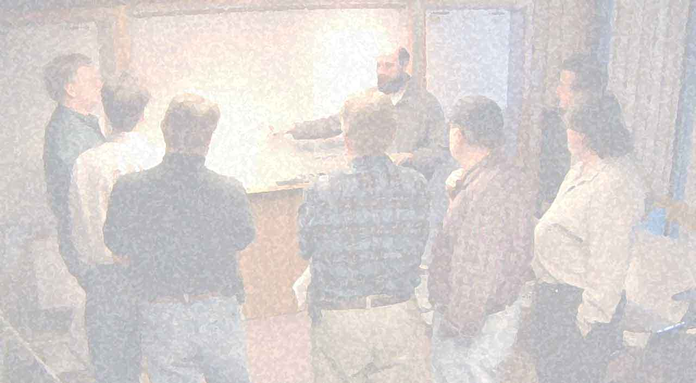
RE Manifesto
Over the years, we have developed requirements as a cornerstone for the delivery of successful IT-systems. Through this work we have come to value
we recognize that the success factors
are on
the left.
While there is much value in
the basic factors on the right,
Genuine empathy and
techniques, models, and templates
Creative solution design and
comprehensive elicitation
In-time elaboration and
upfront specification
Shared understanding and
proper documentation
Notes:
EO 4.4.5 Knowing how to find the right timing of the development cycle

Slide 39


Thank you for your attention
Hans van Loenhoud
✓ http://www.ireb.org
 hans.vanloenhoud@ireb.org
@HansvanLoenhoud

