Slide 1
Business Analysis for IT infrastructure projects
Irina MINOIU, CBAP
President IIBA Romania Chapter

Slide 2
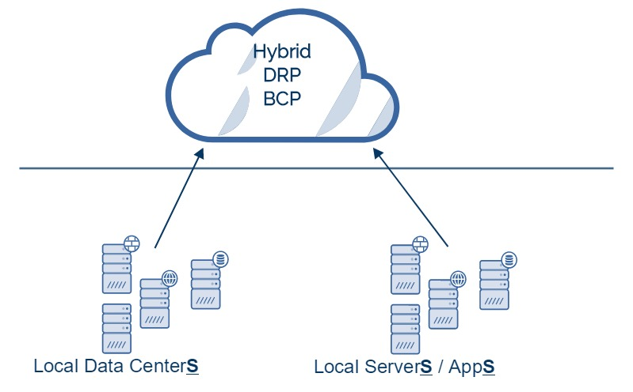
Context
Corporate wide strategic decision to MIGRATE local applications, servers, data centers to hybrid CLOUD

Slide 3
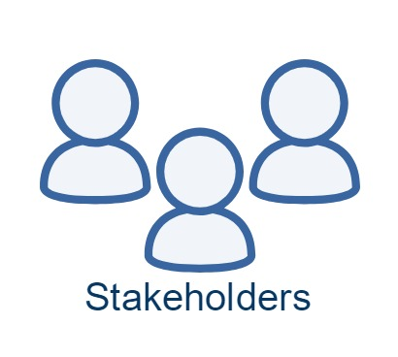
MIGRATION
Disruption
Risk
High costs
Exceeded time line
Extra hassle
Uncharted territory

Slide 4

Business Analyst’s TO DO
ROLE: Change enabler
CONTEXT: Real cause of the concerns
HOW: Migration approaches (process)
WHAT: Possible solutions
WHEN: Timelines
WHOM: Team

Slide 5
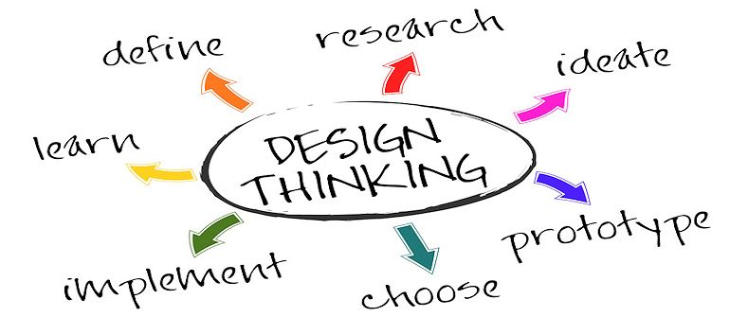
Main BA technique
Client driven
Output : tech scope & road-map

Slide 6
BA
Change enabler
Ask the right questions to uncover needed info
Learn the concerns an theirs's cause
Build trust
Guide building the solution
Minimize change impact

Slide 7
CONTEXT
C-level = managing the business
Is it the right strategic investment?
Would it help us grow?
GDPR compliant?
Line managers = running the business
Outage, downtime
Operational impact
Reliability, efficiency
Data lost
IT = supporting the business
Applications compatibility
Is it the right technology?
TO BE architecture
Access rights & working procedures
New skills & staffing concerns
End users / customers = “using” the business
Should be transparent

Slide 8
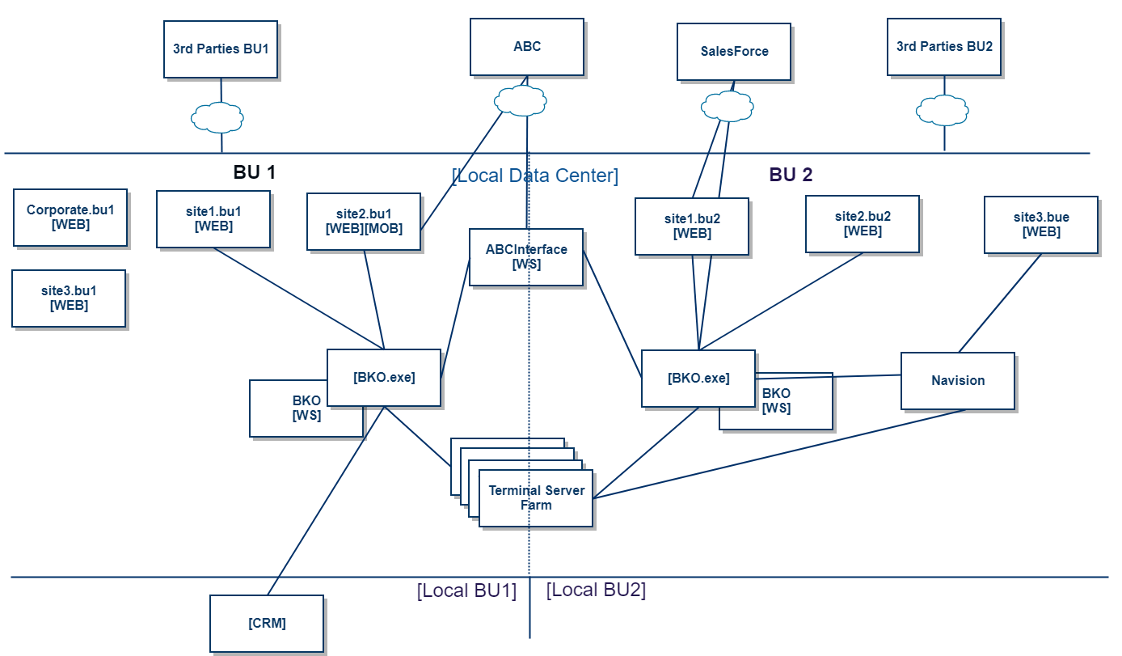
DEFINE
Research
Ideate
Prototype
Choose
Implement
Learn
CONTEXT DIAGRAM
Context Diagram
Business Need
Objective
53 servers
PROD / UAT
Mirrored / Balanced
TSFarm
File / print / …
18 software apps
3rd parties
In house (legacy code, new code)

Slide 9
DEFINE
Research
Ideate
Prototype
Choose
Implement
Learn
Business need
Increase reliability
Increase performance
Decrease costs
Decrease CO2 footprint
Context Diagram
Business Need
Objective
Objective
Migration should not impact the business
Respect the migration window

Slide 10
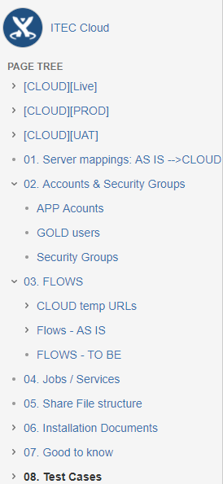
Define
RESEARCH
Ideate
Prototype
Choose
Implement
Learn
Output of research
BA learns about and document
Infra, flows
Key users
Apps and opps flows
Apps location
Security, availability, scalability, monitoring, disaster recovery
Observation
Document Analysis
Interviews
Workshops
Risks
Team
BA
Infra / architecture
Local IT
Key end users

Slide 11
Define
RESEARCH
Ideate
Prototype
Choose
Implement
Learn
Output of research
Technical risks
Technical feasibility: will it work on the new environment?
High risk: Legacy code - should be kept / upgraded / replaced
Low risk: new code, 3rd party code, data bases
Low risk: print, file, exchange servers
Avoid risks: make sure app does not get locked in providers HWs
Minimize risks: do not change functionalities, migrate as it is
Positive risks: upgrade DB and OS!
Observation
Document Analysis
Interviews
Workshops
Risks
Business risks
Costs overrun – budget correctly
Duration

Slide 12
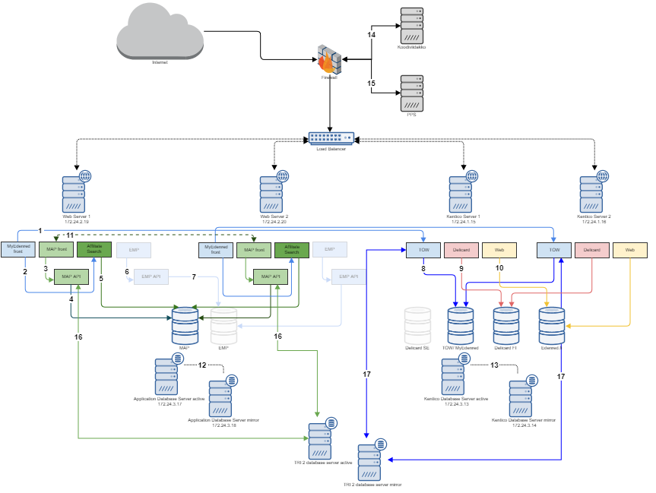
Define
Research
IDEATE &
PROTOTYPE
Choose
Implement
Learn
Output of ideate & prototype
TO BE Architectures & HWs & Mappings
Brain Storming
Collaborative Games
Mind Mapping
Workshops

Slide 13
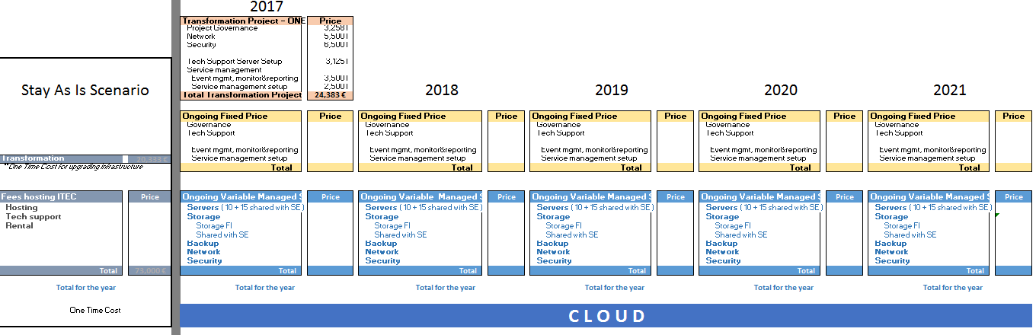
Define
Research
IDEATE &
PROTOTYPE
Choose
Implement
Learn
Output of ideate & prototype
Known costs
Servers, running costs, licenses, maintenance fees
Current vs. future
Input for business case
Cost of not migrating
Brain Storming
Collaborative Games
Mind Mapping
Workshops
Estimate costs ➔Cost overrun ➔Budget with margin
Migration effort + Tech RISKS
Validation effort (test cases & run test cases)– highest effort of migration
Learning – mostly for IT teams
Down-time
Opportunity Costs

Slide 14
Define
Research
Ideate
Prototype
CHOOSE
Implement
Learn
Output of choose
COST of no-migration ➔ MIGRATE
Migration approach
Roll-back at any time
Do not impact the business
Do not touch AS IS solutions
Big-bang vs. phase migration
Test migration with an loosely/non-coupled app!
Decision criteria: systems tightly coupled
Date of migration – business window
TO BE Architecture
Servers & capacity & availability
Co-hosting apps based on technology and usage
Decision criteria: running costs vs. expected load vs. availability
SWOT Analysis
Criteria Scoring
Analytical Thinking
Critical Thinking

Slide 15
Define
Research
Ideate
Prototype
Choose
IMPLEMENT
Learn
Implementation phases
Order servers
Grant access to tech teams
Set-up applications and flows for UAT & PROD
Grant access to end users
First validation UAT & PROD (light)
Freeze AS IS UAT & move to new environment
Acceptance of UAT
1st downtime calculation!!
Production dry-runs migration (~3) & validations
Freeze production & set up last app code
Switch! 6PM – 12PM Perfect!
Agile

Slide 16
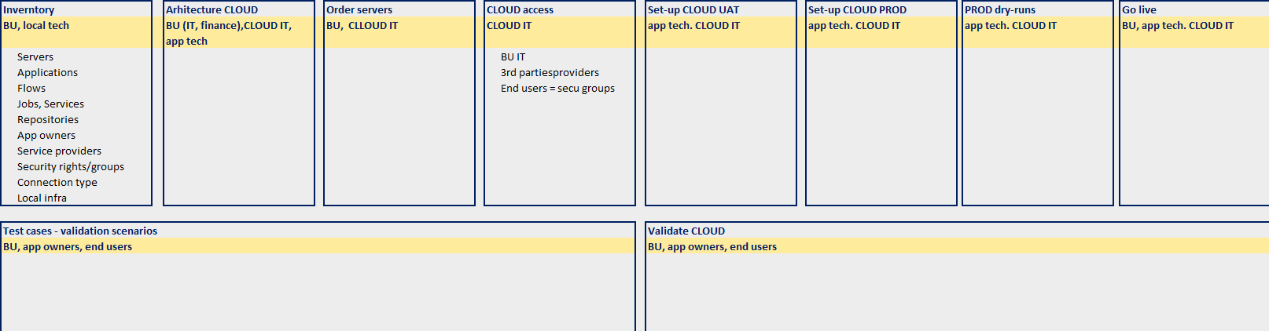
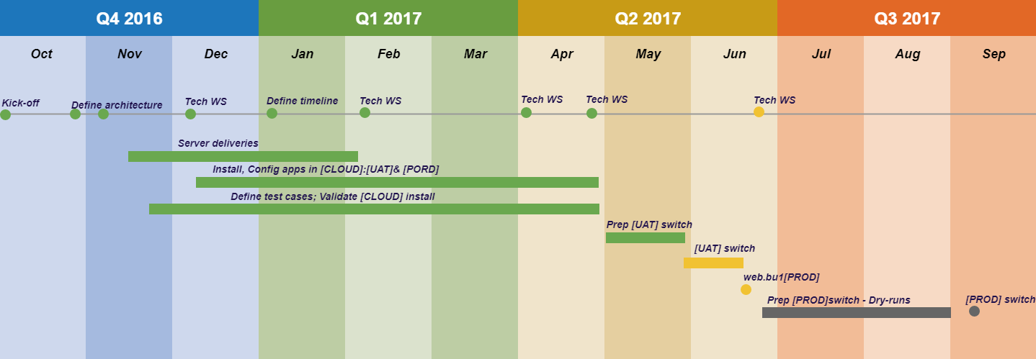
Define
Research
Ideate
Prototype
Choose
IMPLEMENT
Learn
Implementation phases
Agile

Slide 17
Define
Research
Ideate
Prototype
Choose
Implement
LEARN
Implementation phases
50% decrease of the migration period!
Observation
Root Cause Analysis
Critical Thinking

Slide 18
Define
Research
Ideate
Prototype
Choose
Implement
LEARN
Learned!
  The “UP-s”
  TEAM and continuous COMMUNICATION
  Commitment of BUs to the CHANGE
  Pragmatic approach to resource sharing
  Openness to learn as you go
  Kept initial schedule!
  The “Benefits”
  Fresh installs with only what is needed and used
  Align deployments with ITIL
  Confluence & Jira
  The “Challenges”
  Align business commitments and schedules with migration time line
  Flows definition and implementation
  Legacy code
Observation
Root Cause Analysis
Critical Thinking

Slide 19
Questions….!!!!

Slide 20

Thank You! contact@romania.iiba.org https://romania.iiba.org/ https://www.facebook.com/iiba.romania/ https://www.linkedin.com/company/iiba-romania-chapter/

