Slide 1
Polina Peresada, Lead Functional Analyst, Product Owner
Kristina Egorova, Senior Functional Analyst
Management. Leadership. Partnership.
#PositiveImpact

Slide 2
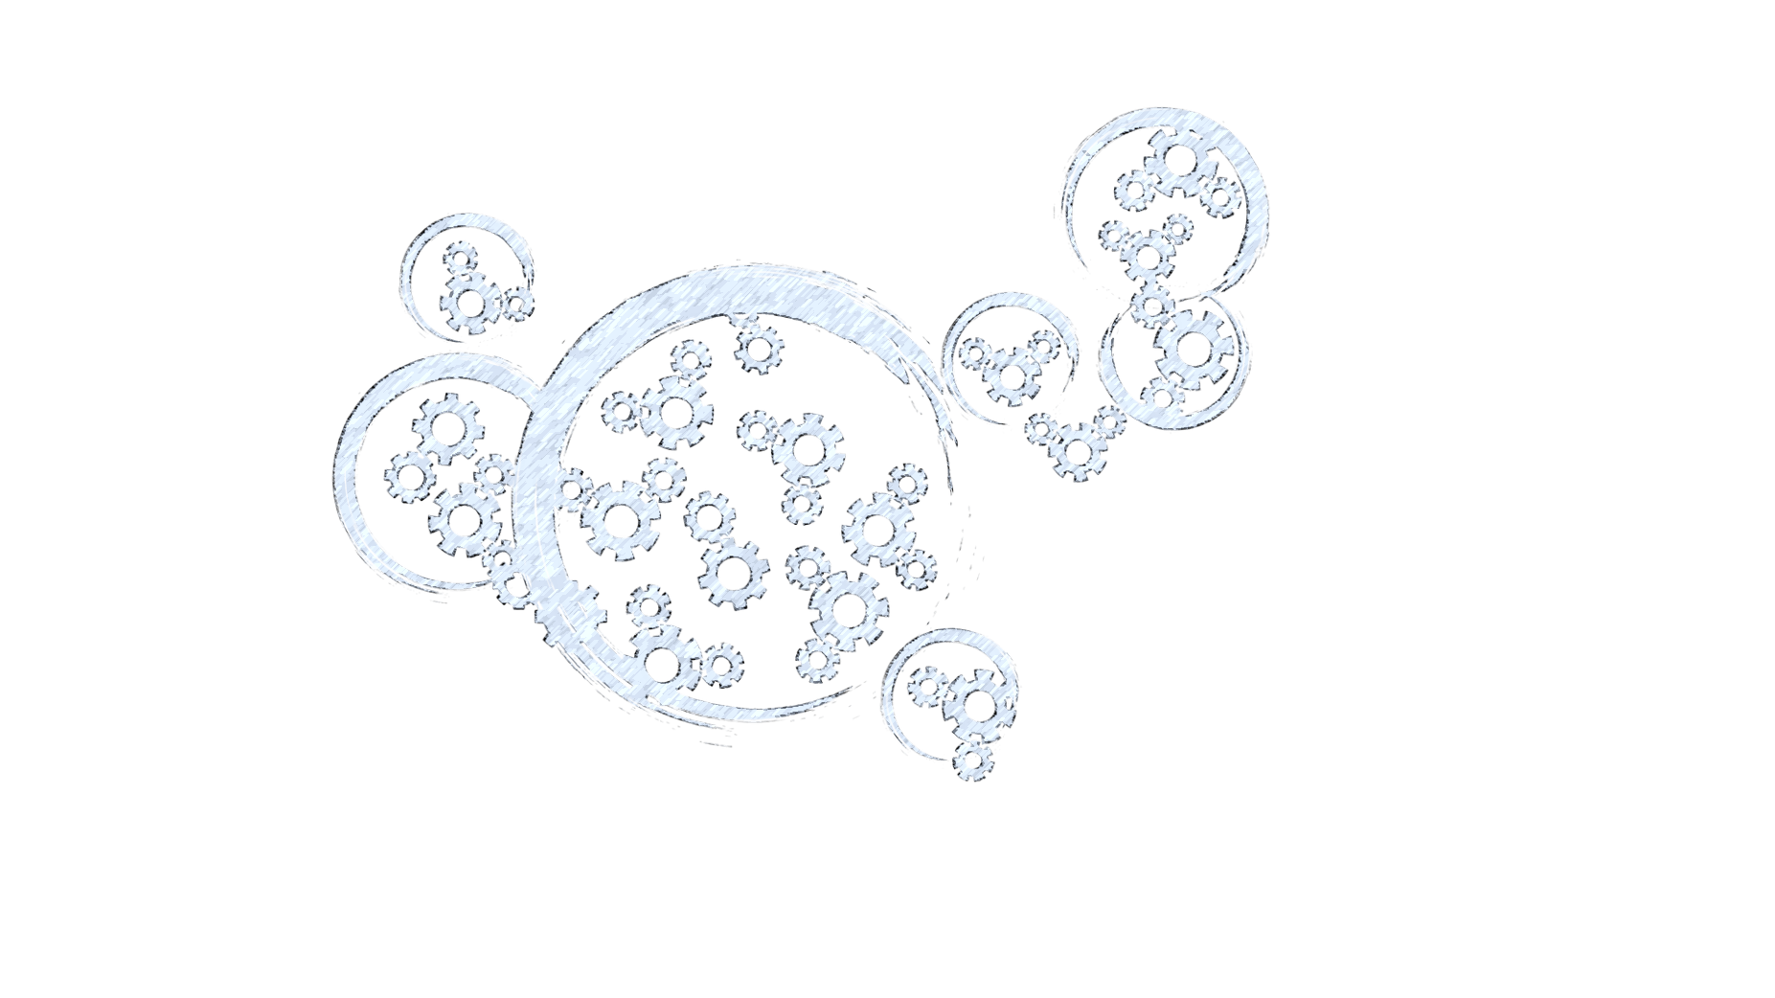
Agenda
    Bank as Ecosystem
    3 models of Team’s setup
    Routine vs Innovation
    Management
    Leadership
    Partnership
    Search for a Balance
    Research
    Discussion

Slide 3

Bank is a Complex Ecosystem
Clients needs
Profits
Regulations
High risk
Innovations
Flexibility
Competition
Stability 24х7
New markets
Time-to-Market
Performance
Business demands
Fintech startups
Seamless integration
Long run strategy
Customer experience

Slide 4

Applications and Teams
Several teams
Various setups
Several
applications
in each
processing
flow

Slide 5

Complexity of a Team
    50+ team
    members
    3 Locations
    15+ years of
    development
    Time
    differences
    Full development
    lifecycle
    Agile Transformation

Slide 6
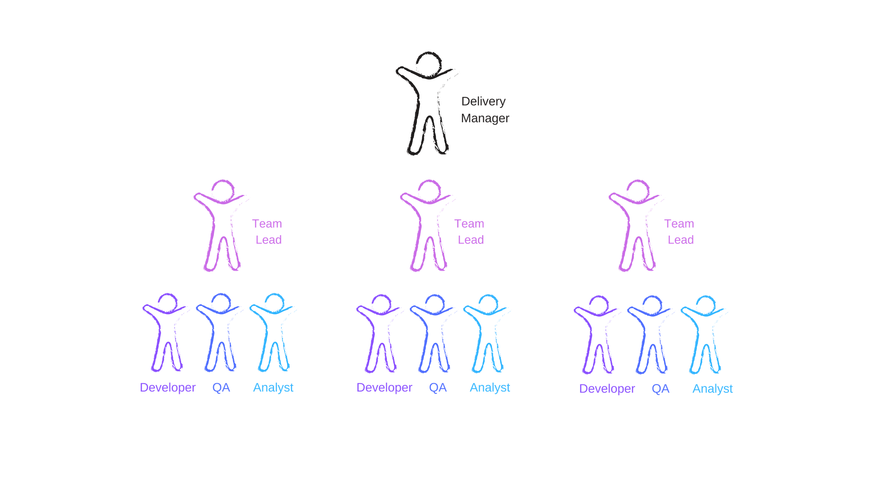
Six years ago: Team Lead model (1)

Slide 7
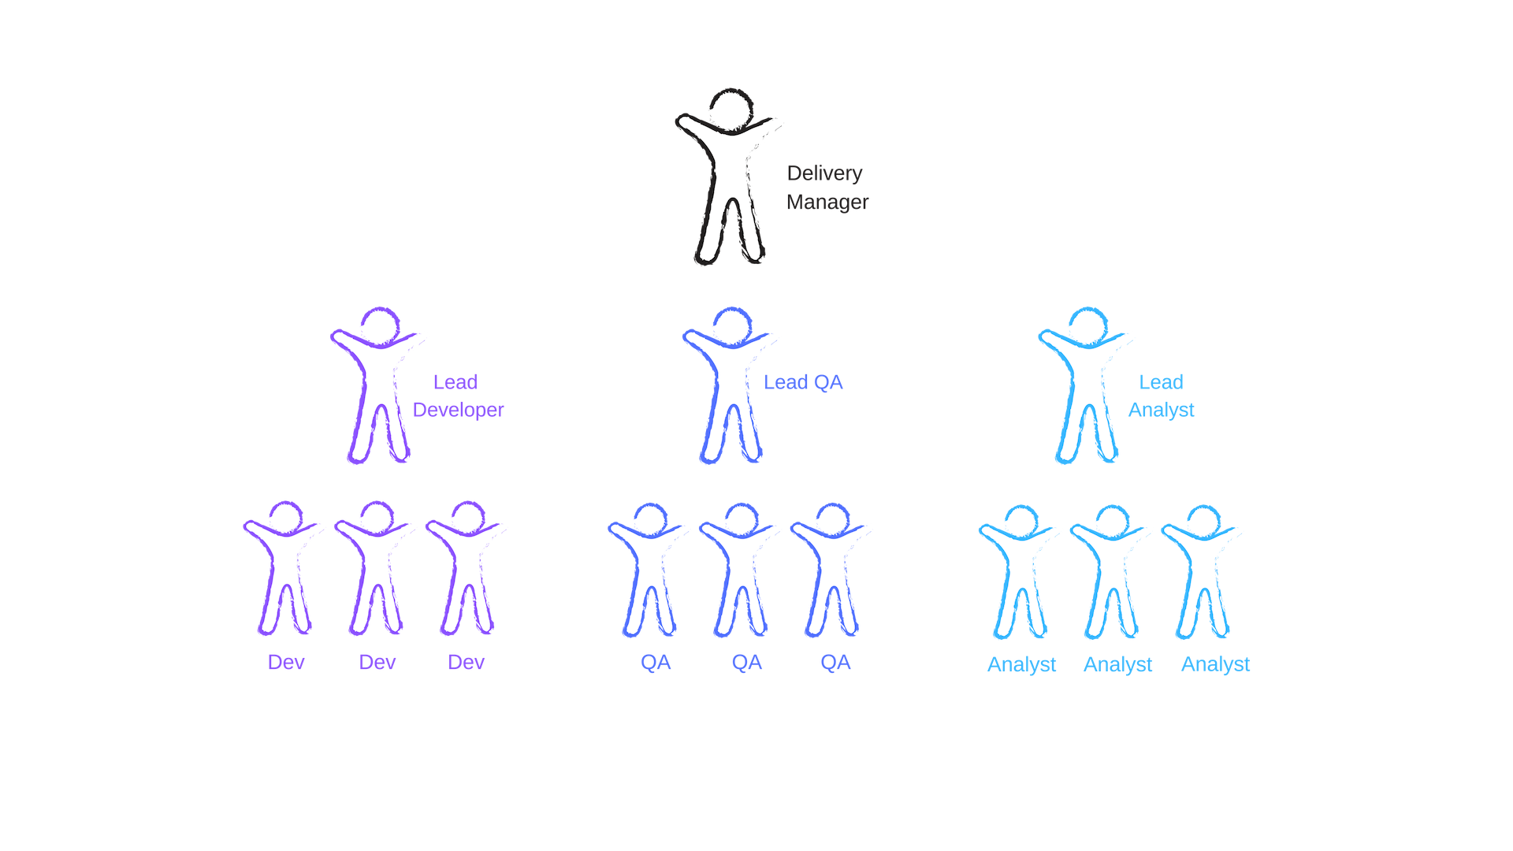
Three years ago: Professional Lead model (2)

Slide 8
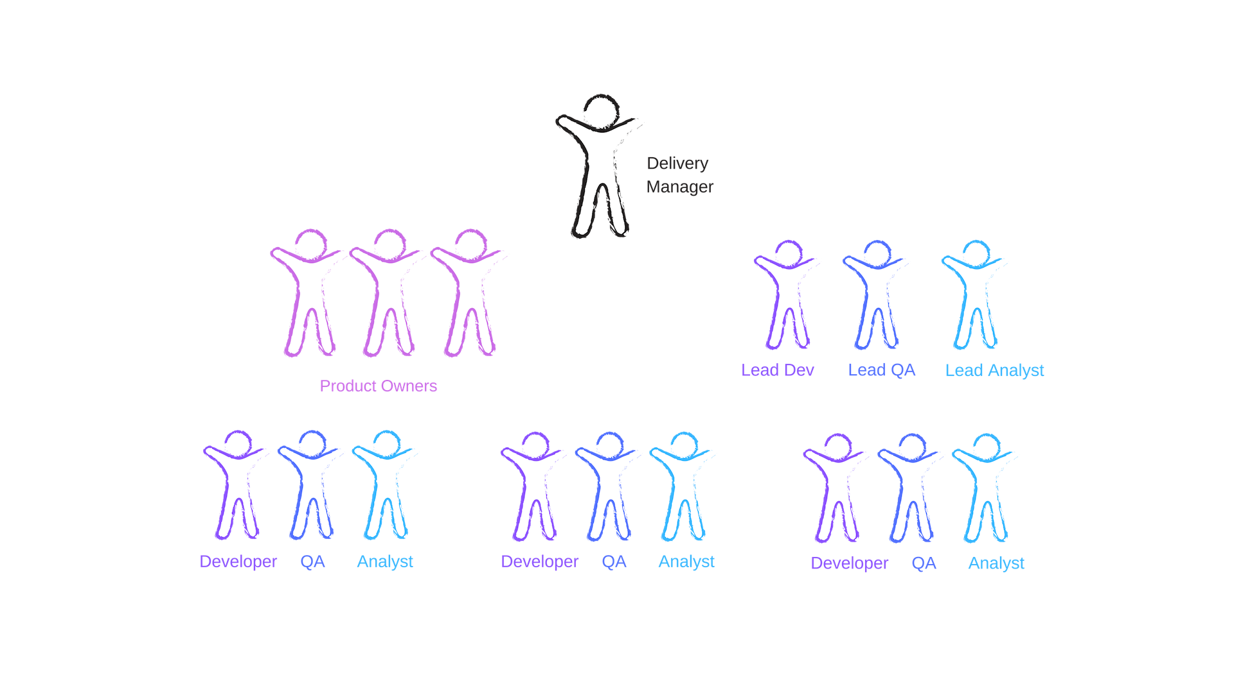
Today: Scaled Agile model (3)

Slide 9



The challenge
Speed
Profit
Transparency
Quality
Business demand
Result
    New strategic product

Slide 10
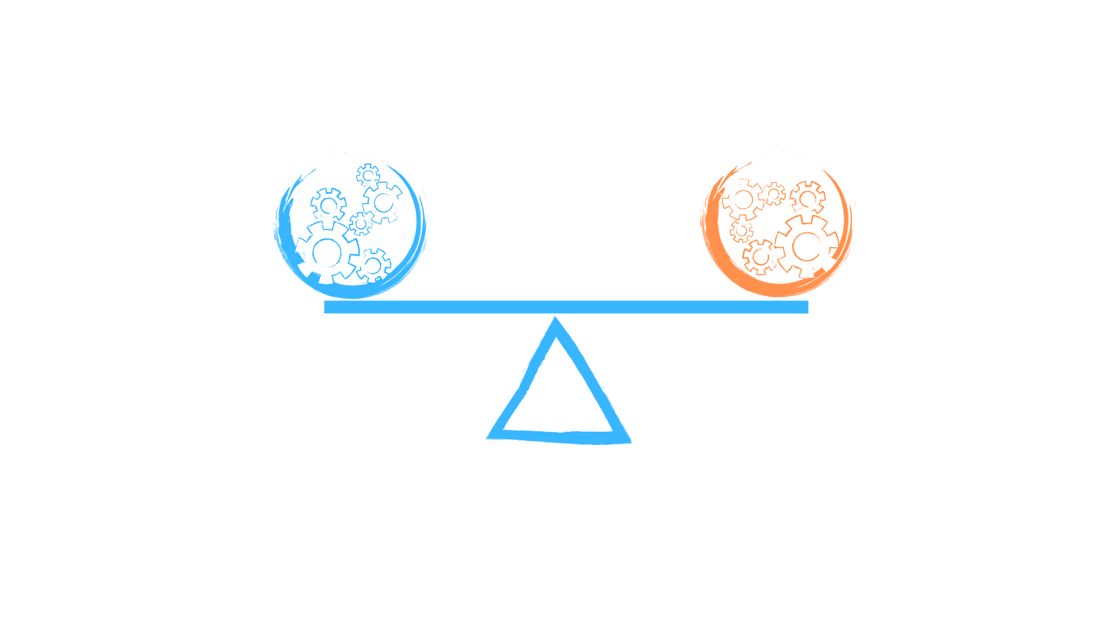
Routine vs Innovation
Regulations
Customer Experience
Stability 24х7
Performance
Seamless integration
Innovation
Flexibility
Time-to-Market
Fintech Startups
Competition
    How to find a balance?

Slide 11
Management: various views
Affinity for control
Attract best talent
Detailed plans
Encourage new mindset & skills
Tidy grids of linear processes
Customer centricity
Digital vision & opportunities
Rigid industry verticals
Volatile climate
Certainty
Fluid dynamics & high velocity
Source [1]

Slide 12
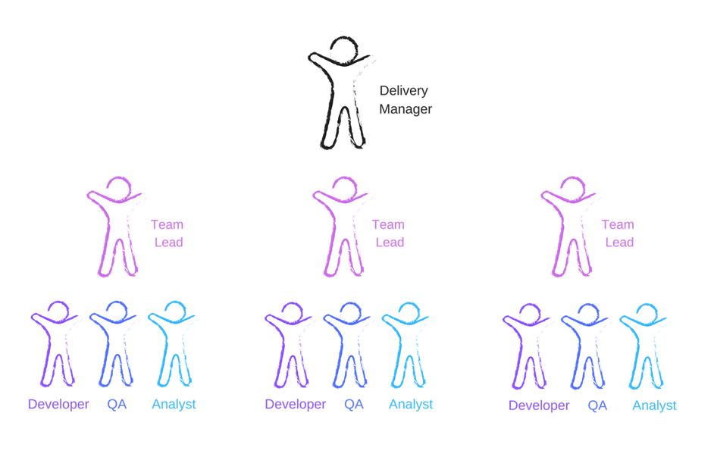

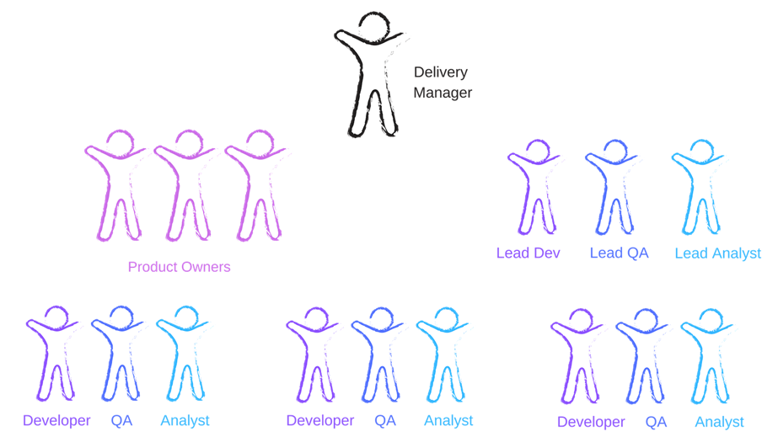
Management in different models
Product
People
Process

Slide 13
Management in Digital Economy
“People who are now enthusiastically engaged in their mission sometimes tend to lose their objectiveness... You need to be distinctive, you need control points, milestones, where people still need to report, and still they need to show their results... It is absolutely necessary.”
Digital Transformation Challenges in Large and Complex Organizations, CFFO White paper
Management
M
Source [4]

Slide 14
Leadership: New personas of digital era
Adventurer
Social Supers
Ambassador
Clarifier
Data-Driven Decisives
Educator
Disruption Drivers
Attractor
Talent Champions
Cartographer
Source [1], [2]

Slide 15
Leadership in different models
Innovations
Best Talents
New mindset

Slide 16
Leadership in digital economy
“Recognize that no individual leader will ever have the perfect blend of all needed leadership behaviors. Build a balanced and cohesive leadership team around you to complement gaps in your leadership style.”
© Graham P. Waller, research vice president at Gartner
Leadership
M
L
Source [1]

Slide 17
Partnership in different models
Evolution
Respect
Collaboration

Slide 18
Partnership in digital economy
What if you need some guidance on a work-related issue? Are you going to talk to the chief operating officer with whom you had one awkward conversation, or are you going to speak with a manager with whom you have worked multiple times and have a rapport? Relationships trump everything else.
© Frank Molinario, Vice President of Human Resources at Security First Insurance
Partnership
P
M
L
Source [3]

Slide 19
Organization Behavior Research
    Leader-Member exchange theory (LMX)
    40+ years of research
    Applied in various domains and contexts
    Captures the process of how the leader-follower relationship evolves over time
    Allows to analyze the outcomes
Role Finding
Role Making
Implementation
Source [4]

Slide 20
Organization Behavior Research
    Leader-Member exchange theory (LMX)
    40+ years of research
    Applied in various domains and contexts
    Captures the process of how the leader-follower relationship evolves over time
    Allows to analyze the outcomes
Role Finding
Role Making
Implementation
Individual outcomes:
Job satisfaction
Personal development & career path
Group level outcomes:
Short group performance
Long term results and stability
Source [4]

Slide 21
LMX-inspired survey
    Participants from different countries
      Russia; Ukraine; Belarus
      Germany; Italy; UK
      Singapore; New Zealand
      USA
    Analysts, Developers, QAs, Support
    and their managers
    IT services for various industries
      Banks & Finance
      Telecom
      Education
      Logistics
      Entertainment
    Teams working together for different time
    Teams working in different setups
    Everyone is happy with their team efficiency

Slide 22
Management:
How important is management in your project?
Questions, capturing importance of process, product and people management
Scale from 1 to 5, 1 – not important, 5 – extremely important
Views from different model perspective
Views from different role perspective

Slide 23
Management:
How important is management in your project?
Are you aware of experts in your team?
Time trend
1 – not aware, 5 – completely aware

Slide 24
Leadership:
How important is leadership in your project?
Questions, capturing importance of innovations, new ideas, experimentation
Scale from 1 to 5, 1 – not important, 5 – extremely important
Views from different model perspective
Views from different role perspective

Slide 25
Leadership:
How important is leadership in your project?
Is it easy to get an expert help from another team?
Time trend
1 - extremely hard, 5 – extremely easy

Slide 26
Partnership:
How important is partnership in your project?
Questions, capturing importance of trust, openness and good relationships
Scale from 1 to 5, 1 – not important, 5 – extremely important
Views from different model perspective
Views from different role perspective

Slide 27
Partnership:
How important is partnership in your project?
What is the leader-membership exchange quality in the team?
Time trend
1 – low LMX quality, 5 – good LMX quality

Slide 28
Summary:
Management. Leadership. Partnership
Views from different model perspective
Views from different role perspective

Slide 29
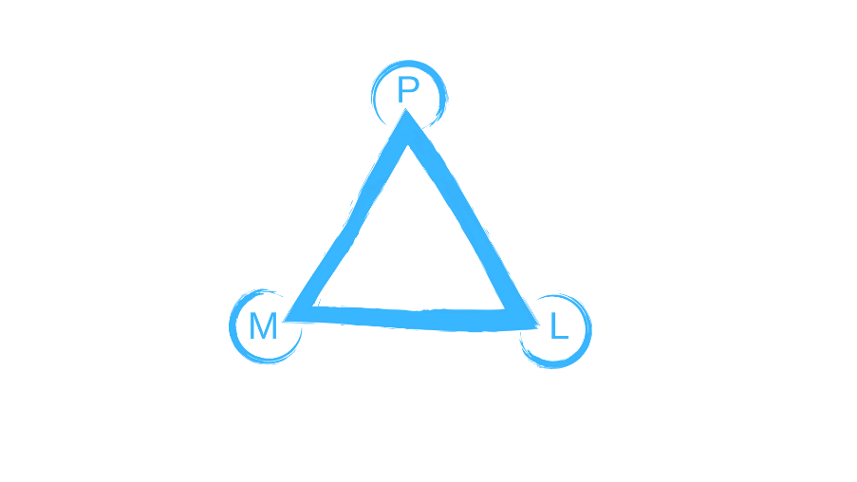
Summary:
Management. Leadership. Partnership
Time trend

Slide 30
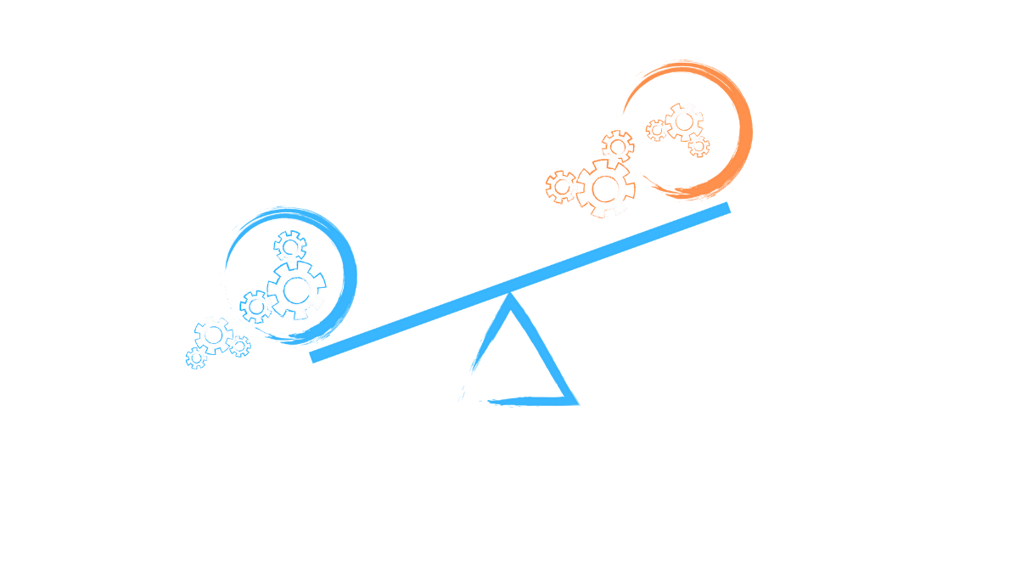
How does lack of Management affect balance?
Initial stage
Compensation
Result
No controls
Drop of quality
Human resources re-arrangement
Missed timelines
‘Big Brother’ mode

Slide 31
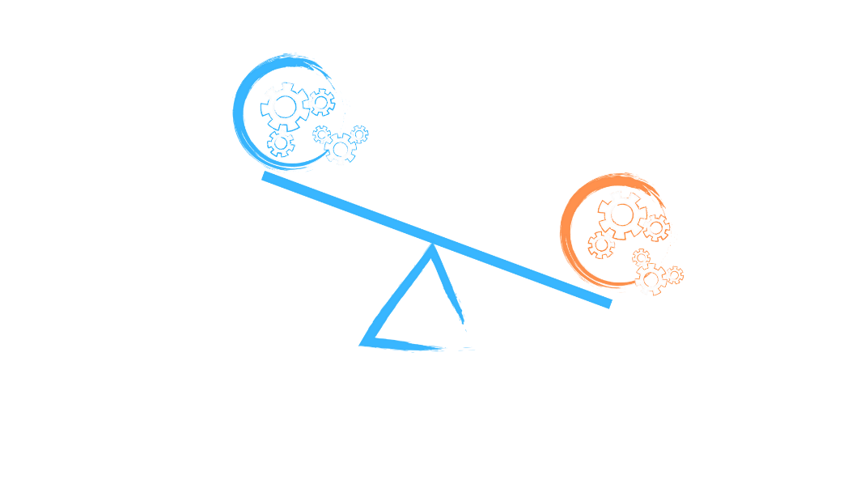
How does lack of Leadership affect balance?
Initial stage
Compensation
Result
No place for experiments or upgrade
Leaders rotation or no visibility to the Team
‘Groundhog day’ mode
Attrition

Slide 32
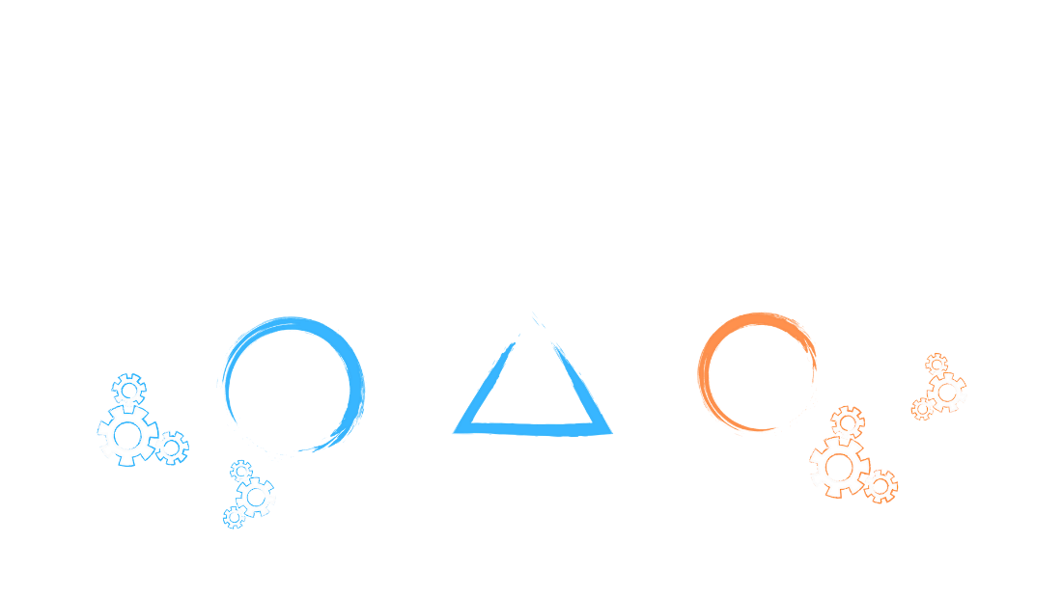
How does lack of Partnership affect balance?
Initial stage
Compensation
Result
No trust
Stricter rules & detailed legal contracts
‘Work-to-rule’ mode
No loyalty
Double work

Slide 33

So, what remains different in digital world?
The right blend of management function, leadership attitude and partnership mindset to balance between routine and innovation.
P
M
L

Slide 34
References
[1] Remake Yourself With Six Digital Leadership Personas, https://www.gartner.com/smarterwithgartner/digital_leadership_personas
[2] The Four Leadership Personas Of The Fourth Industrial Revolution - Which One Are You? https://www.forbes.com/sites/deloitte/2019/01/21/the-four-leadership-personas-of-the-fourth-industrial-revolutionwhich-one-are-you/#1ecde87a7ed0
[3] In Leadership, Relationships Matter Most https://www.forbes.com/sites/forbeshumanresourcescouncil/2018/10/24/in-leadership-relationships-matter-most
[4] Digital Transformation Challenges in Large and Complex Organizations, CFFO White paper, https://futureorg.org/wp-content/themes/futureorg/assets/Deiser-Digital-Transformation.pdf
[5] Research on LMX:
Relationship-Based Approach to Leadership: Development of Leader-Member Exchange (LMX) Theory of Leadership over 25 Years: Applying a Multi-Level Multi-Domain Perspective by George B. Graen & Mary Uhl-Bien
Differentiated leader-member exchange and group effectiveness: a dual perspective by Daejeong Choi

Slide 35
Disclaimer
This is not an offer to provide any services. This material is for information and illustrative purposes only and is not intended, nor should it be distributed, for advertising purposes, nor is it intended for publication or broadcast. Any third party analysis does not constitute any endorsement or recommendation. Opinions expressed herein are current opinions as of the date appearing in this material only and are subject to change without notice This information is provided with the understanding that with respect to the material provided herein, that you will make your own independent decision with respect to any course of action in connection herewith and as to whether such course of action is appropriate or proper based on your own judgment, and that you are capable of understanding and assessing the merits of a course of action. “Deutsche Bank TechCentre” LLC shall not have any liability for any damages of any kind whatsoever relating to this material

