Slide 1



Victoria Cupet
IIBA® Regional Director Europe
Learn to PLAY Business Analysis

Slide 2
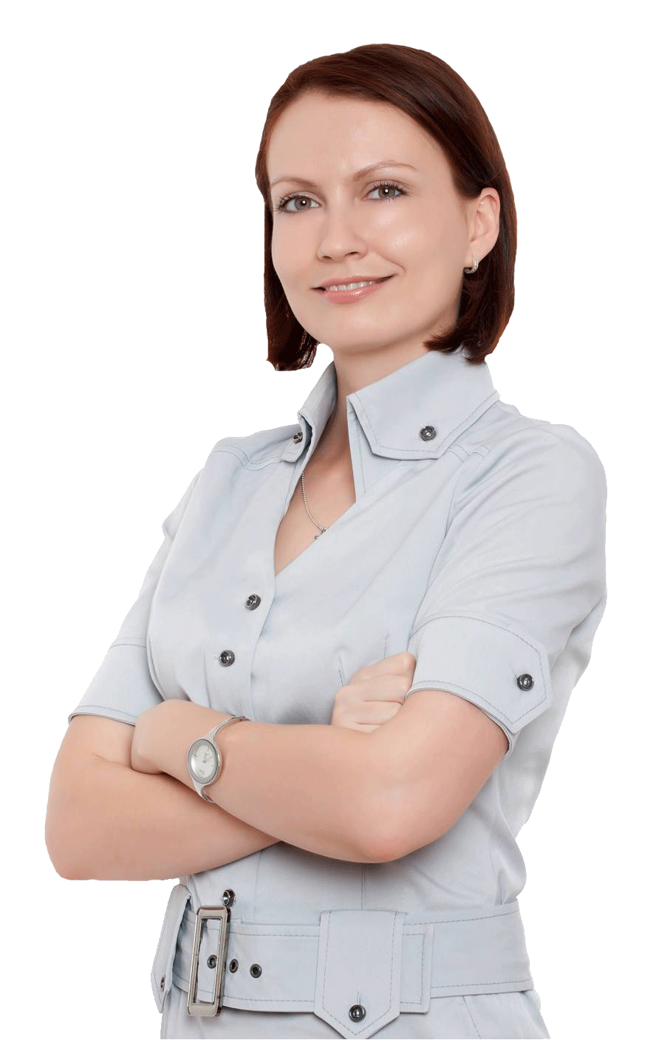


Victoria Cupet CBAP, PMP, PMI-PBA
Regional Director Europe @ IIBA®
LEGO® SERIOUS PLAY® Facilitator
Business Trainer & Coach
Keynote Speaker
Bestselling Author

Slide 3

How?
What?
Why?
Why Playing
Business Analysis?

Slide 4

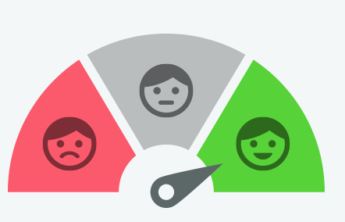
How much FUN do you have in your daily practice?

Slide 5
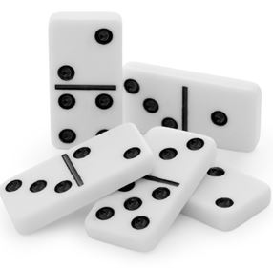



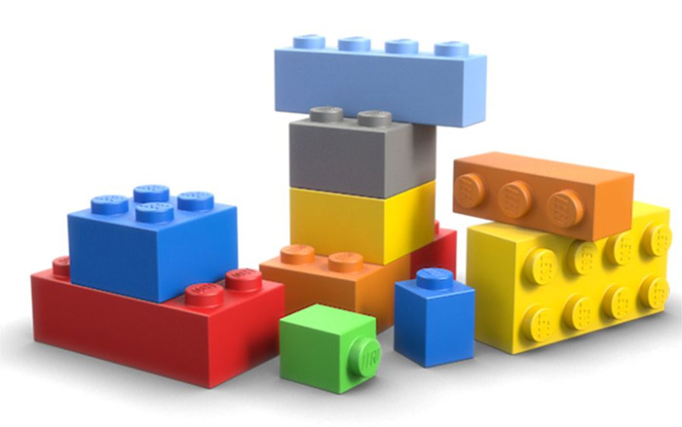
Playing Games

Slide 6
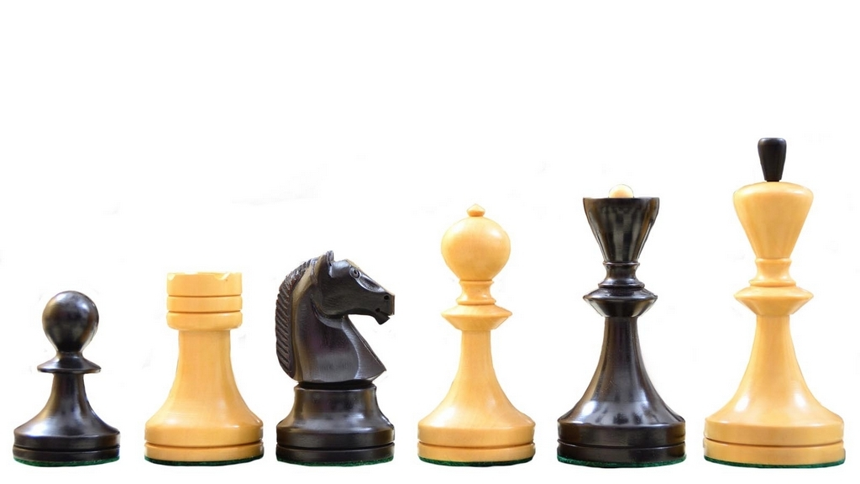
Games
Involves people
Have structure and goals
Operates more like a real-world system
Results are unpredictable
Small changes in variables generate dramatic differences in the result

Slide 7

Four Defining Traits of a Game
GAME
Goal
Rules
Feedback
Voluntary Participation
“Establishes common ground”
“Sense of Purpose”
“Unleash creativity and foster strategic thinking”
“Provides motivation to keep playing”

Slide 8
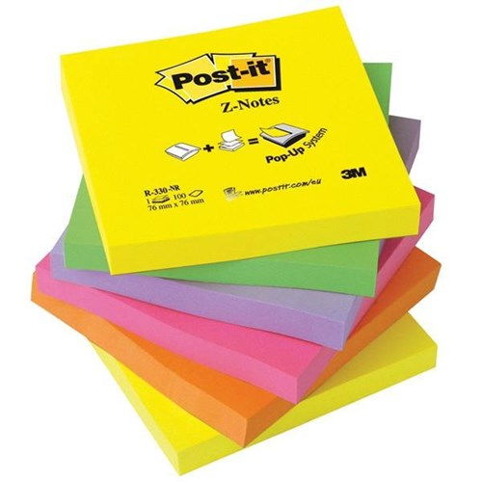

Games in Business Analysis
Are alternatives to standard business meetings
Are structured activities
a facilitator leads a group towards some goal by way of a game
provides scope for thinking freely, even playfully
Require a few props such as
sticky notes, poster paper, markers, random pictures from magazines, or other thought provoking objects

Slide 9
How?
What?
Why?
What to Consider When Playing BA?

Slide 10
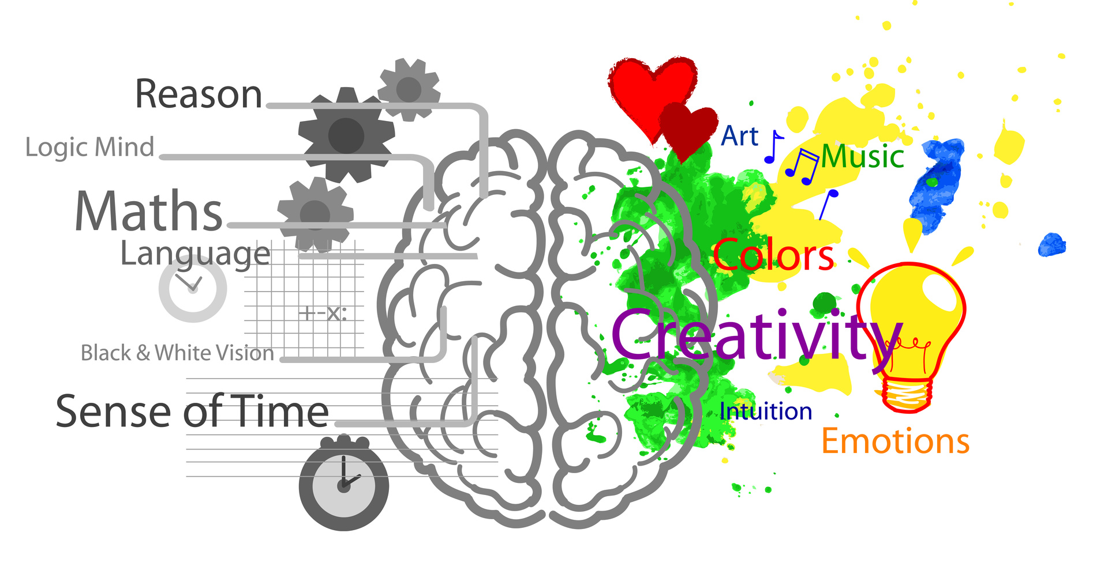
Use your brain…fully
fully
http://experimentexchange.com/living-systems/test-your-brain-for-its-dominant-side/

Slide 11
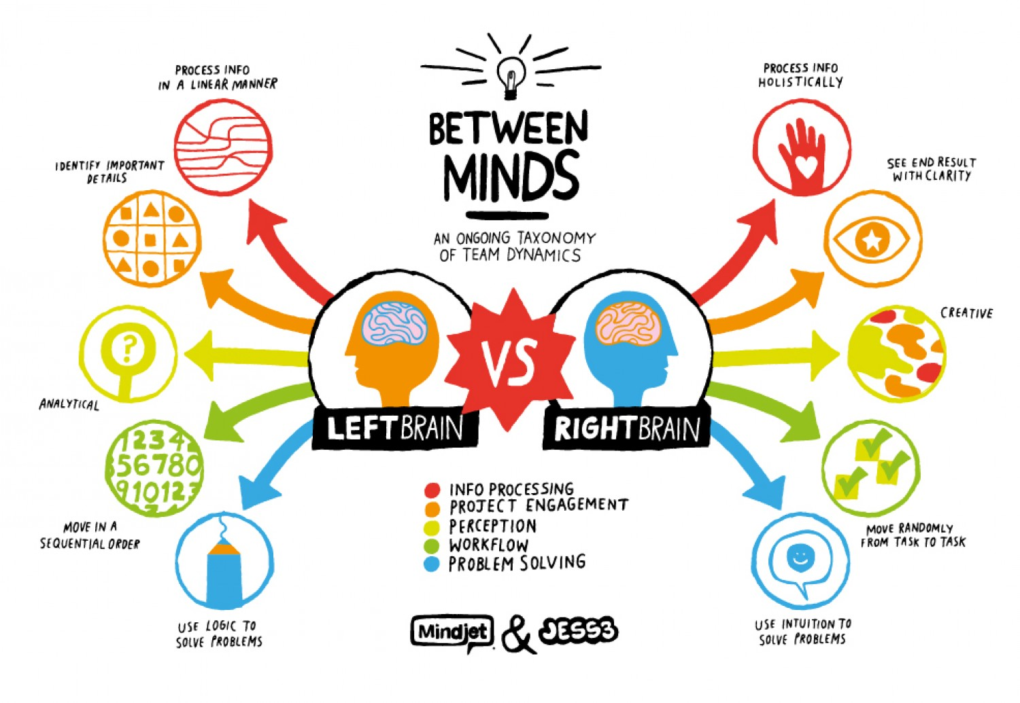
https://thumbnails-visually.netdna-ssl.com/right-brain-vs-left-brain_50291898b1dee_w1500.jpg

Slide 12
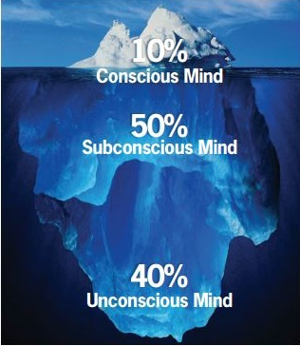
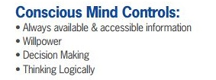
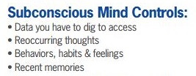
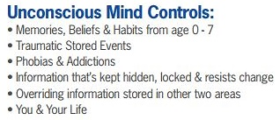











Bring the Awareness
http://anitacoaching.com/thetahealing/

Slide 13
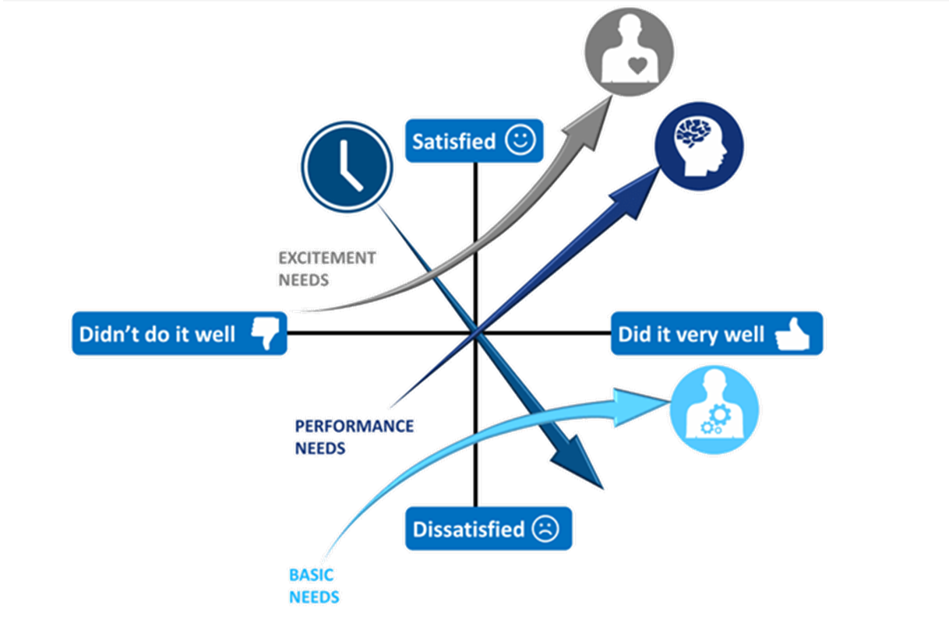
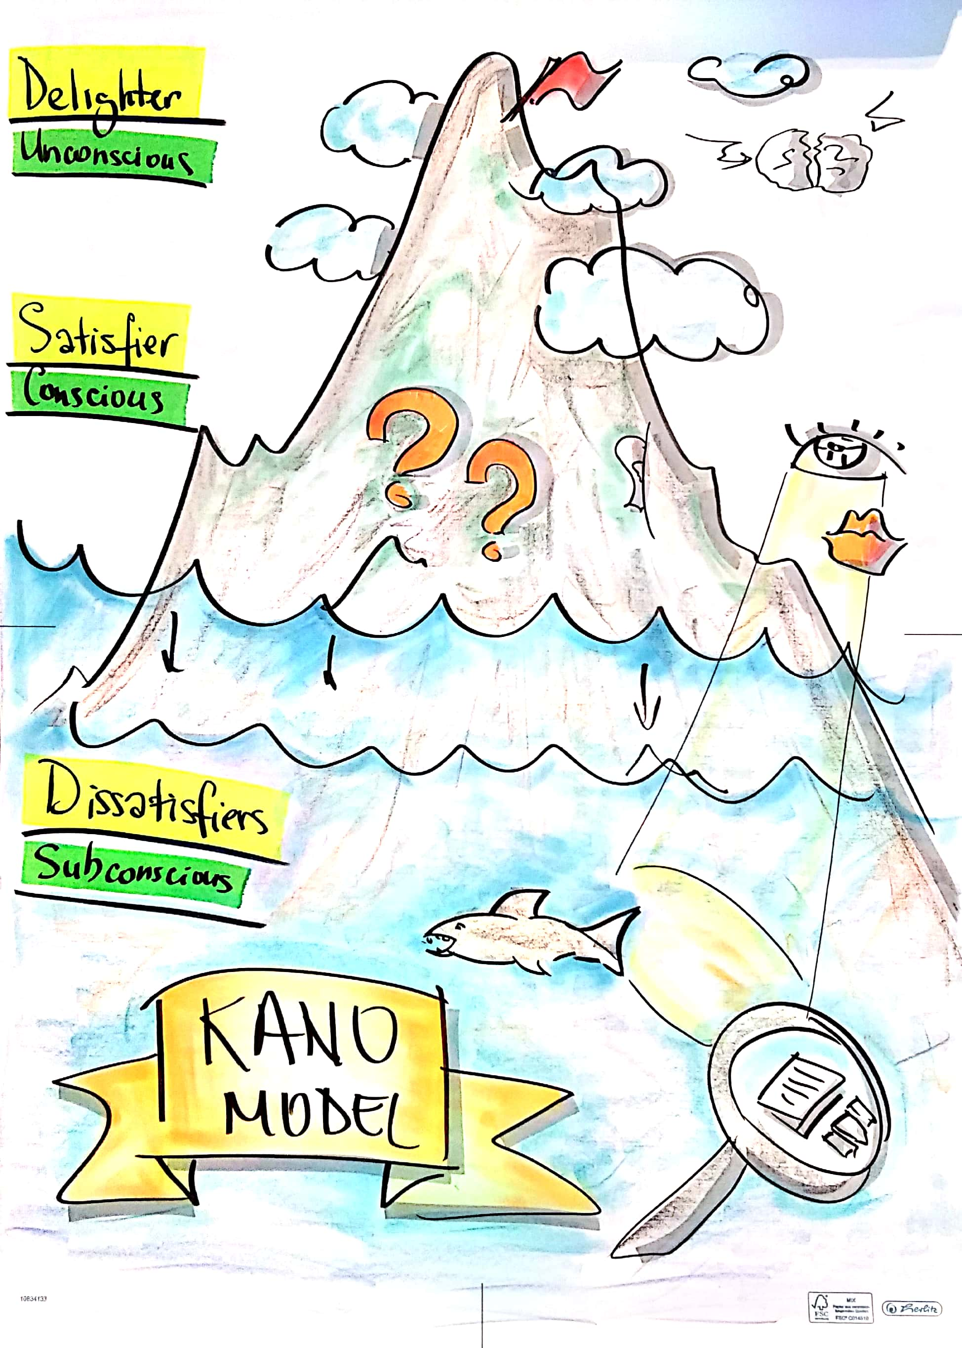
Kano Model
DELIGHTERS
Unconscious Requirements
SATISFIERS Conscious Requirements
DISSATISFIERS Subconscious Requirements
Notes:
Dissatisfiers (subconscious requirements) must be fulfilled by the system in any case. Otherwise, stakeholders will be disappointed and dissatisfied. Completely fulfilled dissatisfiers do not generate a positive disposition but merely help to avoid massive discontent. Dissatisfiers are dominantly influenced by existing systems. Therefore, observation and document-centric techniques are especially well suited for the elicitation of these factors.
Satisfiers (conscious requirements) are properties that are consciously known to the stakeholders and explicitly demanded. When these properties are fulfilled, stakeholders are content and satisfied, which is desirable. If some demanded properties are missing, the stakeholders probably will not accept the product. Their satisfaction decreases with each missing satisfier. Satisfiers can be elicited well using survey techniques.
Delighters (unconscious requirements) are properties of a system whose value is recognized only when the stakeholder can try out the system for herself or the requirements engineer proposes them. Creativity techniques are best suited to elicit delighters.

Slide 14



Communicate Using Right Language
VISUAL Preference
KINESTETHIC Preference
AUDITORY Preference

Slide 15
How?
What?
Why?
How to Play
Business Analysis?

Slide 16
Playful Alternatives For…
Taking Notes
Meeting Facilitation
Discovery & Innovation

Slide 17
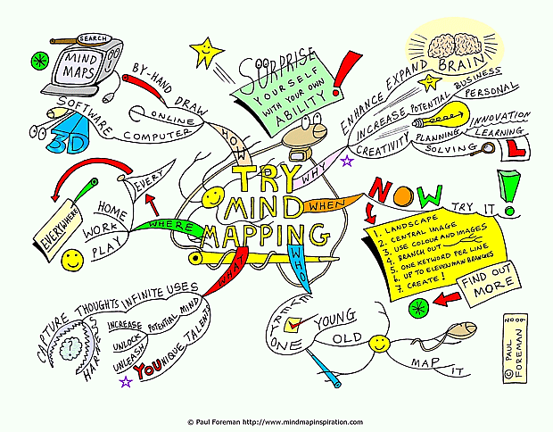
http://www.mindmapinspiration.com/try-mind-mapping-mind-map-paul-foreman/
Notes:
A visual thinking tool that can be applied to all cognitive functions, especially memory, learning, creativity and analysis
Mind Mapping is a process that involves a distinct combination of imagery, colour and visual-spatial arrangement
The technique maps out your thoughts using keywords that trigger associations in the brain to spark further ideas
Mind Maps can be drawn by hand or using software such as iMindMap, FreeMind, XMind, and MindJet and others

Slide 18
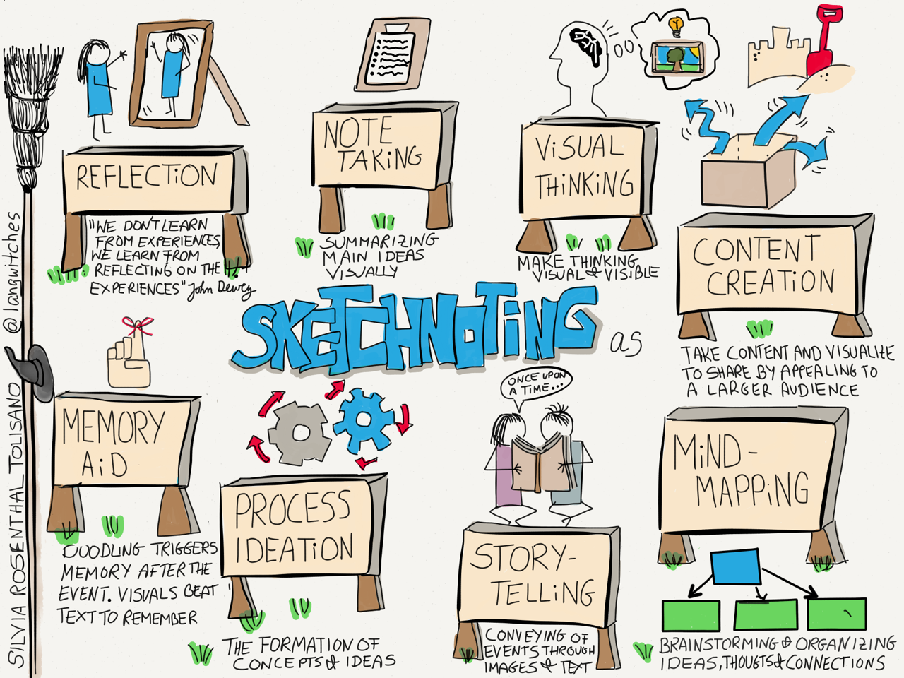
http://langwitches.org/blog/2015/08/11/sketchnoting-for-reflection/

Slide 19
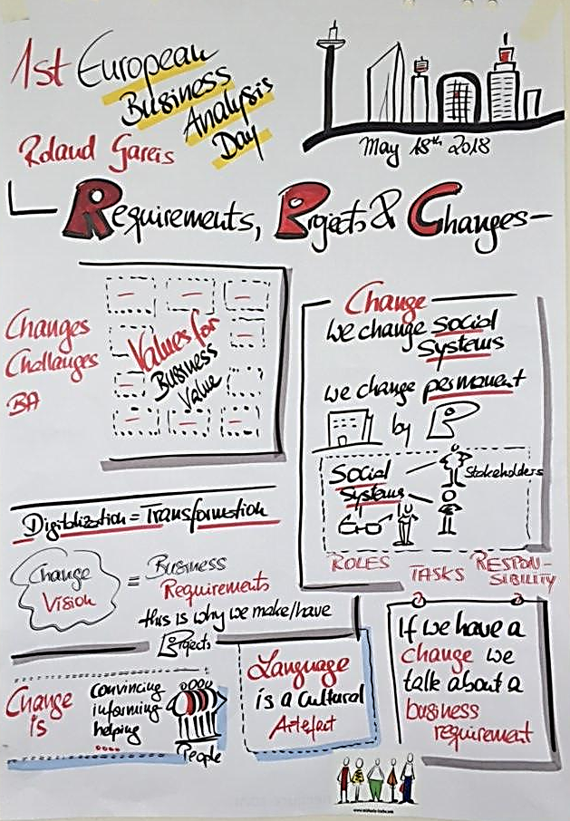
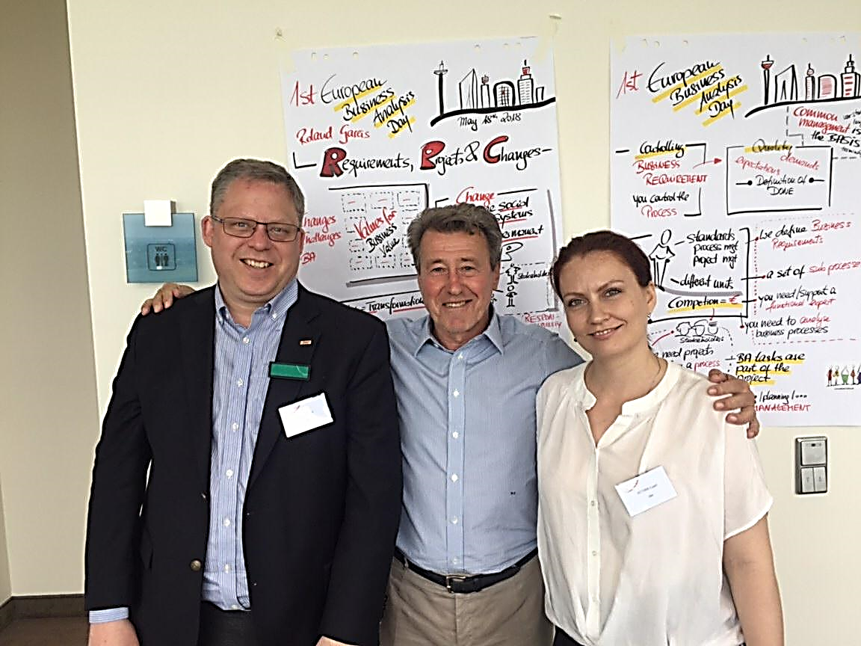

Slide 20
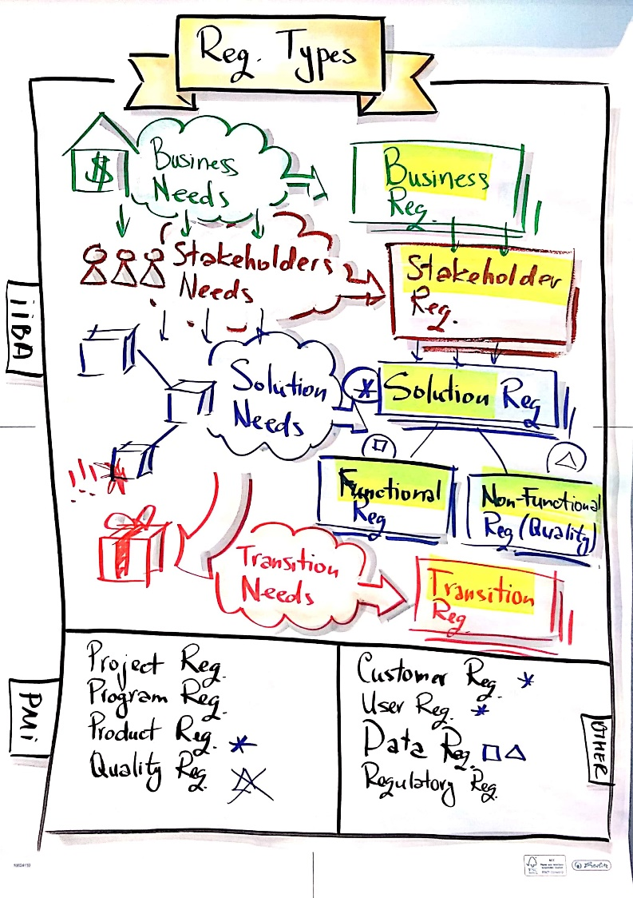
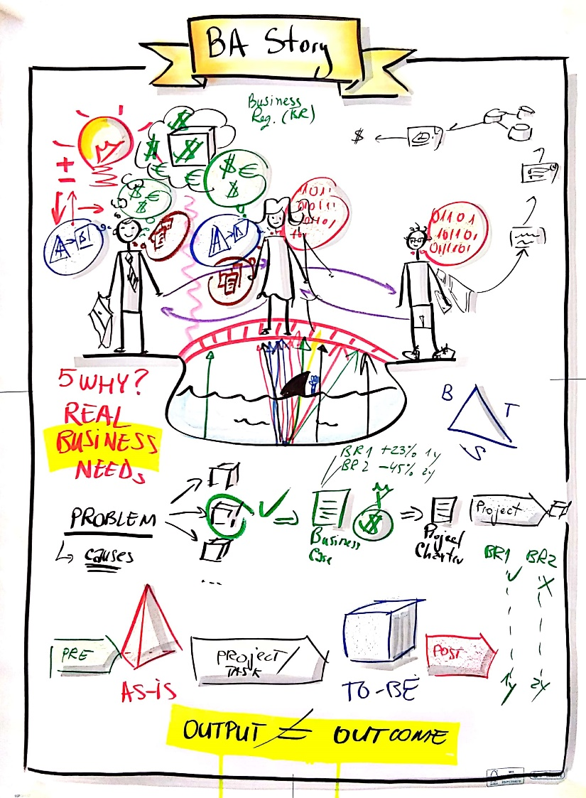
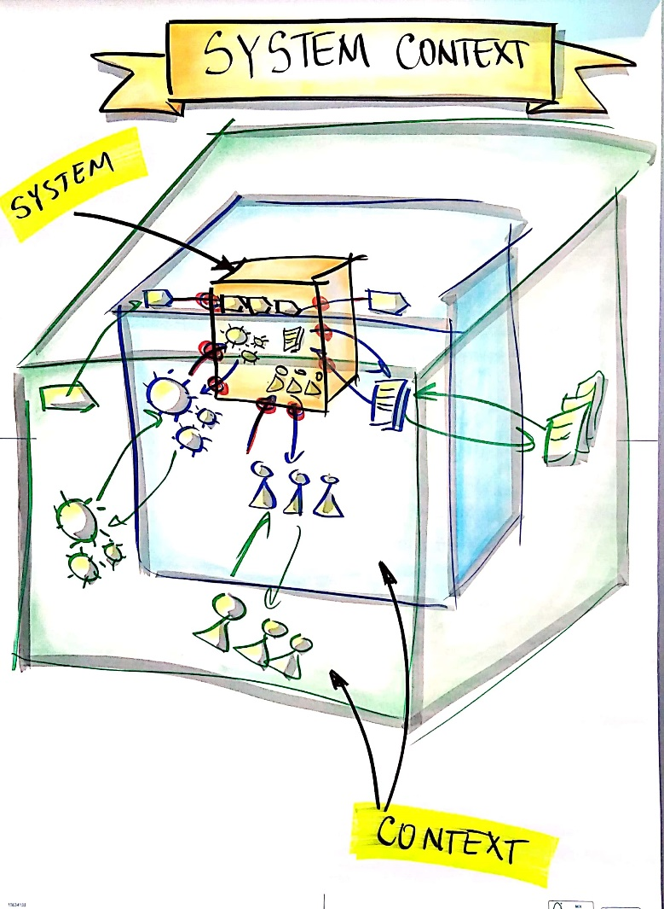

Slide 21


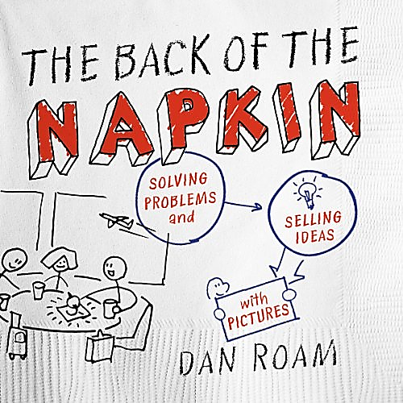
Recommended Books

Slide 22
Playful Alternatives For…
Taking Notes
Meeting Facilitation
Discovery & Innovation

Slide 23
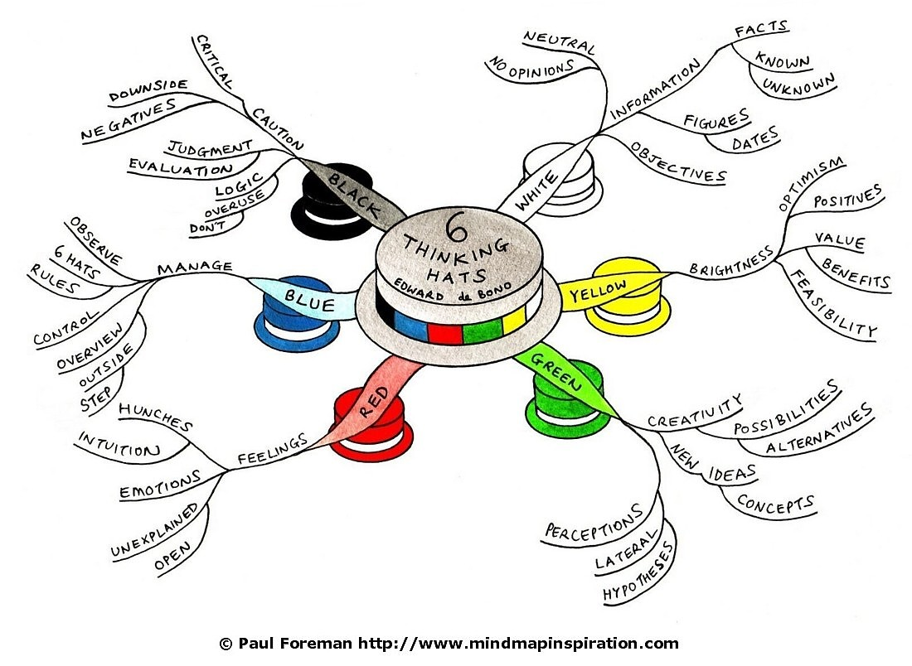

Parallel Thinking
http://www.mindmapinspiration.com

Slide 24
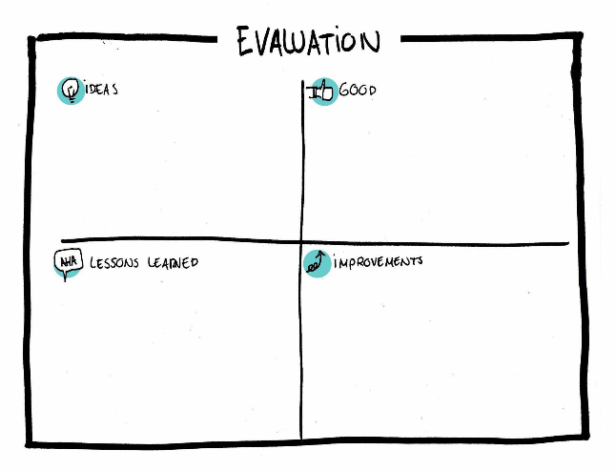

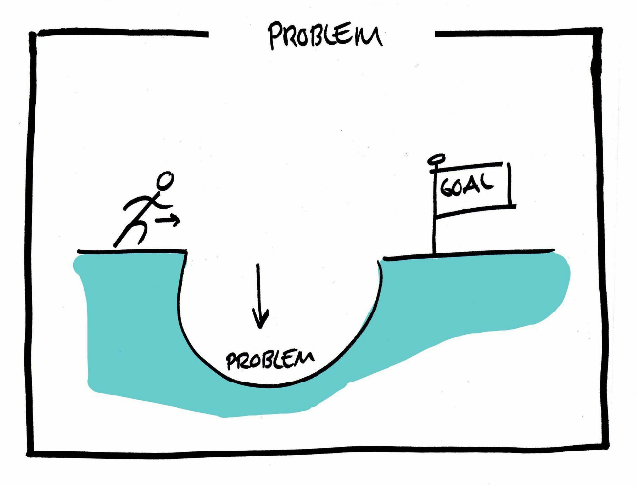
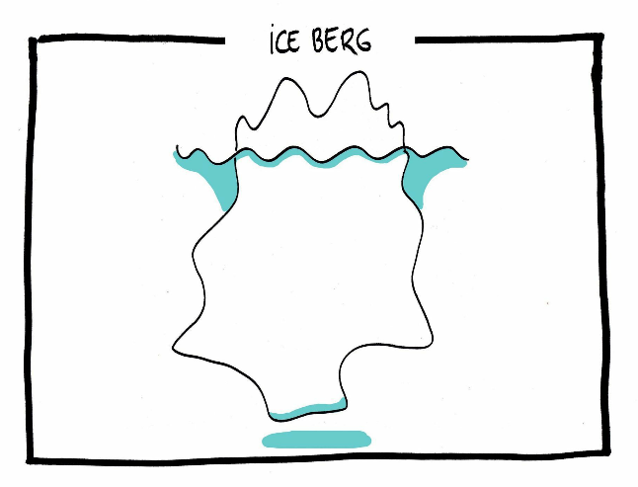
Visual Templates

Slide 25
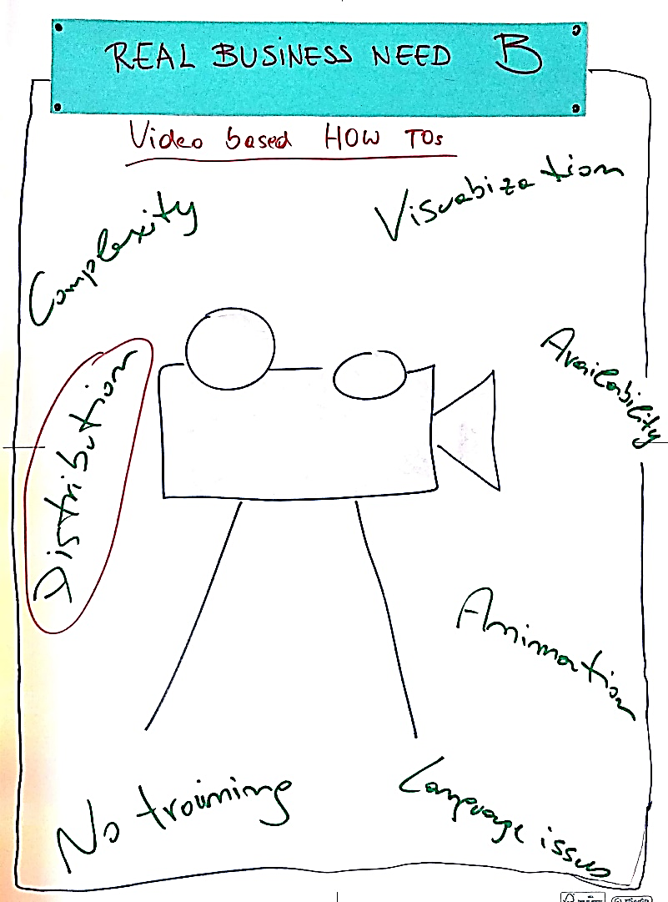
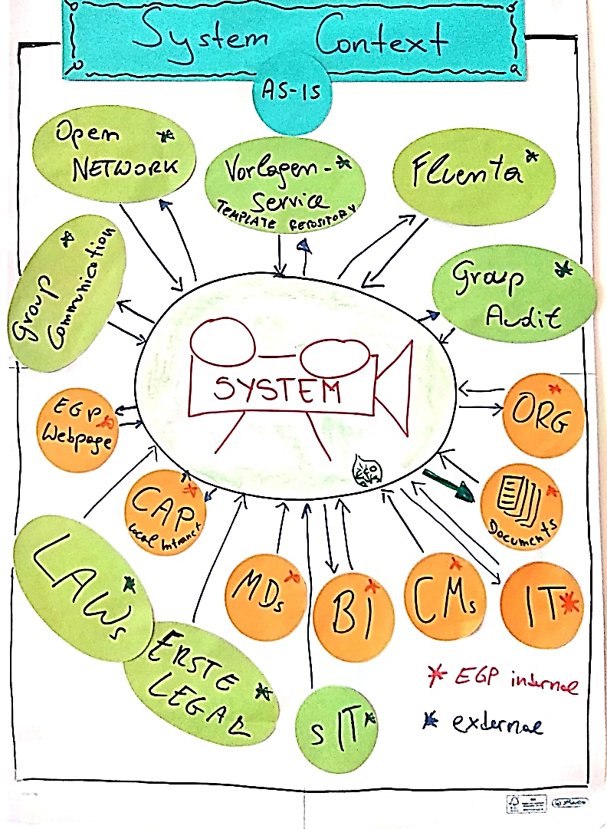
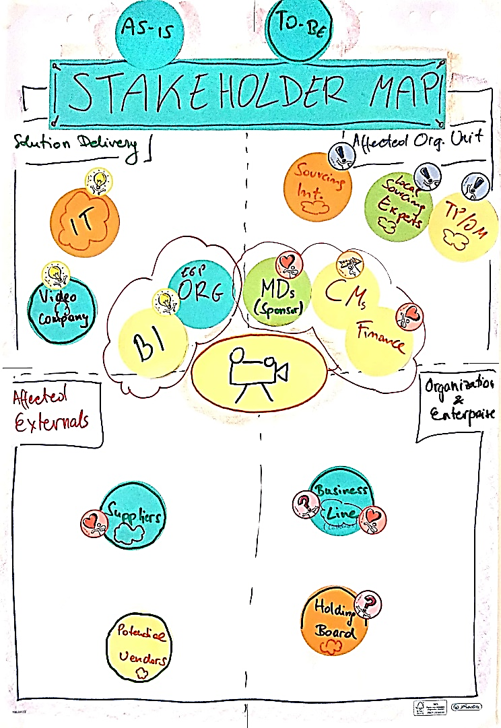
Visual Thinking Examples

Slide 26
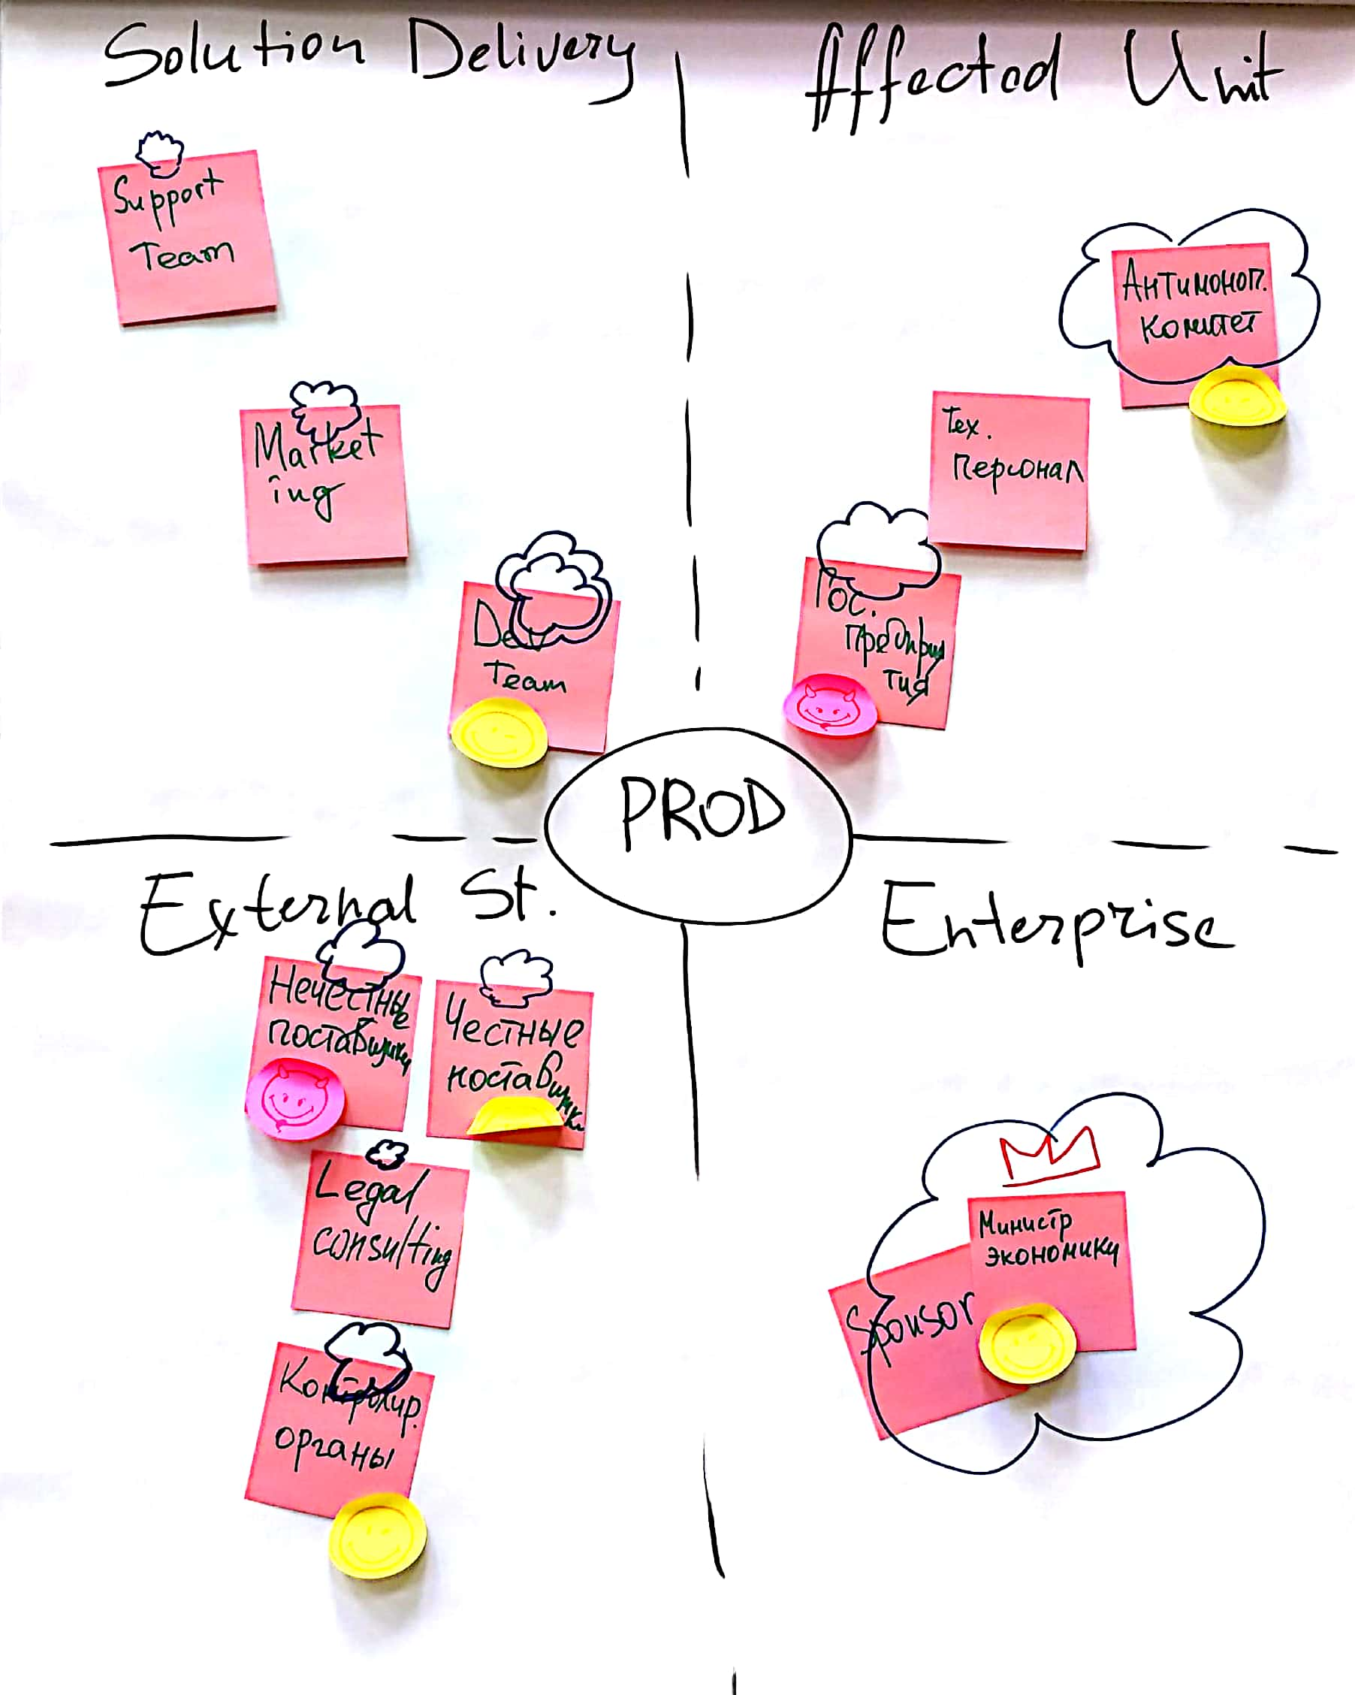
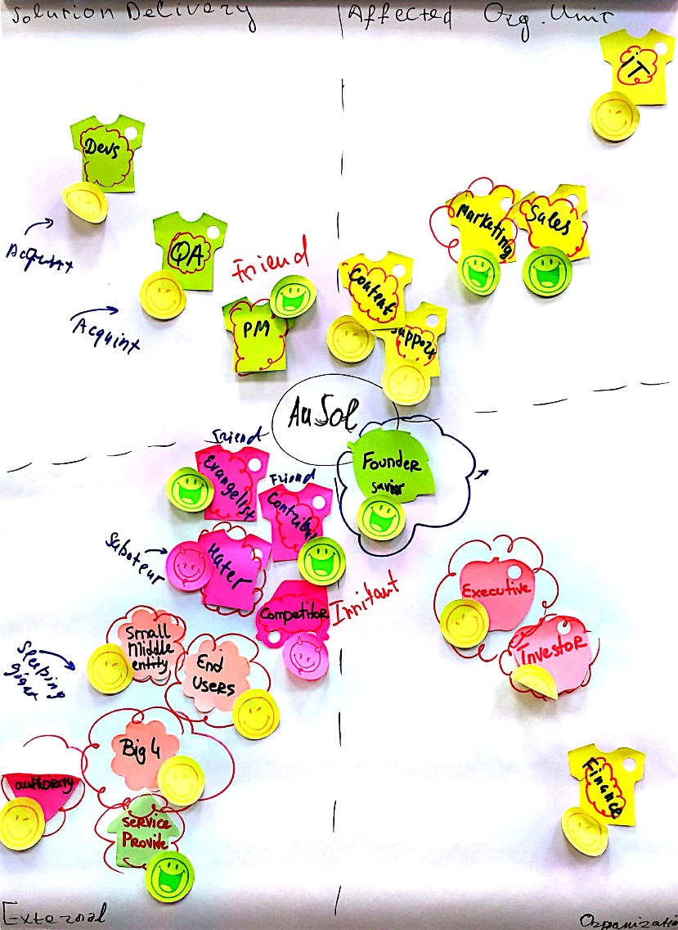
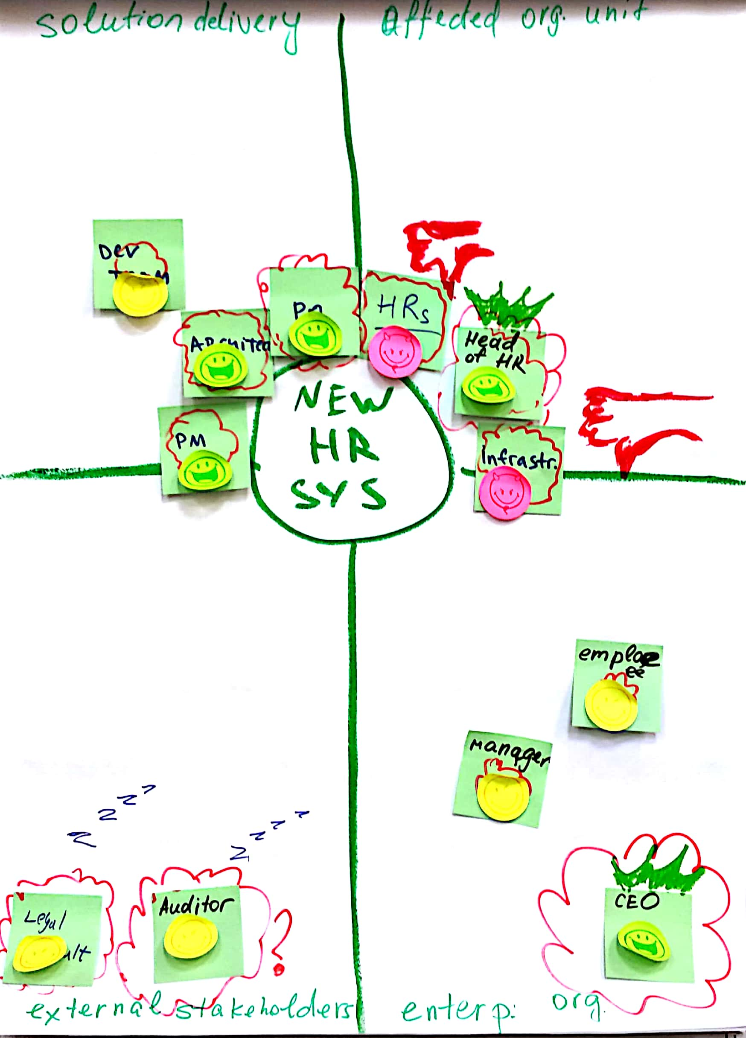
Stakeholder Map Template

Slide 27
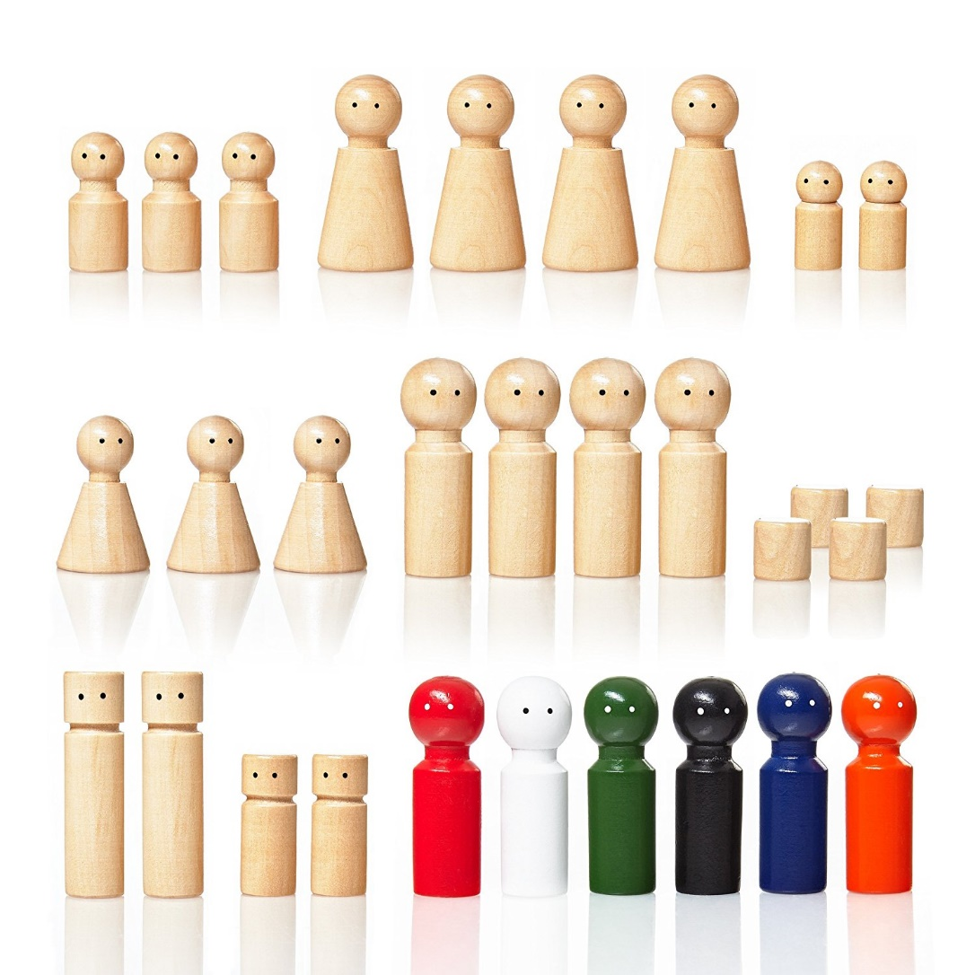
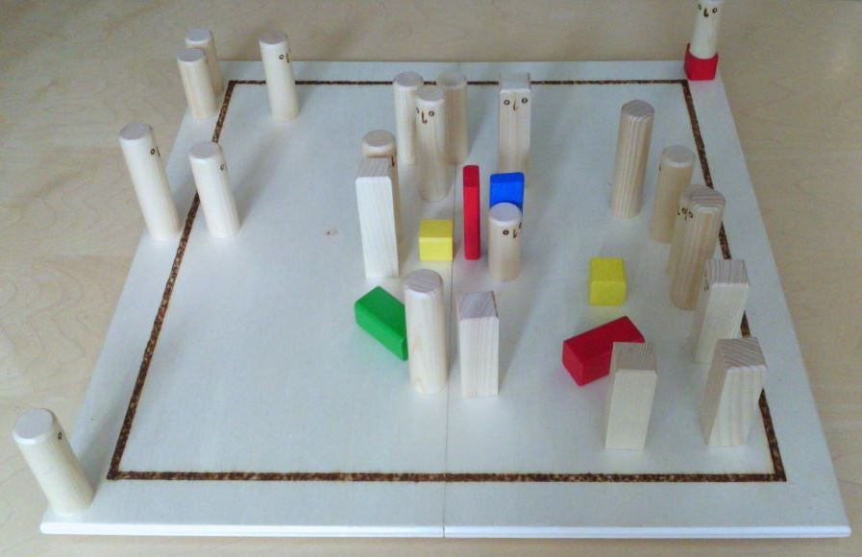
The Systemic Board
https://www.amazon.co.uk/Lumaland-Pedagogical-TRAINING-Systemic-Constellations/dp/B076ZLKVCQ

Slide 28
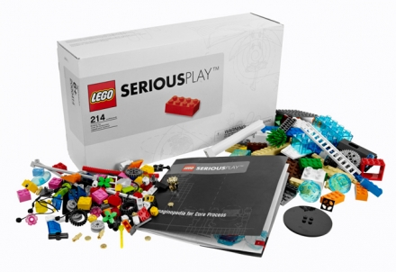
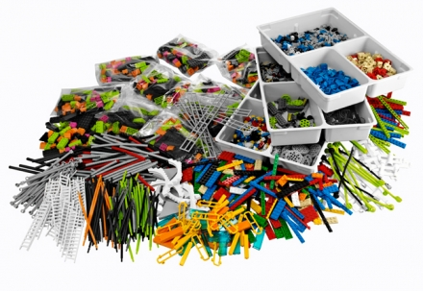
LEGO® SERIOUS PLAY®

Slide 29
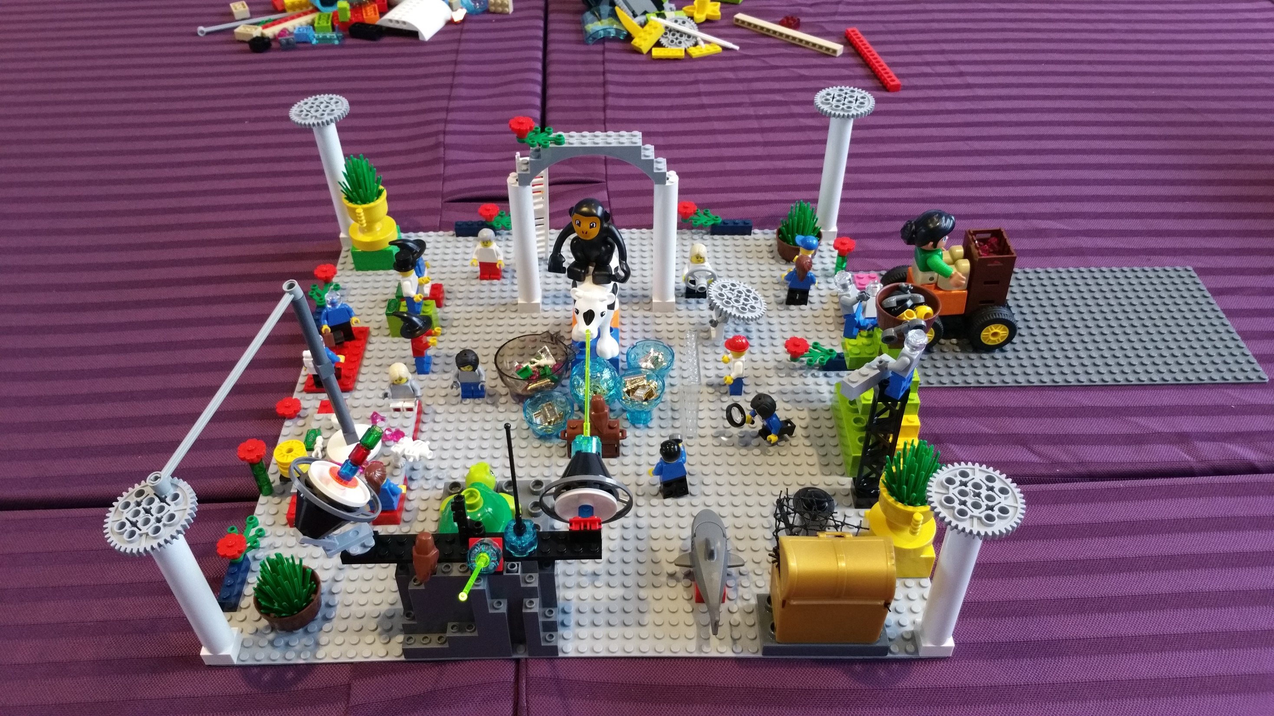
LEGO® SERIOUS PLAY®

Slide 30
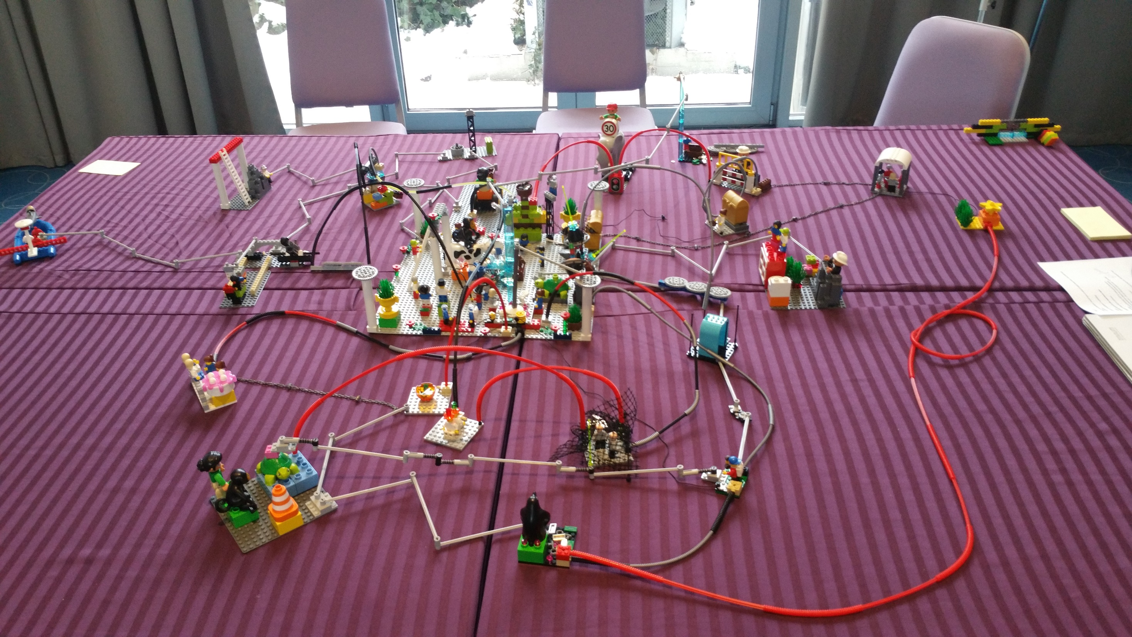
LEGO® SERIOUS PLAY®

Slide 31
Playful Alternatives For…
Taking Notes
Meeting Facilitation
Discovery & Innovation

Slide 32


What Are Innovation Games®?
Are played…
with customers & internal stakeholders
online or in-person
within or across organizational units
in single or multi-game formats

Slide 33
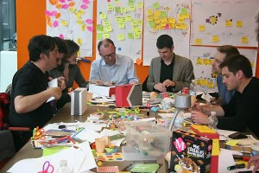
Why Using Innovation Games?
Games of collaborative play
Leverage deep principles of cognitive psychology and organizational behavior
Uncover data that is difficult to uncover using traditional research techniques
Customers are fully engaged in the task
Produces the most honest and useful feedback
https://www.innovationgames.com/agile-teams/

Slide 34
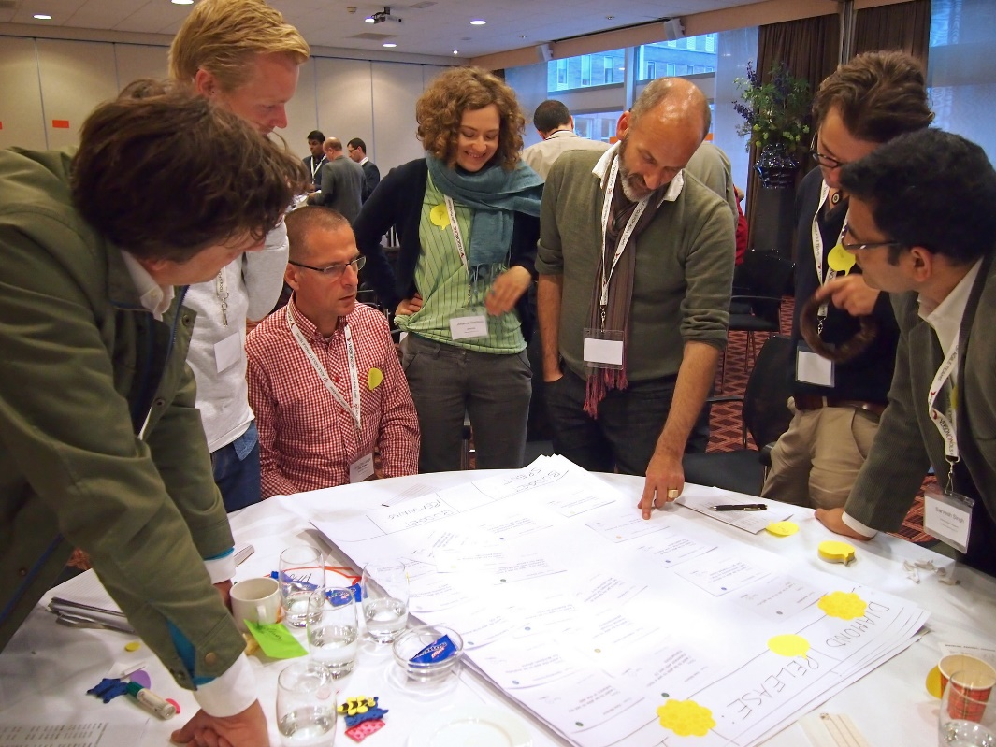
Fields of Application
Applicable for…
Market Research
Product Design
Portfolio Management
Requirements Management
Project Management, etc.
...any number of tasks of…
Innovative Thinking
Brainstorming
Workshops
https://www.innovationgames.com/the-innovation-games/

Slide 35
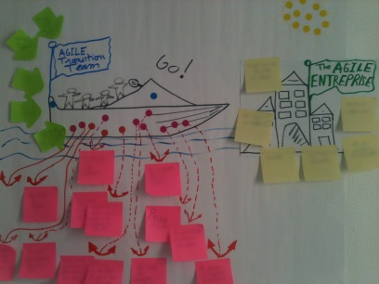
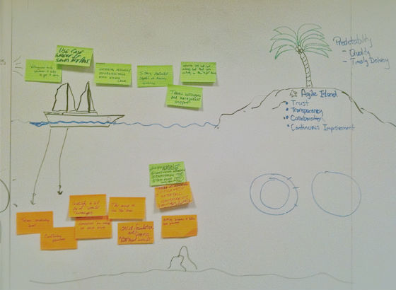
Speed Boat Identify What Customers Don’t Like About Your Product or Service
http://www.agile-ux.com/2011/10/17/a-speed-boat-or-nothing/
https://www.innovationgames.com/2011/04/speed-boat-helps-versionone-client-navigate-the-choppy-waters-of-agile-transformation/

Slide 36
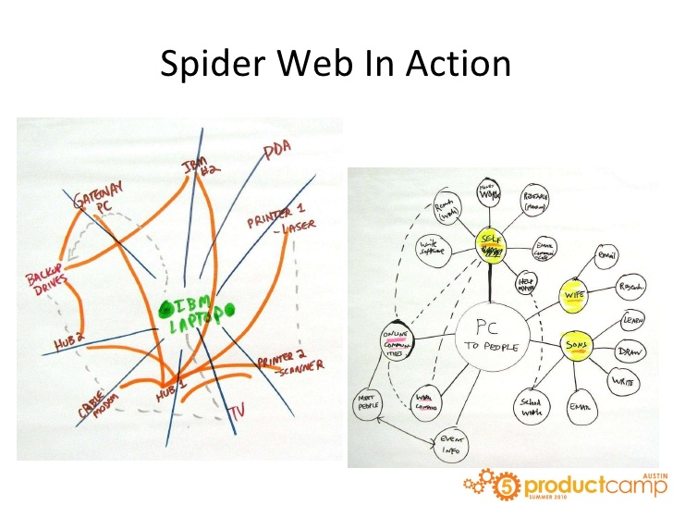
Spider Web Understand Product Relationships
https://www.slideshare.net/jeffbrantley/brantley-innovation-gamespcamp2010done

Slide 37
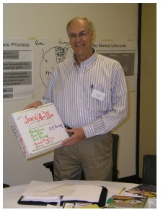
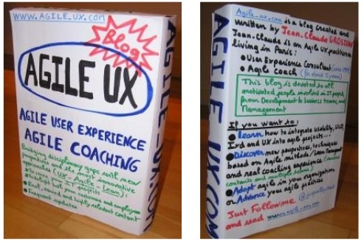
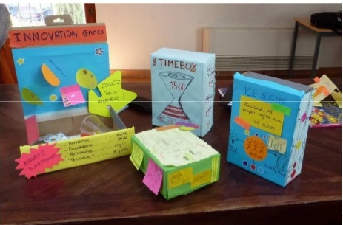
Product Box Identify the Most Exciting Product Features
https://www.slideshare.net/Enthiosys/prioritizing-for-profit-from-agilepalooza
https://www.slideshare.net/prodactive/innovation-games-and-product-box-presentation

Slide 38

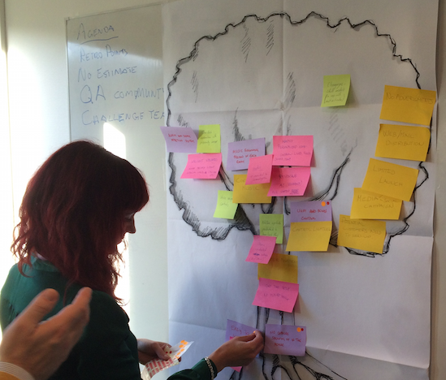
Prune the Product Tree Shape Your Product to Market Needs
https://www.innovationgames.com/the-innovation-games/

Slide 39
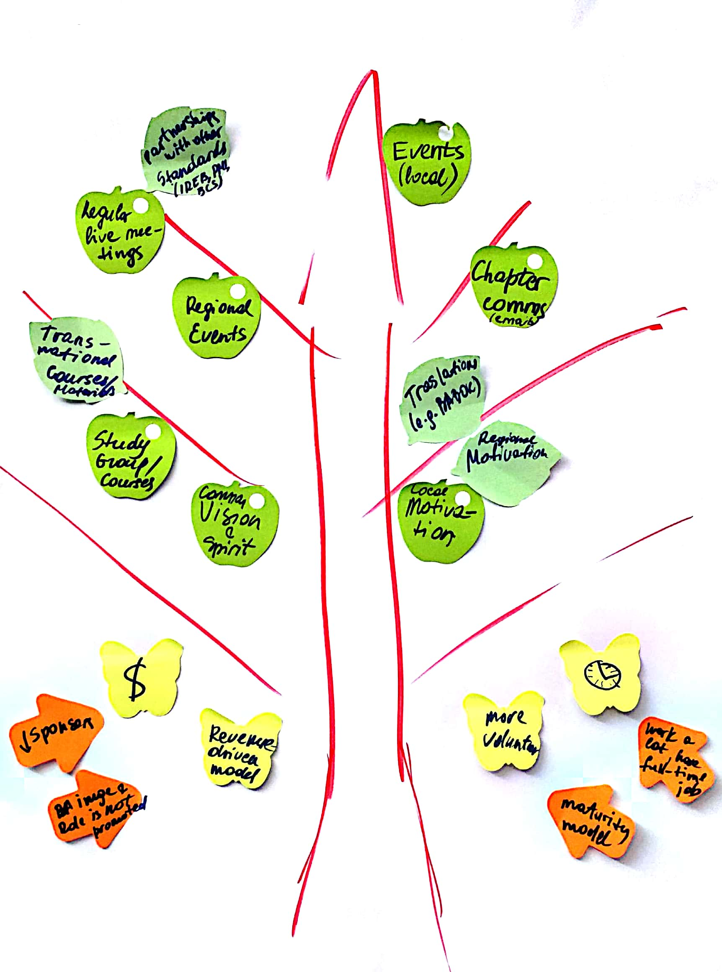

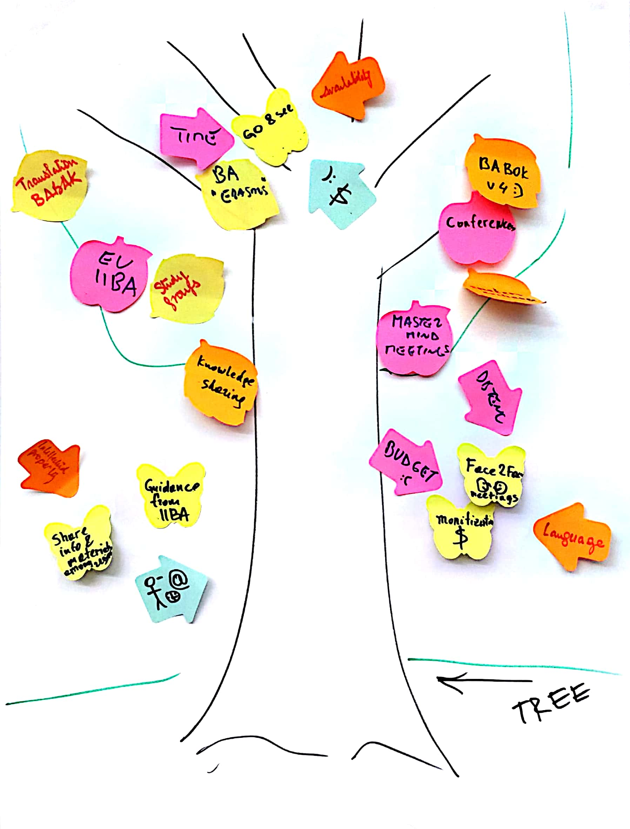
Prune the Product Tree

Slide 40
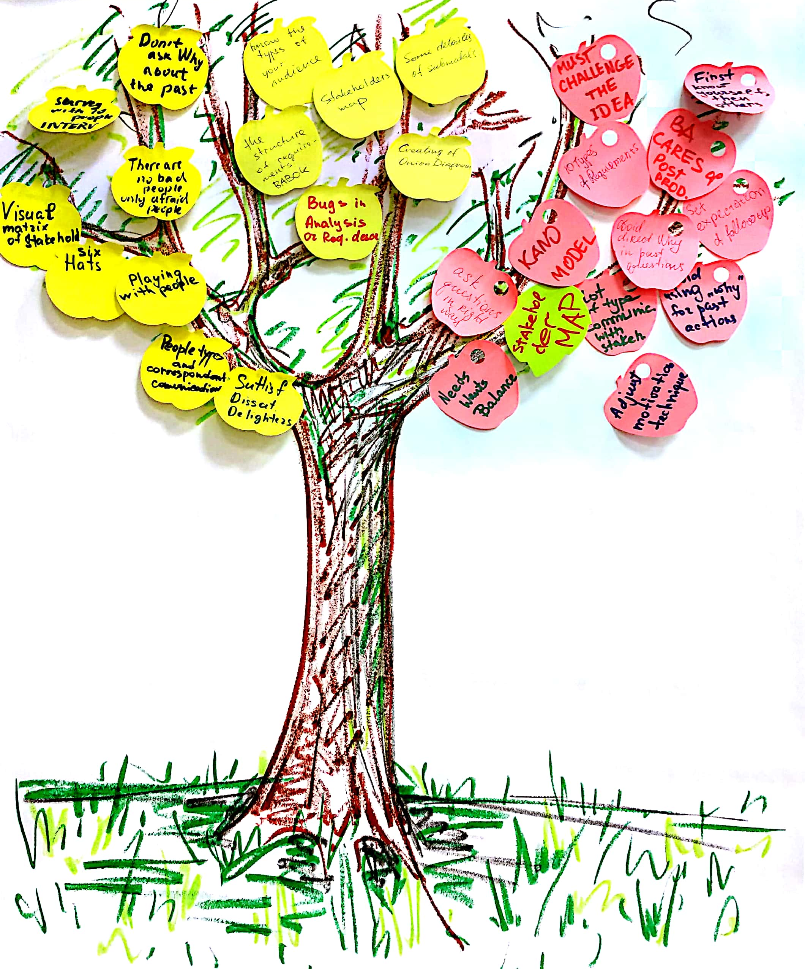

Slide 41


Buy a Feature Prioritize Features
https://www.slideshare.net/21apps/innovation-games-knowing-whats-important

Slide 42




Buy a Feature Prioritize Features
https://www.innovationgames.com/buy-a-feature/

Slide 43



Summary

Slide 44



So… it’s up to YOU!

Slide 45


Victoria Cupet

