Slide 1

Children do not need user manuals
Irina MINOIU, CBAP
President IIBA Romania Chapter

Slide 2

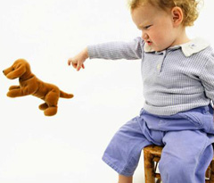
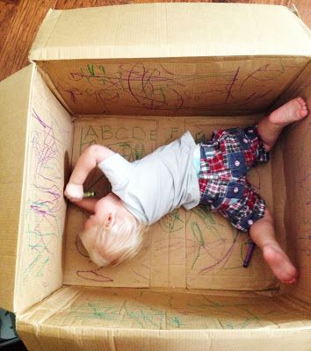
Children do not need user manuals…
They just manage…
…and are known for giving instant negative feedback!
…in surprising ways…

Slide 3
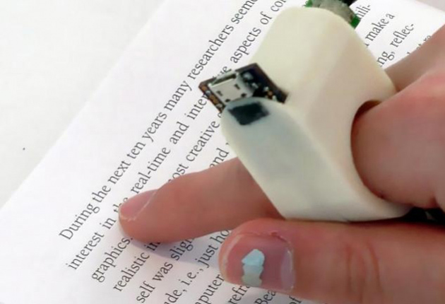
…grownups should neither…
…all staff should fit nicely in our hands

Slide 4
…because all designs have behind:
Personas
Involve end users
Participation design
Intuitive design
DesignOpps
Co-design
Practical knowledge
Cultural knowledge
Design thinking
Interactive design
Prototype
Customer journey
User experience
Notes:
Personas
Involve end userd Participation design
Prototype
Cultural knowledge
Practical knowledge
-------
Designopps
Co-design:
Intuitive design
Design thinking:
Customer journey
User experience / UX/UI
Interactive design

Slide 5










But there were flops…
Notes:
Wesabe
Reactrix
Spiralfrog
Color
Paybytouch
Joost
Cuil: lived from 2008 auntil 2010
Boo.com
Searchme
Friendstern: before myspace and Facebook

Slide 6

How come?

Slide 7
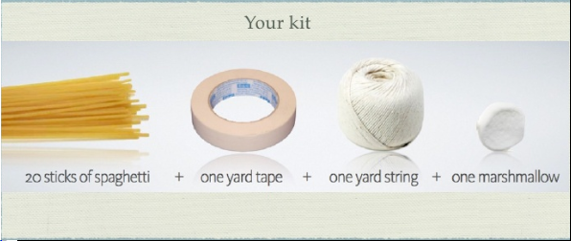
We do constrain our problem solving as we mature… how much we constrain it… and how?
Marshmallow challenge – Peter Skillman
1. Build the tallest free standing structure
2. The entire marshmallow should be on top
3. Freely use the provided materials
4. Time: 18 min

Slide 8
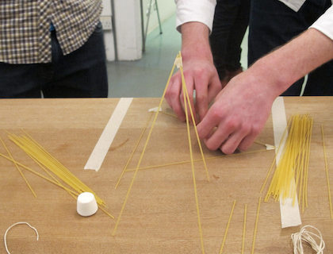

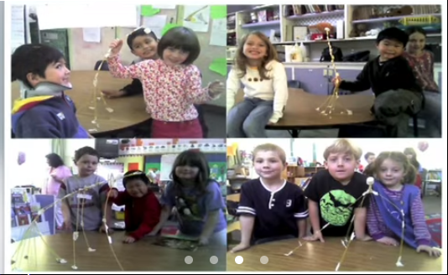

… how much we constrain problem solving…?
Marshmallow challenge – Peter Skillman
Business school graduates
Jokey for power
Trained to fine ONE right plan and act on it
Kindergarteners
Try in many ways
None is trying to be the boss

Slide 9
…and how do we constraint problem solving as we grow up…?
Belonging to the team
Team is creative when people go along
When not fitting in the team, a child leaves by himself or is excluded ☺
In a corporation, removing a un-fitted member of the team is difficult ☹

Slide 10
…and how do we constraint problem solving as we grow up…?
“Saving the face”
Team is creative when people share all types of ideas
Children are not afraid to have theirs ideas consider “stupid” in the end ☺
In brainstorming there is always some “hold back” ☹

Slide 11
…and how do we constraint problem solving as we grow up…?
Willingness to openly criticize
Team is creative when people are wiling to say “The king is naked!”
For children is black or white, like it or not and they are saying it☺
Social norm, fear of authority limit negative feedback ☹

Slide 12
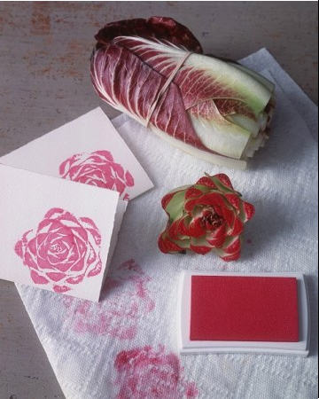

As a BA I want workshop participants to be “child-like” when solving problems
Child + new toy + no instructions ➔ CREATIVITY
Child + new toy + instructions ➔DO AS TOLD

Slide 13
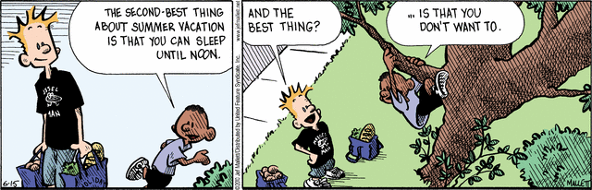
Opportunity cost
What else would you rather do that be here?➔ Belonging to the team
Ask the question to each participant
Use wisely the information to get input from all the participants

Slide 14
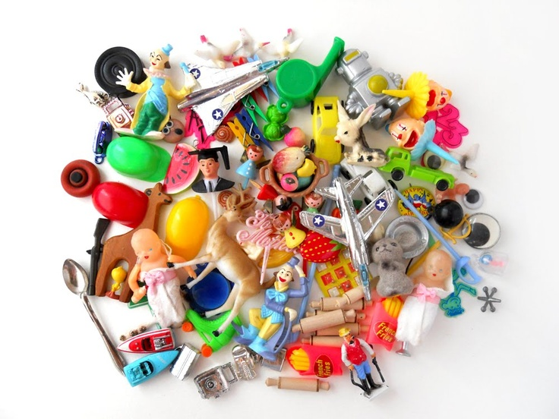
Discover what a workshop participant values, what she/he needs most, Maslow- wise
Beg of staff ➔ Social belonging / part of the team
Give a context to participants: e.g. “night in the forest”
Ask participants to individually build something (DO!) with the staff: e.g “shelter”
Based on the constructions identify what participant values, needs
Wisely use / share / not-share findings during the workshop

Slide 15

Forget the box was even there
Connect the unconnected ➔No idea is “stupid”
Five random objects
List characteristics
Force connections

Slide 16
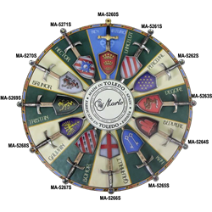
“Toxic” participants
Round table ➔ Team cohesion
Avoid having a participant “head of the table”
All participants to have equal right to speech and opinion

Slide 17

There is no “I” in team
Layer elaboration / Continue the story ➔ belong to the initiative
Draw on transparent plastic sheets put one on top of other
Continue the story of the colleague
Add to existing ideas on a straightforward manner

Slide 18
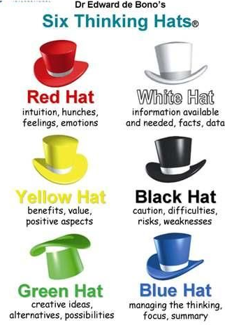
Encourage genuine negative feedback

Slide 19

Awards
Rewards
Gamification ➔ Challenge & Accomplishments
Purpose to go on

Slide 20
Questions….!!!!

Slide 21

Thank You! contact@romania.iiba.org https://romania.iiba.org/ https://www.facebook.com/iiba.romania/ https://www.linkedin.com/company/iiba-romania-chapter/

