Slide 1



Unsolved Problems in Business Analysis
IF YOU DON’T CHANGE YOUR FUTURE THE FUTURE WILL CHANGE YOU
MAY 2019

Slide 2
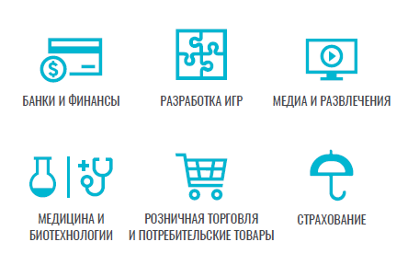
DISCLAIMER. GENERALISTS VS SPECIALISTS
Domain Knowledge
Solution Knowledge
Hard Skills
Soft Skills

Slide 3
IF YOU DON’T CHANGE YOUR FUTURE THE FUTURE WILL CHANGE YOU
WHERE WE ARE?

Slide 4
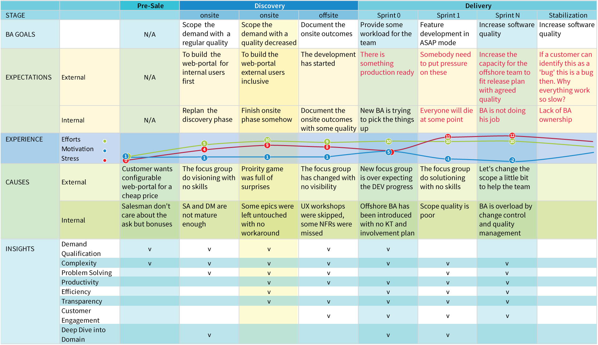
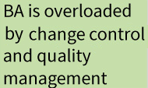
CASE STUDY
Notes:
Структура: timeline по фазам проекта, левая вертикаль с упором на график стресса

Slide 5

THE LIST
1
Demand Qualification
2
Problem Solving
3
Productivity
4
Complexity
5
Efficiency
6
Transparency
7
Customer Engagement
8
Deep Dive into Business Domain

Slide 6

DEMAND QUALIFICATION: IS THERE ANY BOK?
complex/high margin
We deal with a Pandora Box but each ask which a Customer come up with impacts the way how the demand can be broken down into a work

Slide 7
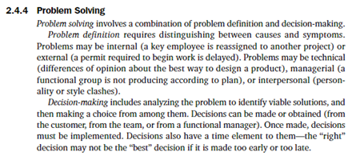
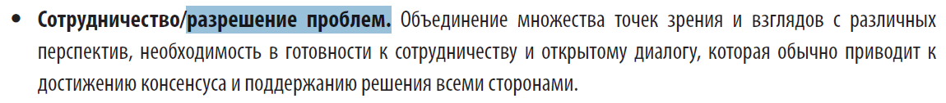
PROBLEM SOLVING: PMBOK 2000 / 2013

Slide 8
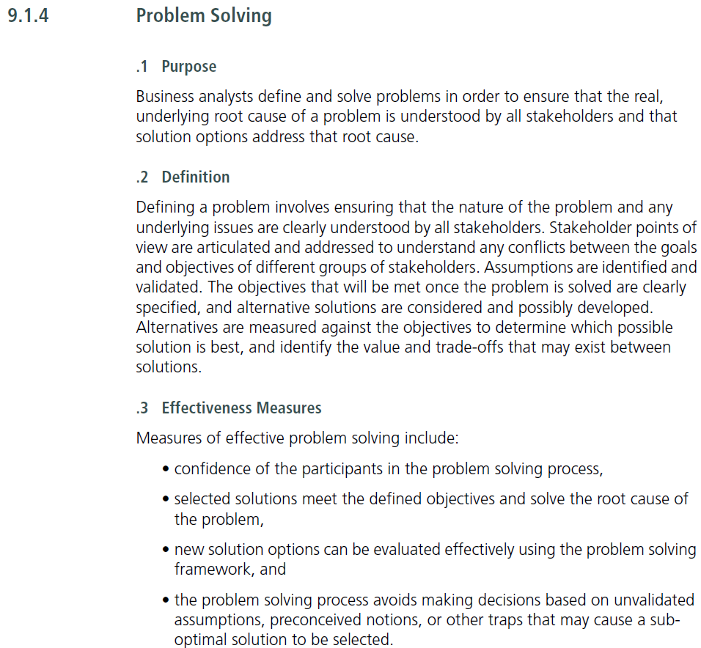

PROBLEM SOLVING: BABOK V3

Slide 9


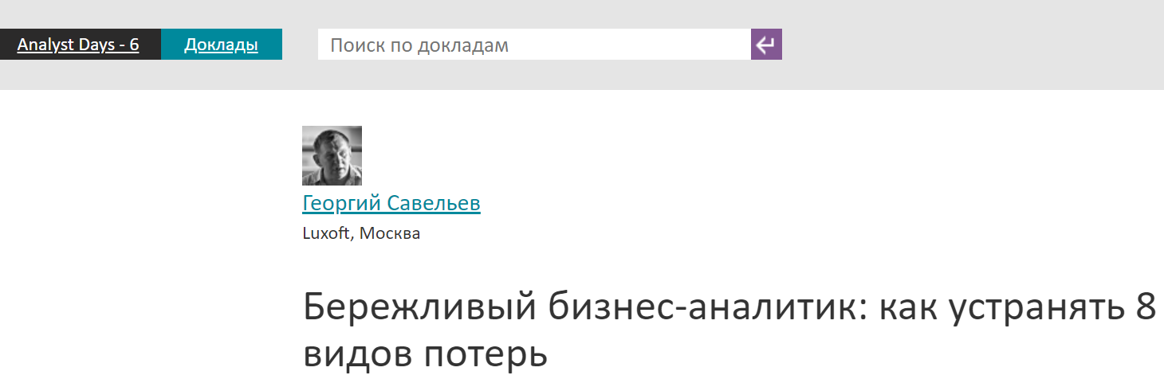


PRODUCTIVITY: BABOK

Slide 10
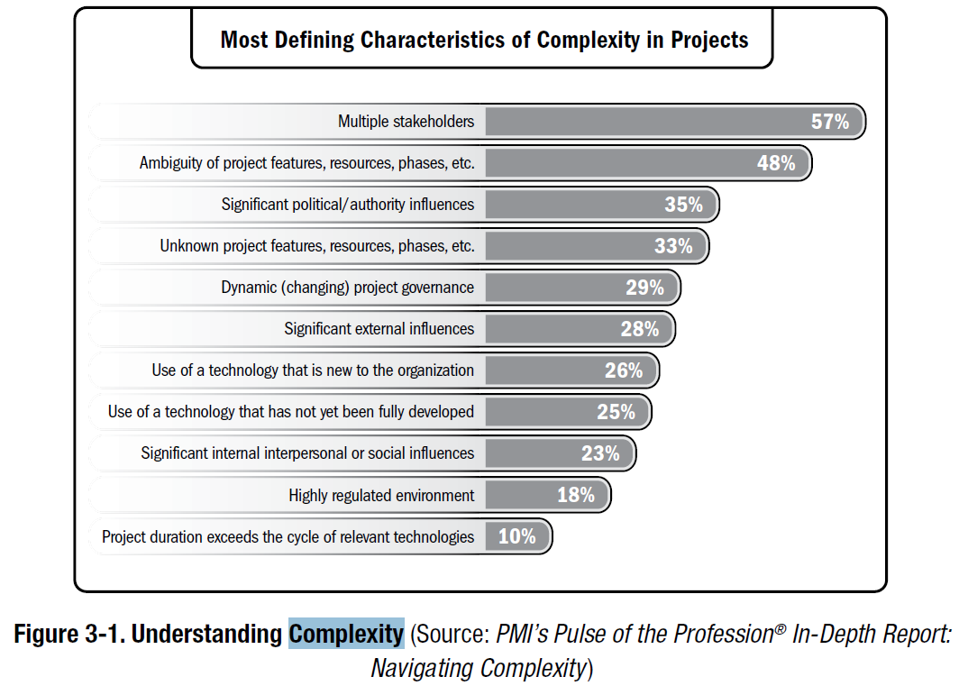
COMPLEXITY: PMI-BA 2015
Notes:
...
Перечислять весь список я не успею, поверьте с остальными инсайтами не лучше

Slide 11
IF YOU DON’T CHANGE YOUR FUTURE THE FUTURE WILL CHANGE YOU
CONTENT QUALITY,
Knowledge,
EXPERIENCE
Notes:
Try to google in youtube

Slide 12
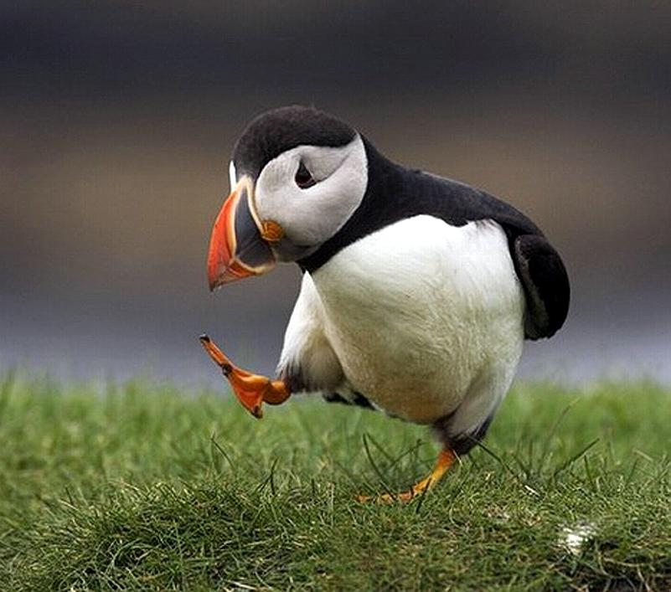
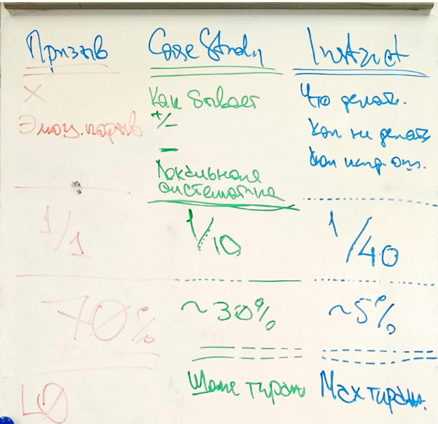
QUALITY CRITERA
Notes:
Инструкция к фарм препарату:
! как обнаружить и что делать при передозировке

Slide 13
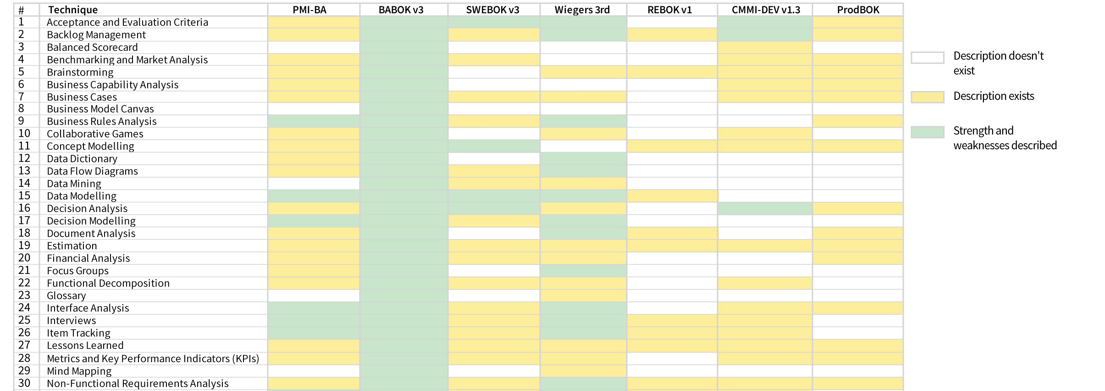
xxBOK HEAT MAP #1
Notes:
Как делать и как не делать ONLY

Slide 14
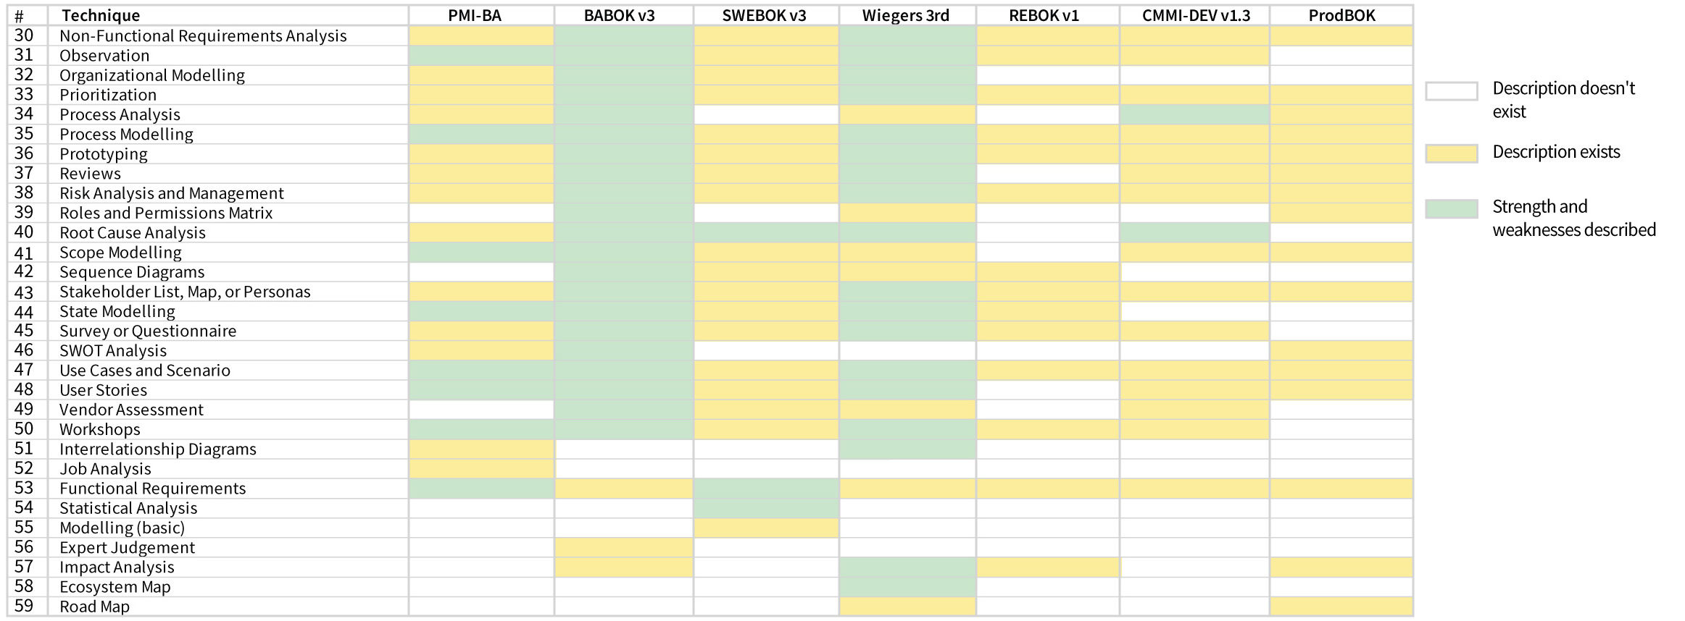
xxBOK HEAT MAP #2
Notes:
...
Но если убрали ! как обнаружить и что делать при передозировке
Изменится ли показатель смертности?

Slide 15
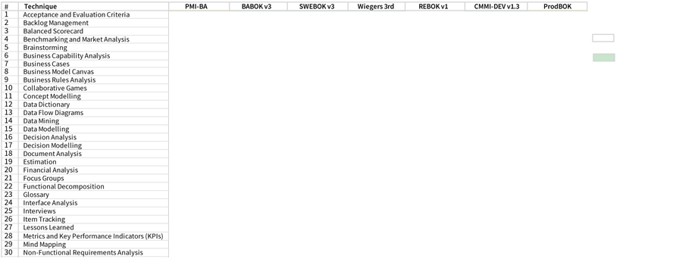
xxBOK HEAT MAP
other
instruction
Notes:
Стандарты в полном интсруктивном смысле выглядят вот так

Slide 16

TUPIK (Atlantic puffin)

Slide 17
IF YOU DON’T CHANGE YOUR FUTURE THE FUTURE WILL CHANGE YOU
BA QUALITY MVP
Notes:
Давайте сами попробуем?

Slide 18
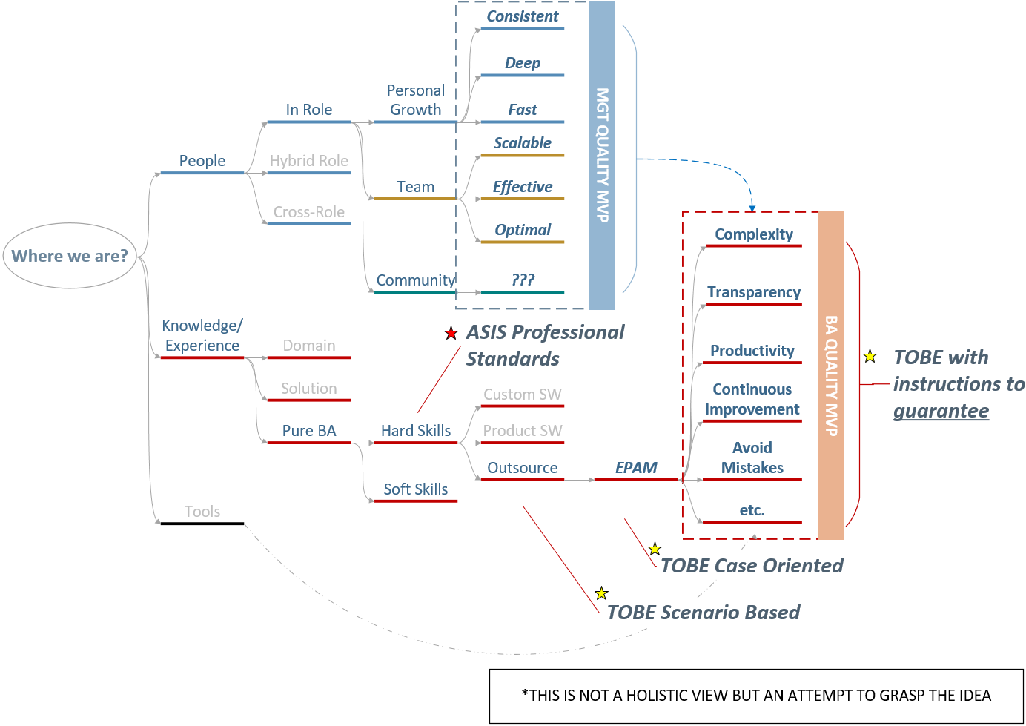

PROBLEM IS A PROBLEM: IMPACT

Slide 19

DO I REALLY NEED THIS?

Slide 20
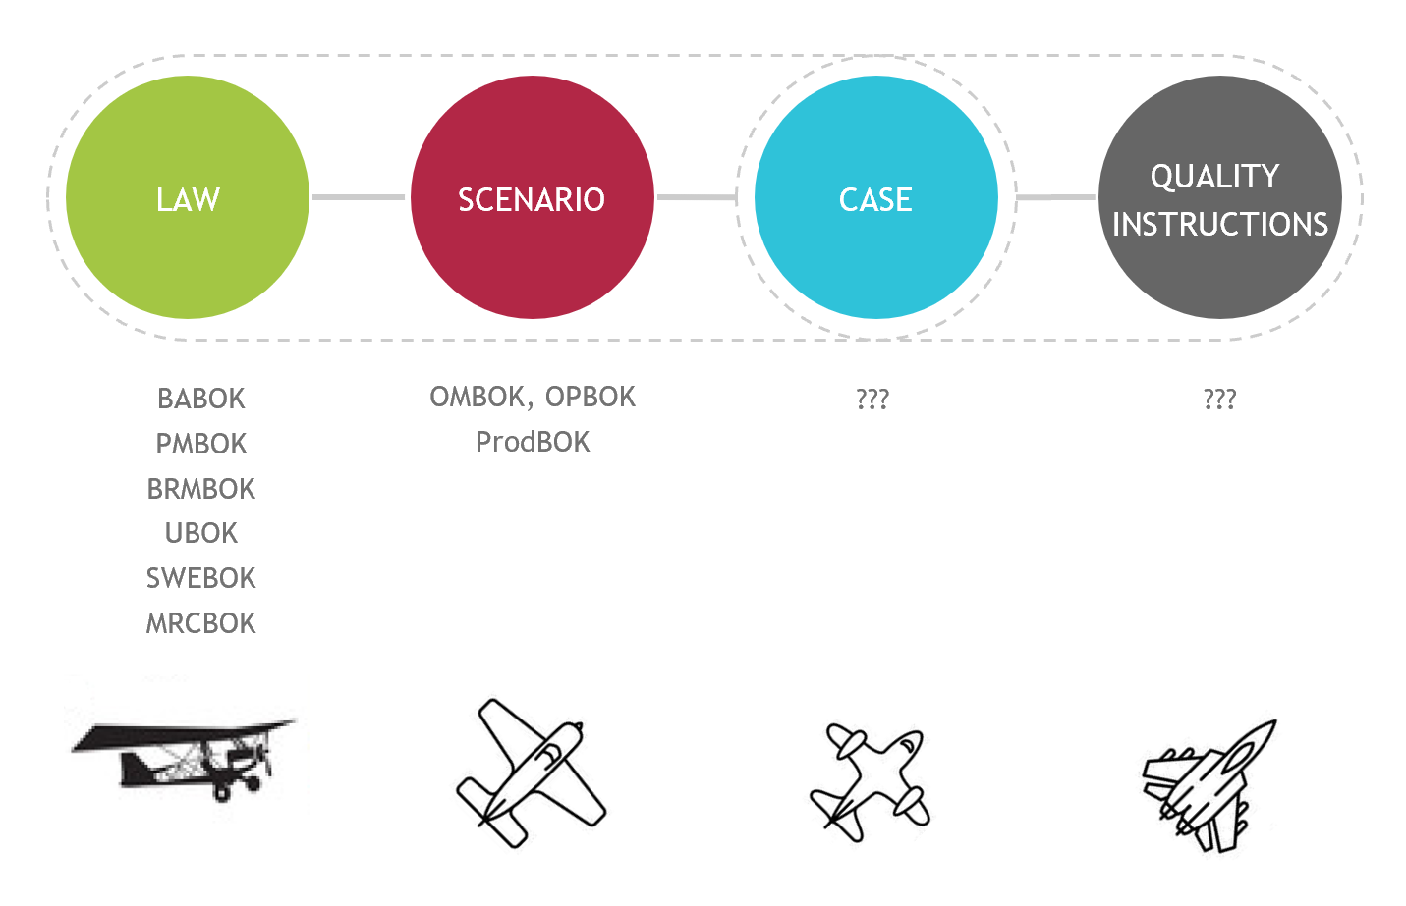
Knowledge and Experience GAPs

Slide 21
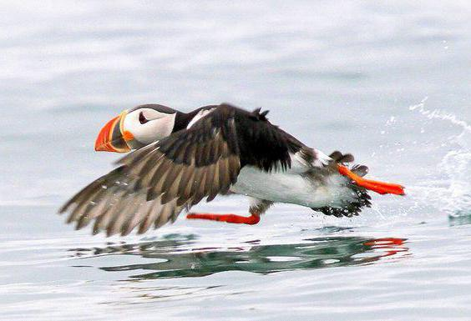
NEW HOPE
Complex cases knowledge base
Best solutions
Time wise
Price wise
etc.
Aggregate cases into segmented frameworks to avoid mistakes
Combine all above into BA script

Slide 22
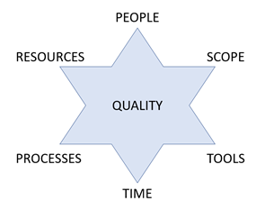
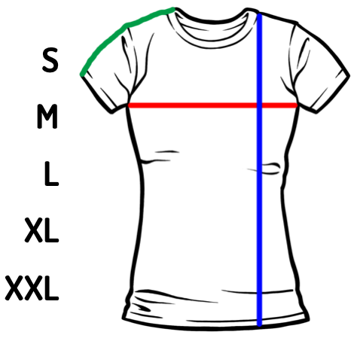
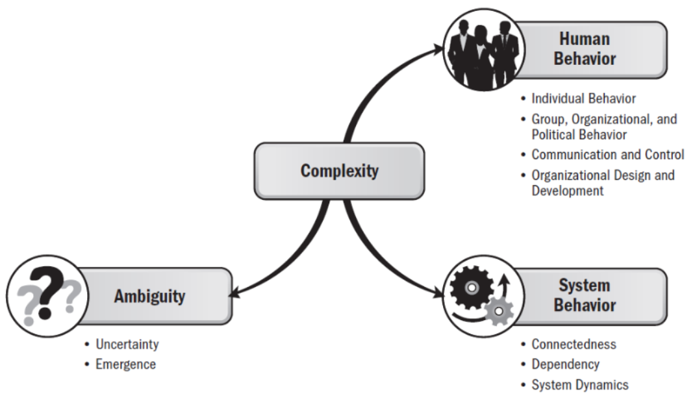
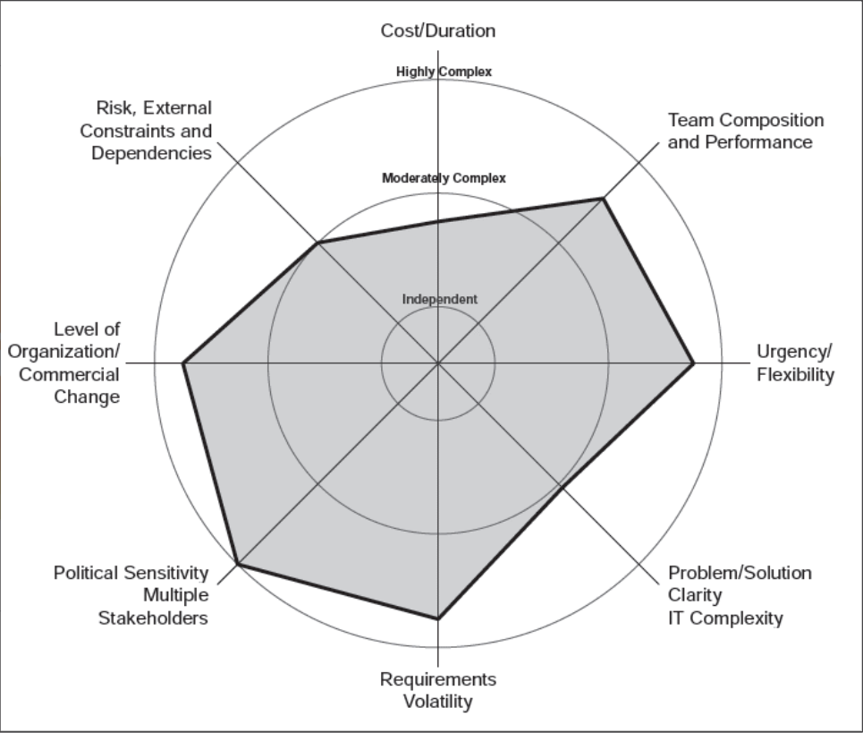
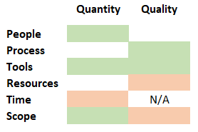
COMPLEXITY STUDY
IMPACT
RISKS
ESTIMATES
Elicit Dimensions
Spot the Uncertainties
Provide T-Shirts

Slide 23

THROUGH THE SELF-IMPROVEMENT
1
Demand Qualification
2
Problem Solving
3
Productivity
4
Complexity
5
Efficiency
6
Transparency
7
Customer Engagement
8
Deep Dive into Business Domain

Slide 24
BA CENTRIC LOOK
Knowledge / Content Quality
Criteria
Complex Examples
Best Practices
BA QUALITY MVP
Complexity
Productivity
Transparency
Avoid Mistakes
BA CAPABILITIES ENRICHMENT
Complexity Study
Case Study knowledge base converted into BA Scripts
SWAT

Slide 25
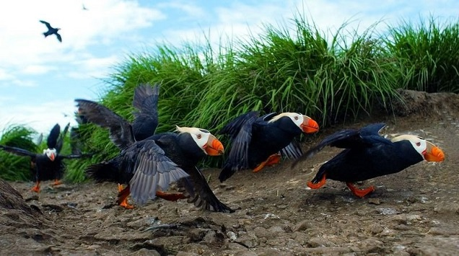
SWAT

Slide 26
THANK YOU!
Iurii Medynskii
Iurii_Medynskii@epam.com

