Slide 1
Interviewer. The good the bad and the ugly.
Julia Alexes,
Lead Business Analyst,
EPAM UK, London

Slide 2

Julia Aleksis
Lead Business Analyst, EPAM UK
More than 8 years in business Analysis
4 years in Project Management
2 years of professional interviews
Certified Business Analysis Professional v3.0
Certified Scrum Product Owner

Slide 3
When the interview begins?

Slide 4
Preparation Steps
Read through person’s CV (pre-screen)
Detect core competencies you need
Prepare List of Questions
Prepare Practical Cases based on experience
Prepare talk about the company

Slide 5

Let the candidate tell you about their personality and experience.

Slide 6
Project-based questions

Slide 7

Company Competencies/Standards

Slide 8
Agile
How did your team accept transformation from Scrum to Kanban?
UML
Please draw me a UML Activity diagram for the supermarket cashier desk?
How did UML Class diagram help you in communication with your customer?
Elicitation
What elicitation techniques were the most powerful for you? And why?
What do you usually do right after the workshop is conducted?
What stumbling blocks did you face with working in scrum teams?

Slide 9

Self-Development & Professional Growth
Future Plans is the key to the Professional Growth
Professional Growth means more productive work achievements!
Person that doesn’t want to grow will likely stay on the same place for years.

Slide 10
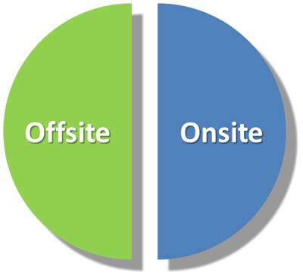
How on-site hiring differs?

Slide 11
To match or
Not to match
Project Based | ✔️ | ✔️
Company competences | ✔️ |  | ✔️
Self-development | ✔️ | ✔️

Slide 12
Let the candidates ask questions
Questions can reveal candidate’s motivation
You can see how questions structured
You can check the ability to ask right questions
You can hear what project types bother your candidate

Slide 13


Slide 14
Now or Later?

Slide 15

Julia Alexes

