Slide 1





The 7 Skills of highly effective teams
Communicate
Empathize
Explore
Communicate
Sell
7 Skills
Collaborate
Tell
Ideate
www.sjsi.org

Slide 2


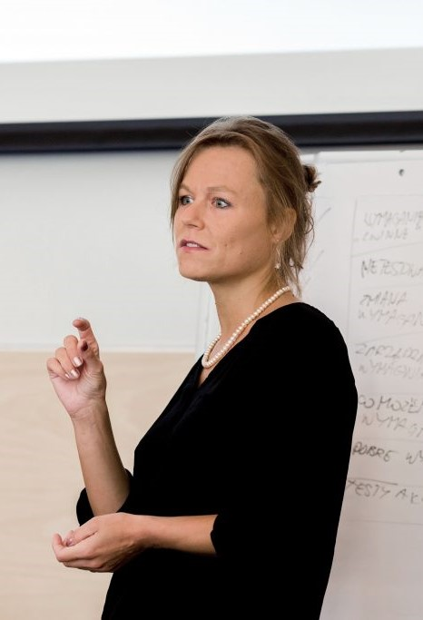
Pleased to meet you
Karolina Zmitrowicz
Chair of the Polish Testing Board (SJSI)
Member of IREB ExCo
IREB Polish Local Community Leader
TMMI Polish Local Chapter Leader
www.sjsi.org

Slide 3
A long time ago in a galaxy far, far away…

Slide 4
An IT project has been started
…

Slide 5
…
There was a team…
a dream team…

Slide 6


Slide 7
…
Ok…not really a dream team…

Slide 8
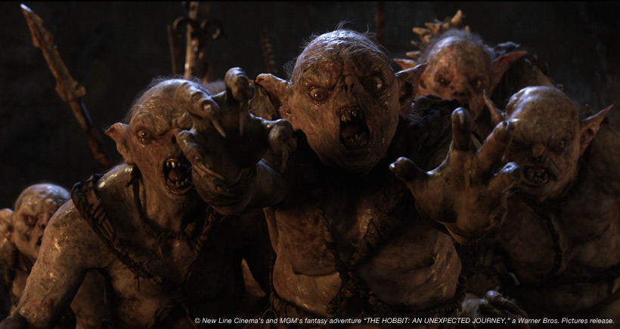

Slide 9
…
There were trying…

Slide 10
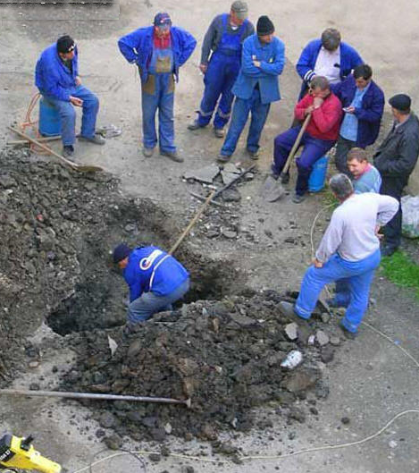
…
Collaboration And Teamwork…

Slide 11

…
Communication…

Slide 12

…
Empathy…

Slide 13
…
What went wrong?

Slide 14
…
How the team was built?

Slide 15
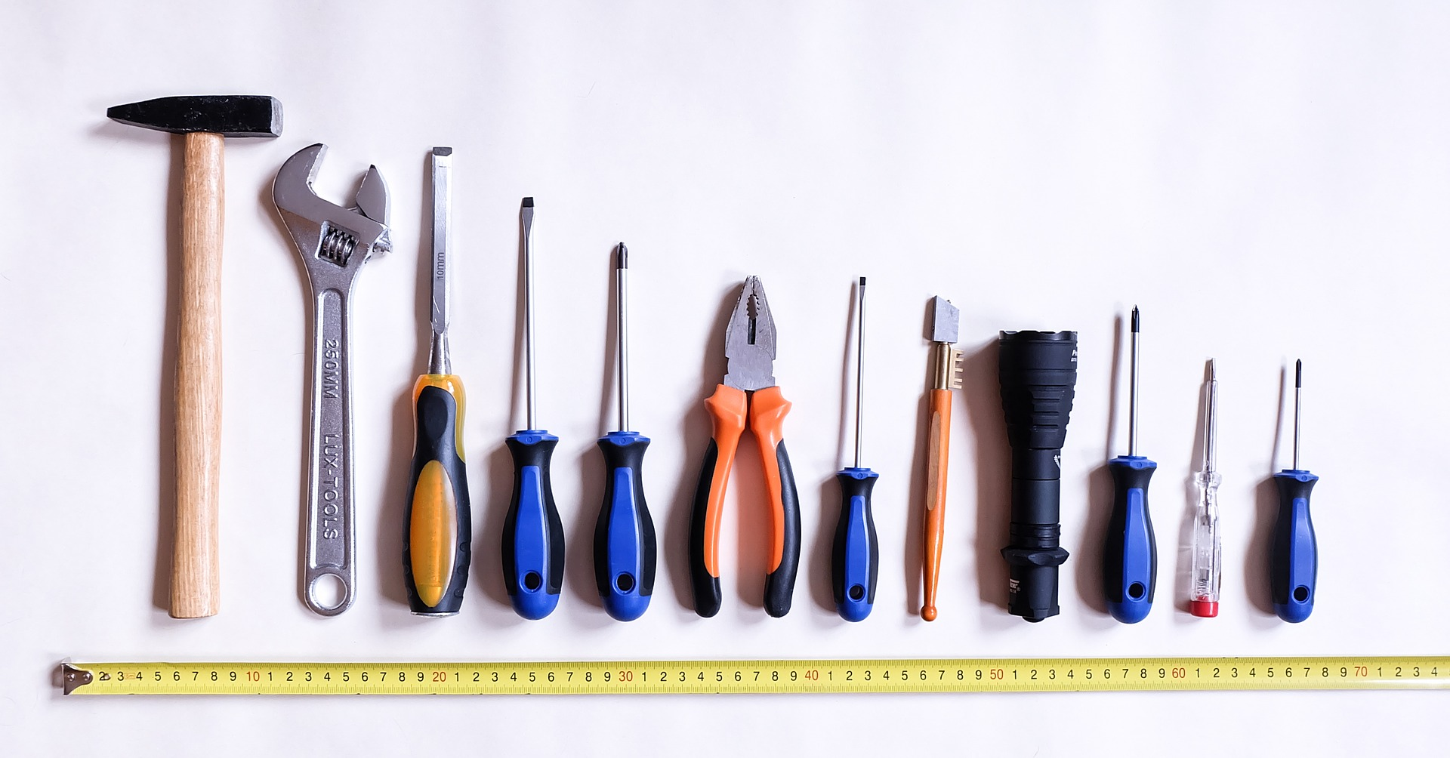
Tools and techniques

Slide 16

…which can kill creativity…

Slide 17
…
What we missed?

Slide 18
Demand facing
Problem
Soft skills
Customer facing
Team facing
Outside
Inside
Solution
Supply facing

Slide 19
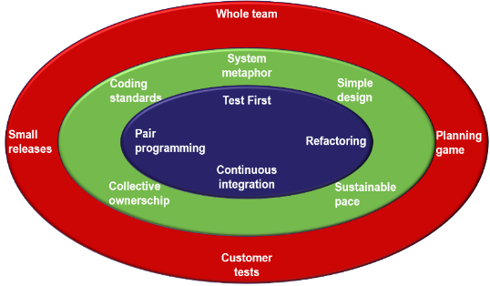









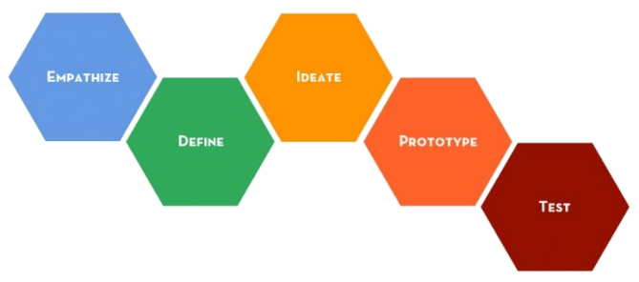




XP
Karolina Zmitrowicz (PL)
Hans van Loenhoud (NL)
Solution
7 Skills
Bernard Rulmont (BE)
Design Thinking
Olivier Denoo (FR)

Slide 20
Communicate
Empathize
Explore
Solution
Communicate
Sell
7 Skills
Collaborate
Tell
Ideate

Slide 21
Demand facing
Communicate
Problem
Communicate
Communicate
Customer facing
Team facing
Outside
Inside
Solution
Supply facing

Slide 22


Communicate
The Shannon-Weaver model
“Tree”
Sender
Encode
Decode
Receiver
Message

Slide 23
Communicate
Schramm’s Feedback Loop
Message
Encode
Interpret
Decode
Redundancy
Decode
Interpret
Encode
Feedback
Message

Slide 24

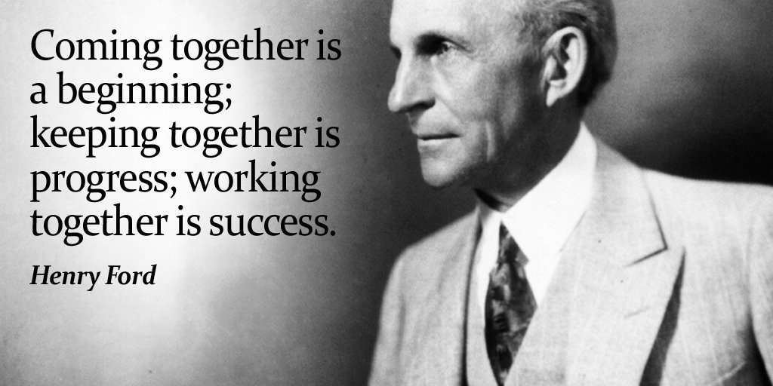
Communicate
00
00
01
02
03
04
05
05
Make groups of about 8 participants
Each group divides into 2 subgroups
The Daisies
The Pansies
You will work together!

Slide 25
Communicate
00
00
01
02
03
04
05
06
07
08
09
10
10
Each subgroup gets a message from the trainer
Encode this message by drawing little sketches on a paper
Don’t use characters, figures nor words
Do your best to a encode a crystal-clear message but keep your encoding rules secret

Slide 26
Demand facing
Communicate
Empathize
Problem
empathize
Communicate
Customer facing
Team facing
Outside
Inside
Team facing
Solution
Supply facing

Slide 27
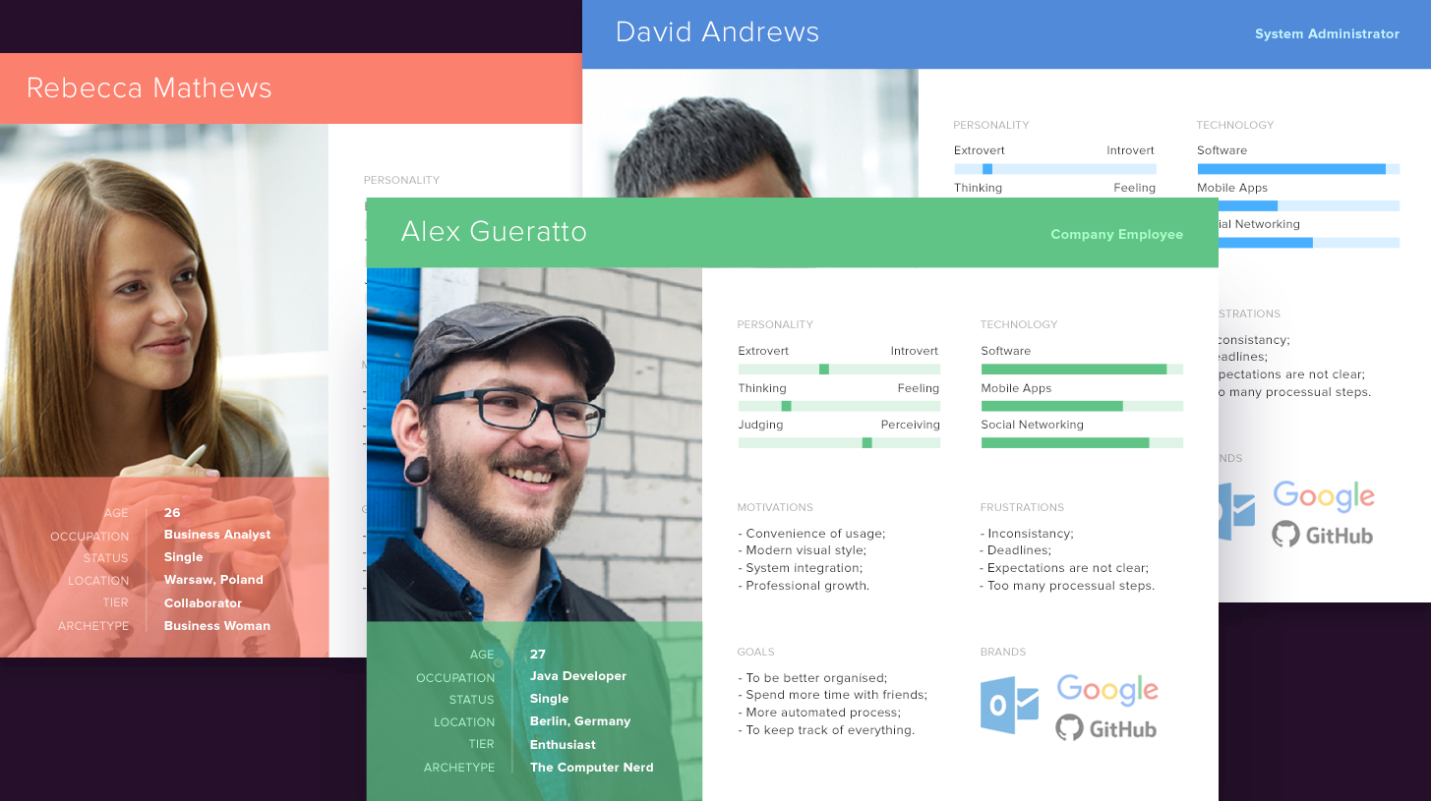
empathize
Persona – give them a face

Slide 28
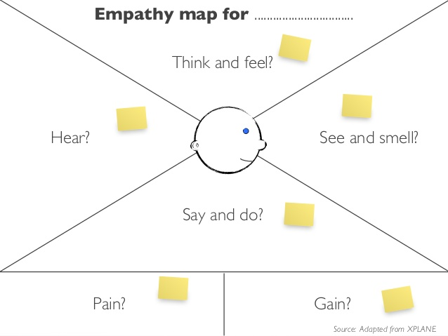
empathize
Empathy map – stand in their shoes

Slide 29
Empathize
00
00
01
02
03
04
05
06
07
08
09
10
10
Each subgroup fills in empathy maps for two personas
The Daisies: box collector; citizen
The Pansies: charity manager; coordinator

Slide 30
Demand facing
Communicate
Empathize
Problem
Explore
Explore
Communicate
Customer facing
Team facing
Outside
Inside
Team facing
Solution
Supply facing

Slide 31



Explore
Problem-Goal-Solution trinity
An idea about a possible state transition
Remove
Enable
A negative present state
A positive future state
Inhibit

Slide 32

Explore
W5H
Why
How
Who
Where
What
When

Slide 33

Explore
The Goal Tree
Why?
How?
Or
And

Slide 34
Demand facing
Communicate
Empathize
Problem
Explore
collaborate
Communicate
Customer facing
Team facing
Outside
Inside
Collaborate
Team facing
Solution
Supply facing

Slide 35
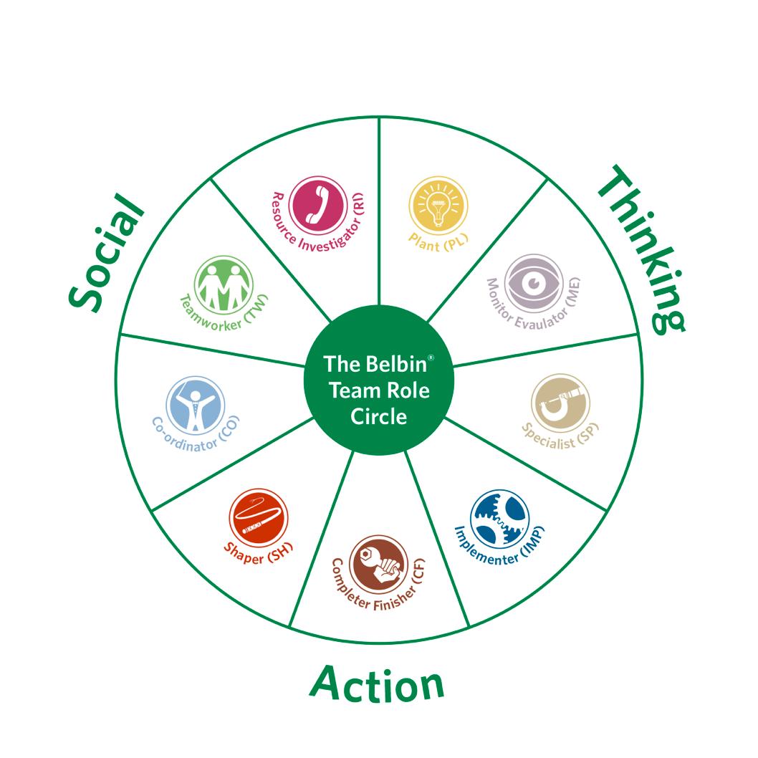
Collaborate
Belbin team roles

Slide 36
Collaborate
00
00
01
02
03
04
05
05
Look at the teammates in your subgroup
Individually, take a piece of paper for each of your teammates, and write her/his name on it and (without telling) the Belbin role that you think would fit best
Now (anonymously), collect the notes on yourself from your fellows
No discussion: this is the way they see you!
Study the notes and try to interpret them
Combine you own idea with theirs and decide for yourself what is your primary role
Usually, you can also identify a secondary / complementary role

Slide 37
Demand facing
Communicate
Empathize
Problem
Explore
Ideate
Communicate
Customer facing
Team facing
Outside
Inside
Collaborate
Team facing
Solution
Ideate
Supply facing

Slide 38

Ideate
brainstorming
Group process to create new ideas (A.F. Osborne, 1939)
General rules
Go for quantity
Withhold criticism
Welcome wild ideas
Combine and improve ideas

Slide 39
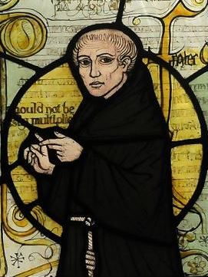
Ideate
Ockham’s Razor
Numquam ponenda est pluralitas sine necessitate (Plurality must never be posited without necessity)
Frustra fit per plura quod potest fieri per pauciora (It is futile to do with more things that which can be done with fewer)
The simplest solution is usually the best one
Simplicity: the art of maximizing the amount of work not done
Keep it simple
William of Ockham (1287–1347)

Slide 40
Ideate
00
00
01
02
03
04
05
05
You are working on an app to support box collectors
Go on, let’s make it fantastic!
No limits but your own imagination
Each of you writes down her/his best idea for the app on a piece of paper
Take the paper of your teammate at your right hand
Based on that idea, add some thoughts and/or new ideas to it and pass it on to your left (= diverge!)
Go on until every idea is processed by all teammates

Slide 41
Demand facing
Communicate
Empathize
Problem
Explore
Tell
Communicate
Customer facing
Team facing
Outside
Inside
Collaborate
Team facing
Tell
Solution
Ideate
Supply facing

Slide 42
Tell
Storytelling
Immerse your audience in a story
Tell a personal story
Create suspense
Bring characters to life
Show, don’t tell
Build up to a S.T.A.R. moment
End with a positive takeaway
Group process to create new ideas

Slide 43
Tell
Storytelling
Show time!!

Slide 44
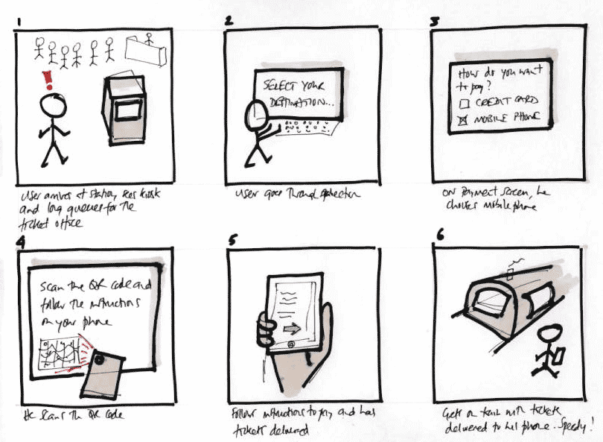
Tell
Storyboarding
Describe scenarios about people doing something
Every (major) interaction of a persona gets its own frame
The board shows the flow between the frames
Sketch – it’s not the Mona Lisa

Slide 45
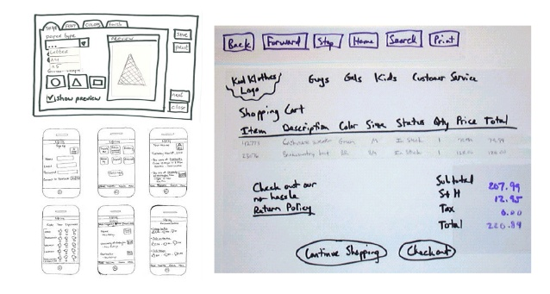
Tell
Prototyping
Through prototyping, your stakeholders can experience certain aspects of your product at an early stage
You will receive more and better feedback

Slide 46
Tell
00
00
01
02
03
04
05
06
07
08
09
10
10
Your group develops a fantastic solution to support box collectors
What are you going to tell to potential users?
Imagine how one of your personas will be using this app
Of course, she is delighted about it!
Tell the story of this persona with your app
Draw a comic strip to show the story
Show the events that occur, her actions, screen shots of the app
Don’t forget about emotions
Just roughly, quickly sketch – it’s not the Mona Lisa

Slide 47
Demand facing
Communicate
Empathize
Problem
Explore
Sell
Communicate
Customer facing
Sell
Team facing
Outside
Inside
Collaborate
Team facing
Tell
Solution
Ideate
Supply facing

Slide 48
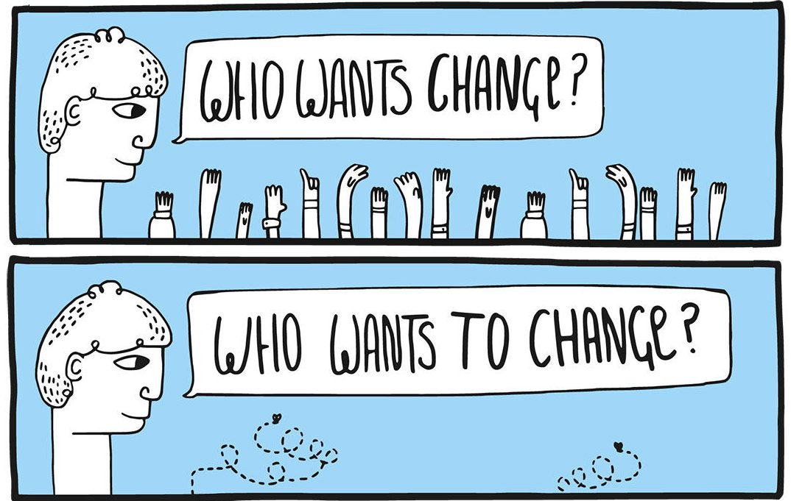
Sell
FUD
Even with a fantastic solution, you will meet change resistance
Your customers will feel
Fear
Uncertainty
Doubt
Listen to their problems and take them seriously
Mitigate the issues and turn them into benefits

Slide 49
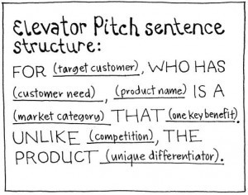
Sell
Elevator Pitch
You will have only one chance to convince your customers
You will have only one minute to catch their attention
In this one minute, you must explain
what solution you can offer
what benefits this will bring to them
what are the next steps

Slide 50

THE GOAL

Slide 51

YOUR IDEAS?

Slide 52
Building better quality in IT
Stowarzyszenie Jakości Systemów Informatycznych ul. Poznańska 16 lok. 4 00-680 Warszawa
Karolina Zmitrowicz k.zmitrowicz@sjsi.org
www.sjsi.org

