Slide 1
IT Analyst Days, St. Petersburg
BA: A Set of Services &
Sub-Processes
Roland Gareis, April 2018

Slide 2
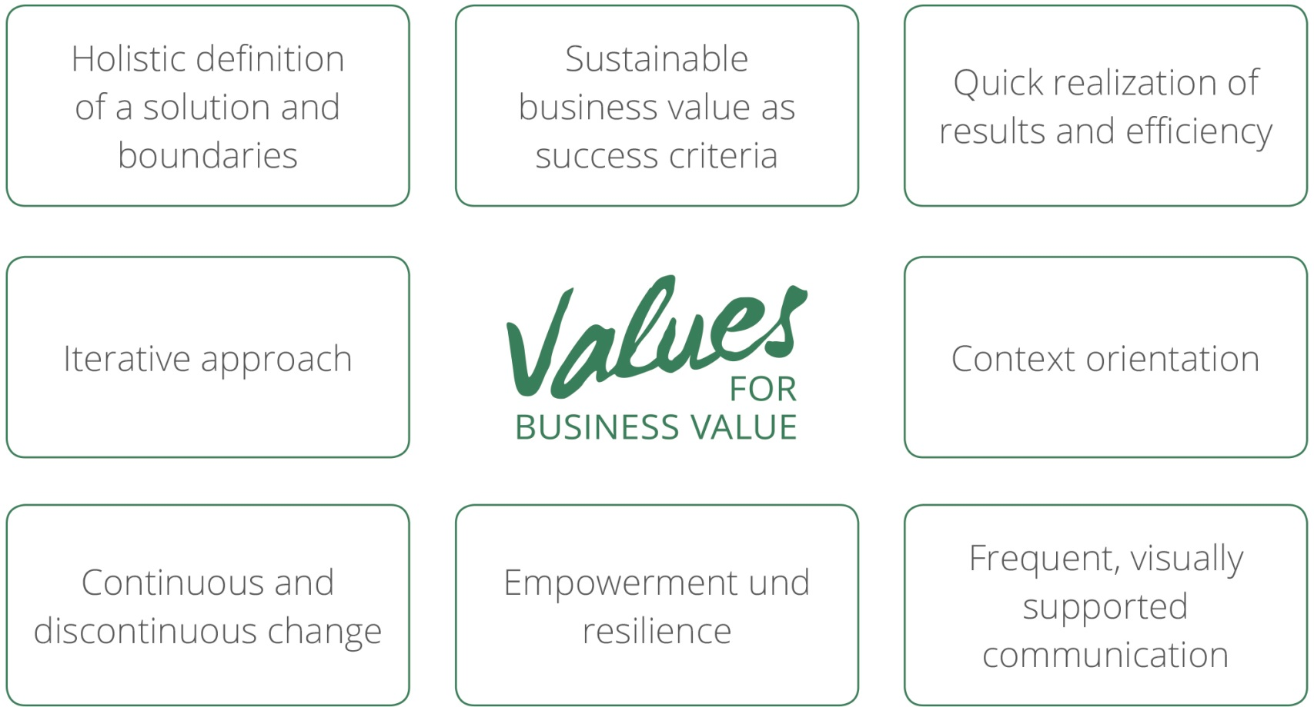
Notes:
Continuous and discontinuous learning – ausbessern

Slide 3
Agenda
Perceptions of BA
BA as a set of services & sub-processes
Positioning BA in companies

Slide 4
Traditional Perception of BA
Consequences
Focus is on What? How? not on Why?
No optimal decisions
Business , stakeholder, solution and
transition requirements are not clearly
differentiated
No clear responsibilities, no differentiation between business case and project
No holistic perception of problem dimensions
Only sub-optimizations are achieved

Slide 5
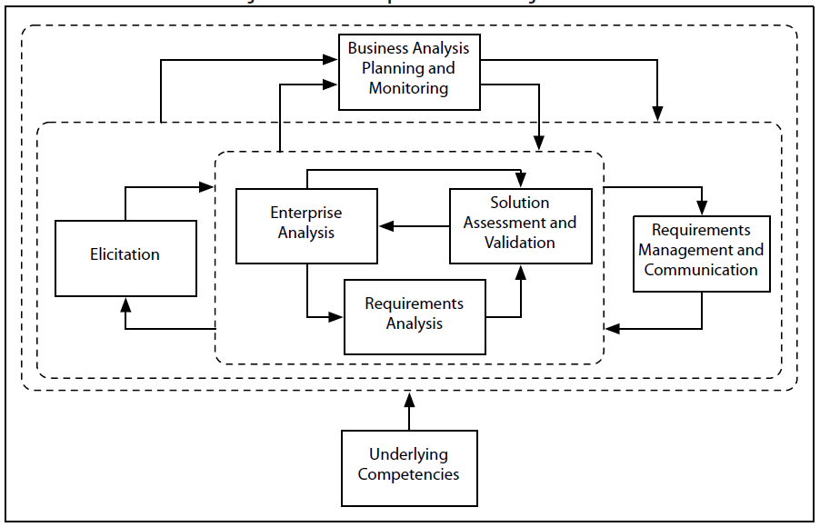
BA perceived as a set of knowledge areas
no sales-orientation
no processes-orientation
Unclear role of the Business Analyst
IIBA – BABOK v2.0: Knowledge Areas

Slide 6
Investment Life Cycle
Management attention for the early phases
Benefits realization management and benefits responsibility accounting
Process-orientation
BA a set of services & sub-processes
Focus on What?, How? and Why?
Holistic Problem Perception
Considering IT, but also services, organization, personnel, stakeholder relations, etc.
Requirements & Objectives
Business requirements basis for business case objectives
Solution requirements basis for project objectives
BA Perception of RGC

Slide 7
How do you perceive BA?
How is the Role of the BA understood in your organization?

Slide 8
Agenda
Perceptions of BA
BA as a set of services & sub-processes
Positioning BA in companies

Slide 9
BA objectives
Contributing to organizational changes
Assuring a holistic perception of changes
BA services: Contributing …
to strategic planning/controlling
to developing a feasibility study
to implementing a new solution
to optimizing an existing solution

Slide 11
Service Description: 2.1 Performing as-is and to-be analysis
Objectives | Business need, as-is situation (e.g. via benchmarking) documented & commonly understood To-be situation analyzed and documented under consideration of products, markets, processes, roles, IT architecture, etc. Gaps to reach to-be situation identified Business and stakeholder requirements defined & aligned Basic solution requirements defined
Deliverables | Business need definition Documentation of as-is and to-be situation Gap analysis Business, stakeholder and basic solution requirements document
Benefits | Common view of as-is situation, agreed on to-be situation by stakeholders SMART defined business and stakeholder requirements Basis for definition of adequate solution approaches Basis for definition of costs/benefits and project objectives Basis for decision about next-steps
Out of scope | Definition of detailed solution requirements & solution approaches

Slide 12
Service Description: 2.2 Developing solution alternatives & analyzing costs/benefits
Objectives | Markets regarding possible solutions (e.g. suppliers, competitors) analyzed Solution approach and solution alternatives described Possible vendors shortlisted Cost benefit analyses for solution alternatives performed Solution alternative recommended Decision making process supported
Deliverables | Market analyses Request for Proposal (RFP) for possible vendors Shortlist of possible vendors Solution alternatives including cost benefit analyses
Benefits | Market overview available Neutral facilitation of vendor selection process Basis for the solution alternative decision
Out of scope | Decision for a solution alternative Selection of a vendor

Slide 13
Service Description: 3. Contributing to implementing a new solution
Objectives | Requirements management and communication Elicitating and analyzing detailed solution and transition requirements Changing requirements during designing, developing, testing, initial application Contributing to designing IT/organization/personnel/etc. solution Business-oriented contributing to testing, to migrating and going live Performing defect analyses Evaluating the final solution and verifying benefits
Deliverables | Business and stakeholder requirements document Solution requirements document, Traceability matrix change requests document Test cases and testing documents ….
Benefits | Assurance that a new solution, meeting the defined business, stakeholder and solution requirements is implemented
Out of scope | Detailed implementation planning

Slide 14
BA: A Set of Services
Perceiving BA from a client‘s point of view
Differentiating BA services
Supporting the marketing of BA services
Providing a basis for a holistic definition of BA sub-processes
Organizing appropriately for different BA services

Slide 15
Which BA services does your organization provide …
today?
in the future?

Slide 16
Processes, to which BA is contributing
Strategic planning
Strategic controlling
Developing a feasibility study
Implementing a new solution
Managing an IT demand of an existing solution
Optimizing
an existing solution

Slide 17
Process: Developing a Feasibility Study
Process start | Decision to perform a feasibility study made, assignment given |  |  | Process end |  | Decision to implement a solution (or not) made and communicated
Objectives | As is and to be analysis performed, solution alternative described Cost benefit analyses for solution approaches performed Project plan for the implementation developed Decision to implement a new solution (or not) made
Non-objectives | New solution implemented
Preceding process | Deciding to perform a feasibility study
Following process | Implementing a new solution
Process owner | BA community of practice leader
Process documentation | File ZT
Impacts | short term | mid term X | long term
 | local | regional X | global

Slide 18
 |  | Project sponsor | Project manager | Business Responsible | Business Analyst | IT Implementation SME | R-IT & AMM (Operations) | Tester | Process management | Procurement
1 | Project Management
1.1 | Project starting (including BA Planning) | C | P | C | C | C |  | C | C | C
1.2 | Project controlling (including BA Monitoring) |  | P |  | C
1.3 | Project closing | I | P |  | C
2 | Perform As-Is Analysis
2.1 | Define Business need | C | M | C | P
2.2 | Analyze Markets & Products |  | M | P | C
2.3 | Analyze Processes, Roles & Personnel |  | M | C | P |  | C |  | ?
2.4 | Analyze Stakeholder Relations |  | M | P | C
2.5 | Analyze Enterprise IT architecture & Interfaces |  | M | C | P | C | C
2.6 | Align & document As-Is | I | M | C | P | C | C
Developing a Feasibility Study I
P.. Performing, m… managing
c… cooperating, I… being informed

Slide 19
 |  | Project sponsor | Project manager | Business Responsible | Business Analyst | IT Implementation SME | R-IT & AMM (Operations) | Tester | Process management | Procurement
3 | Define To-Be Situation
3.1 | Define Markets & Products |  | M | P | C
3.2 | Define Processes, Roles & Personnel |  | M | C | P | C | C
3.3 | Define Stakeholder Relations |  | M | P | C
3.4 | Define Enterprise IT architecture & Interfaces |  | M | C | P | C | C
3.5 | Align & document To-Be | I | M | C | P | C | C
3.6 | Identify Gaps to reach to-be situation |  | M | C | P | C
4 | Define Requirements
4.1 | Define Business and stakeholder requirements |  | M | C | P
4.2 | …..
5 | Market Analysis
 | …
6 | Define Solution Approach, Describe Solution Alternatives
Developing a Feasibility Study II
P.. Performing, m… managing
c… cooperating, I… being informed

Slide 20
High, middle, low complexity of BA services, of processes BA contributes to
Requiring different …
business analysis organizations
qualifications of Business Analysts
elicitation & modeling methods
cooperations with client‘s representatives
duration and costs

Slide 21
Which advantages and disadvantages do you see from defining BA as …
a set of services?
a set of sub-processes?

Slide 22
Agenda
Perceptions of BA
BA as a set of services & sub-processes
Positioning BA in companies

Slide 23
BA in Companies: Personnel Development
Developing a BA career path
Defining relevant certifications
Performing BA trainings
Contents: Business analysis, process, project & change management, social competences
Participants: Business analysts, process managers, project managers and representatives of (internal) clients
Performing BA coachings
Individual coaching, Peer Group coaching (in groups)

Slide 24
BA in Companies: Organizational Development
Describing BA roles
Junior BA, BA, Senior BA
Establishing a BA community of practice
Performing BA consulting
Providing BA standards
BA procedure, templates

Slide 25
Business Analysis Procedure
1. Introduction
2. BA services
2.1. List of BA services
2.2. Descriptions of BA services
2.3. Complexities of BA services
3. Processes, to which BA contributes
3.1. List of processes, to which BA contributes
3.2. Descriptions of the processes
3.3. BA methods
4. ….

Slide 26
Business Analysis Procedure (cont.)
4. Organizing for BA
4.1. Business analyst roles (overview)
4.2. Business analyst career path
4.3. BA community of practice
4.4. Relationships: BA, process, project & change management
5. Attachments
5.1. BA templates
5.2. Descriptions of business analyst roles
5.3. Descriptions of BA methods
5.4. BA glossary of terms

Slide 27
BA Methods to Elicit Requirements
Method
Link to BA CoP Collaboration Room
Elicitation
Brainstorming
Document Analysis
Focus Groups
Interface Analysis
Interviews
Observation
Prototyping
Requirements Workshop
Survey/Questionnaire
https://collaboration.rbiat.rbinternational.corp/collrooms/bab/Documents/3000 Standards and Techniques/2000 BA Techniques/Elicitation
https://collaboration.rbiat.rbinternational.corp/collrooms/bab/Documents/3000 Standards and Techniques/2000 BA Techniques/Brainstorming
https://collaboration.rbiat.rbinternational.corp/collrooms/bab/Documents/3000 Standards and Techniques/2000 BA Techniques/Document Analysis
https://collaboration.rbiat.rbinternational.corp/collrooms/bab/Documents/3000 Standards and Techniques/2000 BA Techniques/Focus Groups
https://collaboration.rbiat.rbinternational.corp/collrooms/bab/Documents/3000 Standards and Techniques/2000 BA Techniques/Interface Analysis
https://collaboration.rbiat.rbinternational.corp/collrooms/bab/Documents/3000 Standards and Techniques/2000 BA Techniques/Interviews
https://collaboration.rbiat.rbinternational.corp/collrooms/bab/Documents/3000 Standards and Techniques/2000 BA Techniques/Observation
https://collaboration.rbiat.rbinternational.corp/collrooms/bab/Documents/3000 Standards and Techniques/2000 BA Techniques/Prototyping
https://collaboration.rbiat.rbinternational.corp/collrooms/bab/Documents/3000 Standards and Techniques/2000 BA Techniques/Requirement Workshops
https://collaboration.rbiat.rbinternational.corp/collrooms/bab/Documents/3000 Standards and Techniques/2000 BA Techniques/Survey, Questionnaire

Slide 28
BA Glossary: Example
# | Term | Description | Questions | Example
1 | Business Need | Problem that the business analyst is trying to find a solution for. | Why is the change required? | “IFRS 9 compliance to be ensured for RBI, RZB and Network Banks”
2 | Business Vision | Long term goals (of the enterprise) | What are your long-term goals? | “Ensure fast and efficient month-end-closing process”
3 | Business Requirement | Goals, objectives and outcomes why a project shall be initiated. | What are you trying to achieve? Why project shall be initiated? | “Make the loans subledger IFRS 9 capable”
4 | Stakeholder Requirement | Needs of stakeholders that must be met in order to achieve the business requirements. | What do you need from the solution? | “Need to flag customers as impaired according to IFRS stage 3”
5 | Solution Requirement | Capability or quality of a solution that meets the stakeholder requirements. Can be further split into functional and non-functional requirements. | What characteristics must the solution support? | “The solution must be capable to select customers out of a searchable list and flag them as impaired via a checkbox”
6 | Business Rule | A specific directive that is under control of business and that serves as a criterion for guiding behavior, shaping judgments, or making decisions | What are the standards and regulations upon you operate? | “For categorization of deals a benchmark test has to be executed before it is committed”

Slide 29
Challenges
Unclear expectations versus the role of the Business Analyst
Difficult to involve (internal) clients
No integrative management approach

Slide 30
Do you use …
similar/different approaches
for positioning BA in your company?

Slide 31
Roland Gareis
www.rolandgareis.com

Slide 32
Business Analysis Procedure: Objectives
Contributing to a common business analysis understanding of involved organizations
Providing a basis for …
an efficient cooperation of the involved organizations
communicating the business analysis services
quality assessments and for feedback to the business analysts
Not objective
To be a “police-document”

Slide 33
Criteria for Differentiating Complexities of BA Services
Object of consideration: New feature of an existing solution, new solution, new comprehensive solution
Type of BA service: strategic planning/controlling, feasibility study, implementing, optimizing
Scope of work: Contributing to a small, medium, large change
Financial impact („project“ costs): small IT solution, minor project, project, group program
Number of bank products affected: Few, some, many
Number of IT systems affected: Few, some, many
Number of processes affected: Few, some, many
Number of organizational units involved: Few, some, many
Development approach planned: Agile, iterative/waterfall, mixed
Relationship to other solutions: Few, some, many
Duration: Very short, short, mid-term
Resources required, costs: Small, middle, high

Slide 34
Organization & Personnel Planning for BA Services of Different Complexities
BA organization planning for performing a BA process
BA part of a project or not
BA roles (BA lead, BAs for different solution components, BA team)
Communication of the BA organization
Communications with stakeholders
BA personnel planning for for performing a BA process
Required qualifications of the BA personnel
Recruiting BA personnel
Developing BA personnel

