Slide 1


Where we as BAs are in this digital economy
Aleš Štempihar, IIBA Slovenia Chapter, Digital42
@AlesStempihar
27-28 April 2018, St. Petersburg

Slide 2




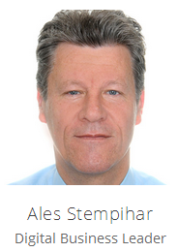

Slovenia
Ales is a digital strategist, innovator of business models and accelerator of changes in organizations. As a digital strategist he helps companies with preparing a digital strategy and roadmap execution. As an innovator he creates new business models and as the leader of Digital42 initiative he takes care for the program of digital projects.
President of IIBA CHAPTER SLOVENIA since 2009
BABOK v3 co-writer

Slide 3
Agenda
Warming up – Icebreaker
The future
The reality
The House of Digital Business
Mind the gap
Closing

Slide 4


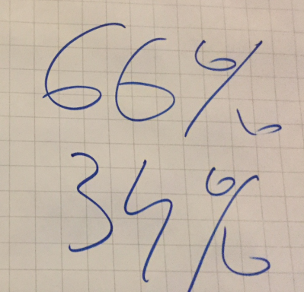
Warming up
Is your organization/company more like a ….
Ship
Boat

Slide 5
Agenda
Warming up – Icebreaker
The future is (almost) here
The reality
The House of Digital Business
Mind the gap
Closing - Takeaways

Slide 6

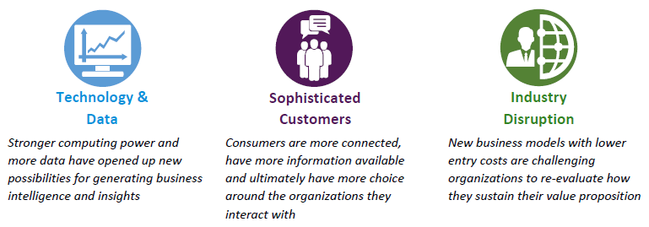
Macro business and technology trends are …

Slide 7
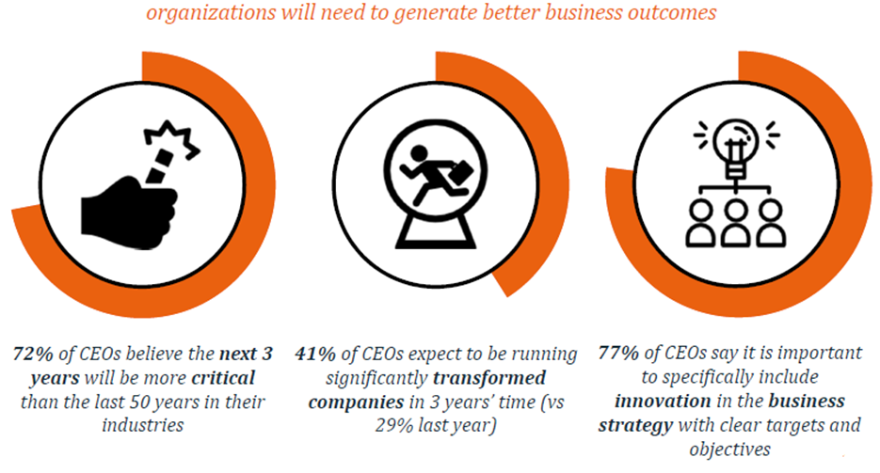
In the next 3 years ….

Slide 8
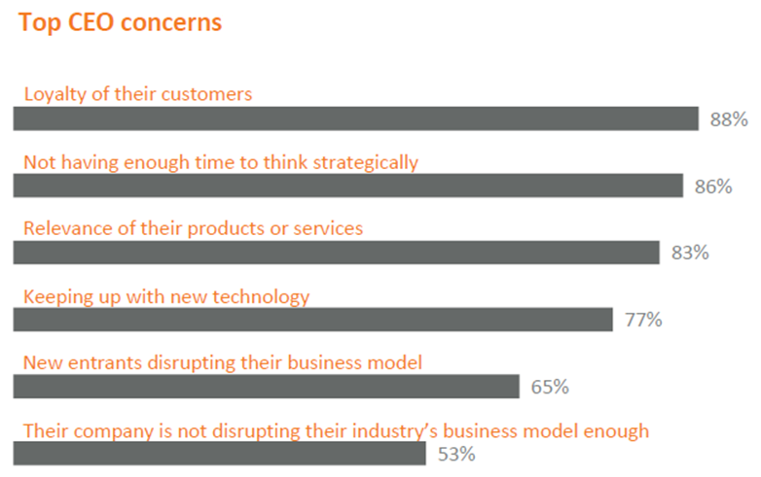

Why do CEOs wake up at night?

Slide 9
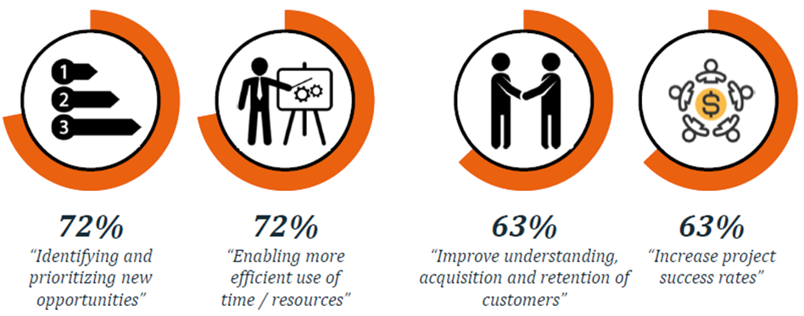
Where CEOs see the value of BAs?

Slide 10
Agenda
Warming up – Icebreaker
The future is (almost) here
The reality (check)
The House of Digital Business
Mind the gap
Closing - Takeaways

Slide 11
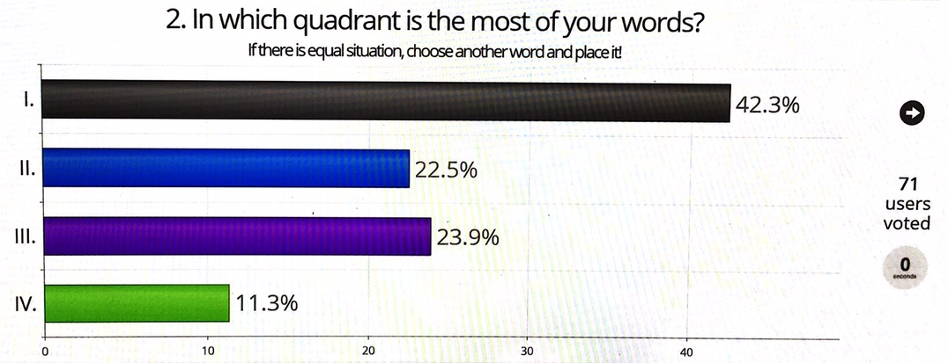
The Analyst days 2018 results

Slide 12
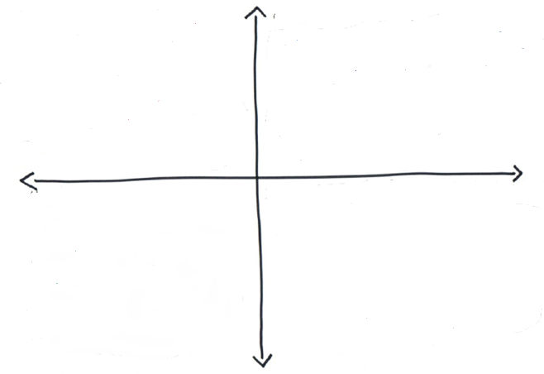
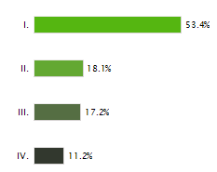
The BBA 2017 conference results
53,4 %
18,1 %
17,2 %
11,2 %

Slide 13
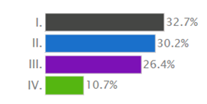
The BA Istanbul 2017 conference results
32,7 %
30,2 %
26,4 %
10,7 %

Slide 14
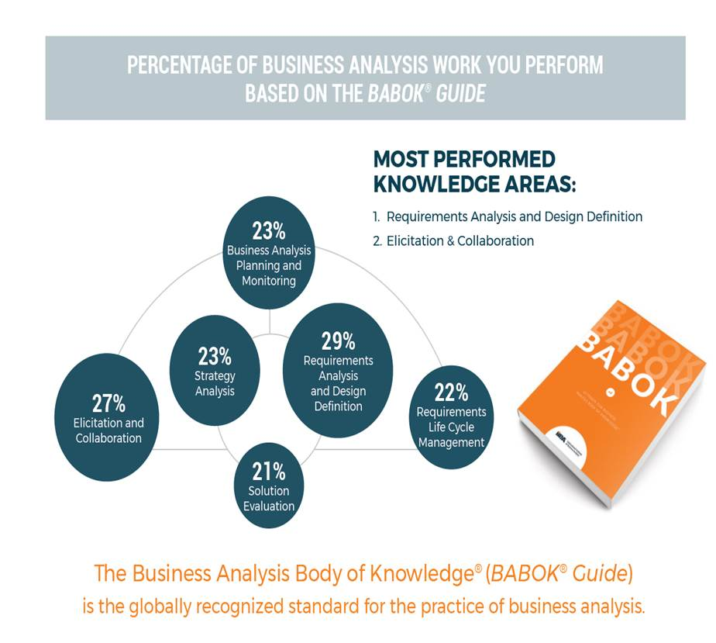
The IIBA BABOK v3 survey results
67 %
23/2% + 21%/2= 22 %
23/2% = 11%

Slide 15


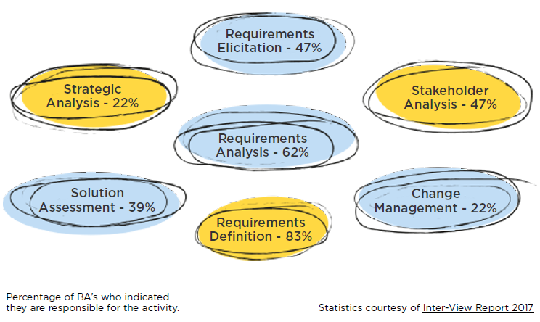
South Africa Research
I.
II.
III.
IV.
III.
II.
IV.

Slide 16
Where are we?
Requirements
Pre-project
II.
I.
III.
IV.
Change
Transformation

Slide 17
Reality check: past, present, future
Past / Present
Requirements
I.
Pre-project
II.
Present
Future
III.
IV.
Change
Transformation

Slide 18
Agenda
Warming up – Icebreaker
The future is (almost) here
The reality (check)
The House of Digital Business
Mind the gap
Closing - Takeaways

Slide 19
Where is digital business?
Requirements
I.
II.
Pre-project
III.
Digital business
Change
Transformation
IV.

Slide 20
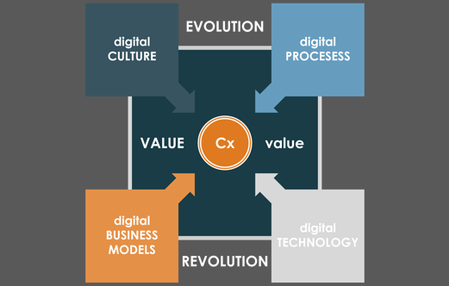

What does digital business really mean?

Slide 21
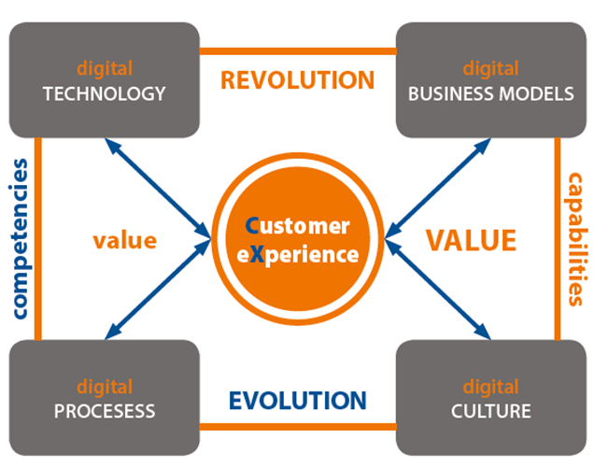
The House of Digital Business

Slide 22
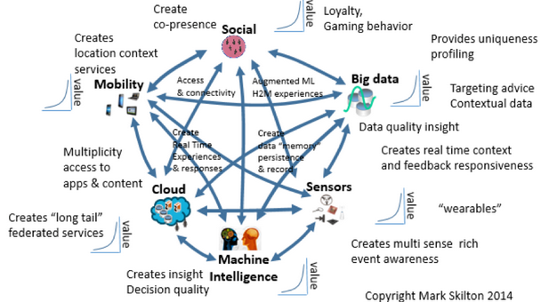
digital
TECHNOLOGY
Notes:
Kaj so bistvene tehnologije

Slide 23

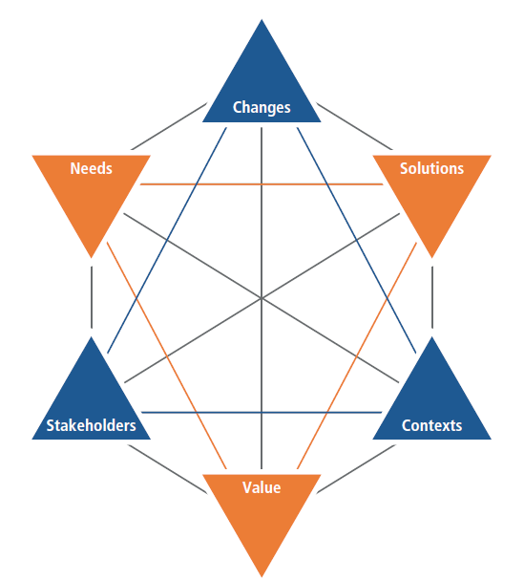

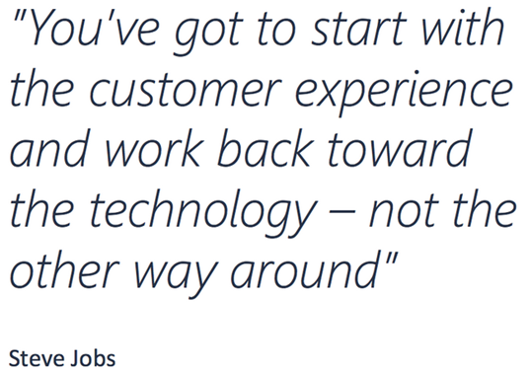


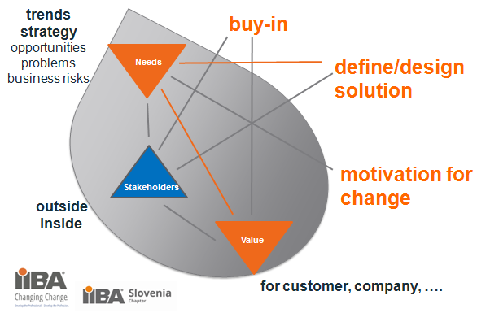
BAs in
digital
TECHNOLOGY
Solution
Need, Stakeholder, Value, CX

Slide 24
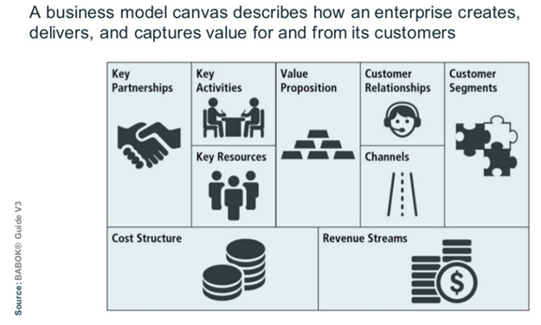



digital BUSINESS MODELS
Notes:
Opisuje, kako organizacija kreira in ohranja in ohranja vrednost zase in za svoje stranke. To je po Canvasu-
V čem je finta UBER? Value proposition: za nižjo ceno dajo boljšo uslugo. Vozniki niso zaposleni ampak so partnerji. Podpora z app, kjer so ocene šoferjev.
Tehnologija pomaga pri izgradnji zaupanja.

Slide 25
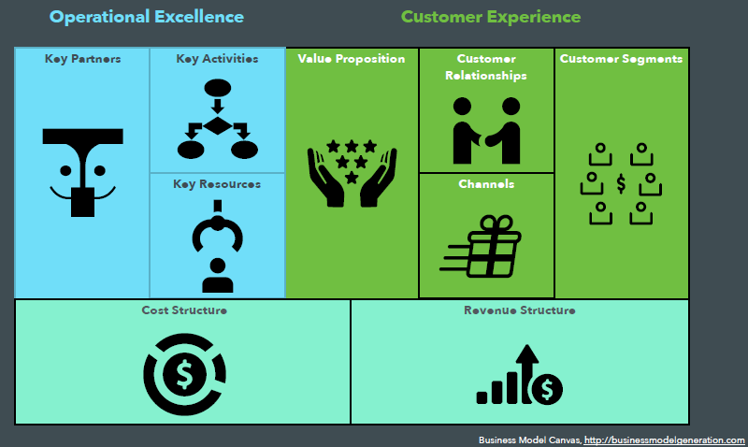
BAs in
digital BUSINESS MODELS

Slide 26
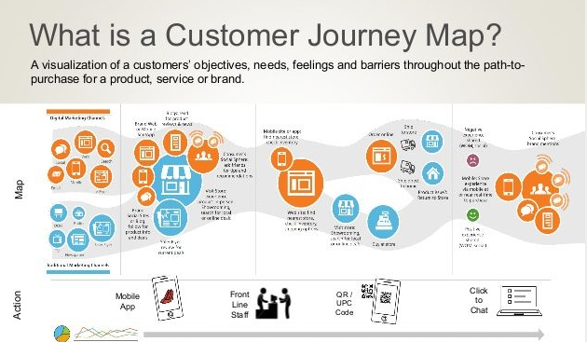
digital
PROCESESS
Notes:
Bistvo je da se procesi gledajo od zunaj na notri. Iz vidika stranke, kako bi si ona želela poslovati z nami, mi se moramo prilagajati-

Slide 27
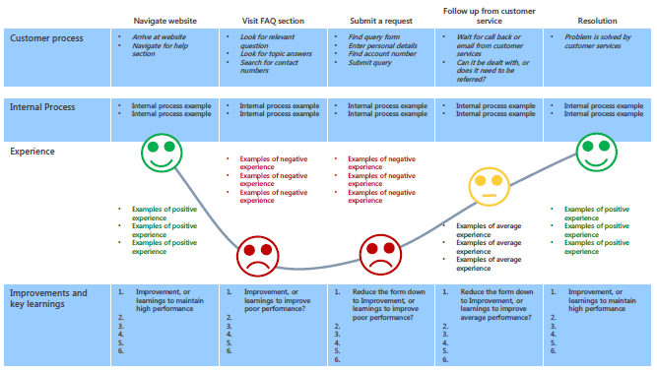
BAs in
digital
PROCESESS
Notes:
Bistvo je da se procesi gledajo od zunaj na notri. Iz vidika stranke, kako bi si ona želela poslovati z nami, mi se moramo prilagajati-

Slide 28
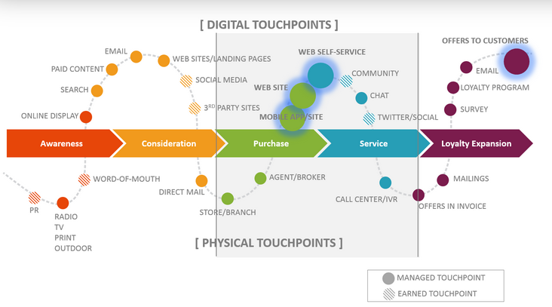
BAs in
digital
PROCESESS
Notes:
Zadovoljstvo merimo na tuchpointih, ki so

Slide 29

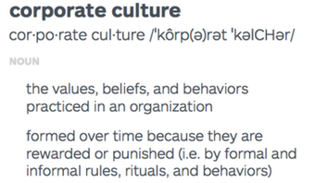
Culture is the crucial part of digital business (transformation) ….
digital CULTURE
Notes:
You know Peter Drucker quatation: Culture eats strategy for breakfast. Digital culture eats strategy even before breakfat.

Slide 30
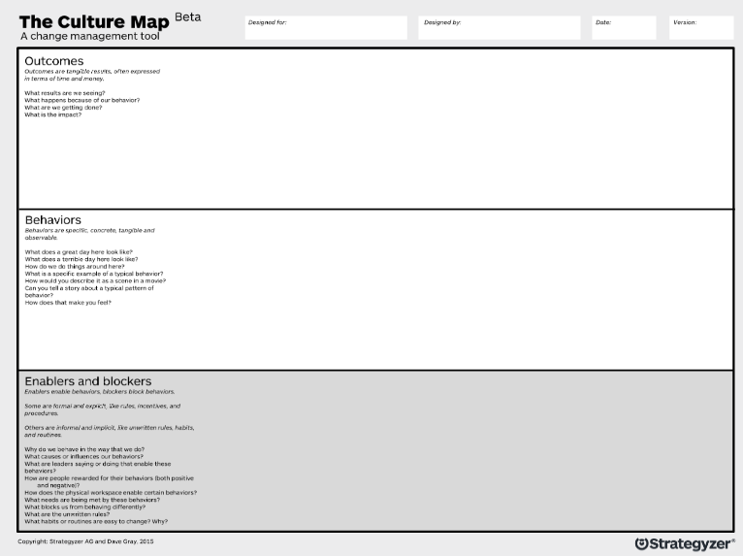

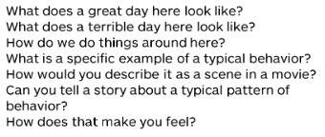
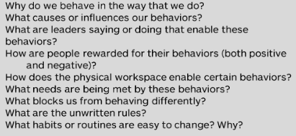
BAs in
digital CULTURE
helping with …

Slide 31

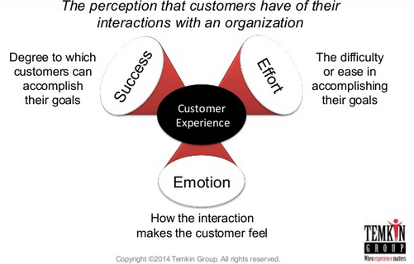

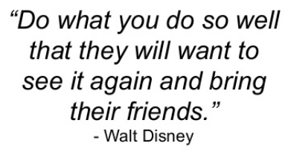
What is CX – Customer eXperience
Notes:
UVOD: film CX,
Kdo je v resnici primarna stranka kontrolinga? Ali je to še vedno vodstvo podjetja?

Slide 32

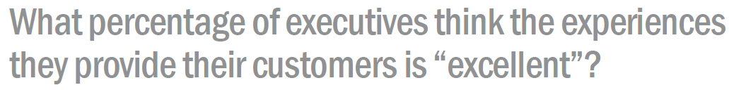
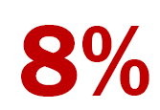
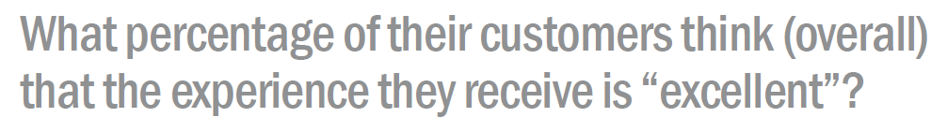
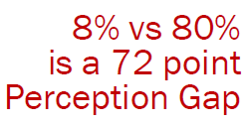
BAs in
need to work on this gap ….
This is the BAs opportunity!

Slide 33
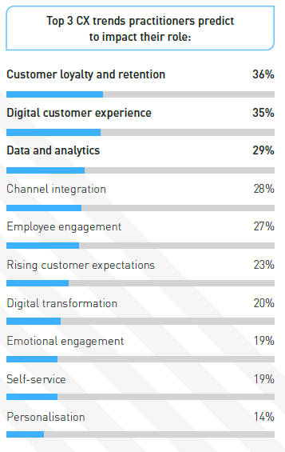
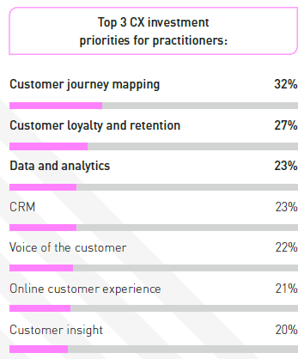


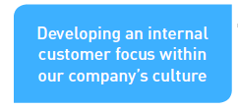
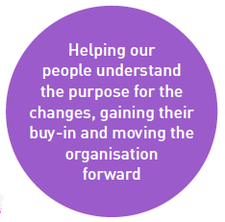


BAs in

Slide 34




… so the BA role in digital business is …
…primary to help executives to spread agile culture and to support digital business models innovation.
Besides this, BAs also help management to:
focus on CX and customer value proposition:
truly understand customers needs,
define the customer journey map and touchpoints,
help to change internal processes according to touchpoints and Cx;
match customer needs & CX with digital solutions:
design and validate digital solutions,
prepare digital projects
help to calculate the actual VALUE achieved.

Slide 35


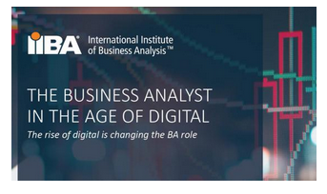

More about the BA role in digital business

Slide 36

Agenda
Warming up – Icebreaker
The future (is almost here)
The reality (check)
The House of Digital Business
Mind the gap
Closing

Slide 37


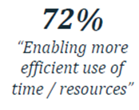
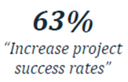


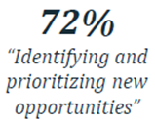
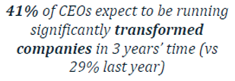
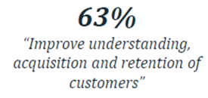

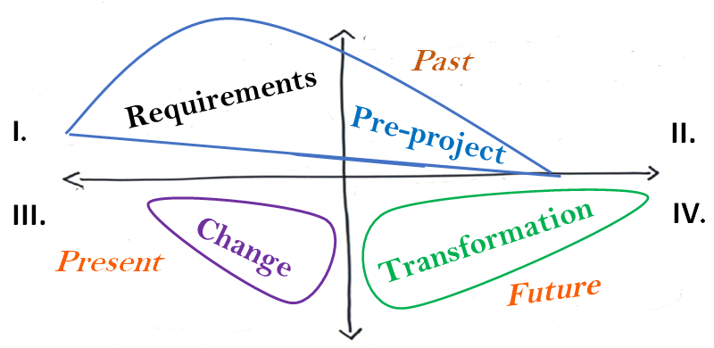
Our reality check
& BA value in the eyes of CEO
42 %
23 %
I.
II.
III.
IV.
24 %
11 %
Digital business

Slide 38


What we as BAs need to mind the gap?
New mindset and competencies.
Executives who understand the broader BA role.
Executive perspective as preamble to BABOK.
IIBA need to be recognize by corporates as business institute and their “Hand of the King”.
BA success stories – benefit realizations.
More BAs to come from business.
Notes:
You know Peter Drucker quatation: Culture eats strategy for breakfast. Digital culture eats strategy even before breakfat.

Slide 39

NEW mindset and competencies
New mindset:
Help me help you / not “I know, I’ll tell you”, “I have right”
Agile / not just waiting for tasks
Value for all / not just profit for our company
Help people to trust each other / not just elicitation their data
New competencies:
see the bigger picture and innovate (design thinking)
Empathy (personas, customer journey)
deep down discovering (needs) and help to design (solutions)
facilitation (IAF and IIBA are partners)
Notes:
You know Peter Drucker quatation: Culture eats strategy for breakfast. Digital culture eats strategy even before breakfat.

Slide 40
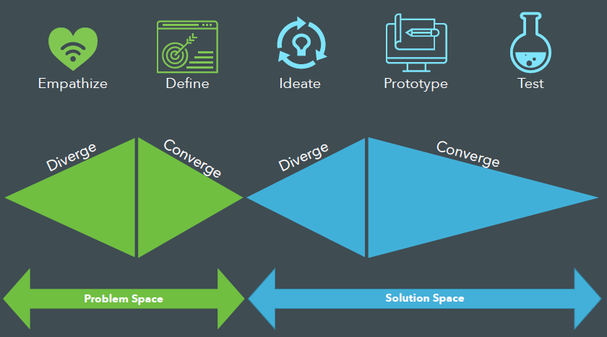
New competencies – e.g. Design thinking

Slide 41
Agenda
Warming up – Icebreaker
The future is (almost) here
The reality (check)
The House of Digital Business
Mind the gap
Closing

Slide 42
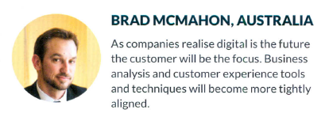

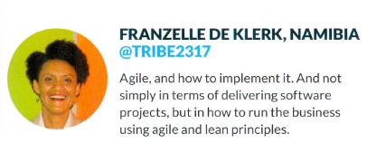
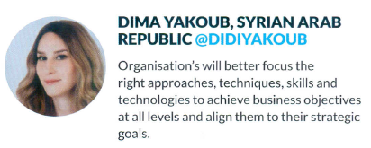
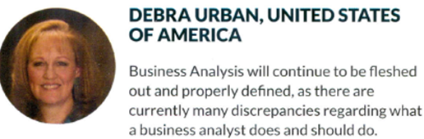
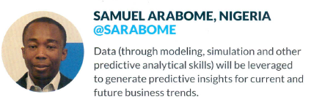
What do BAs predict about their future?

Slide 43


... and be sure ...

Slide 44


Adding value to business outcomes
Thanks for attention!
IIBA Slovenia & Digital42
Ales Stempihar, @AlesStempihar
president@slovenia.theiiba.org
go@digital42.biz

