Slide 1

Beyond Brainstorming: Creative Thinking Approaches for Business Analysts
www.linkedin.com/in/divnasimeunovic
www.linkedin.com/in/divnasimeunovic
Divna Simeunovic
Comtrade, Serbia
www.linkedin.com/in/divnasimeunovic

Slide 2
Many Faces of Creativity
Creativity =
Generating Ideas?
Viewing Things from Diferrent Angle?
Finding Solution for Wicked Problem?
Writing Poem?
Brainstorming?

Slide 3

Let’s Try to Define Creativity
Creativity is ability to create NEW:
Product
Service
Solution
Insight
…
The emphasis is on NEW.

Slide 4
Creativity vs Innovation
Implementation
Convergent
Thinking
4
Think
Plan
Do
Review
Prototype
3
Explore
Discover
Develop
Validate
Idea
Divergent
Thinking
2
Problem
1

Slide 5


Problem „Zone“
Problem is the king of creativity!
No Problem
No Creativity
And here is why

Slide 6




Theory Behind Creativity Wallis' model of the creative process
Problem
?
Preparation
Incubation
Illumination
Verification
Research
Gather information or data
See what has already been achieved in that field
Distancing from the problem
Background processing collected information
Suddenly coming accross connection
Light bulb
„Aha“ moment
Tresting
Trying to apply
See if it fits

Slide 7
Multiple Creativity „Levels“
Apply creative approach to everyday (small or big) challenges
Find solution for significant permanent problem
Be innovative

Slide 8
Problems with Problem
Problem Solving
You are assigned a task to solve specific problem
Problem is DEFINED.
Innovation
You are expected to propose something new.
Problem is:
not known or
not obvious or
not perceived as the problem
Innovation is more Challenging!

Slide 9




Creativity in Problem Zone
Observation (observe behaviour, spot problems)
Do not ask „Do you have any idea…“ – listen to „If I only could …“ instead
Pay attention to desires, unsatisfied needs, unsaid pains
Create situations in which you can observe, listen, tell stories
Use stories/personas

Slide 10

Going up to Idea Zone
Once we have found problem that:
Hasn’t been solved yet
We believe is worth solving
Is related to our area of expertise
Now, we are ready for IDEAS!

Slide 11
Creativity „Flow“
Implementation
Convergent
Thinking
4
Think
Plan
Do
Review
Prototype
3
Remove Obstacles
Improve Ideas
Generate Ideas
Explore
Discover
Develop
Validate
Idea
Divergent
Thinking
2
Problem
1

Slide 12
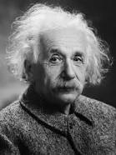
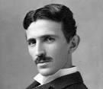

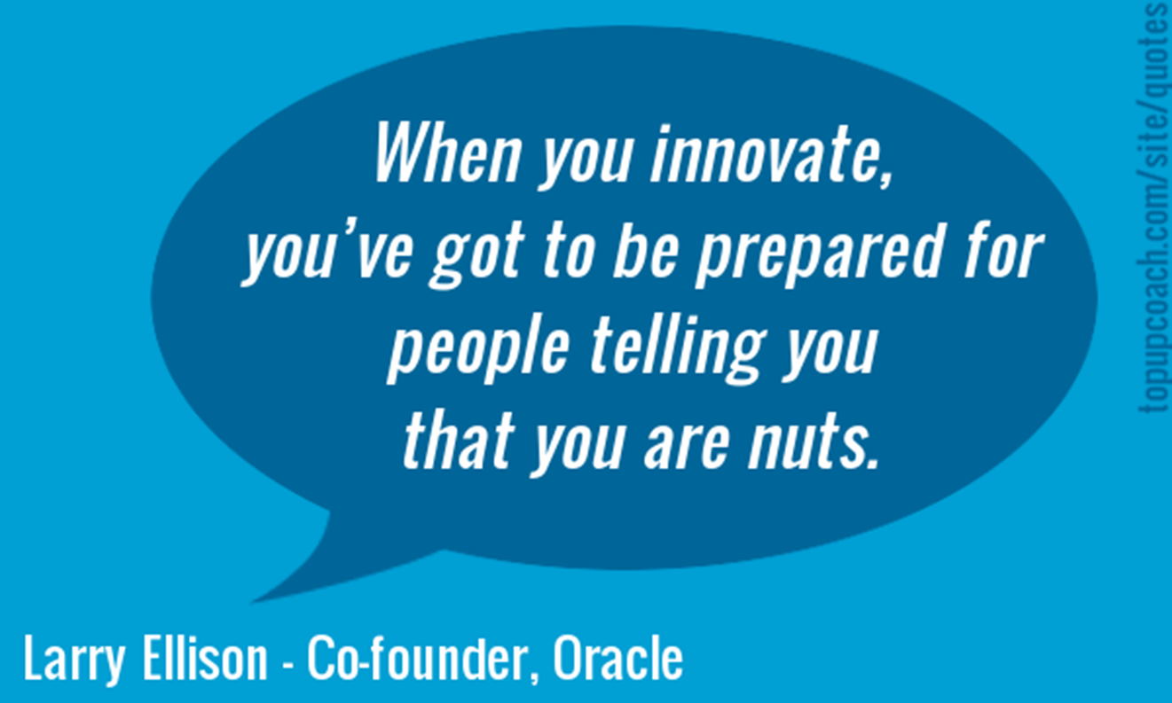
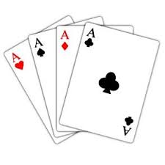
Some Ideas on Ideas
Q: What do you need to generate ideas?
A: In order to generate ideas, you need:
Lot of passion and little bit of opsession
Knowledge and information, up to date achievements
Strong desire to help
Strong self-confidence
A genius mind?
Imagination?
Good luck?

Slide 13
Ideas happen here
Problem
?
Preparation
Incubation
Illumination
Verification
Research
Gather information or data
See what has already been achieved in that field
Distancing from the problem
Background processing collected information
Suddenly coming accross connection
Light bulb
„Aha“ moment
Tresting
Trying to apply
See if it fits

Slide 14



From Incubation to Illumination
What can we do to shorten Incubation time?
Individual level - help your subconsciousness:
Distance from the topic for a while (distraction)
Do daydreaming
Try associative thinking
Find inspiration using your social contacts
Team level – exploit diversity:
Exchange
knowledge
collected information
research results
Remove inhbitions
Collaborative games
„Opposite“ game
Combine individul and team work.

Slide 15

Ideas typically do not come when you need them
Illumination happens suddenly - be prepared to write down any interesting thought that comes to your mind
While working on projects or everyday tasks, don’t let ideas diminish – make a break, and catch them
Watch for ideas
Project Actiivity
Watch for ideas
Everyday work
Watch for ideas
Chores

Slide 16
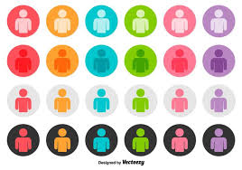
Brainstorming, or even better, brainwriting
Improved version of brainstorming – based on anonymous contribution to idea pool with possibility to be inspired by previously submitted ideas
Problem Statement
Idea 1
Idea 2
Idea 3
Person 1
Idea 1
Idea 2
Idea 3
Person 2
…
…
…
Person 3

Slide 17
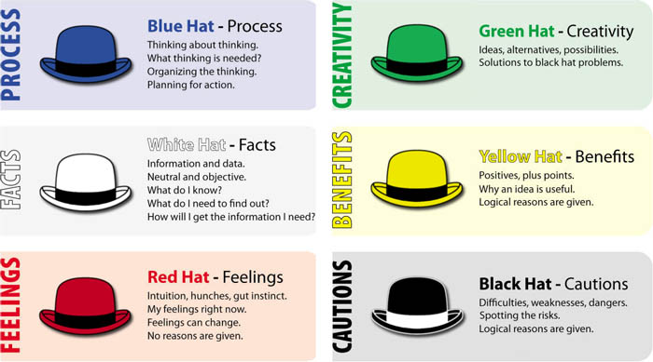
We need even radical ideas
don’t throw them away!
Example:
Implant chips under person’s skin so he/she be easily found by police in case of kidnapping.
Maybe proposed solution is not acceptable, but the problem may definitely go to the list of problems worth solving.
Use „Six Thinking Hats“ - it may be beneficial in multiple ways:
Evaluate ideas
Improve ideas
Generate new ideas
Rephrase problem that you are trying to solve

Slide 18
Some Creativity „Hints“
Knowledge is important for creativity
Multidisciplinary people are more creative
Sometimes concepts from one field may be applied to another
Combine and connect various ideas
Don’t let ambiguity or lack of information discourage you
Sometimes is helpful to create information layers and to handle them separately

Slide 19
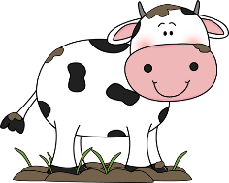
Combine two ideas - example
The Challenge: Propose a business case in which you use „cow“
Idea 1 (submitted by Team 1):
Web portal that will connect producers and consumers of organic food
Problems:
Could not explain how they will gurantee that food is organic
Idea 2 (submitted by Team 2):
Anti-stress farm – people spend their holidays working on the farm which is supposed to have therapeutical effect
Problems:
Could not convince anyone that anybody will pay to work on the farm
Combined idea:
Let’s build the community of people interested in consuming organic food who agree to spend a week (once a year) on the farm supervising food production.
Food production will always be under supervision of those who will consume it, which is guarantee that the food is organic.

Slide 20
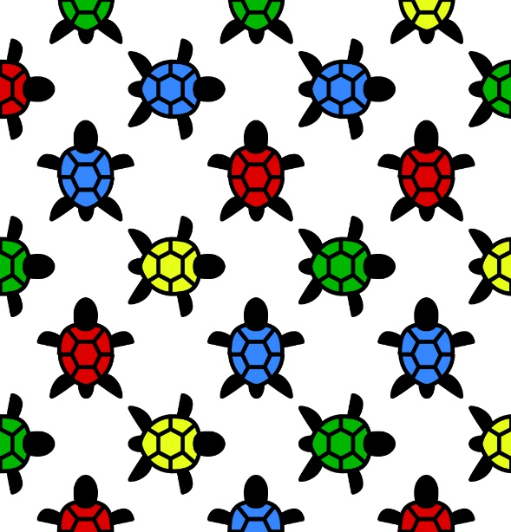
Let’s solve Head-Tails Puzzle together

Slide 21
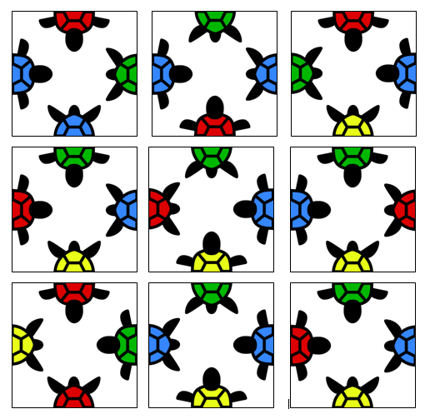
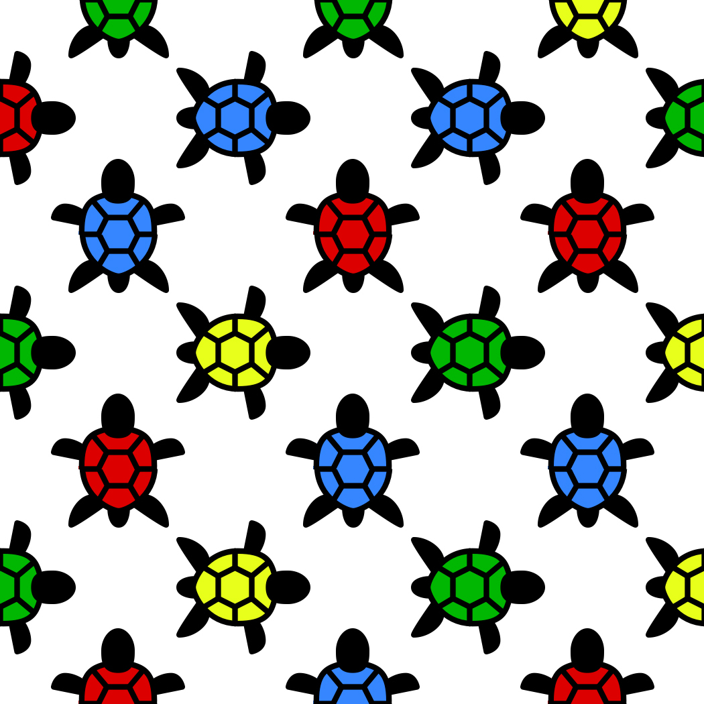

Head-Tails Puzzle
Board consists of 9 tiles. Game objective:
match turtles' heads with their tails in respective colors.
TAIL
HEAD

Slide 22

Head – Tails Puzzle
Tail
Head

Slide 23
We need here a blue tail
?
?
?
There are FIVE possibiilties -
too many for guessing!
?
?

Slide 24
New Insight
T
T
T
H
T
H
T
H
T
H
H
H
T
T
T
H
T
H
T
H
T
H
H
H
T
T
T
H
T
H
T
H
T
H
H
H

Slide 25
We need here a blue tail
THHT
THHT
?
?
THHT
TTHH
?
T
H
T
?
?
H
TTHH
TTHH

Slide 26
Head – Tails Puzzle Solved

Slide 27

Thanks for attention
Divna Simeunovic
Comtrade, Serbia
www.linkedin.com/in/divnasimeunovic

