Slide 1

ENDING the ICE AGE
Business Analyst’s Role in
Digital Transformation of Legacy Software
Irina MINOIU, CBAP, PMP, MBA
President IIBA Romania Chapter
Notes:
Hello,
Happy for the opportunity to be present at this conference.
How many of you know IIBA?
IIBA is the International Institute of Business Analysis. Started 15 years ago and its goal is to
We are where we are today, almost taking electricity and 4G communication for granted, because along the ages there was the “The NEED”

Slide 2

Notes:
The NEED of the day in a good number of experienced companies is the “digitalization”, that is going from software solutions that were great decades ago, that are robust and still doing their job to better and updated solutions, in line with today technology.
“Digitalize” is the buzz-word. Digitalize-your-self or you will become extinct as a business.

Slide 3


Notes:
But you are a mammoth, with heavy IT systems, processes that developed (for better or worse) as the business grew.
You just can not put all on hold and build from scratch a new IT system. Your existing system needs to be maintained and the sales, marketing might need new features to be added so that you can stay in business,
You need to become step by step a flock of birds, agile and adaptive.
It is a story I am currently leaving, a story of transforming a mammoth in a flock of birds.

Slide 4





BENEF-YOU
60 years on the market
Service company: rewards and benefits for employees
Product types:
      - gift boxes
      - paper gift vouchers
      - gift cards
      - digital gift cards (new)
      Business partners:
      Clients = companies buying gift solutions for employees and business partners
      Users = persons receiving and using the gifts solutions
      Suppliers = shops, service providers
Notes:
BENEF-YOU is a company with a 60 years history, present in more that 50 countries around the world
Its business: help other companies, its clients. offer rewards and benefits packages to employees and business partners,
The rewards and benefits they are capable to offer differ form one country to another and have various forms: personalized gift boxes, paper gift vouchers, gift cards, digital gift cards.
How the business go?
First are the clients: the companies acquiring the “gift solutions” solutions. Afterwards come the users, people enjoying the different gifts solutions
BENEF-YOU is a facilitator. The gift solutions are built toghether with suppliers. And there is a diversity of suppliers from travel agencies, shops, restaurants, gyms to theatres and trainers.

Slide 5





BENEF-YOU’s Business Model
Customers
BENEF-YOU
Users
Suppliers
Notes:
Together with the suppliers, BENEF-YOU is building a gift solutions
The customers are purchasing the gift solutions for theirs partners and employees, that is the users.
Users, receiving the gift solutions, are just enjoying them at the supplier. Travelling, eating or attending a course. And, of course, shopping!

Slide 6
BENF-YOU’s achievement:
seamlessly transform its legacy software
attract new customer segment
easy to configure digital gift solutions
Notes:
BENEF-YOU is not an IT company, but relays heavily on IT.
Thinking the right things right they managed to:
seamlessly transform its legacy software
attract new customer segment
easy to configure digital gift solutions
s

Slide 7

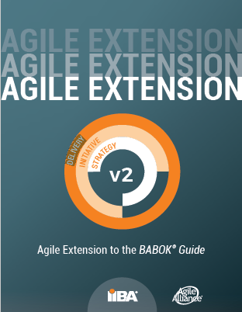
Strategy
Initiative
Delivery
Notes:
How?
The key of the achievement
Business Analysis done at right at each level of the enterprise.
The BA needs to be performed at all the floors between the C-level and operation level.
The tools, techniques and approach to BA is adapted to the specificities of each level and the info needs to be communicated and integrated between the levels.
IIBA came with a guide-line for performing BA at top-down ← → bottom-up in a enterprise (Agile Extension of the BABOK):
C-level – setting the strategy
Product managers – conducting the initiatives issued from the strategy
Initiatives coming alive at delivery…and as the pieces are added to the envisioned product of the imitative the questions “does it bring value?”, “is what we need”, “should we continue”? Are asked, information circulates up and down and everyone understands the global strategy and hers/ his contribution.
It is the BA at the different levels that makes sure the questions are asked, information circulates.

Slide 8

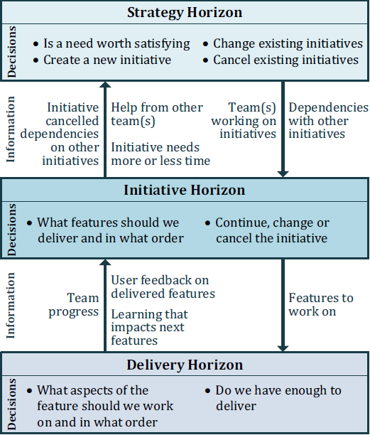
Notes:
Quick zoom-in on BABOK
Different Bas with different skills, knowledge and tasks (job descriptions) present at every horizon of the initiative
Strategy: what makes sense and money to do? What need, opportunity identified is worth satisfying? Should we continue doing what we are doing? Should we allocate the existing resources to something else?
Initiative: here are the application owners, the product managers. They translate the strategy in initiatives and check, feature by feature, if the initiative is going in line with the strategy if the right value is added, Is up to them, most of the time, to put the initiative back on track of to say “IT HAS TO STOP”. They integrate the info from the delivery and from strategy. They make sure that C-level knows about the advancements and the colleagues from the implementation levels know how their work contribute and brings value.
At delivery are the cross-functional, self-managed agile teams working with the demos, backlogs, reviews and retrospectives. The

Slide 9


Notes:
An enterprise is a complex mechanism and the agile most talked about (SCRUM, KANBAN) represent the building blocks

Slide 10
BENEF-YOU’s ECOSYSTEM
Notes:
Zooming-out and coming back to BENEF-YOU which is not alone .
There are internal and external forces and factors influencing. These factors are the starting points in its journey from mammoth to agile flock of birds

Slide 11

BENEF-YOU’s ECOSYSTEM
          Opportunities:
          New friendly technologies
          Target Small-Medium-Enterprise clients
          Threats:
          Digital, less differentiable products
          Lower entry barriers
Strategy
Initiative
Strengths
Innovative spirit
Strong market position
Weakness
Legacy software
Heavy operational flows
Delivery
Notes:
..starting simply with a SWOT - with the opportunities, threats, strengths and weakness – of course at the strategic level, with a strategist BA
Must take advantage of the new technologies become easier to access : are friendly and are the gate-way to a new pool of customers – the small companies
But the life can get easier for the rest of the market: technology is putting lowering the entry barriers and the products are less differentiable
On theirs side is the “innovative” spirit that never left them and a strong leading market position – especially the trust of the customers and not to mention the power of investment
On the other part of the balance is the legacy software and the operational flows that got heavier with the years by adding functionalities and products needed to keep up with the market.

Slide 12
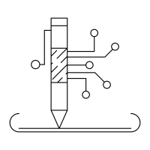
BENEF-YOU’s Business ECOSYSTEM “AS IS”
      Clients
      Company size
      Industry
      Relation with technology
      Ordering pattern
      Customer journey
      Tools
      Benchmarking
      SWOT
      BCG matrix
      Personas
      Data analysis
      Surveys
      Focus groups
Strategy
      Users
      Geographic areas
      Type of jobs
      Age
      Relation with technology
      User experience
Initiative
Delivery
      Suppliers
      Industry
      Size
      Relation with technology
Notes:
Remaining at the strategic level and going deeper in understanding the eco-system:
Three axis of analysis – corresponding to the business partners: clients, users, suppliers. One metric common to all the partners – the relation with the technology as the opportunity states ”new friendly technologies”. The rest are “classic”.
Tools used – nothing “fancy”, just good, reliable ones. A tool is as good as you know to use it.

Slide 13
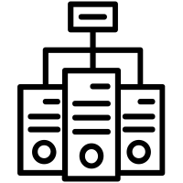



BENEF-YOU’s IT ECOSYSTEM “AS IS”
Strategy
Initiative
Delivery
Notes:
The business analyst should be “T”- shaped – that is to know very well a domain and have enough knowledge about the conexe domains, areas
The strategic BA should understand the systems and operations flows of the entropies, including the IT system. Just in enough detail to allow her/him to propose relevant and pertinent solutions.
Directly interacting with the clients placing orders trough email and a light web-portal
Heavily interconnected with the IT system of the suppliers (remainder: together with the suppliers are built the gift solutions)

Slide 14

BENEF-YOU “AS IS” results
1. “45%” customers
- have >100 employees
- bulk orders, regular intervals
- no diversity in the orders
2. Ordering methods equally splinted between email and web
3. Partial insight on how users are using the gifts
4. Core application
- Data model permits flexibility in product design
- Granular data
5. Web development needed when a new product is defined
6. Implementations specific to each supplier interface
7. New technologies lower the market entering barriers
8. Targeting SMEs could increase market share bay “35%”
Strategy
Initiative
Delivery
Notes:
Note: “All % are for presentation purpose”

Slide 15

BENEF-YOU: Defining strategy
(A) In 2 years SMEs represent “45%” of customers
(B) In 2 years increase by 150% the suppliers
(C) In 2 years 60% of products to be services
Strategy
Increase operational work and cost per order
Increased interface complexity
(D) GDPR compliant
Initiative
Delivery
(1) 7 clicks to self-register and place order for a new SME
(2) Plug & Play integration of new suppliers
(3) Client and User access to theirs data
(4) Decommission the legacy software
Notes:
Strategy translate in objectives. Objectives are measurable and time-bounded.
There should be a project, development initiative, to fulfill the objective.
The strategic BA does not longer work “alone”. It works together with the BAs in the “initiative” level, converting business objectives in “hands-on” projects
The components of the strategy: increase SMEs segment, increase suppliers and dematerialize the products.
Having all this in place with the current “AS IS” IT system and processes would not be feasible because will icrease the operational work load and complexity of interfaces with the suppliers
The “new” systems should be added…to respond to strategy; a more intuitive portal (more means less, that is only 7 clicks); to differentiate the products (services and significantly increase the number of suppliers) it is needed a capability that allows the immediate integration with external – the plug and play integration
GDPR is about transparency and trust! Let the customer and users know what you know about them and why you know!
The Initiative BAs have clear enough definitions on what needed to start defining the scope of the projects that will fulfill the business objectives
4 business objectives translate in 4 initiatives.
The 4th initiative, dealing with the legacy system is transversal : than is – each initiative (IT architecture behind the initiative) needs to integrate it.

Slide 16

BENEF-YOU: Defining Initiatives
(1) New customer portal and data referential - IMMEDIATE
- Phase 1: dedicated to SMEs
- Phase 2: migrate existing clients to new portal
- (A) & (D) & (1)
(2) Suppliers APIs – 1.5 Years
Phase 1: APIs to be uses by new suppliers
Phase 2: migrate all existing suppliers’ interfaces to the APIs
(B) & (C) & (2)
Strategy
Initiative
(3) Core application – 3 Years
Replicate business logic of core application to API’s and portal
Replicate data of core application in data referential
Discontinue core application
(4)
Delivery
Guidelines
Core application DB remains the data referential until the new solutions are complete-enough and stable
Only necessary data will be transferred in the new referential
Notes:
…and it the BA at the Initiative horizon have enough technologic knowledge to describe in the developer language
Traceability is Ariadna’s thread – each initiative need to be reflected in the strategy and business objective,
Prioritization comes also from the technical constraints, technical and business quick wins and the available resources.
Zooming in on the first initiative

Slide 17

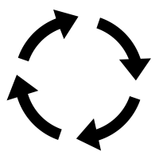

BENEF-YOU: New Portal “Click-BENEF”
(1) New customer portal and Data referential
- Phase 1: dedicated to SMEs
- Phase 2: migrate existing clients to new portal
Business approach to client migration to new portal:
All new SMEs
Existing SMEs using email ordering
Existing SMEs using on-line ordering
New big customers
Existing big customers using email ordering
Existing big customers using on-line ordering
Strategy
Initiative
Delivery
Portal features prioritized
For each migration wave business definition for:
Personas
Customer journey (features)
Value of each feature
Notes:
The delivery team comes into picture…and needs to know how to prioritize the backlog, what to put in the sprint, on what grounds to add to the sprint
Business guidelines – the order of migrating the clients – reason mitigate the risk of creating issues with the existing clients – and it is also technological safe - test small before going big ➔ big deployment phases
The business know the customers and what is relevant for each client segment and on how they interact with technology
The delivery team are agile cross functional teams, integrating the business. So we have personas, customer journey and value of each feature. The value reflects at the strategic level
The priorities need to be kept in line with the realities of the market and technology…realities that evolve each day… the backlog items need to be continuously reviewed

Slide 18


CLIK-BENEF: Features prioritized
Register customer
Create order
Manage customer and order in core app
Customers migration to CLICK-BENEF
Portal features prioritized
Strategy
Replicate to CLICK-BENF order history
Manage customer in CLIKC_BENF (self-manage)
Initiative
Suppliers APIs
Delivery
Manage order in CLICK-BENEF
Users access to CLICK-BENF to see the gifts
Notes:
Putting it all together the order of delivery is:
And as each element is delivered – check the value – up to the strategic level = is still of interest? Is still in line with the eco-system and strategy.
…and…is the strategy still the right one
We talk about continuous delivery…it exists only with continuous analysis and information integration at all the levels of the enterprise
find the suitable way to envolve and make the key parties be present at the demo
Put them in the first line to test

Slide 19
CLIK-BENEF’s Delivery approach
  3 wk sprints, new MVP every 6 wk
Design 2 sprints ahead
MVP’s features corresponding to the characteristics of each migration wave
UX around personas
Validate new features with friend clients
Light interface with core application for the 1st client wave
Portal features prioritized
Strategy
Initiative
Delivery
Notes:
Looking further to the way the team worked and decide on what to work

Slide 20

BA = vehicle of change
BA = value manager
BA = communicator
BA = information integrator
BA role adapts to each phase of initiative
BA role adapts to the enterprise architecture
BA should be present at each organization level
Notes:
Of change we are certain…and it will be boring-nice to have the change in an controlled, smooth environment.

Slide 21

Notes:
Of change we are certain…and it will be boring-nice to have the change in an controlled, smooth environment.

Slide 22


Notes:
Of change we are certain…and it will be boring-nice to have the change in an controlled, smooth environment.

