Slide 1
Business Architecture Essentials
Roger T. Burlton, P.Eng. , CMC
+1-604-240-5436
Roger.burlton@processrenewal.com
Twitter: @RogerBurlton
www.processrenewal.com
Notes:
Hello, my name is... this class is...
Housekeeping information: bathroom locations, cell phones, etc.

Slide 2
Notice of Confidentiality
All materials provided in this session are copyrighted by Process Renewal Group.
The materials must not be copied, duplicated, or reproduced in any manner, or transmitted to others without the written consent of Process Renewal Group.
Roger Burlton
President and Managing Partner
Process Renewal Group
Suite 305, 125 Milross Ave
Vancouver, BC V6A 0A1
Phone: +1-604-240-5436
Roger.burlton@processrenewal.com
www.processrenewal.com

Slide 3
AGENDA
Why Business Architecture
Main concepts
Approach to build Business Architecture
A set of starting principles
S

Slide 4
Business Architecture *
Business Architecture is the structured description of the concepts and facts relevant to designing, planning, analysing, operating, changing, managing a business.
The goal of Business Architecture is ultimately to identify non-redundant, reusable resources to be able to execute the business strategy.
* According to Burlton, Ross, Zachman
R

Slide 5
Discussion 1
What domains of Business Architecture would be relevant to your organization ?
How are they connected to other domains?
R

Slide 6









There are many possible Domains of a Business Architecture
Stakeholder Expectations
Business Transformation
Business Sustainability
Strategic
Framing
Business Performance
Change
Program
Strategic
Intent
Business Processes
Business Decisions
Transformation Roadmap
Business
Results
Process-Centric Management
Business Ecosystem
Business Information
Business Rules
Continuous Improvement
Business Capabilities
Change Priorities
S

Slide 7
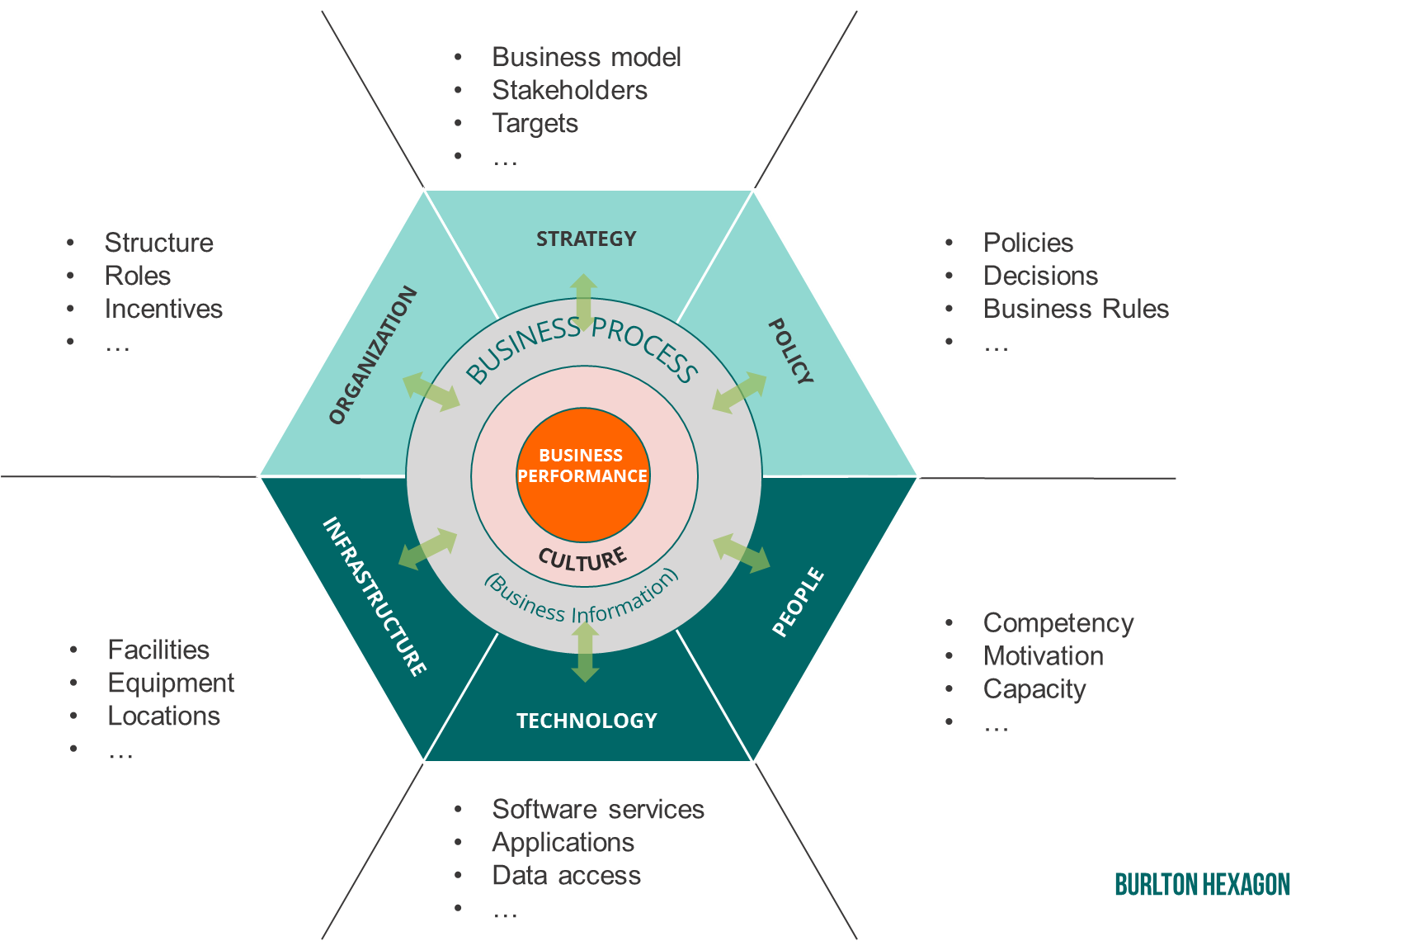
Business Architecture: Business Solutions Require Alignment
A Strategic Capability brings together a number of supporting resources to deliver intended value results
R

Slide 8
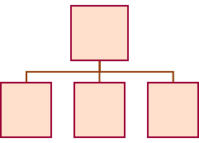


Approach to build Business architecture
Strategic Context
Business Design
Business Change
Business Operations
Business Ecosystem
Strategic
Framing
Business Capabilities
Business Performance
Change Priorities
Change
Roadmap
End to End Management
Business Sustainability
1
2
3
Strategic
Intent
Strategic
Requirements
Business Processes
Business Information
Resource Requirements
Resource Transformation
Continuous Improvement
Business
Results
S
Notes:
Development of the Business Architecture requires professional practices, this is our approach to that. At PRG we take the following approach to building Business Architecture…. <explain the landscape>

Slide 9





Stakeholders Item exchanges with the Value Chain, Stream or Process
Know your business
Reports
Penalties
Product
Invoice
Regulator
Customer
Regulations
Certification
Order request
Payment
Supplies
Invoice
Job
Pay
Supplier
Staff
Ideas
Investment
$
Reports
P.O.
Payment
Job Appl.
Time
Owner

Slide 10
Stakeholder Value attributes: Who Cares?
There must be a relevant stakeholder
All aspects are potentially important
Exchanged Items
Expected Outcomes
Experience
Some aspects could predominate
Full value comes from full realization

Slide 11
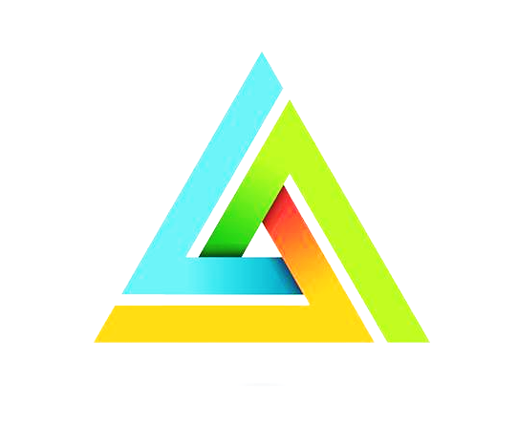

The North Star: Integration of stakeholder value and KPIs
Value criteria before decisions – always!
Notes:
20.Must understand both needs – the delivery of output results and expectations of how service will be provided.

Slide 12
Approach to build Business architecture
Strategic Context
Business Design
Business Change
Business Operations
Business Ecosystem
Strategic
Framing
Business Capabilities
Business Performance
Change Priorities
Change
Roadmap
End to End Management
Business Sustainability
1
2
3
Strategic
Intent
Strategic
Requirements
Business Processes
Business Information
Resource Requirements
Resource Transformation
Continuous Improvement
Business
Results
R
Notes:
Development of the Business Architecture requires professional practices, this is our approach to that. At PRG we take the following approach to building Business Architecture…. <explain the landscape>

Slide 13
Discovering Key Concepts *
Small sample involving Stakeholders: Consumer, Regulator and Partner
Financial Transaction
provides authorization for
Regulator
Order
provides
places
Partner
Regulation
Consumer
agrees to
constrains
commits to
Partnership Agreement
Financial
Service
FS Agreement
prices
Is given for
is relevant for
* Basis for Information, Processes, Capabilities, Rules, KPIs
R

Slide 14

Exercise 2: Workshop
Develop a Concept Model for a pub you just acquired:
Discover 5 business concepts
Define 1 term
Guidelines
Stick to the core concepts related to providing customer services
Avoid concepts not directly related to the core for now
Notes:
Use post its – make sure Jeremy has them handy along with flip charts and good pens as well as tables

Slide 15
Approach to build Business architecture
Strategic Context
Business Design
Business Change
Business Operations
Business Ecosystem
Strategic
Framing
Business Capabilities
Business Performance
Change Priorities
Change
Roadmap
End to End Management
Business Sustainability
1
2
3
Strategic
Intent
Strategic
Requirements
Business Processes
Business Information
Resource Requirements
Resource Transformation
Continuous Improvement
Business
Results
R
Notes:
Development of the Business Architecture requires professional practices, this is our approach to that. At PRG we take the following approach to building Business Architecture…. <explain the landscape>

Slide 16

A Business Process: About work that transforms and is of value
A Process
Outcomes of Stakeholder Value
Stakeholder Expectations
Input
Output
A business process describes the work of an organization
The work performed in a business process transforms physical or informational inputs into outputs
The work performed must create value by satisfying stakeholder expectations (needs and experiences)
English: * http://www.bptrends.com/bpmmanifesto.cfm
S
Notes:
Do a simple 1 activity model for your process of getting your coffee
3-4 inputs and 3-4 outputs
6 minutes

Slide 17
Architecture Scope, Value Chains and Streams
Value Chain
A value chain defines all of the work required to conceive, plan, market, sell, deliver, optimize and manage a set of products or services that satisfy a given set of customers.
All products or services servicing the same market are the result of a single value chain.
Value Stream
The value stream is an end-to-end set of value creating processes (activities) that create a result of value for a customer or other external stakeholder in response to a specific trigger.
Also can be named a high level process
Value streams provide a context for and are enabled by business capabilities

Slide 18
Process Architecture Decomposition Illustration
Create Guiding Value
Develop strategic plans
Enhance brand
Optimize Regulator relationship
Ensure regulatory compliance
Mitigate business risk
Protect intellectual property
Establish policies and rules
Gain Board direction
Budget & Control finances
Make Consumer Products and Services Available
Create Operating Value
Transact with Business Partners
Client markets
Provide Consumer Services
Create Enabling Value
Improve business processes
Provide information
Provide employees
Share knowledge
Provide facilities
Acquire & maintain equipment
Provide IT services
Oversee Tech Partners
Optimize supplier relationship
Provide supplies

Slide 19
Illustration of Process Lifecycle for a Customer Relationship Journey For ‘provide Consumer Services’ L1
A good Level 2 process is countable
Customer Process | Bank Business Process | State
 |  | Consumer Unaware
Recognize Company | Promote to Consumer Market | Customer Aware
Request Information | Inform Consumer | Customer Informed
Determine Interest | Qualify Consumer | Consumer Qualified
Agree to Services | Gain Agreement to Consumer Services | Consumer Order Accepted
Receive Consumer Services | Provide Consumer Services | Consumer Services Provided
Request Account Closure | Close Consumer Accounts | Consumer Account(s) Closed
Review Accounts | Report Accounts to Consumer | Consumer Account(s) Reported
Review Transactions | Prevent Consumer Losses | Consumer Losses Prevented
Settle Consumer Complaints and Claims | Settle Consumer Complaints and Claims | Consumer Complaints and Claims Settled
Evaluate Company Relationship | Evaluate Consumer Relationship | Consumer Relationship Evaluated
Terminate Company Relationship | Terminate Consumer Relationship | Consumer Relationship Terminated
Establishment Stage
Operations Stage
Re-assessment
Stage
S

Slide 20
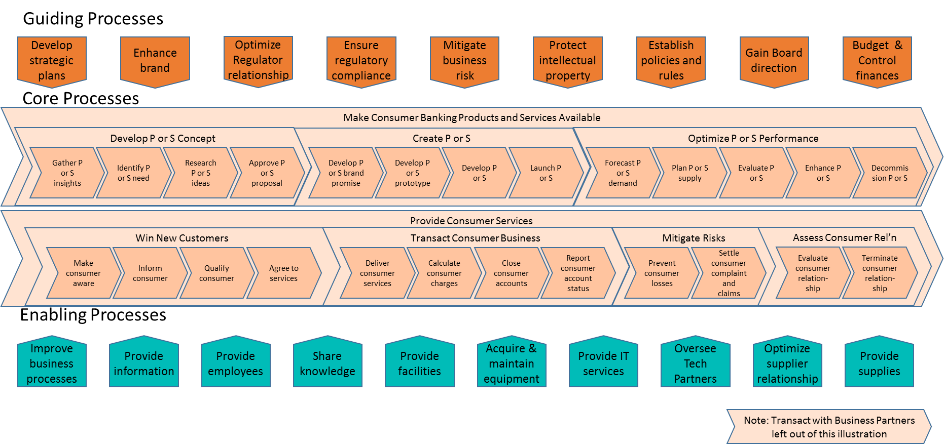
Process Architecture with Core at level 1 and 2 Consumer Financial Services Value Chain Process Architecture
R

Slide 21
Exercise 3: Workshop
Identify the processes and transition points in the journey of:
The Customer Relationship
Guidelines
Include all three stages, from unawareness through termination
Verb - noun please
Outcome oriented name
Try for no more than 10 processes
S
Notes:
Use post its – make sure Jeremy has them handy along with flip charts and good pens as well as tables

Slide 22
Approach to build Business architecture
Strategic Context
Business Design
Business Change
Business Operations
Business Ecosystem
Strategic
Framing
Business Capabilities
Business Performance
Change Priorities
Change
Roadmap
End to End Management
Business Sustainability
1
2
3
Strategic
Intent
Strategic
Requirements
Business Processes
Business Information
Resource Requirements
Resource Transformation
Continuous Improvement
Business
Results
R
Notes:
Development of the Business Architecture requires professional practices, this is our approach to that. At PRG we take the following approach to building Business Architecture…. <explain the landscape>

Slide 23
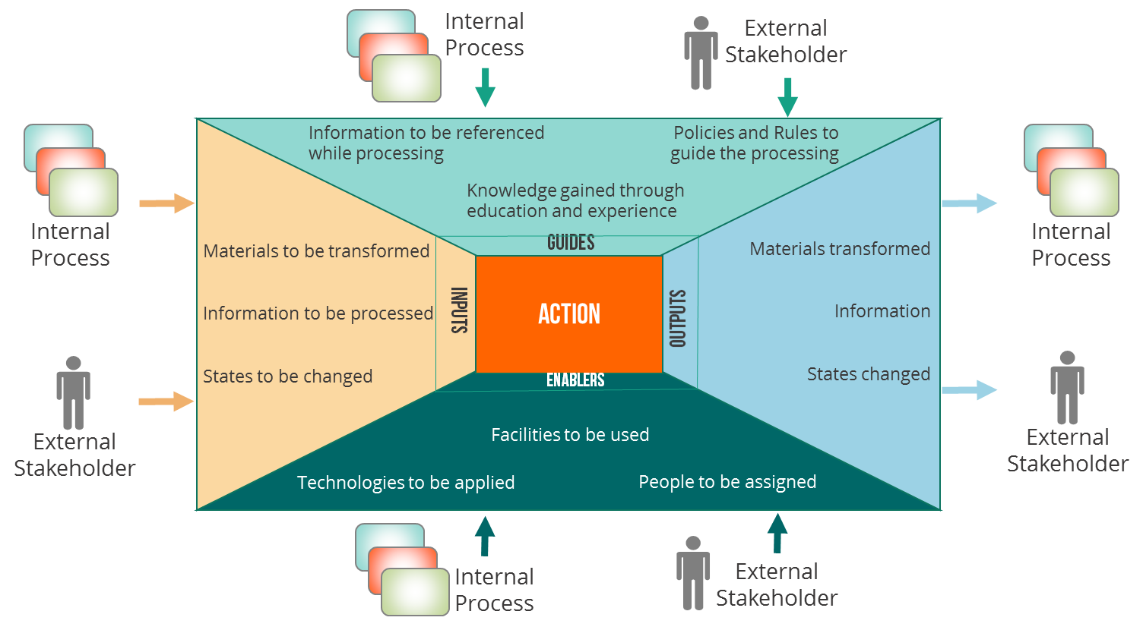
Main Value-Defining Business Architecture Artifacts
As per discussions in the Business Architecture Guild’s BA and BPM Working Group
Shared Value Structure
Organization or Value Chain (Architecture Scope)
BP / Value Stream 1
BP / VS Stage 1.1
Decomposed Processes
Capabilities
Derived
BP 1.1.1
Capabilities required
BP 1.1.1.n.n
Processes enabled
Resource
Models

Slide 24
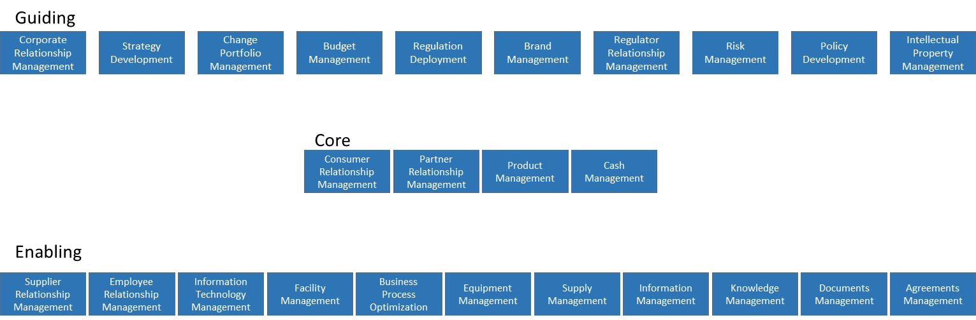
Capabilities are structured around Business concepts
The top levels of a business process architecture can look a lot like a top level capability map if both are value oriented and not functionally or organizationally motivated
R

Slide 25
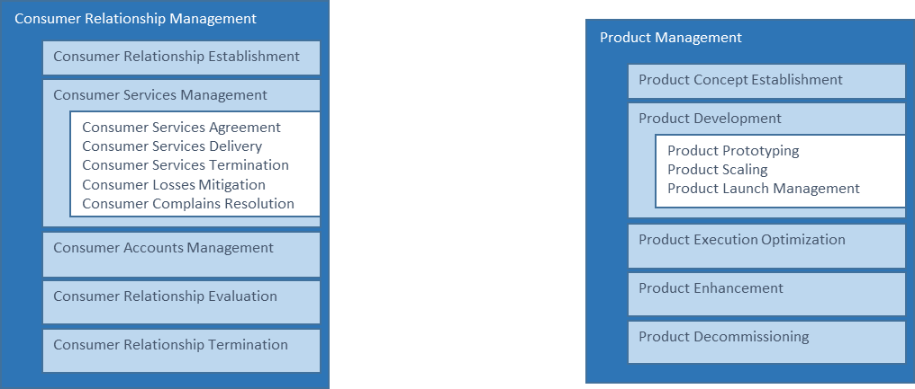
Determining the components of a capability
The components of any capability are also capabilities – just more fine grained and more likely to be used in multiple processes
R

Slide 26
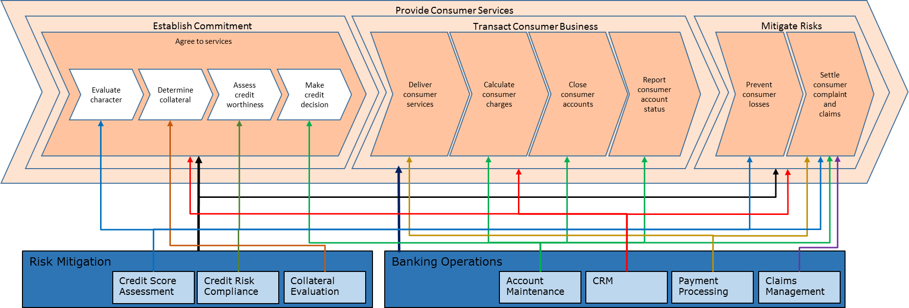
Value Chain and Lower Level Non-Redundant Capabilities
The real value of a good Capability map is to expose and be able to subscribe to non-redundant capabilities and services that will support multiple processes.
Remember the CSF technique:
‘In order to deliver the required outcomes and performance of the value processes, it is critical that we are capable of …’
Value Process (subset only)
Capability (subset only)
Notes:
26

Slide 27
Exercise 4: Workshop
For one of the processes in your L2 architecture determine some capabilities required
Identify any possible shared capabilities that may be required for other processes
Guidelines
Use capability noun phrases
S
Notes:
Use post its – make sure Jeremy has them handy along with flip charts and good pens as well as tables

Slide 28
Approach to build Business architecture
Strategic Context
Business Design
Business Change
Business Operations
Business Ecosystem
Strategic
Framing
Business Capabilities
Business Performance
Change Priorities
Change
Roadmap
End to End Management
Business Sustainability
1
2
3
Strategic
Intent
Strategic
Requirements
Business Processes
Business Information
Resource Requirements
Resource Transformation
Continuous Improvement
Business
Results
R
Notes:
Development of the Business Architecture requires professional practices, this is our approach to that. At PRG we take the following approach to building Business Architecture…. <explain the landscape>

Slide 29
Measurement is Uniquely Tied to Stakeholders and Process Value
Agility
Effectiveness
Quality
Efficiency

Slide 30
Approach to build Business architecture
Strategic Context
Business Design
Business Change
Business Operations
Business Ecosystem
Strategic
Framing
Business Capabilities
Business Performance
Change Priorities
Change
Roadmap
End to End Management
Business Sustainability
1
2
3
Strategic
Intent
Strategic
Requirements
Business Processes
Business Information
Resource Requirements
Resource Transformation
Continuous Improvement
Business
Results
R
Notes:
Development of the Business Architecture requires professional practices, this is our approach to that. At PRG we take the following approach to building Business Architecture…. <explain the landscape>

Slide 31

Invest in Value: Heatmaps that will Make a Difference
Stakeholder Expectations
Business Performance
Business Information
Candidates
Most Lacking in Performance
Business Processes
Business Capabilities
Strategic
Intent
Most Relevant for Value Achievement
Strategic
Framing

Slide 32
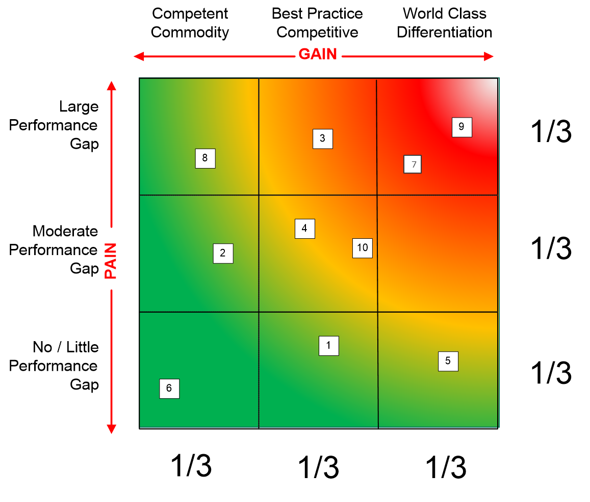
Prioritize Processes: Pain-Gain Triage (Nine Block)
Invest in what’s both strategic and potentially broken
Process Gain
World Class will set us apart from others
Best Practice provides no value in being better than others BUT is noticed if it is worse
Competent means that getting by somehow and doing it the hard way is OK
Process Pain
Bottom third (smallest gap)?
Middle?
Top (largest gap)?
R
Notes:
ADD THAT THE CRITERIA MUST BE ESTABLISHED FIRST – AGAINST THE STRATEGIC INTENT AND ESPECIALLY THE VALUE PROPOSITION
- Water the flowers

Slide 33
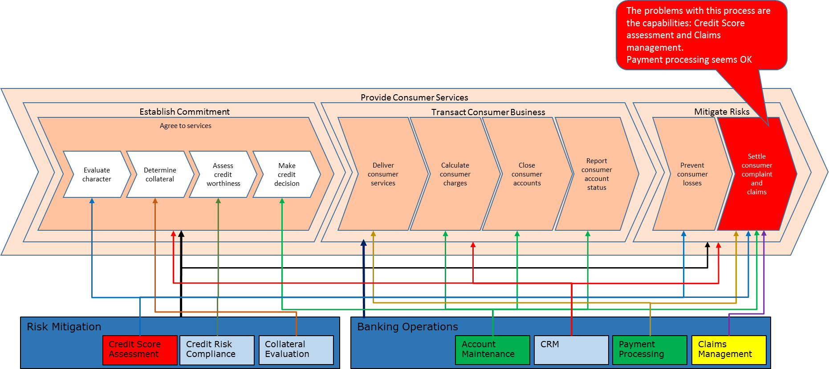
What Kinds of Process and Capability Projects are you Faced with?
Fan out from processes to the capabilities
A process improvement priority does not tell you which capabilities are an issue.
Some will be OK and others a real problem.
Process
Capability
R

Slide 34
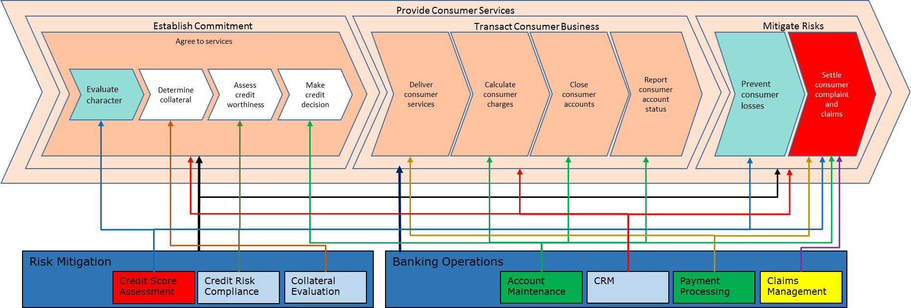
What Kinds of Process and Capability Projects are you Faced with?
Fan out from capabilities to the processes
A process improvement priority does not tell you which capabilities are an issue.
Some will be OK and others a real problem.
But changing Credit score assessment will potentially affect other processes that use that capability
Capability
R

Slide 35
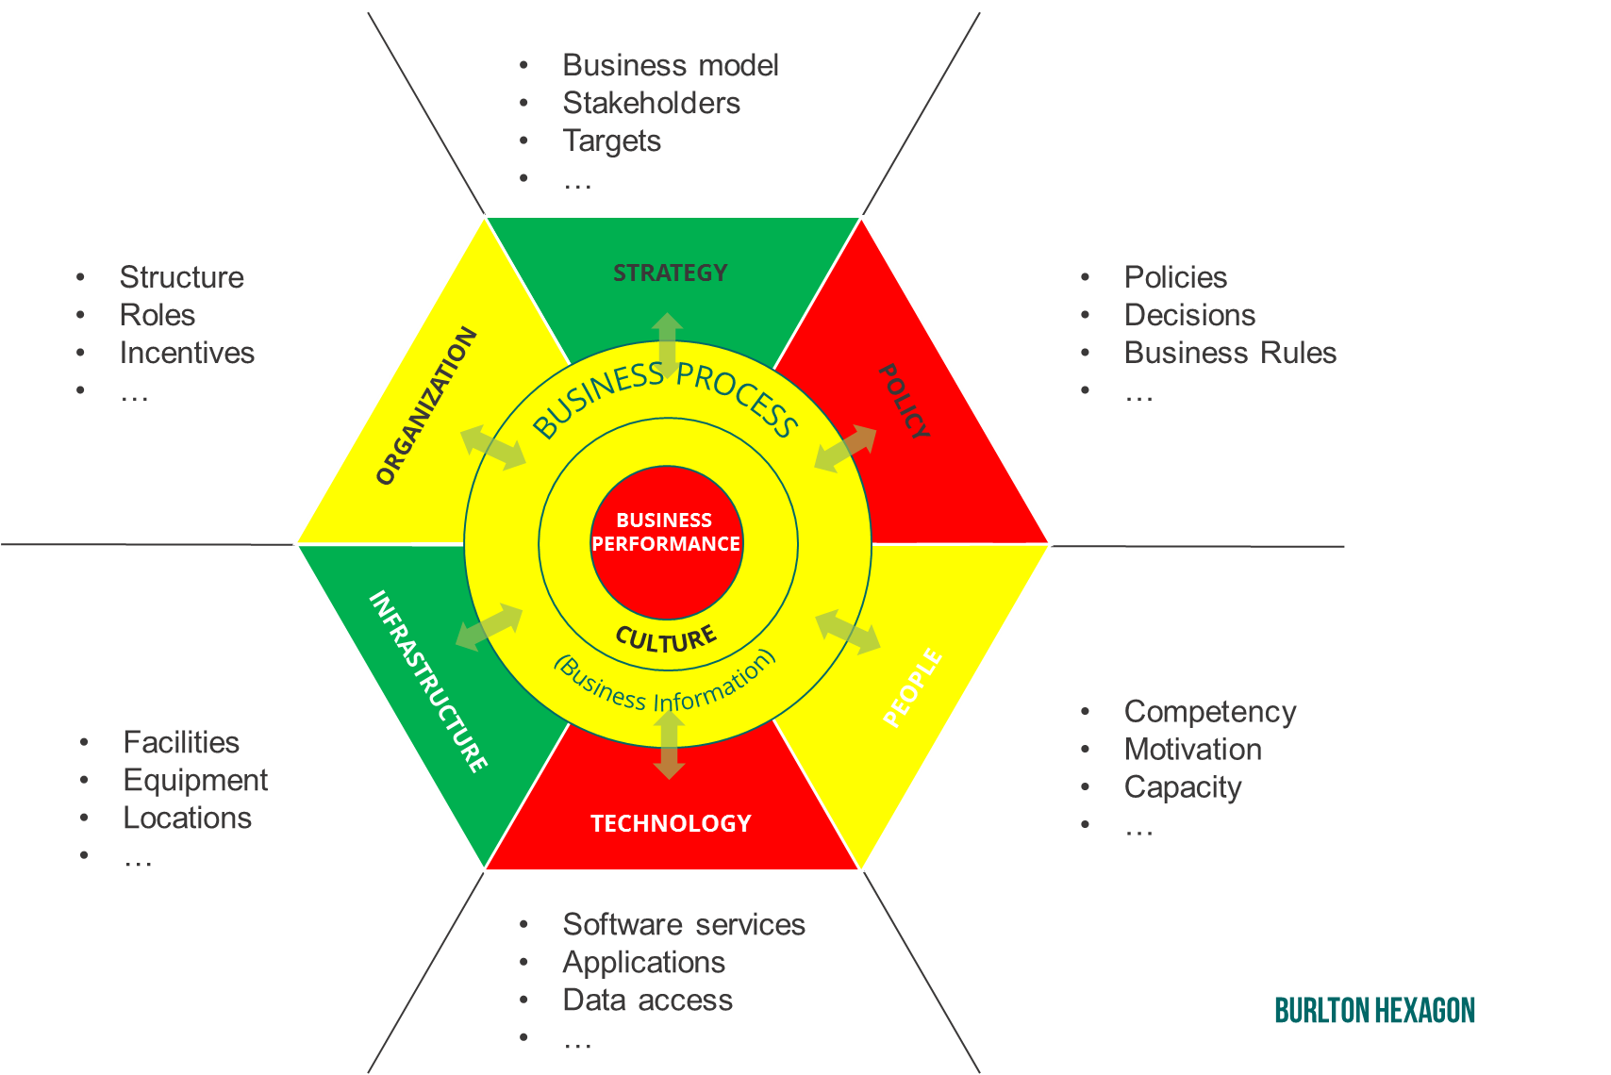
Use the Burlton Hexagon to help structure your capability change program
Cause of Performance and Plan for Transformation
S

Slide 36
The essence of Business architecture - a set of starting principles
Clear Business Scope: Boundaries established
Contextually driven: Stakeholders, Traceable and Performance motivated.
Associate do not Integrate: Not just hierarchies but associations
Organization is Just a Domain: Domains not built around organizational units
An Abstraction: Architecture is a simplification of reality
Elegant Models: should be simple yet powerful
Notation Agnostic: Implementation notations are unsuitable for architecture
Traceability: North / South connectivity across levels
Semantically Consistent: Consistent semantic structure
Sustainment: Business Knowledge sustains value
Journey not a Destination: There is no architectural destination
R

