Slide 1





Managing complexity
How to build a framework for managing BA?
Karolina Zmitrowicz

Slide 2
What are we going to talk about
Complexity. Challenge or not?
Building a framework for BA process
Real case example
Summary and recommendations

Slide 3
Complexity. Challenge or not?

Slide 4
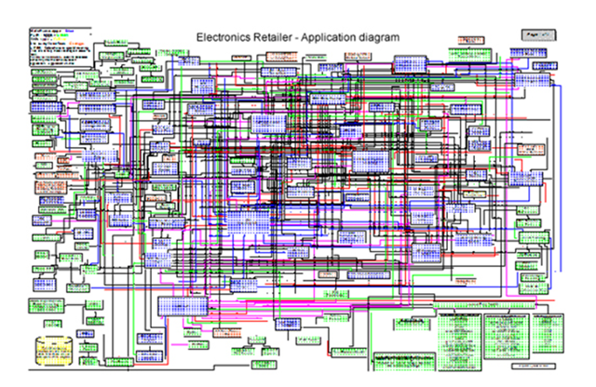

Why do we have to manage complexity of IT projects?

Slide 5
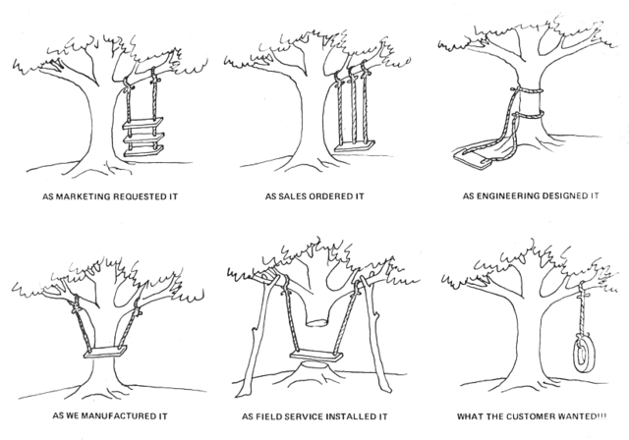

Slide 6
Building a framework for BA process

Slide 7
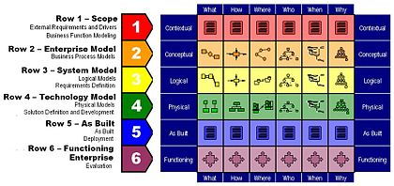
Framework
Zachman framework

Slide 8
Framework
Context analysis
Establishing goals for business analysis works
Determining BA work products and traceability requirements
Planning information architecture
Putting it all together – creating a BA process framework

Slide 9
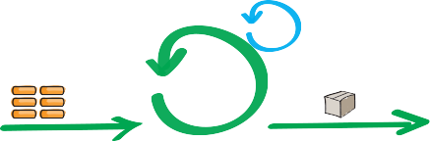
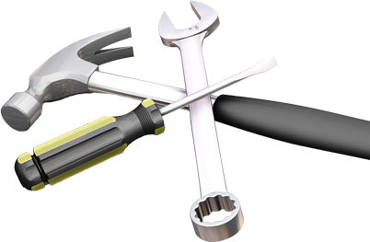




Context analysis

Slide 10
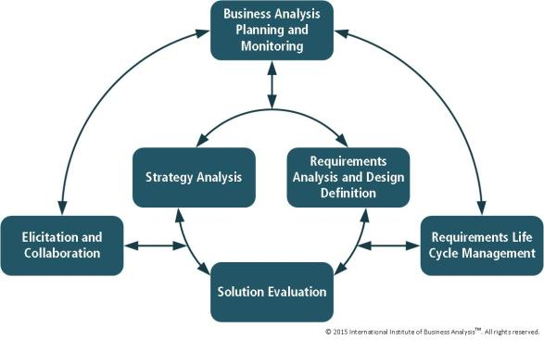
Goals and activities
Problem analysis
Elicitation
Requirements analysis and tracing
Requirements and solution scope negotiation
Documentation and specification
Quality assurance

Slide 11

BA work products
Business needs
Business case
Feasibility study
List of stakeholders
List of risks/issues
Requirements (different levels)
Requirements specification
Requirements documentation
Solution proposal
Solution concept
Models

Slide 12
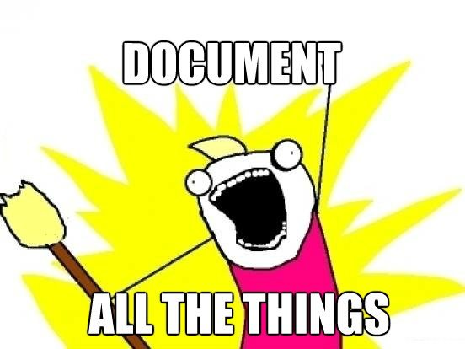

Slide 13
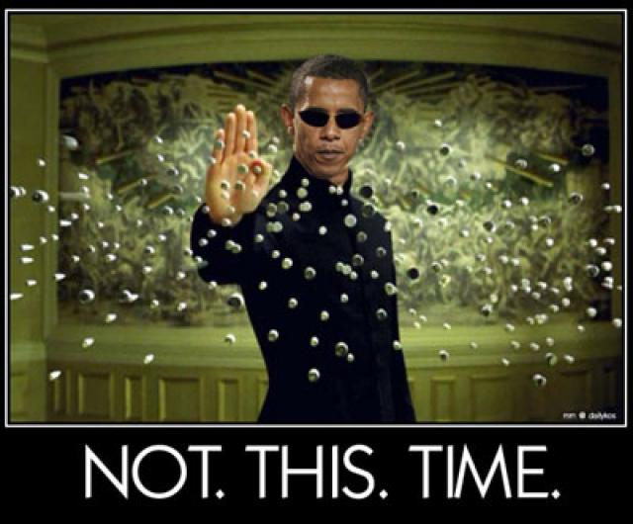

Slide 14
Other process requirements
UX
Digital Design
System Design
Strategy Analysis
Market Research
Innovation
Documentation
Communication

Slide 15
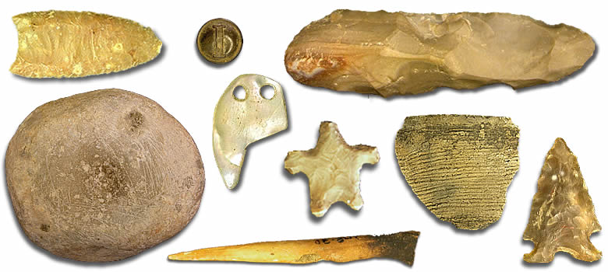
Your turn
Notes:
Practice – give BA work products required/used in your company and establish activities needed to their development

Slide 16

Information architecture

Slide 17

Do you know where to look for information?
Do you know the structure of deliverables?
Do you know the source of information?

Slide 18


Information architecture
What we want...
....What we get

Slide 19
Stakeholders
Business context
Business goals
Business processes
Risks
Business requirements
System requirements
UI mockups
Deisgn
Data
Test cases
Interfaces

Slide 20
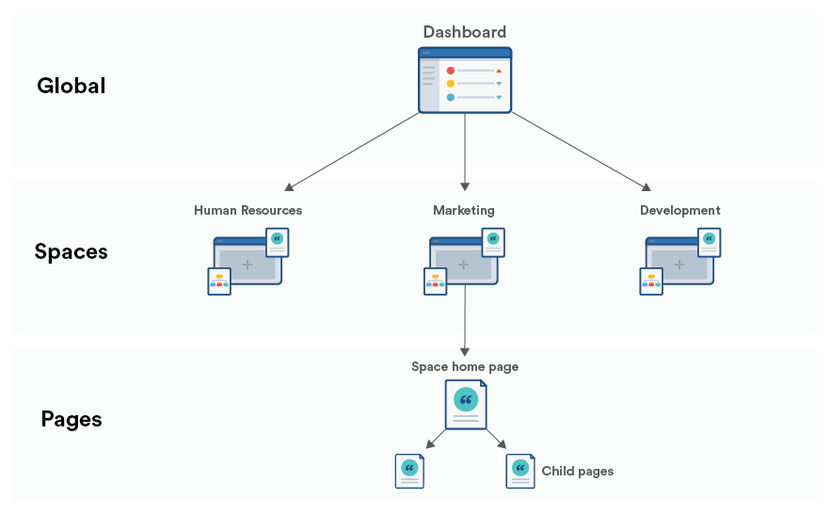
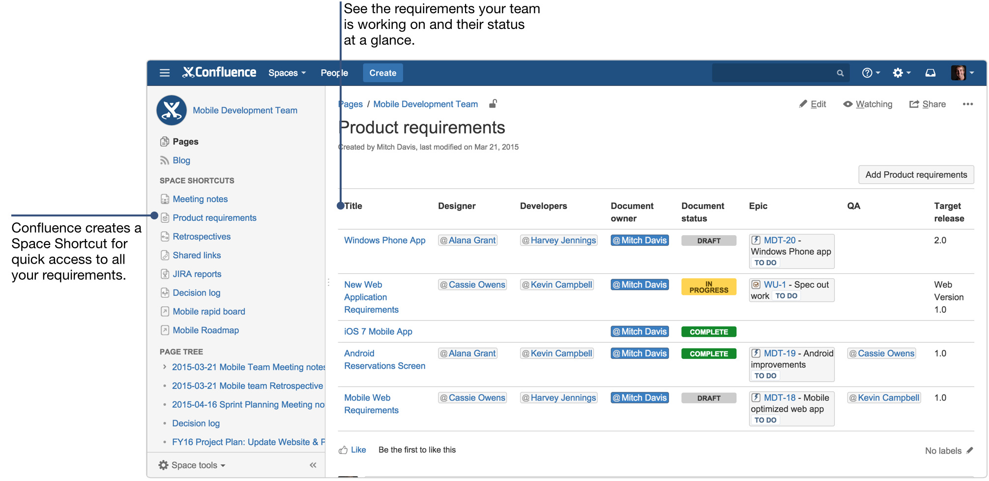

Slide 21
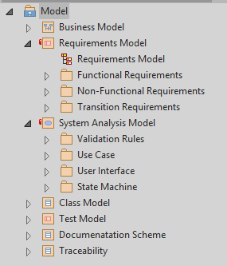
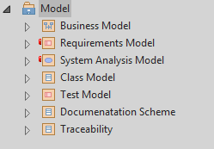
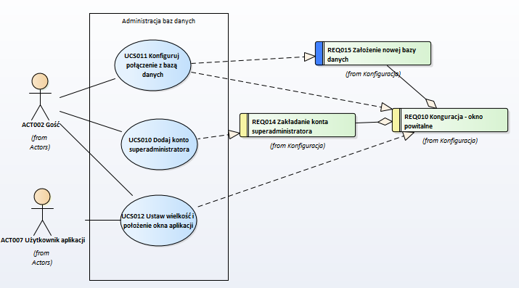

Slide 22
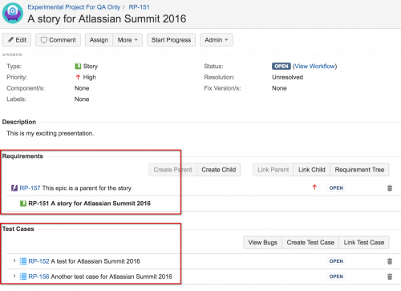
Traceability
http://www.softwaretestingmagazine.com/knowledge/choosing-a-test-case-management-solution-for-jira/

Slide 23


AS IS

Slide 24
Real case example of a simple project

Slide 25
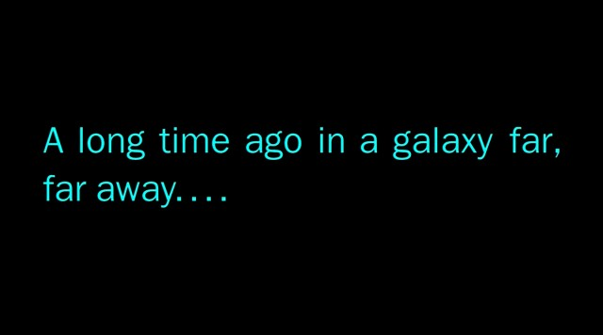
My turn
Notes:
Practice – go through EA project to show BA framework

Slide 26
Summary and recommendations

Slide 27

Context
Goals
Stakeholders
Artifacts, deliverables, processes
Information architecture
Good luck ☺

Slide 28

Your turn

Slide 29

reQuest for inspiration
www.request.pl
4-5.10.2018
WARSAW, POLAND

Slide 30
Thank you for your attention!
Stowarzyszenie Jakości Systemów Informatycznych ul. Poznańska 16 lok. 4 00-680 Warszawa
Karolina Zmitrowicz k.zmitrowicz@sjsi.org

