Slide 1


Process Improvement
With Roles and Responsibilities explained
JULY 10, 2017

Slide 2
Table of Contents
Marketing and product strategy
Release and scope management
Product development life cycle
Roles and responsibilities
Transparency and control
Q&A
© EPAM 2017. PRIVATE & CONFIDENTIAL
1

Slide 3
Marketing
and Product Strategy
Communication plan between Marketing, Product and R&D teams
Market events input and outcomes (IBM, Gartner etc.)
Market requirements
Market segmentation
Customer segmentation
Problem statements and mapping
Competitive benchmarking
© EPAM 2017. PRIVATE & CONFIDENTIAL
2

Slide 4
DWCH TIMELINE (HALF A YEAR PERSPECTIVE)
M1 | M2 | M3 | M4 | M5 | M6 | M7 | M8 | M9 | M10 | M11 | M12
Elaboration
Approved Business Requirement Documentation
Functional Analysis
Project Implementation Architecture Documentation
Software Requirements Documentation
Core Development and Testing
Deployed System, Sources
Issues in Defect Tracking System
Test Specification, Artifacts & Results
EXAMPLE
Dev., Approval and Distribution of CAT Interface Public Specification
Draft CAT Interface Public Specification
Update of CAT Interface Public Specification Based on Feedback
Approved CAT Interface Public Specification
Integration of the System with SROs
SRO Rollout Schedule
Rollout of the System for SROs
System Deployed to Production
Integration Testing
Test Results
Dev Infrastructure Build-out
Industry Testing, Forensic Analysis, and improvement
Test Results: Feedback to Participants
QA Infrastructure Build-out
Int Infrastructure Build-out
Prod Infrastructure Build-out for Exchanges and Market Data
DR Infrastructure Build-out
© EPAM 2017. PRIVATE & CONFIDENTIAL
3

Slide 5
DESIRED TIMELINE
M1 | M2 | M3 | M4 | M5 | M6 | M7 | M8 | M9 | M10 | M11 | M12
Release 001 Planning
Feature Development
BA/UX
QA
Go live
Market Requirements
Roadmap
Release 002 Planning
BA/UX
…
Strategic
Planning
Competitive Benchmarking
Market Requirements
Release 003 Planning
Roadmap
© EPAM 2017. PRIVATE & CONFIDENTIAL
4

Slide 6
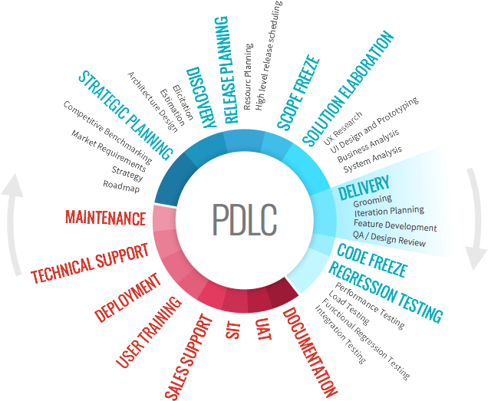
Product Development Life Cycle
Phase 1 – FDD
Phase 2 – BDD
© EPAM 2017. PRIVATE & CONFIDENTIAL
5

Slide 7
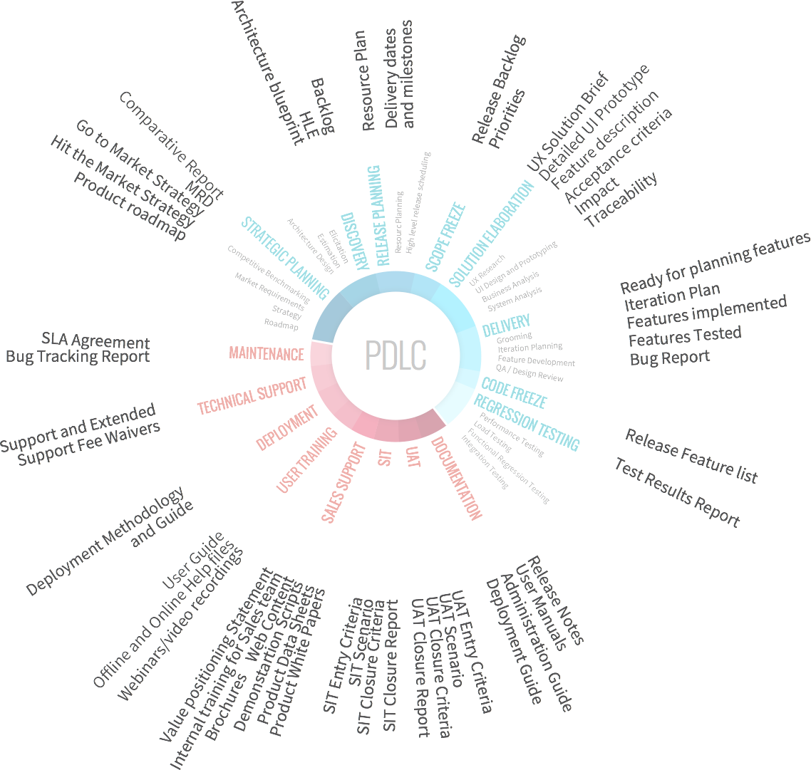
Product Development Life Cycle
Phase 1 – FDD
Phase 2 – BDD
© EPAM 2017. PRIVATE & CONFIDENTIAL
6

Slide 8
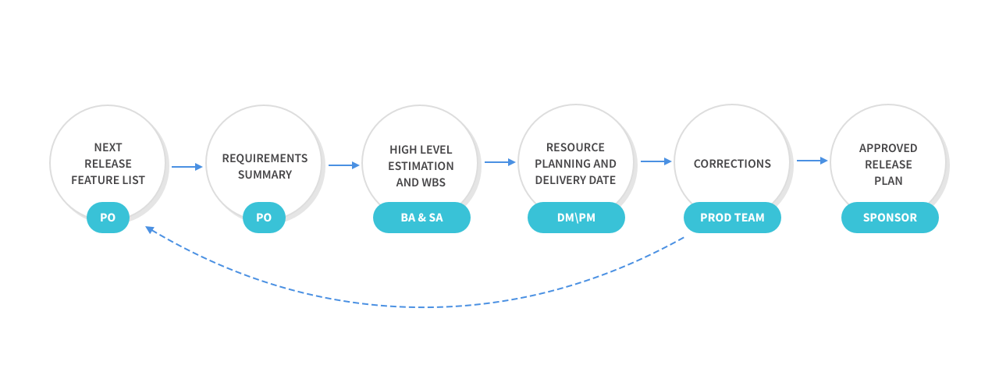
Release planning process
© EPAM 2017. PRIVATE & CONFIDENTIAL
7

Slide 9
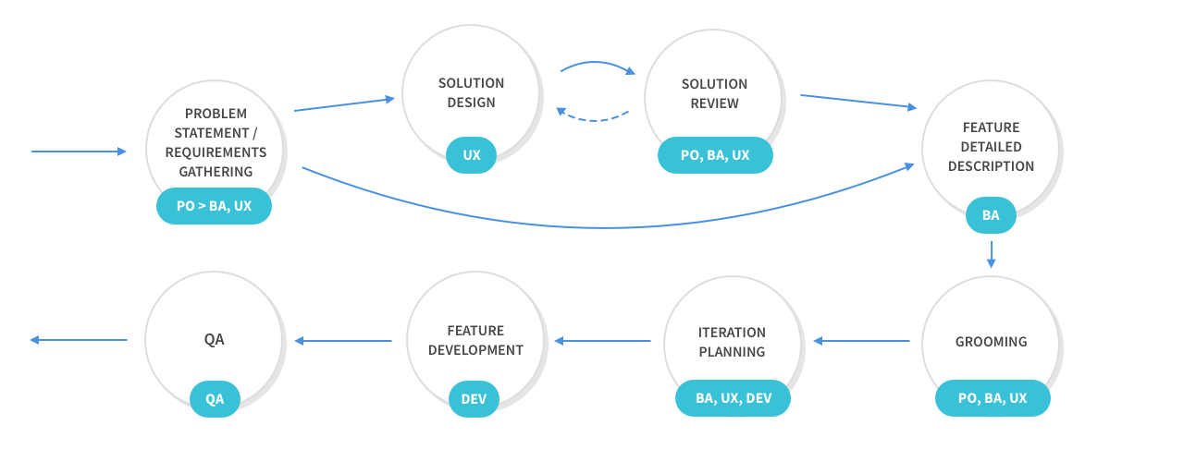
FEATURE DEVELOPMENT PROCESS
© EPAM 2017. PRIVATE & CONFIDENTIAL
8

Slide 10
THE FIRST CONTACT POINT
Stream 1
Stream 2
BA
Team
BA
TEAM
BA
TEAM
…
Stream N
© EPAM 2017. PRIVATE & CONFIDENTIAL
9

Slide 11
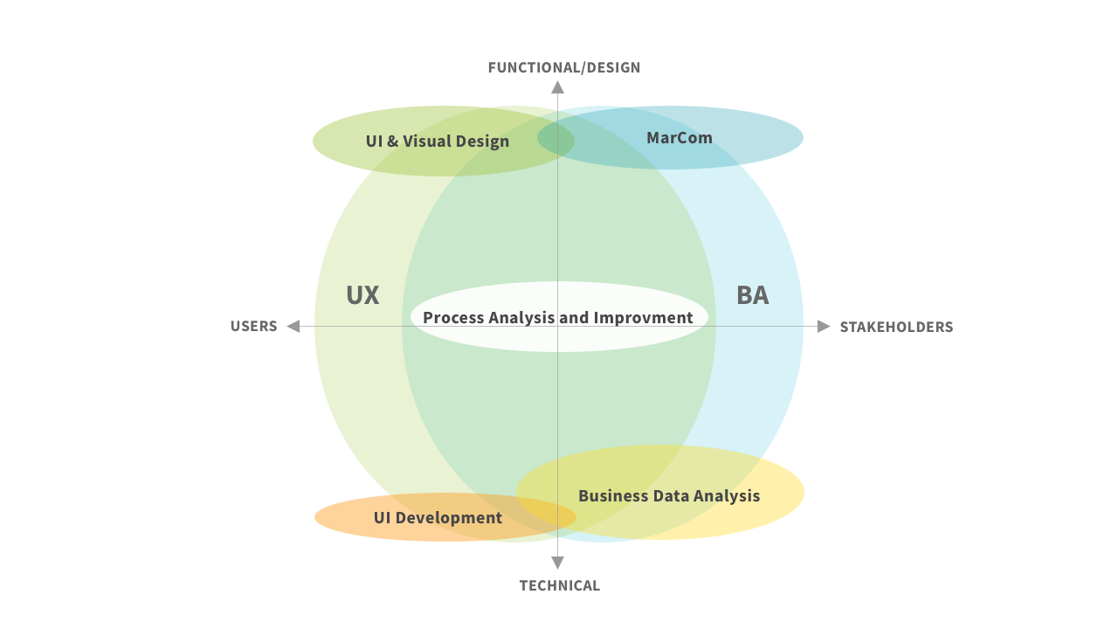
BA AND UX
© EPAM 2017. PRIVATE & CONFIDENTIAL
10

Slide 12
ROLES AND RESPONSIBILITIES
BUSINESS ANALYST
DEVELOPMENT
UX & VISUAL DESIGN
Create and refine Backlog in line with Datawatch goals
Review Business User’s tasks and Opportunities
Implement continuous PDLC improvement approach
Support Features and User Stories prioritization
Increase transparency and control on the project
Analyze requirements and architecture constraints
Identify internal and external dependencies
Agree on solution components for the Datawatch product based on technical requirement
Define and document Datawatch technical architecture
Design solutions for planned Swarm Features. UI design
Design evaluation based on outlined goals and priorities
Information architecture
Build design consistency and product alignment with main product experience principles
Support shaping product vision
© EPAM 2017. PRIVATE & CONFIDENTIAL
11

Slide 13

DATAWATCH SWARM
Design Involvement phases
Operative
Tactical
strategic
Problem Based Tasks Approach
Design Evaluation
Analytics
Design Guidelines
Design Review
User Validation
Cover design requests
User Validation
Product Principles
Co-design
Business-based KPI’s
UX Research (User-based)
Competitive Analysis
Design System
Deep Cross-team communication
ISSUES TO COVER
Design Quality
Product Quality
Teams Miscommunication
Time to Market
ISSUES TO COVER
Risks Reduction
Increase User Base
Brand Support
Decision Making Support
© EPAM 2017. PRIVATE & CONFIDENTIAL
12
Notes:
Start-up is about moving fast. More about shooting than reaching the target > lack of consistency and targeting
Solid product > solid product with holistic experience. We can reach target and don’t answer question is we are reaching right target.
We are between operative and tactical involvement now.
______________
Swarm at the point when it getting stop being start-up.
Proper background to focus on being user-centric and thus become design driven product
Focus on designing solutions that people will care about and be motivated to use

Slide 14
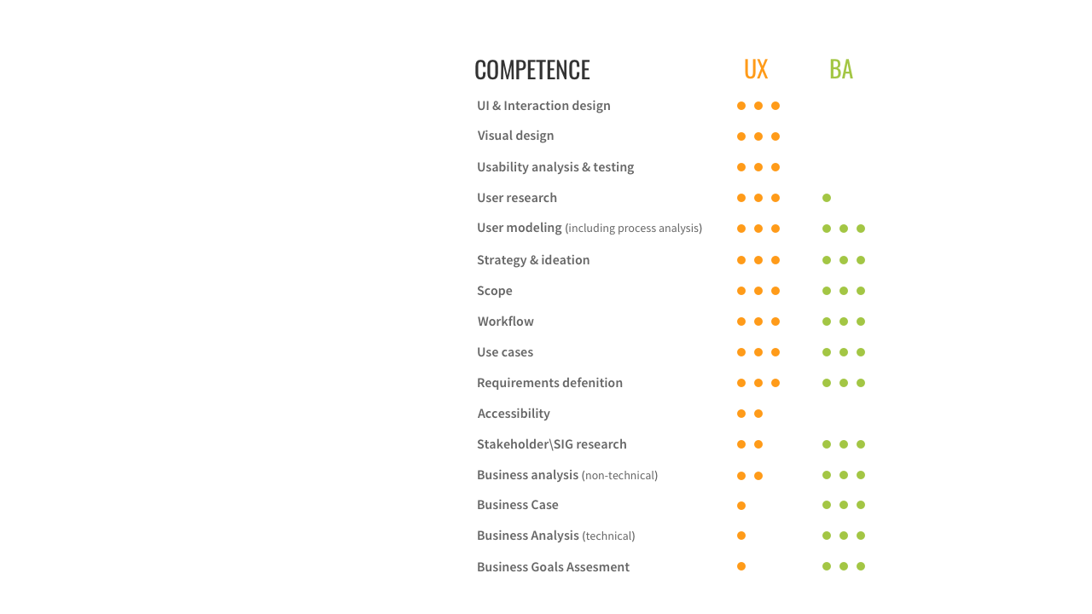
BA UX
Competencies
© EPAM 2017. PRIVATE & CONFIDENTIAL
13

Slide 15







people TO contact WITH
END USER
Creator
Sig
Sponsor
Those who use/will use the system
The main group of people who provide
requirements
Special Interest
Groups who provide
constrains or constraining
requirements against
a solution
A person who accept the
solution against Market
requirements and company
strategy
Internal Users
External Users
Product Team
System Administrators
Methodologies
Auditors
Legal
UX
UX
BA
BA
DM
BA
© EPAM 2017. PRIVATE & CONFIDENTIAL
14

Slide 16
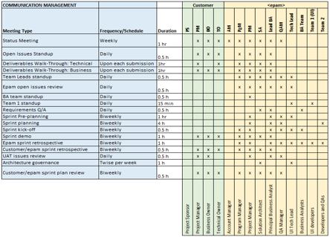
Transparency and Control
EXAMPLE
© EPAM 2017. PRIVATE & CONFIDENTIAL
15

Slide 17
BUSINESS ANALYSIS ACTIVITIES
COMPUTE BACKLOG IN ITERATIONS
GAIN PRODUCT VISION
AND SCOPE UNDERSTANDING
IDENTIFY BUSINESS NEEDS
Requirements GAP exercise
Create, decompose and confirm Epics, Features, User Stories and Scenarios decomposition
Estimations: HLE, Sprint, Release
Prioritization: Features and user stories
Business processes and Data Strategy
Stakeholder goals and success criteria
Business User past and present tasks
Problems/Benefits analysis
Solution dos and don’ts
Business Rules captured
ESTABLISH REQUIREMENTS
MANAGEMENT RULES
RESEARCH AND DEVELOPMENT SUPPORT
Requirements traceability
Real options
Sign off process
Change management
Backlog playground rules
Sign off process
© EPAM 2017. PRIVATE & CONFIDENTIAL
16

Slide 18

References
© EPAM 2017. PRIVATE & CONFIDENTIAL
17

Slide 19

QUESTION & WRAP UP
© EPAM 2017. PRIVATE & CONFIDENTIAL

Slide 20
Thank you
© EPAM 2017. PRIVATE & CONFIDENTIAL

