Slide 1

Фреймворк автоматизированных критериев приёмки как «живая» документация системы

Slide 2
Settlement Engine
система автоматизации процесса взаиморасчётов по торговым операциям с ценными бумагами в инвестиционном банке
Сложность разработки обусловлена:
Вариативностью процессов в связи с законодательными и регуляторными требованиями
Разнообразием пользователей и стейкхолдеров системы
Многообразием интерфейсов с системами банка и внешними участниками процессов
Высокими требованиями к надежности, производительности и поддерживаемости системы
Высокой ценой ошибки
Территориально-распределённой разработкой
Регламентом процесса разработки

Slide 3
Сложности документирования автоматизированных систем
Трудоемкость и необходимость выделения специальных ресурсов
Необходимость вклада и ответственности всех разработчиков
Необходимость разработки общих правил и контроля
Необходимость разработки структуры документации
Возможные ошибки и неточности

Slide 4
Пирамида автоматизации тестирования
End to End Test
System Test
Business Facing
Component Test
Acceptance tests
Technical tests
Unit Test
Technology Team Facing

Slide 5
Цикл разработки ПО
E2E Tests Scenarios Definition
Business Flow Description
High Level Solution Design Feature Acceptance Criteria Product Backlog
Business Case
High Level Business Requirements Feature Breakdown
Discovery
Feature Elaboration
System and Components Tests Scenarios Definition
Main and Alternate Flows
Detailed Solution Requirements Solution Design
US Acceptance Criteria
Customer Verification
User Story Refinement
Unit Tests Scenarios Definition
All Level Tests Implementation
Global Integration Testing
User Story Delivery

Slide 6
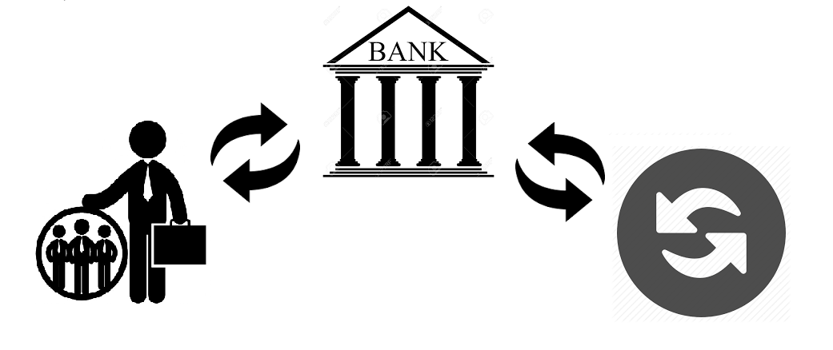
Артефакты, используемые для создания автоматизированных критериев приемки
На примере автоматизации курсовых списаний в процессе, где банк выступает агентом клиента на рынке в случае взаиморасчетов в разных валютах

Slide 7
Цикл разработки ПО
E2E Tests Scenarios Definition
Business Flow Description
High Level Solution Design Feature Acceptance Criteria Product Backlog
Business Case
High Level Business Requirements
Feature Breakdown
Discovery
Feature Elaboration
System and Components Tests Scenarios Definition
Main and Alternate Flows
Detailed Solution Requirements Solution Design
US Acceptance Criteria
Customer Verification
User Story Refinement
Unit Tests Scenarios Definition
All Level Tests Implementation
Global Integration Testing
User Story Delivery

Slide 8
Discovery
Feature Description and Acceptance Criteria
As a Trade Control Analyst
I need Currency Write Off Below Tolerance to be processed and accounted
So that Profit or Loss of changed currency rate is reflected correctly in financial reports
Business Background
Flow is a deviation of Agency Flow in case of settlements on the market and with client happen in different currencies and the currency rate changes during client order execution. As a result cash difference appears on the Currency Control Account. It is actually profit or loss for the bank.
Feature Acceptance Criteria
Currency Write Off is generated in FO Order Management System in case of currency rate has been changed during client order execution. It is processed and accounted in Settlement Engine.

Slide 9
Цикл разработки ПО
E2E Tests Scenarios Definition
Business Flow Description
High Level Solution Design Feature Acceptance Criteria Product Backlog
Business Case
High Level Business Requirements Feature Breakdown
Discovery
Feature Elaboration
System and Components Tests Scenarios Definition
Main and Alternate Flows
Detailed Solution Requirements Solution Design
US Acceptance Criteria
Customer Verification
User Story Refinement
Unit Tests Scenarios Definition
All Level Tests Implementation
Global Integration Testing
User Story Delivery

Slide 10
Feature Acceptance Scenarios
Feature elaboration
SCENARIO1. CURRENCY WO BELOW TOLERANCE
Step 1. Trade Date
When
Market Trade
Client Trade
Currency Conversion
Currency Write Off
Are processed
Then Accounting Movements fit specified T charts
Step 2. Settlement Date
Given Trades are processed
When Trades are settled
Then Accounting Movements fit specified T charts
SCENARIO2. CURRENCY WO ABOVE TOLERANCE
Step 1. Trade Date
When
Market Trade
Client Trade
Currency Conversion
Currency Write Off
Are processed
Then Accounting Movements fit specified T charts
Currency Write Off is reconciled
User is notified about Currency WO
Step 2
WO Manual approval
Step 3. Settlement Date
Given Trades are processed
When Trades are settled
Then Accounting Movements fit specified T charts
Currency Write Off is reconciled

Slide 11
Feature Acceptance Cases
Feature elaboration
Profit/Loss
Above/Below Tolerance
Sell/Buy Client Order
Backlog
US1. Processing and accounting Currency WO Below Tolerance.
US2. Processing and accounting Currency WO Above Tolerance.
US3. Currency WO Reconciliation
Case | Input |  |  | Output
 | Sell/Buy | Profit/Loss | Above/ Below Tolerance | Accounting | User Notification | Reconciliation
Case 1.1 | Sell | Profit | Below | Fit T-charts | No | Yes
Case 1.2 | Buy | Loss | Below | Fit T-charts | No | Yes
Case 2.1 | Sell | Loss | Above | Fit T-charts | Yes | Yes
Case 2.2 | Buy | Profit | Above | Fit T-charts | Yes | Yes
End to End test
Scenario 1. Case 1.1

Slide 12
Цикл разработки ПО
E2E Tests Scenarios Definition
Business Flow Description
High Level Solution Design Feature Acceptance Criteria Product Backlog
Business Case
High Level Business Requirements Feature Breakdown
Discovery
Feature Elaboration
System and Components Tests Scenarios Definition
Main and Alternate Flows
Detailed Solution Requirements Solution Design
US Acceptance Criteria
Customer Verification
User Story Refinement
Unit Tests Scenarios Definition
All Level Tests Implementation
Global Integration Testing
User Story Delivery

Slide 13
User Story Description
User Story Refinement
As a Trade Control Analyst
I need Currency Write Off Below Tolerance to be processed and accounted
So that Profit or Loss of changed currency rate is reflected correctly in financial reports
User Story Acceptance Criteria
Vanilla Scenario
When Currency WO with <input parameters from SbE > is processed
Then Accounting Movements as <output parameters from SbE> are generated
Negative Scenario
Given Currency WO with <input parameters from SbE> is processed
When it is cancelled
Then Reversed Accounting Movements are generated
Case |  |  |  | Input |  |  | Output
 | Sell/ Buy | Profit/ Loss | Above/ Below Tol. | Trade Date | WO Amount | … | Value Date | … | Account | Ccy | Amount
1 | Sell | Profit | Below | 02.11.2015 | USD 29 |  | 02.11.2015 |  | Currency Control ABC | USD | -29.00
 |  |  |  |  |  |  | 02.11.2015 |  | PnL 123 | USD | 29.00
2 | Buy | Loss | Above | 03.11.2015 | GBP -117.81 |  | 03.11.2015 |  | Currency Control ABC | GBP | 117.81
 |  |  |  |  |  |  | 03.11.2015 |  | PnL 123 | GBP | -117.81
…..

Slide 14
Test Plan
User Story Refinement
 | Tech. Changes | Unit Tests | Component Tests | System Tests | E2E
AC1 Vanilla Scena-rio | Ch 1. Message Processing |  | FIXML Allocation Report Parser Junit Test should be extended with Currency WO scenario to prove new tag is accepted and new values are recognized |  | Agency Flow Concordion Test should be extended with Currency Write Off Below Tolerance Scenario
 | Ch 2. Transaction Creation | Accounts derivation Jbehave Test should be extended with Currency WO scenario to prove new accounts are set up |  | Transaction Creation Jbehave Test should be extended with Currency WO scenario to validate transaction type and accounts of created transaction
 | Ch 3. Accounting Message Creation |  | Accounting Message Creation Jbehave Test should be extended with Currency WO scenario to validate message type
 | Ch 4. Accounting Movements Creation |  | Accounting Movements Creation Test should be extended with Currency WO scenario to validate accounting movements created based on Accounting Message
AC2 Nega-tive Scena-rio | Ch 2. Transaction Creation |  |  | Transaction Creation Jbehave Test should be extended with Currency WO scenario to validate transaction type and accounts of created transaction
 | Ch 4. Accounting Movements Creation (Accounting Module) |  | Reverse Accounting Movements Creation Test should be extended with Currency WO scenario to validate accounting movements created based on Accounting Message

Slide 15
Цикл разработки ПО
E2E Tests Scenarios Definition
Business Flow Description
High Level Solution Design Feature Acceptance Criteria Product Backlog
Business Case
High Level Business Requirements Feature Breakdown
Discovery
Feature Elaboration
System and Components Tests Scenarios Definition
Main and Alternate Flows
Detailed Solution Requirements Solution Design
US Acceptance Criteria
Customer Verification
User Story Refinement
Unit Tests Scenarios Definition
All Level Tests Implementation
Global Integration Testing
User Story Delivery

Slide 16




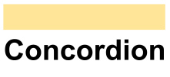
Test Tools
Feature: Installation
Scenario: Basic installation
Given WordPress application is uninstalled
When I install WordPress application
And install Membership Login plugin and activate
Then no errors appeared

Slide 17

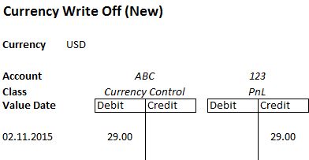
Test Examples
Delivery
FIXML Allocation Report Parser Junit Test When FIXML Message in tag 555 is received Then Message with value CURRENCY_WO of Message Type is put in Messages queue
 | Change | Unit Tests | Component Tests | System Tests
Vanilla Scena-rio | Ch 1. Message Processing |  | FIXML Allocation Report Parser Junit Test When FIXML Message in tag 555 is received Then Message with value CURRENCY_WO of Message Type is put in Messages queue
 | Ch 2. Transaction Creation | Accounts derivation Jbehave Test When Transaction Type is <TR_TYPE> Then <ACCOUNT> is used as PNL account |  | Transaction Creation Jbehave Test When Currency Write Off Message is received Then Transaction is created And Transaction Type is CURRENCY_WO And 123 is used as PNL account
 | Ch 3. Accounting Message Creation |  | Accounting Message Creation Jbehave Test When CURRENCY_WO Transaction is committed Then AccountingMessage is created And Message Type is CURRENCY_WO
 | Ch 4. Accounting Movements Creation |  | Accounting Movements Creation Test. In-house Tool When CURRENCY_WO Account Message is received Then Accounting Movements fit NEW CURRENCY_WO T-charts
Accounts derivation Jbehave Test When Transaction Type is <TR_TYPE> Then <ACCOUNT> is used as PNL account
Transaction Creation Jbehave Test
When Currency Write Off Message is received Then Transaction is created And Transaction Type is CURRENCY_WO And 123 is used as PNL account
Accounting Movements Creation Test. In-house Tool When CURRENCY_WO Account Message is received Then Accounting Movements fit <NEW CURRENCY_WO T-charts>

Slide 18
Test Examples
Case |  |  |  | Input |  |  |  | Output
 | Sell/Buy | Profit/ Loss | Above/ Below Tol. | Trade Date | Settlement Date | …. | WO Amount | Value Date | … | Account | Ccy | Amount
1 | Sell | Profit | Below | 02.11.2015 | 04.11.2015 |  | USD 29 | 02.11.2015 |  | Currency Control ABC | USD | -29.00
 |  |  |  |  |  |  |  | 02.11.2015 |  | PnL 123 | USD | 29.00
2 | Buy | Loss | Above | 03.11.2015 | 05.11.2015 |  | GBP -117.81 | 03.11.2015 |  | Currency Control ABC | GBP | 117.81
 |  |  |  |  |  |  |  | 03.11.2015 |  | PnL 123 | GBP | -117.81
…..
Delivery
CURRENCY WRITE OFF
Narrative
Flow is a deviation of Agency Flow in case of settlements on the market and with client happen in different currencies and the currency rate changes during client order execution. As a result cash difference appears on the Currency Control Account . It is actually profit or loss for the bank.
Currency Write Off is generated in FO Order Management System in such case. It is processed and accounted in Settlement Engine.
In case Write Off amount is over Tolerance additional manual approval is required.
Currency Write Off below Tolerance Scenario
Client buys 100 ABC shares.
On the trade date order is executed on the market for 9999.99 PNL
As Client wants to pay in USD his payment forms 2702,70 USD according to the rate 3,7 PNL/USD.
Currency is exchanged with the rate 3,73 which forms profit of 21,74 reflected as Currency Write Off.
On the settlement date Market trade and Client trade are settled.
As the result of operation
1. Cash movements in both currencies affect Nostro on settlement date.
2. Currency exchange profit is accrued on PnL account.
3. Currency Control Account is flat.
Value Date | Account | Cсy | Amount |  | Comment
Settlement Date | Nostro | USD | 2702,7 | Debit | 1
Settlement Date | Nostro | PNL | 9999,99 | Credit | 1
Settlement Date | PnL | USD | 21,74 | Credit | 2

Slide 19
Cложности, возникающие при создании живой документации
TO IMPROVE
TO DO
Единая структура документации
Единая терминология
Правильность написания тестов
Разработка единого подхода документирования
Создание единого словаря терминов
Проверка тест-планов и созданных тестов разработчиками из других команд и тест менеджерами
Разделение задач по реализации и тестированию функционала между разными членами команды
Использование средства автоматизации процесса

Slide 20
Преимущества внедрения живой документации
GOOD
BENEFITS
Усовершенствование цикла разработки ПО
Усиление сотрудничества и улучшение взаимопонимания бизнеса и разработчиков
Обеспечивает регрессионное тестирование в рамках процесса непрерывной интеграции
Используется в качестве критериев приемки для получения sign off без классического демо
Документирует систему As Is
Используется для проигрывания сценариев What If и анализа влияния
Используется для воспроизведения проблем, возникающих в продакшн окружении

Slide 21
THANK YOU
!

Slide 22
ВОПРОСЫ
?

